Slide 1
CycleCloud demo
Tuesday afternoon, 2:00pm
Igor Sfiligoi <isfiligoi@ucsd.edu>
Leader of the OSG Glidein Factory Operations
University of California San Diego

Slide 2
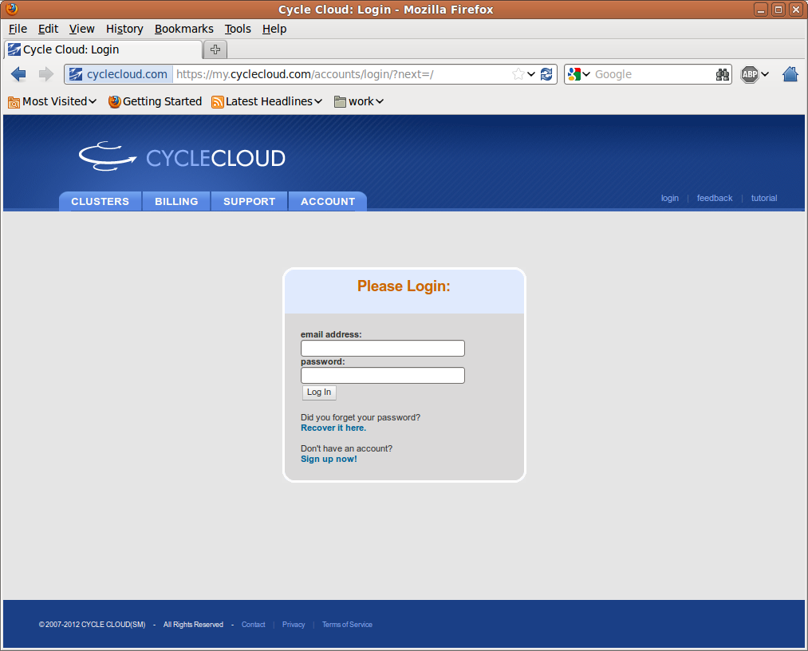
CycleCloud Login

Slide 3
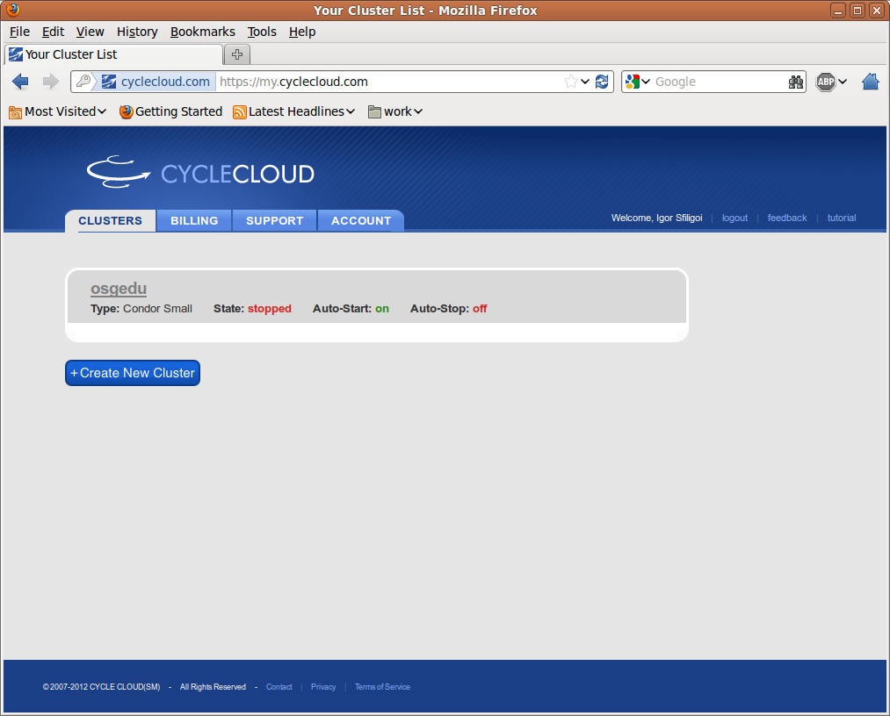
Cloud Cluster Control Center

Slide 4
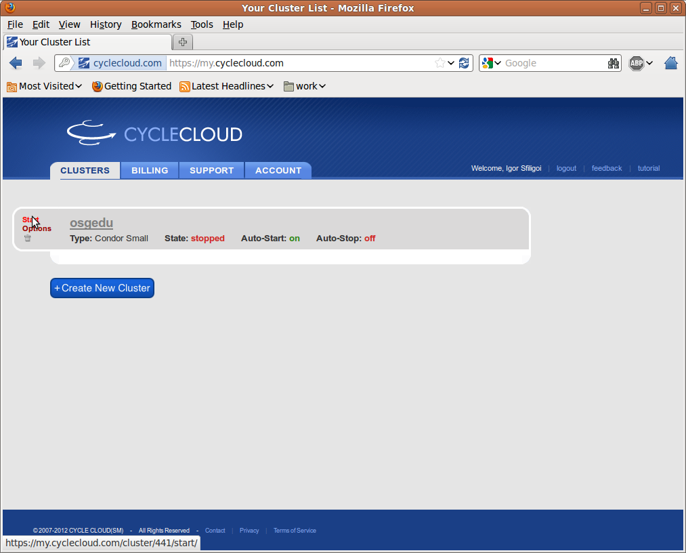
Starting the cluster

Slide 5
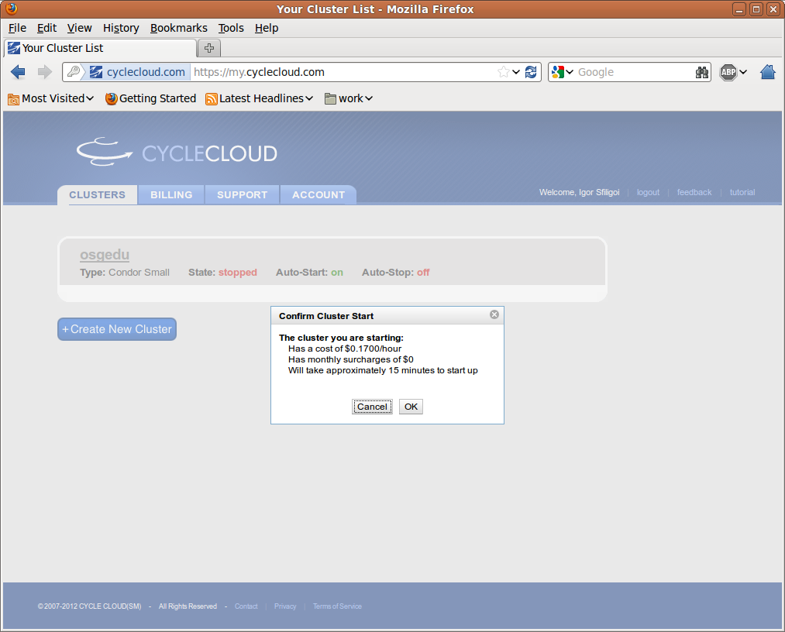
Cost information

Slide 6
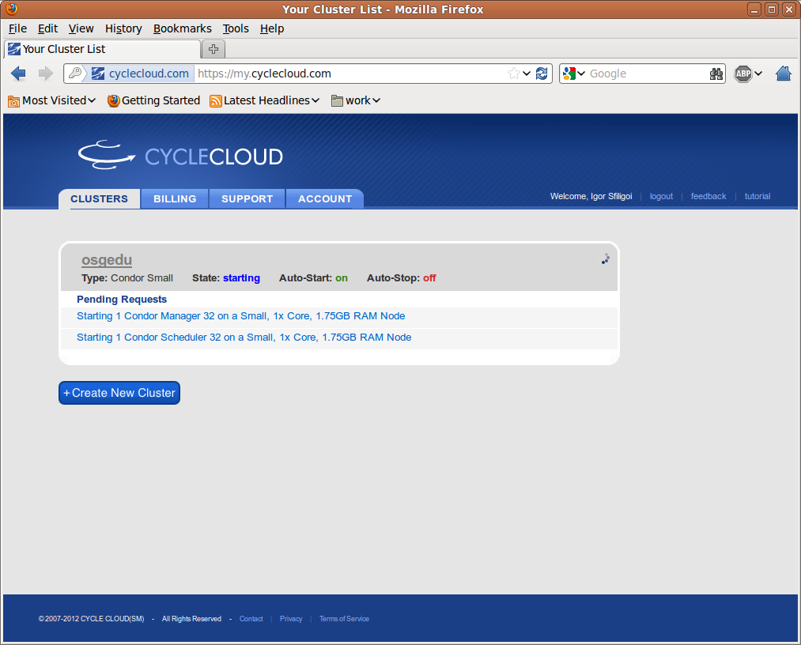
Waiting for login node to start

Slide 7
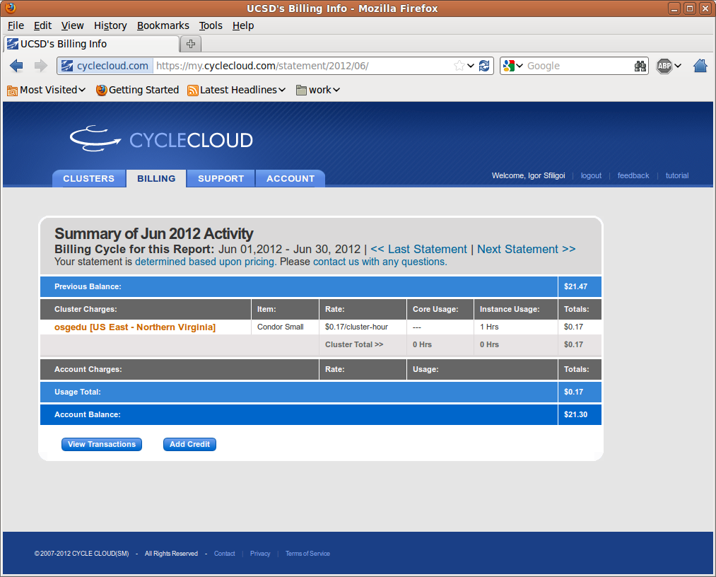
Billing information

Slide 8
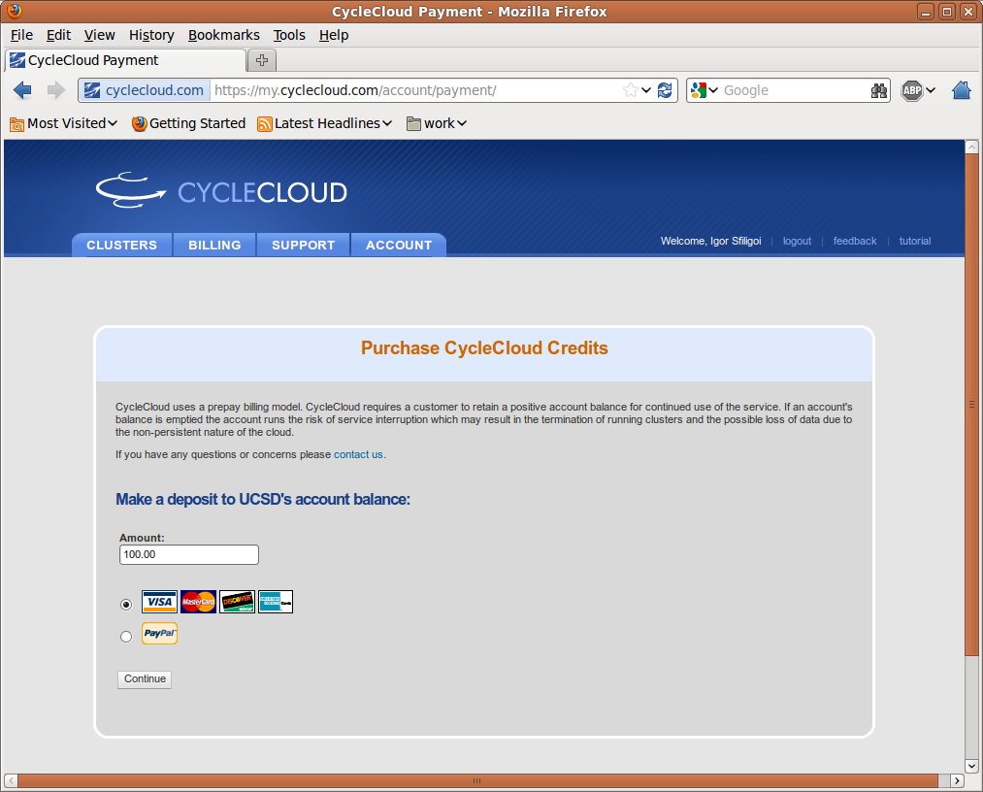
Adding credit is easy

Slide 9
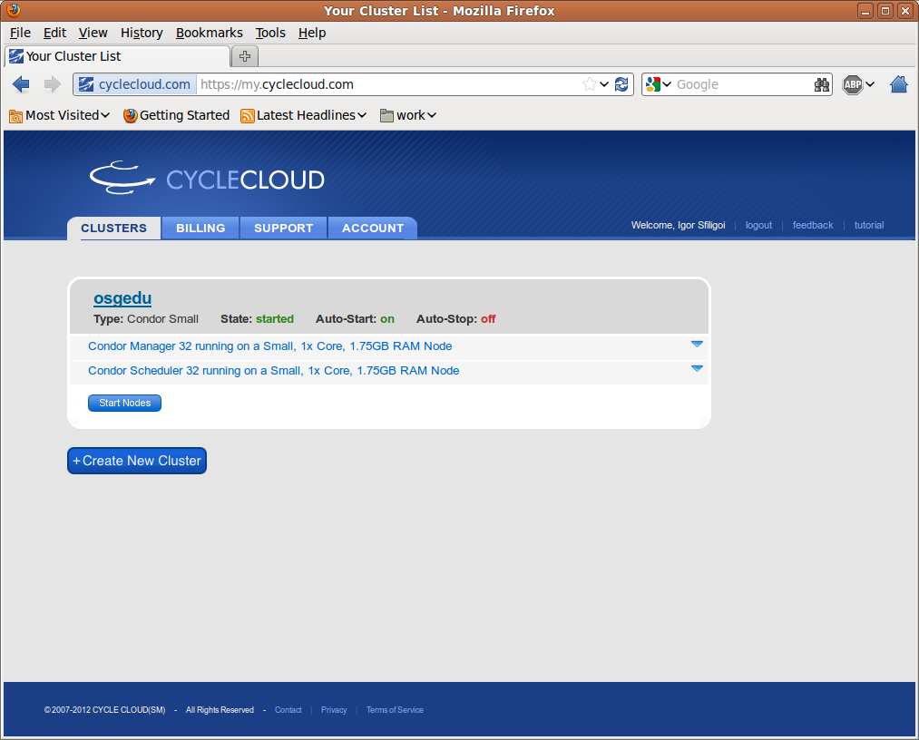
The submit node is ready

Slide 10
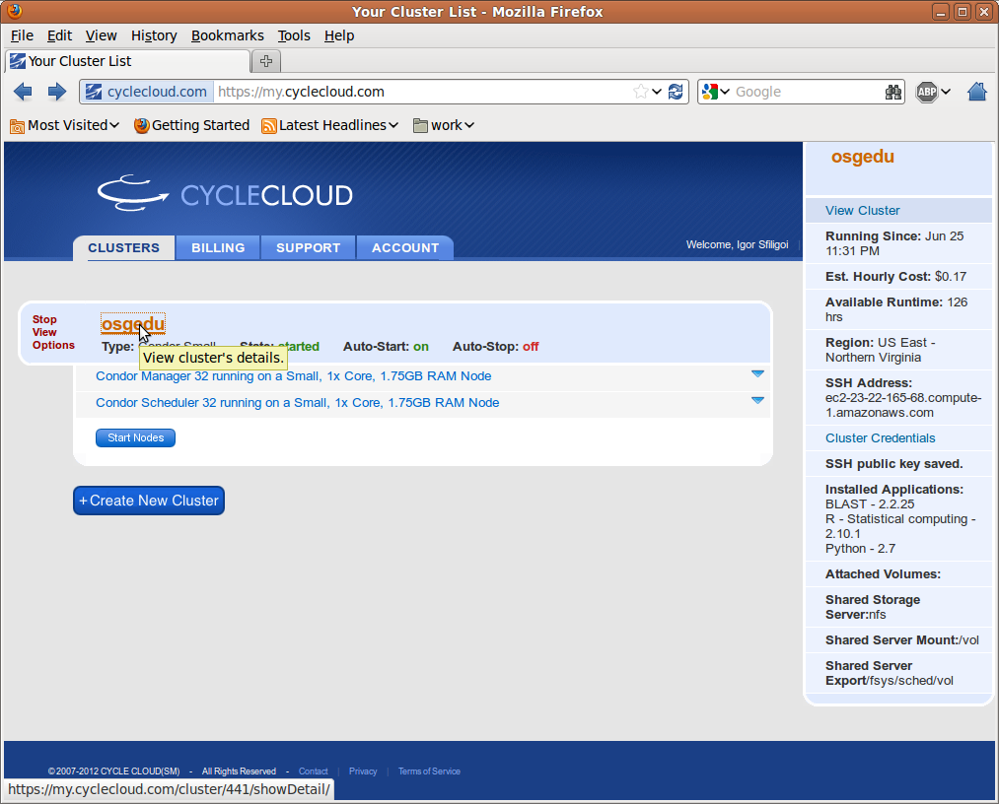
Getting the details

Slide 11
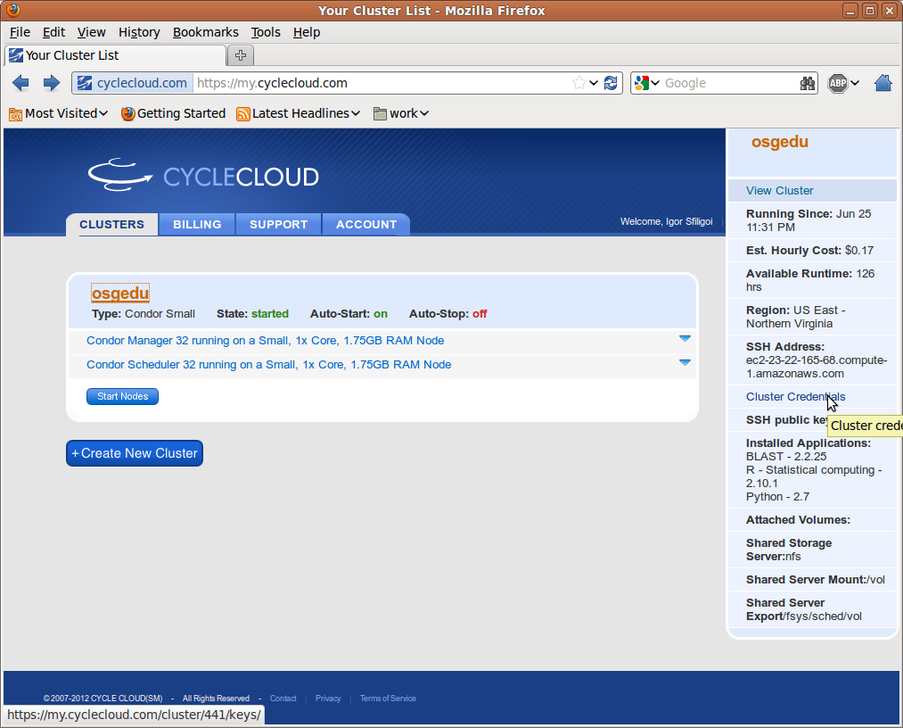
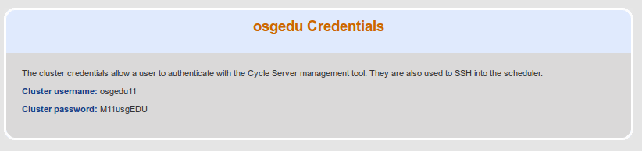
The ssh credentials

Slide 12
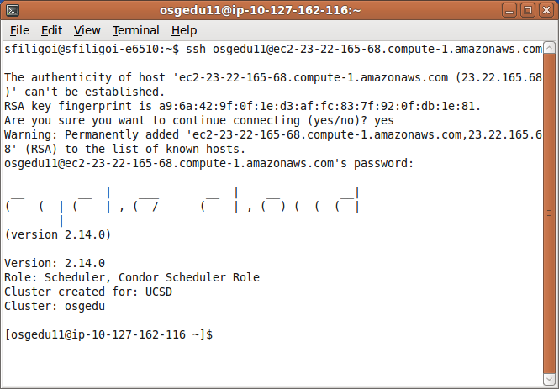
And we are in

Slide 13
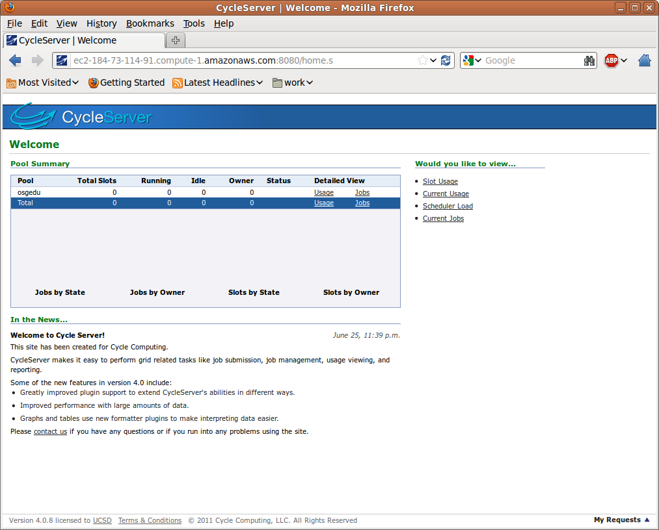
We also get a CycleServer

Slide 14
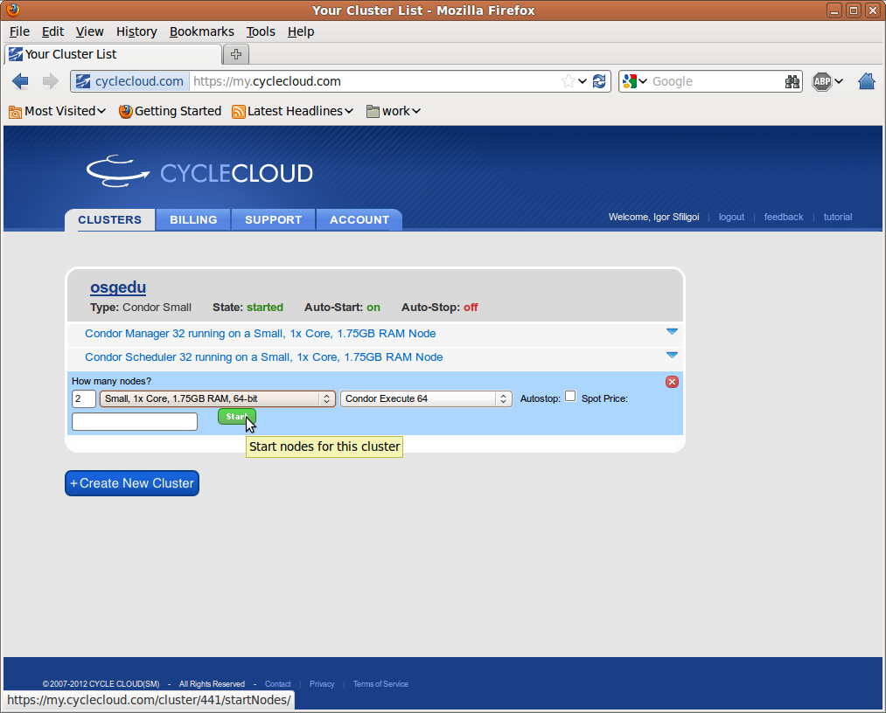
Let's start some compute nodes

Slide 15
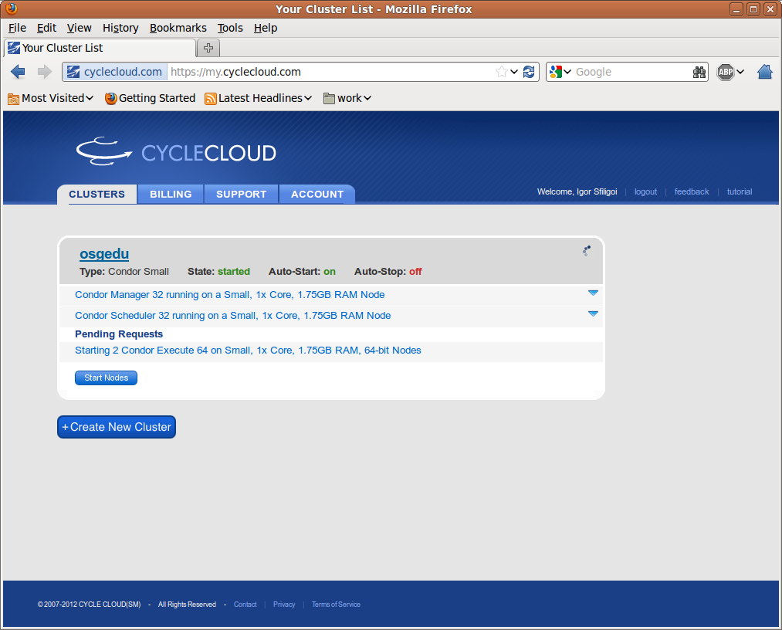
And wait patiently

Slide 16

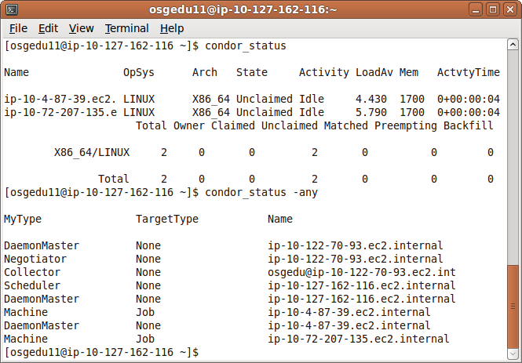
Here is our Condor pool

Slide 17
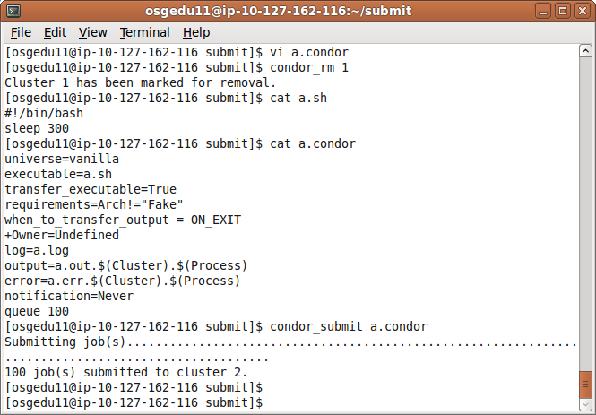
Let's submit some jobs

Slide 18
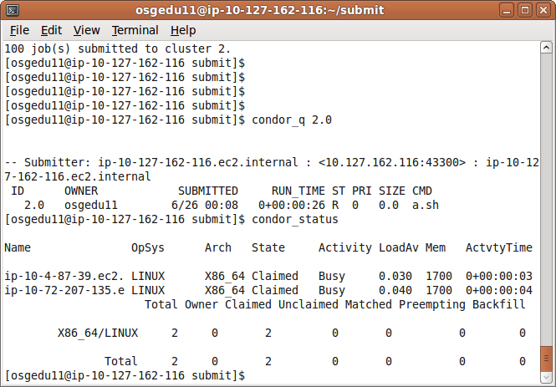
And we have running jobs

Slide 19
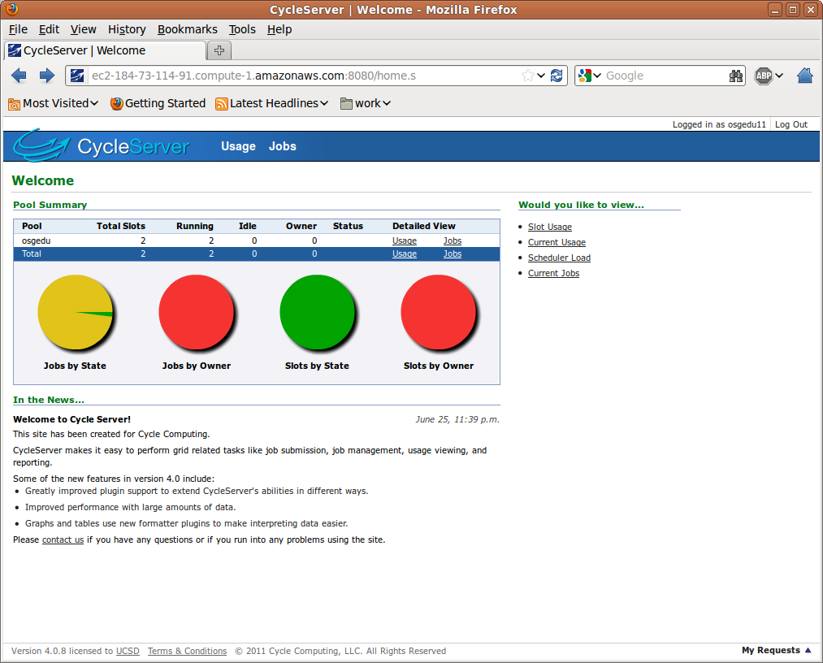
CycleCloud shows this as well

Slide 20
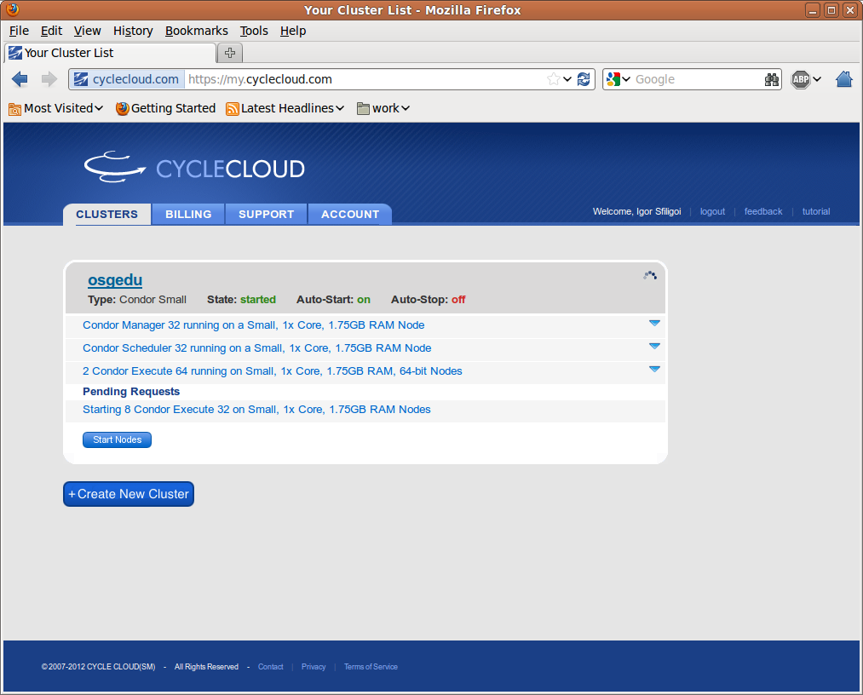
With auto-start, more WNs on the way

Slide 21
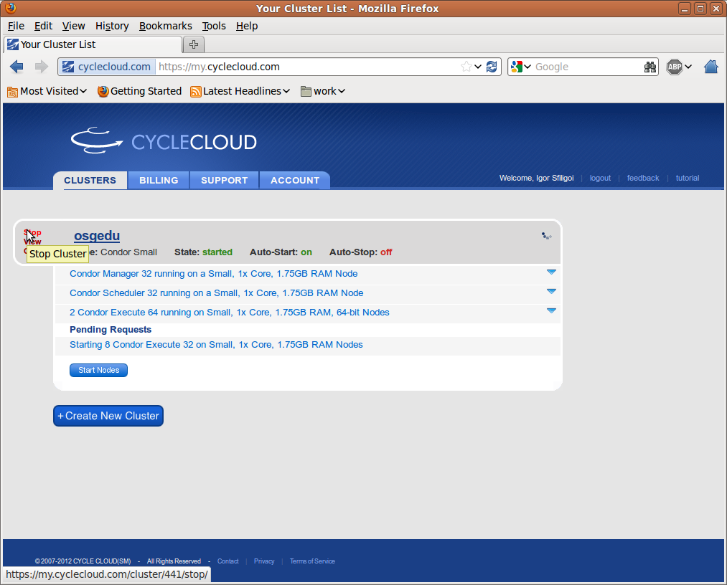
But enough for the demo

Slide 22
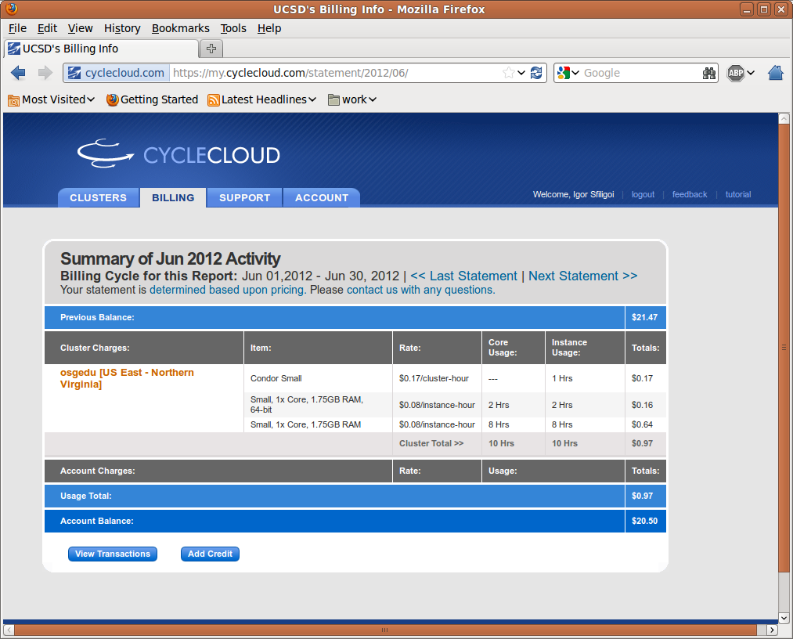
A final look at the cost

Slide 23
Questions?
Questions? Comments?
  Feel free to ask me questions anytime:
  Igor Sfiligoi <isfiligoi@ucsd.edu>

