Slide 1

Scientific Workflows on the Grid

Slide 2
Goals
Enhance scientific productivity through:
Discovery and application of datasets and programs at petabyte scale
Enabling use of a worldwide data grid as a scientific workstation

Slide 3
Virtual Data and Workflows
Challenge is managing and organizing the vast computing and storage capabilities provided by Grids
Workflow expresses computations in a form that can be readily mapped to Grids
Virtual data keeps accurate track of data derivation methods and provenance
Grid tools virtualize location and caching of data, and recovery from failures

Slide 4
Example Application:
High Energy Physics
Data Analysis
mass = 200
decay = bb
mass = 200
mass = 200
decay = ZZ
mass = 200
decay = WW
stability = 3
mass = 200
decay = WW
stability = 1
LowPt = 20
HighPt = 10000
mass = 200
decay = WW
mass = 200
decay = WW
stability = 1
mass = 200
event = 8
mass = 200
decay = WW
stability = 1
event = 8
mass = 200
plot = 1
mass = 200
decay = WW
event = 8
Work and slide by
Rick Cavanaugh and
Dimitri Bourilkov,
University of Florida
mass = 200
decay = WW
plot = 1
mass = 200
decay = WW
stability = 1
plot = 1

Slide 5
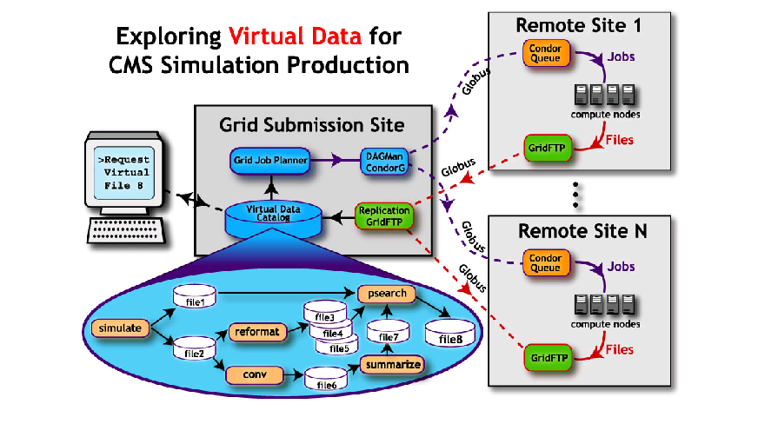
Executing a scientific workflow

Slide 6
What must we “virtualize” to compute on the Grid?
Location-independent computing: represent all workflow in abstract terms
Declarations not tied to specific entities:
  sites
  file systems
  schedulers
Failures – automated retry for data server and execution site un-availability

Slide 7
Mapping the Science Process to workflows
Start with a single workflow
Automate the generation of workflow for sets of files (datasets)
Replicate workflow to explore many datasets
Change Parameters
Change code – add new transformations
Build new workflows
Use provenance info

Slide 8
How does Workflow
Relate to Provenance?
Workflow – specifies what to do
Provenance – tracks what was done
Query
What I
Am Doing
Executed
Edit
Executing
What I
Did
What I
Want to Do
…
Executable
Waiting
Execution environment
Schedule

Slide 9
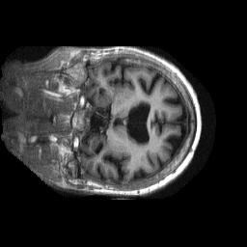
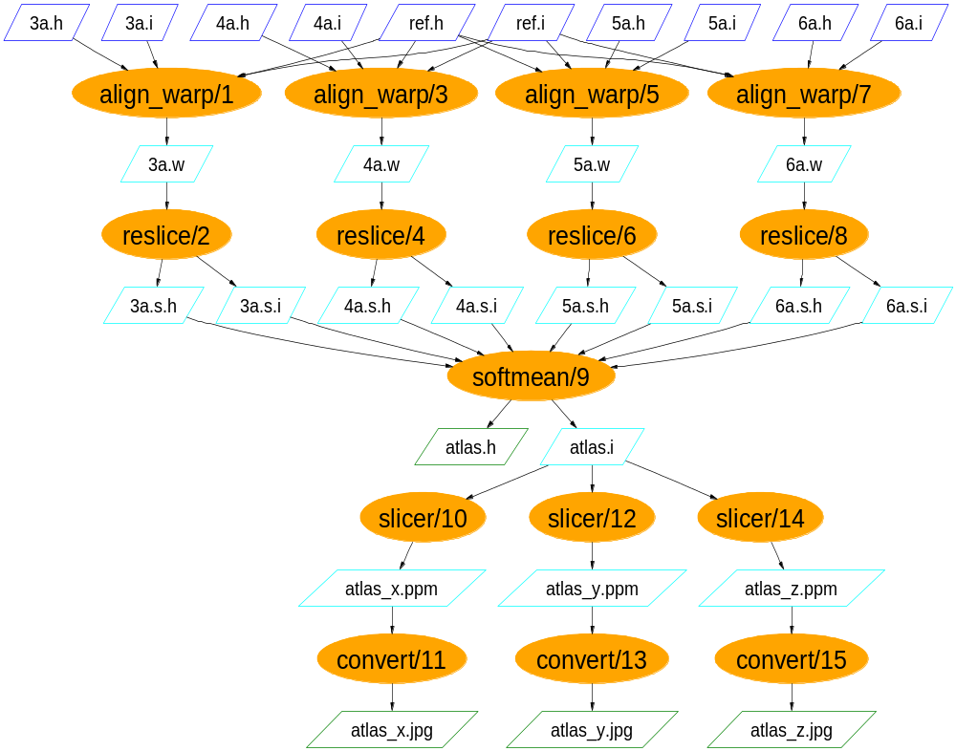
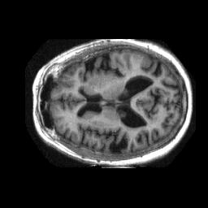
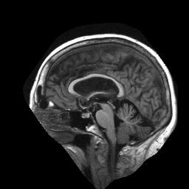
Functional MRI Analysis
Workflow courtesy James Dobson, Dartmouth Brain Imaging Center

Slide 10
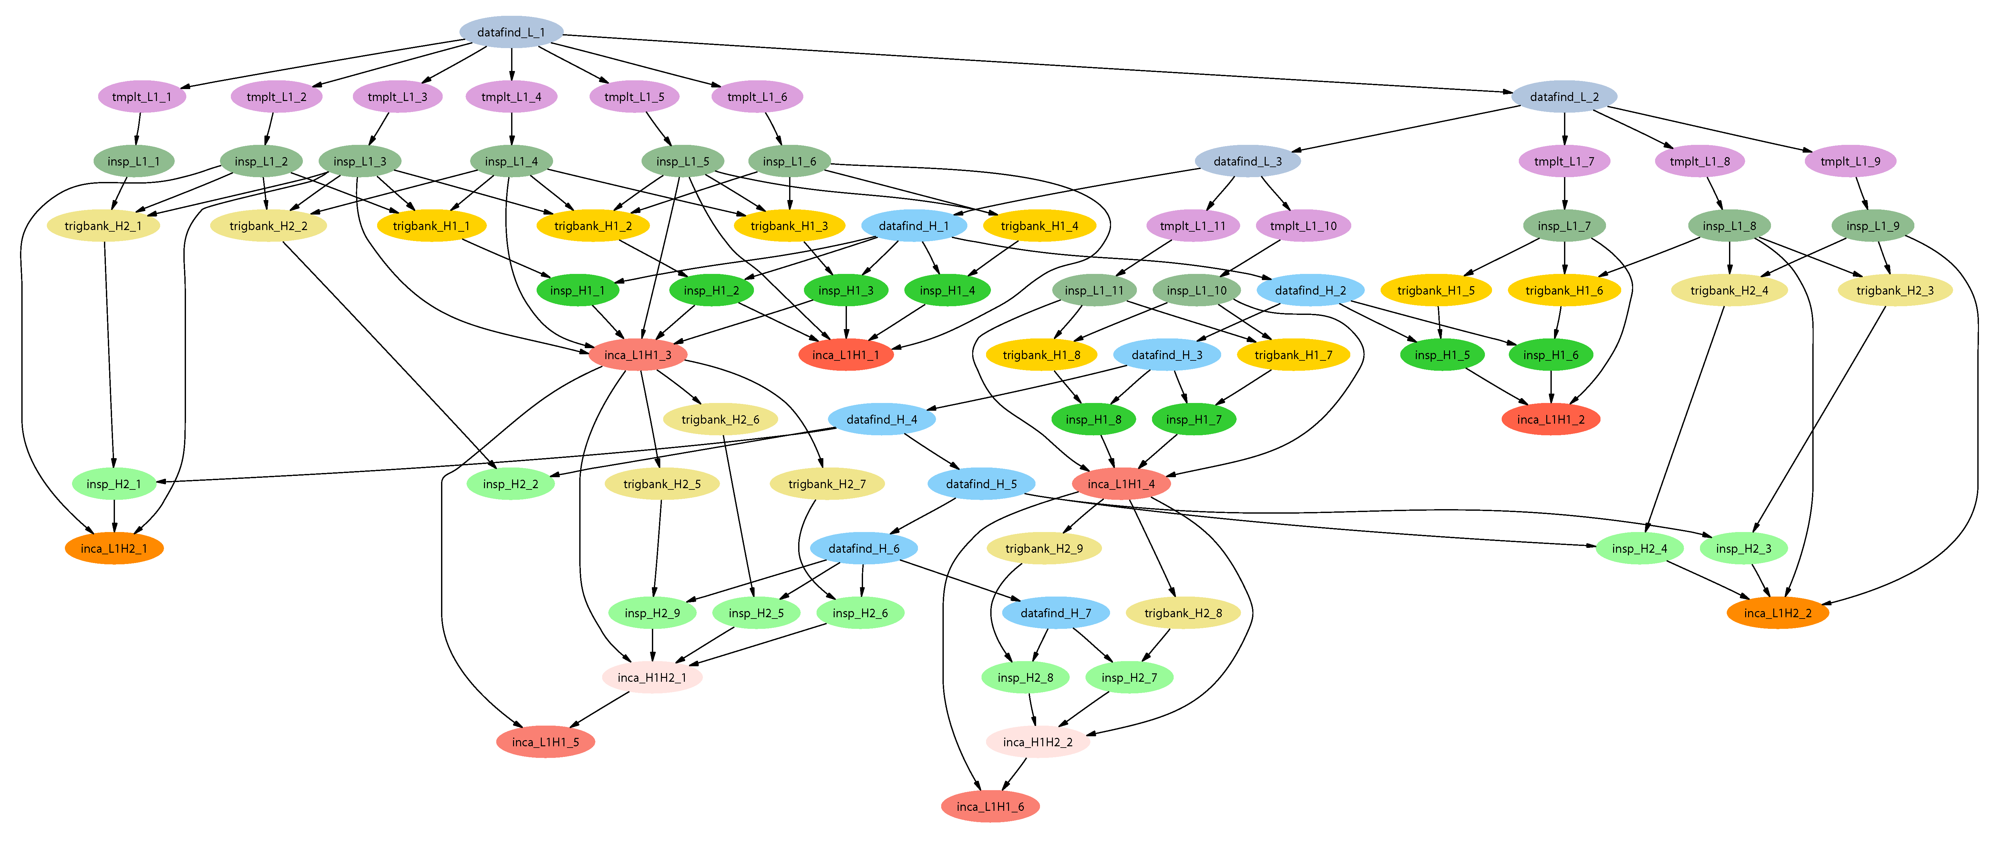
LIGO Inspiral Search Application
Describe…
Inspiral workflow application is the work of Duncan Brown, Caltech,
Scott Koranda, UW Milwaukee, and the LSC Inspiral group

Slide 11
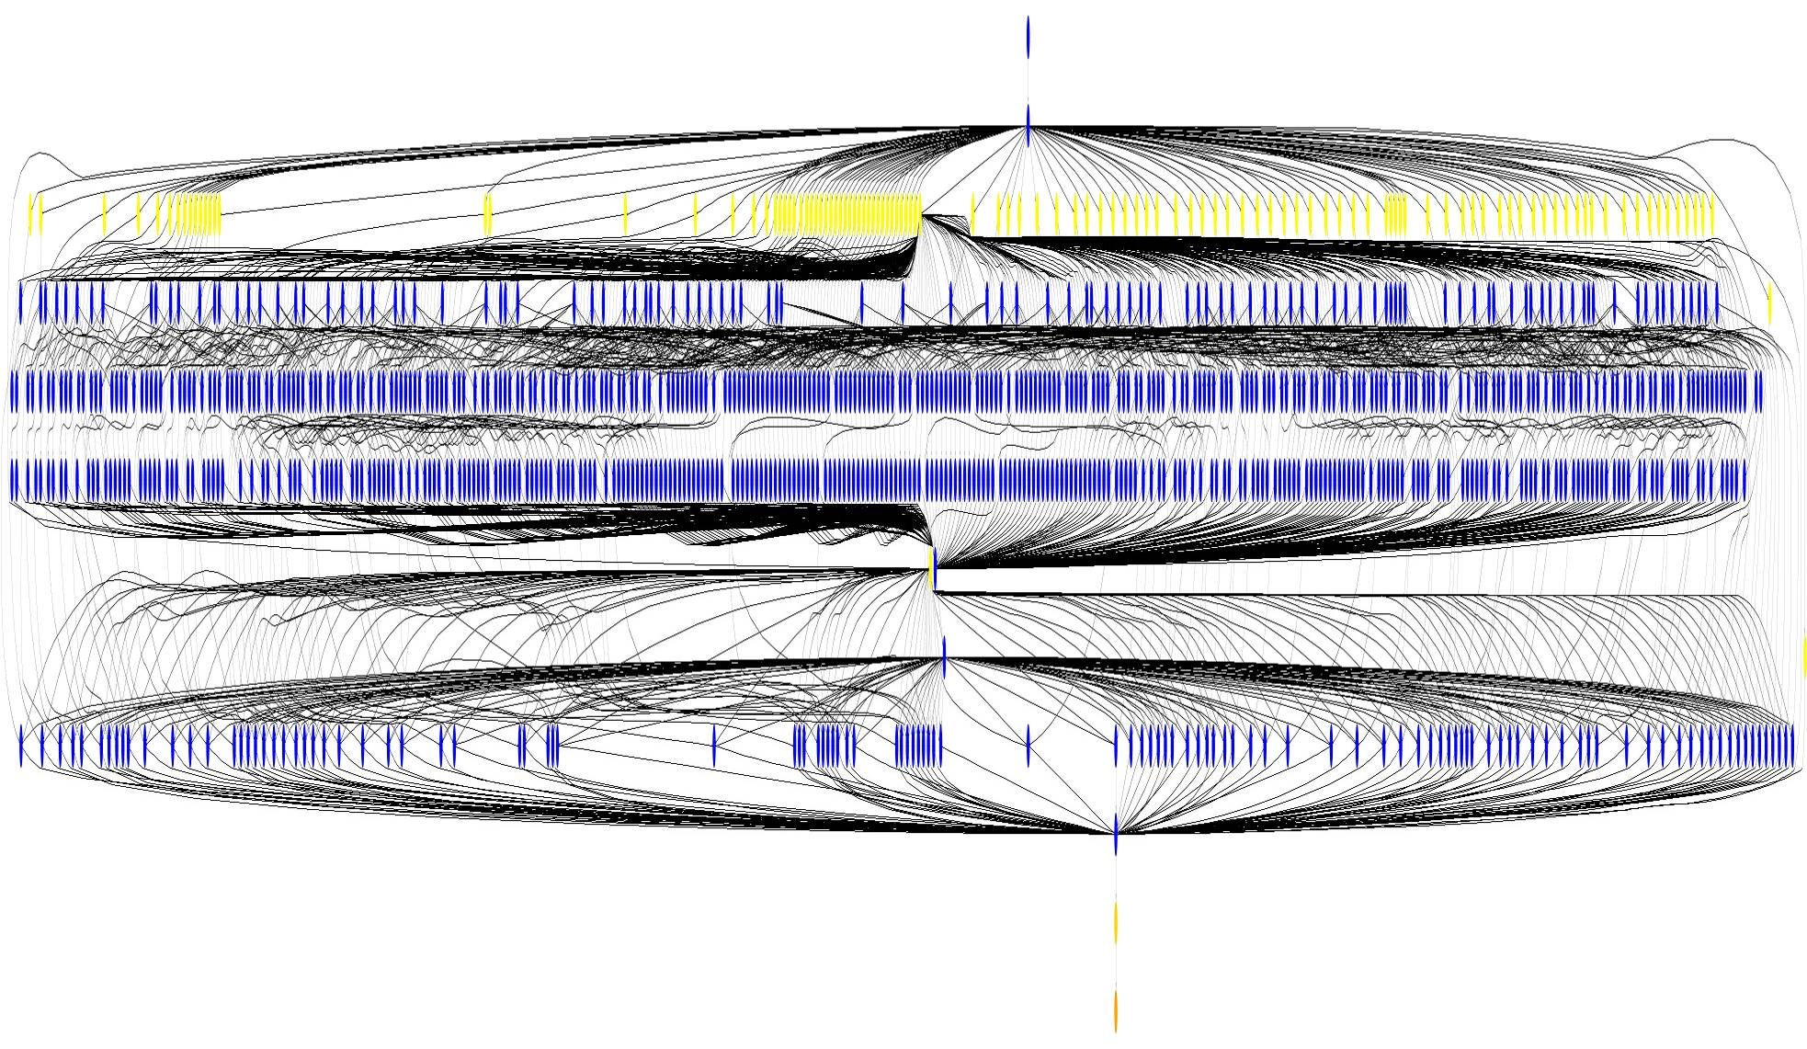
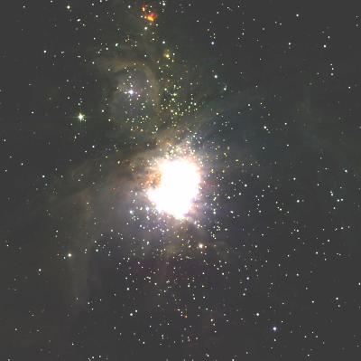
Example Montage Workflow
~1200 node workflow, 7 levels
Mosaic of M42 created on
the Teragrid using Pegasus
http://montage.ipac.caltech.edu/

Slide 12
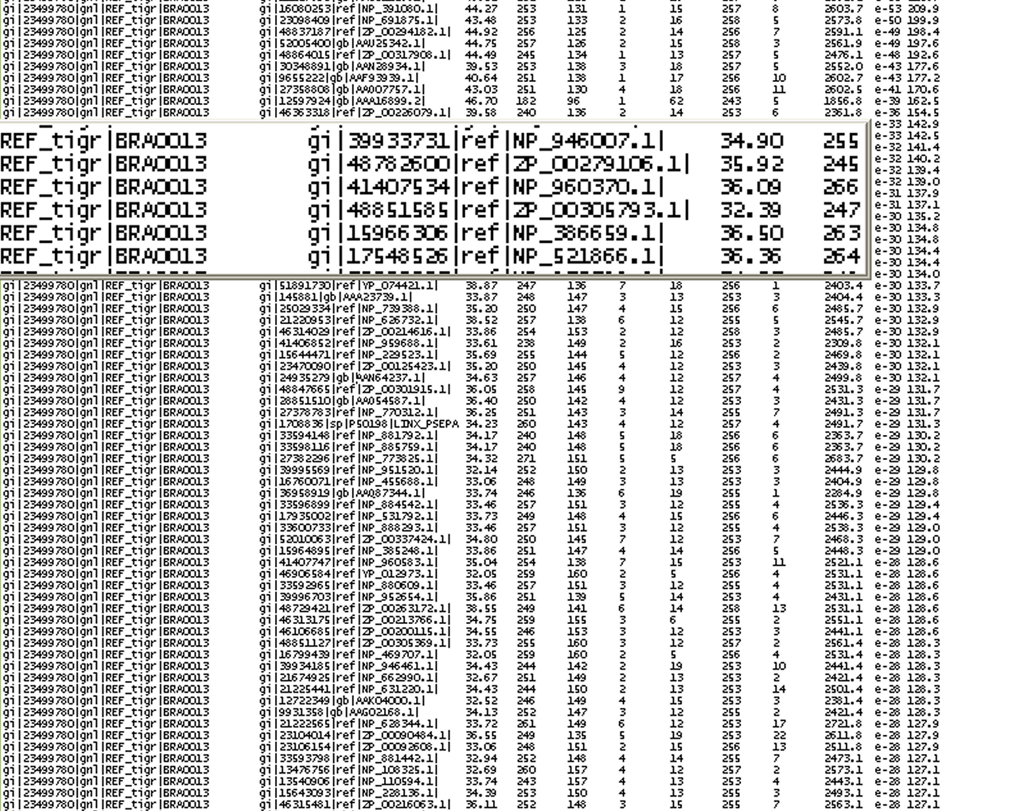
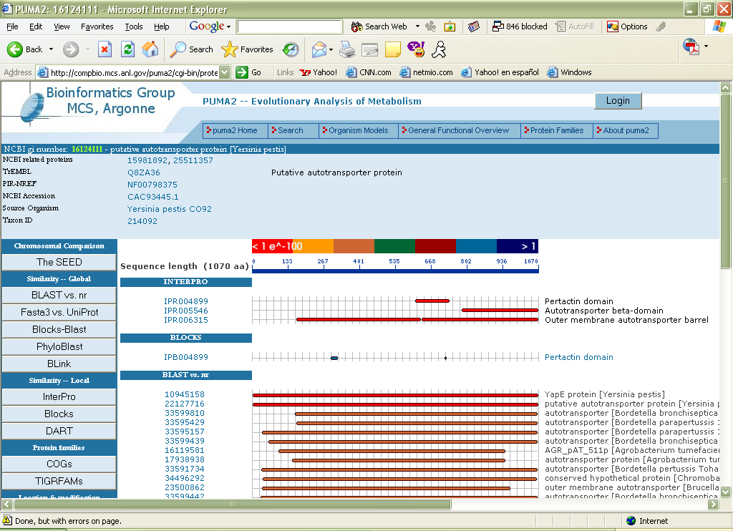
Blasting for Protein Knowledge
BLAST compare of complete nr database for sequence similarity
and function characterization
Knowledge Base
PUMA is an interface for the researchers to be able to find information about a specific protein after having been analyzed against the complete set of sequenced genomes (nr file ~ approximately 3 million sequences)
Analysis on the Grid
The analysis of the protein sequences occurs in the background in the grid environment. Millions of processes are started since several tools are run to analyze each sequence, such as finding out protein similarities (BLAST), protein family domain searches (BLOCKS), and structural characteristics of the protein.

Slide 13
FOAM:
Fast Ocean/Atmosphere Model
250-Member Ensemble
Run on TeraGrid under VDS
Remote Directory Creation for Ensemble Member 1
Remote Directory Creation for Ensemble Member 2
Remote Directory Creation for Ensemble Member N
FOAM run for Ensemble Member 1
FOAM run for Ensemble Member 2
FOAM run for Ensemble Member N
Atmos Postprocessing
Atmos Postprocessing for Ensemble Member 2
Ocean Postprocessing for Ensemble Member 2
Coupl Postprocessing for Ensemble Member 2
Coupl Postprocessing for Ensemble Member 2
Results transferred to archival storage
Work of: Rob Jacob (FOAM), Veronica Nefedova (Workflow design and execution)

Slide 14
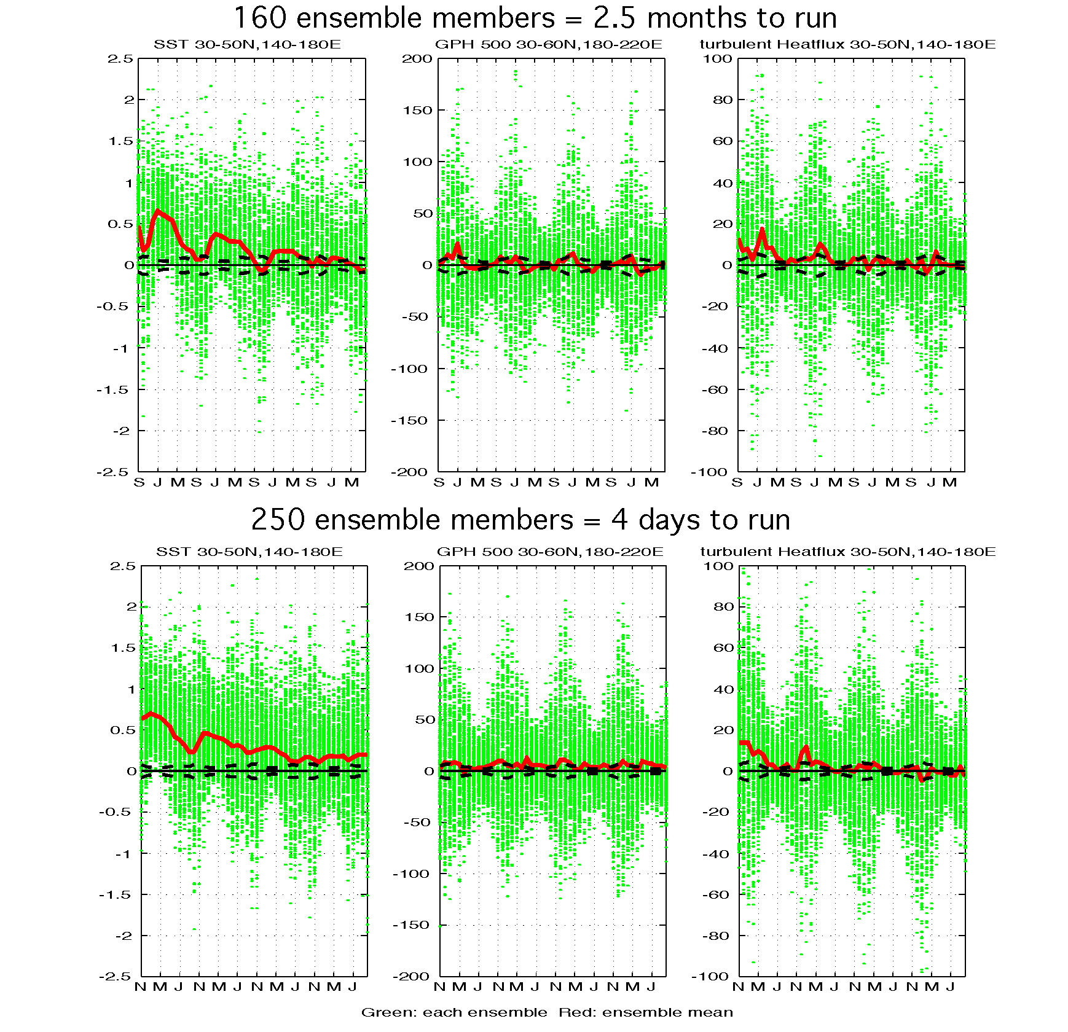
FOAM: TeraGrid/VDSBenefits
Climate Supercomputer
FOAM application by Rob Jacob, Argonne; VDS workflow by Veronika Nefedova, Argonne Visualization courtesy Pat Behling and Yun Liu, UW Madison..
TeraGrid with NMI and VDS

Slide 15
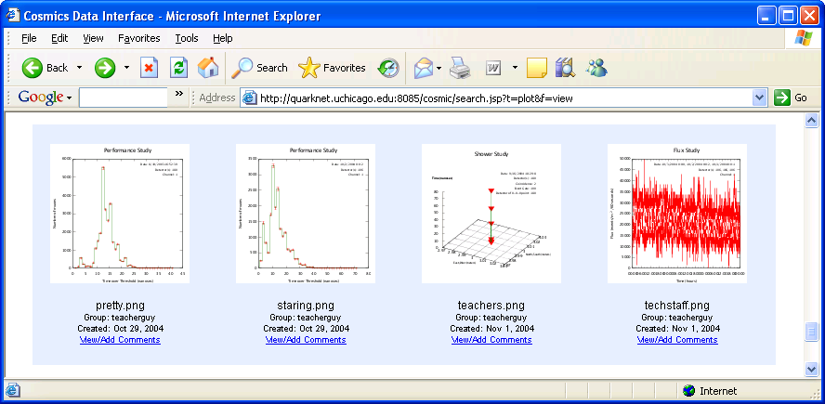
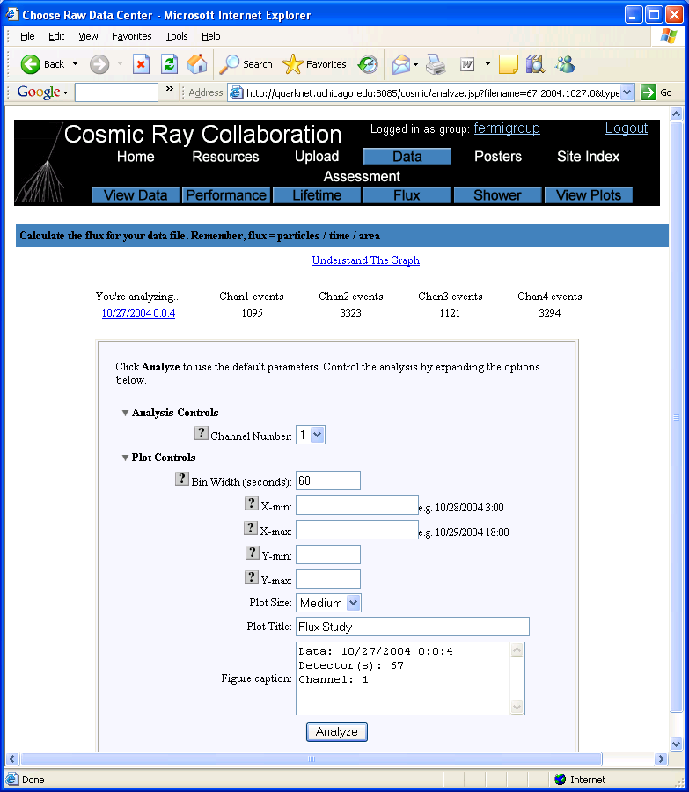
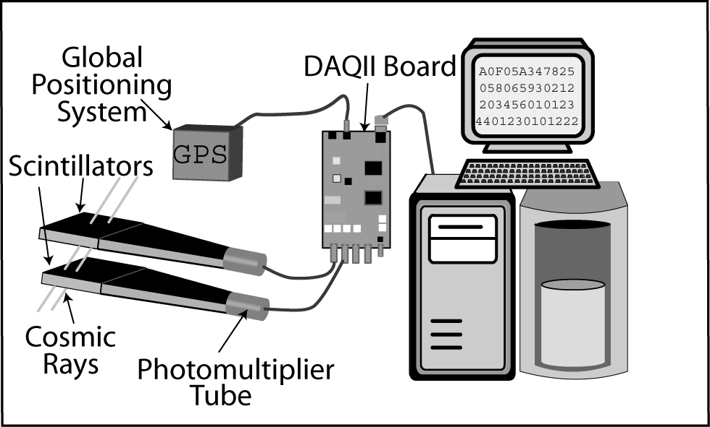
i2u2 - Leveraging Virtual Data for Science Education

Slide 16
VDS Applications
Application
Jobs / workflow
Levels
Status
ATLAS
HEP Event Simulation
500K
1
In Use
LIGO
Inspiral/Pulsar
~700
2-5
Inspiral In Use
NVO/NASA
Montage/Morphology
1000s
7
In Use
GADU
Genomics: BLAST,…
40K
1
In Use
fMRI
AIR, freeSurfer prepro
100s
12
In Devel
QuarkNet
CosmicRay science
<10
3-6
In Use
SDSS
Coadd; Cluster Search
40K
500K
2
8
CS Research
FOAM
Ocean/Atmos Model
2000 (core app runs
250 8-CPU jobs)
3
In use
GTOMO
Image proc
1000s
1
In Devel
SCEC
Earthquake sim
1000s
In use

Slide 17
Some workflow systems
DAGman – part of Condor
VDS – VDL+Pegasus
Swift

Slide 18
DAGMan
Directed Acyclic Graph Manager
DAGMan allows you to specify the dependencies between your Condor jobs, so it can manage them automatically for you.
  By default, Condor may run your jobs in any order, or everything simultaneously, so we need DAGMan to enforce an ordering when necessary.
Example: “Don’t run job “B” until job “A” has completed successfully.”
Notes:
In the simplest case…

Slide 19
What is a DAG?
A DAG is the data structure used by DAGMan to represent these dependencies.
Each job is a “node” in the DAG.
Each node can have any number of “parent” or “children” nodes – as long as there are no loops!
Job A
Job B
Job C
Job D
Notes:
a DAG is the best data structure to represent a workflow of jobs with dependencies
children may not run until their parents have finished – this is why the graph is a directed graph … there’s a direction to the flow of work
In this example, called a “diamond” dag, job A must run first; when it finishes, jobs B and C can run together; when they are both finished, D can run; when D is finished the DAG is finished
Loops, where two jobs are both descended from one another, are prohibited because they would lead to deadlock – in a loop, neither node could run until the other finished, and so neither would start – this restriction is what makes the graph acyclic

Slide 20
Defining a DAG
A DAG is defined by a .dag file, listing each of its nodes and their dependencies:
  # diamond.dag
  Job A a.sub
  Job B b.sub
  Job C c.sub
  Job D d.sub
  Parent A Child B C
  Parent B C Child D
each node will run the Condor job specified by its accompanying Condor submit file
Job A
Job B
Job C
Job D
Notes:
This is all it takes to specify the example “diamond” dag.
DAGMan will output the log file for each job to determine what to do next.

Slide 21
Submitting a DAG
To start your DAG, just run condor_submit_dag with your .dag file, and Condor will start a personal DAGMan daemon which to begin running your jobs:
  % condor_submit_dag diamond.dag
condor_submit_dag submits a job with DAGMan as the executable.
  This job happens to run on the submitting machine, not any other computer.
Thus the DAGMan daemon itself runs as a Condor job, so you don’t have to baby-sit it.
Notes:
Just like any other Condor job, you get fault tolerance in case the machine crashes or reboots, or if there’s a network outage
And you’re notified when it’s done, and whether it succeeded or failed
% condor_q
-- Submitter: foo.bar.edu : <128.105.175.133:1027> : foo.bar.edu
ID OWNER SUBMITTED RUN_TIME ST PRI SIZE CMD
2456.0 user 3/8 19:22 0+00:00:02 R 0 3.2 condor_dagman -f -

Slide 22
Running a DAG
DAGMan acts as a “meta-scheduler”, managing the submission of your jobs to Condor based on the DAG dependencies.
DAGMan
A
Condor
Job
Queue
.dag
File
A
B
C
D
Notes:
First, job A will be submitted alone…

Slide 23
Running a DAG (cont’d)
DAGMan holds & submits jobs to the Condor queue at the appropriate times.
DAGMan
A
Condor
Job
Queue
B
B
C
C
D
Notes:
Once job A completes successfully, jobs B and C will be submitted at the same time…

Slide 24
Running a DAG (cont’d)
In case of a job failure, DAGMan continues until it can no longer make progress, and then creates a “rescue” file with the current state of the DAG.
DAGMan
A
Condor
Job
Queue
Rescue
File
B
X
D
Notes:
If job C fails, DAGMan will wait until job B completes, and then will exit, creating a rescue file. Job D will not run.
In its log, DAGMan will provide additional details of which node failed and why.

Slide 25
Recovering a DAG
Once the failed job is ready to be re-run, the rescue file can be used to restore the prior state of the DAG.
DAGMan
A
Condor
Job
Queue
Rescue
File
B
C
C
D
Notes:
Since jobs A and B have already completed, DAGMan will start by re-submitting job C

Slide 26
Recovering a DAG (cont’d)
Once that job completes, DAGMan will continue the DAG as if the failure never happened.
DAGMan
A
Condor
Job
Queue
B
C
D
D

Slide 27
VDS
Virtual Data System
  Virtual Data Language (VDL)
    A language to express workflows
  Pegasus planner
    Decides how the workflow will run
  Virtual Data Catalog (VDC)
    Stores information about workflows
    Stores provenance of data

Slide 28
Virtual Data Process
Describe data derivation or analysis steps in a high-level workflow language (VDL)
VDL is cataloged in a database for sharing by the community
Grid workflows are generated from VDL
Provenance of derived results stored in database for assessment or verification

Slide 29
Planning with Pegasus
High Level
Application
Knowledge
Resource
Information
and Configuration
Data Location
Information
Pegasus Planner
DAX abstract workflow, from VDL
Plan to be submitted to the grid (e.g condor submit files)

Slide 30
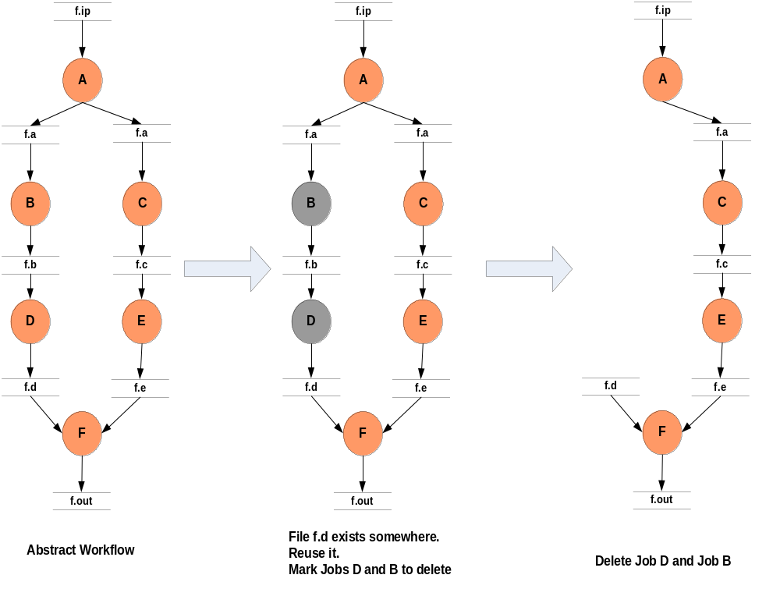
Abstract to Concrete, Step 1: Workflow Reduction

Slide 31
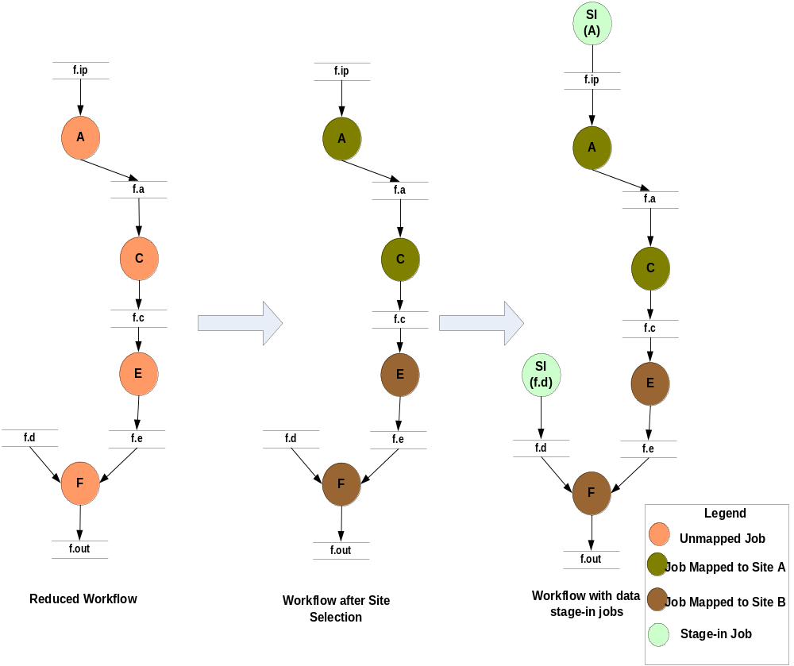
Step 2: Site Selection & Addition of Data Stage-in Nodes

Slide 32
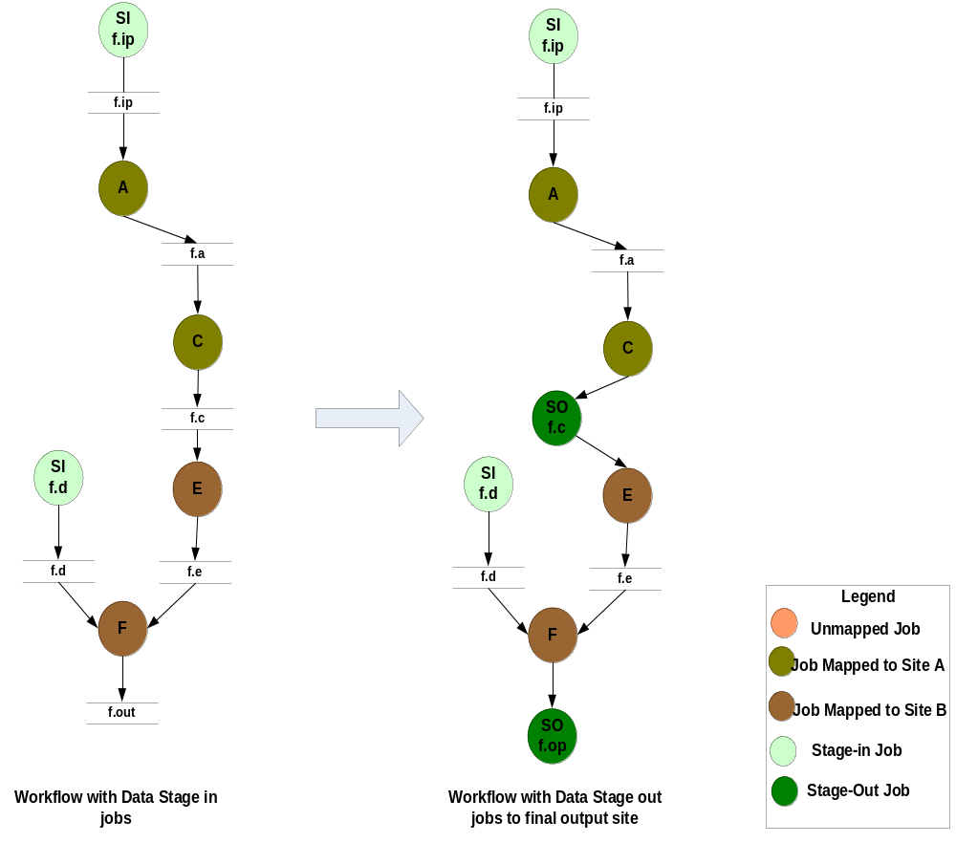
Step 3: Addition of Data Stage-out Nodes

Slide 33
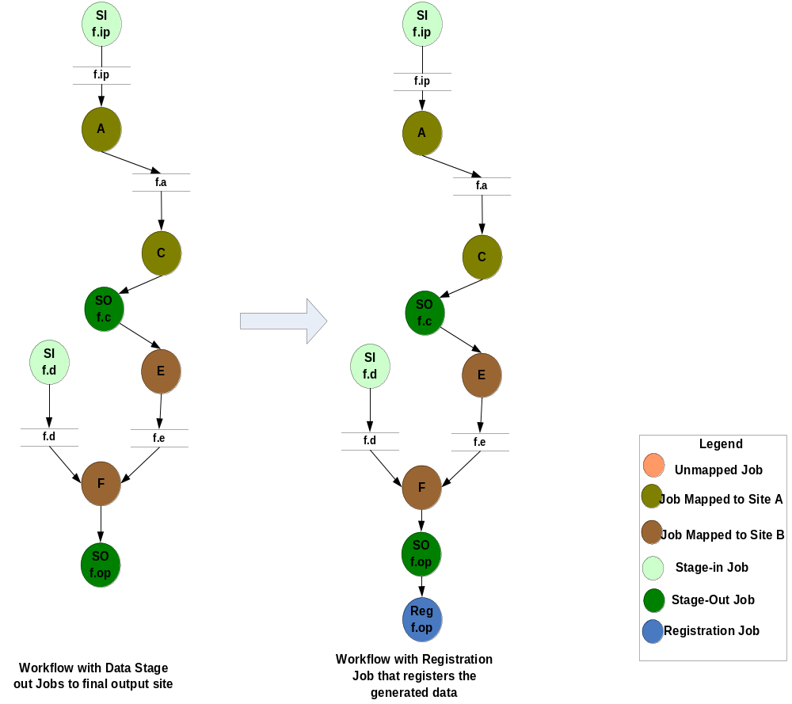
Step 4: Addition of Replica Registration Jobs

Slide 34
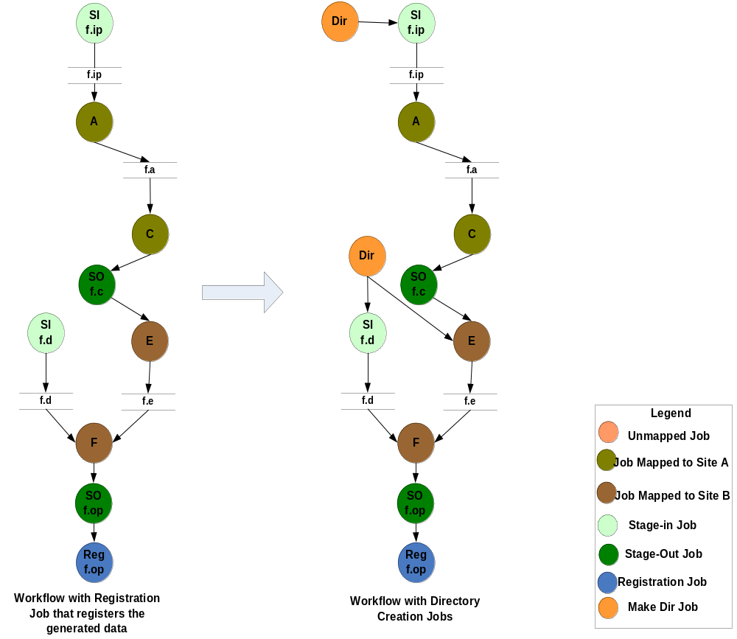
Step 5: Addition of Job-Directory Creation

Slide 35
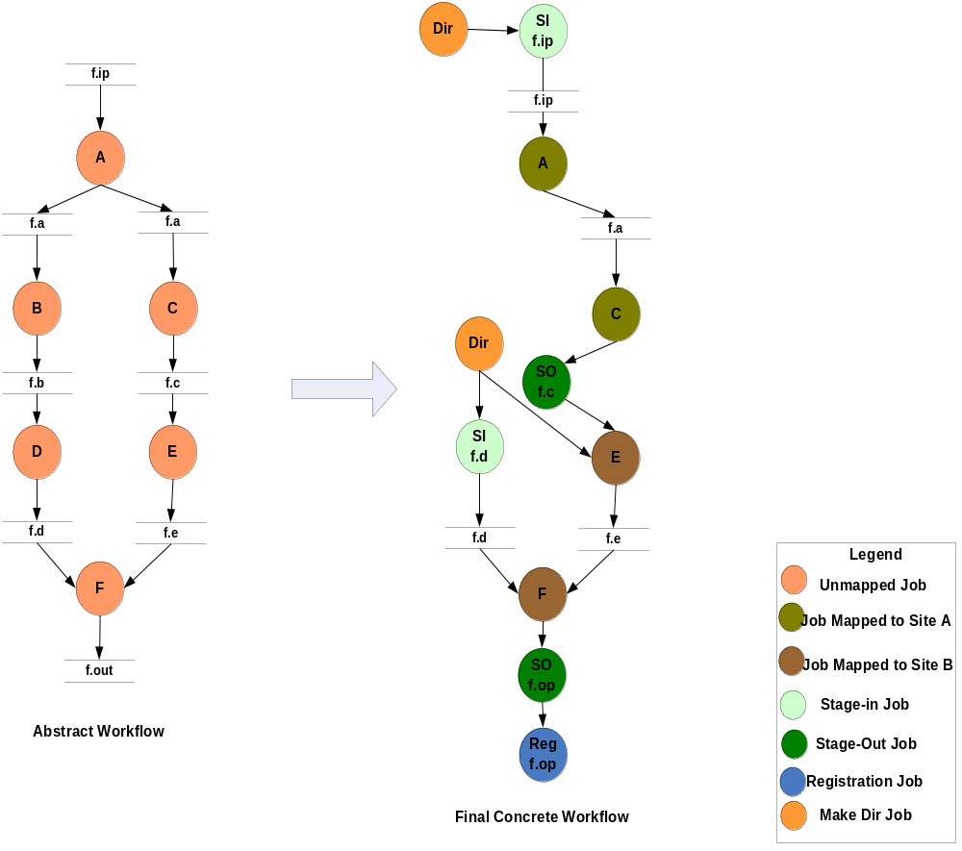
Final Result of Abstract-to-Concrete Process

Slide 36
Swift System
Clean separation of logical/physical concerns
  XDTM specification of logical data structures
+ Concise specification of parallel programs
  SwiftScript, with iteration, etc.
+ Efficient execution on distributed resources
  Lightweight threading, dynamic provisioning, Grid interfaces, pipelining, load balancing
+ Rigorous provenance tracking and query
  Virtual data schema & automated recording
→ Improved usability and productivity
  Demonstrated in numerous applications
Notes:
XDTM: XML Data Typing and Mapping
Also note: uses several components of the VDS: APIs and formats for site and transformation description databases; kickstart application and XML provenance record.

Slide 37
AIRSN Program Definition
(Run or) reorientRun (Run ir,
string direction) {
foreach Volume iv, i in ir.v {
or.v[i] = reorient(iv, direction);
}
}
(Run snr) functional ( Run r, NormAnat a,
Air shrink ) {
  Run yroRun = reorientRun( r , "y" );
  Run roRun = reorientRun( yroRun , "x" );
  Volume std = roRun[0];
  Run rndr = random_select( roRun, 0.1 );
  AirVector rndAirVec = align_linearRun( rndr, std, 12, 1000, 1000, "81 3 3" );
  Run reslicedRndr = resliceRun( rndr, rndAirVec, "o", "k" );
  Volume meanRand = softmean( reslicedRndr, "y", "null" );
  Air mnQAAir = alignlinear( a.nHires, meanRand, 6, 1000, 4, "81 3 3" );
  Warp boldNormWarp = combinewarp( shrink, a.aWarp, mnQAAir );
  Run nr = reslice_warp_run( boldNormWarp, roRun );
  Volume meanAll = strictmean( nr, "y", "null" )
  Volume boldMask = binarize( meanAll, "y" );
  snr = gsmoothRun( nr, boldMask, "6 6 6" );
}
Notes:
Shows how we can arbitrarily nest Swift procedures, similar to how it was done in VDL.
At the “leaves” of a nested procedure call graph are “atomic procedures” – the actual executable programs of a user’s application domain. Then swift procedures nest calls to these atomics or to other “compound” procedures.
Atomic procedures are typically executed at worker nodes, while composite procedures are handled within Swift’s Karajan workflow engine.

Slide 38

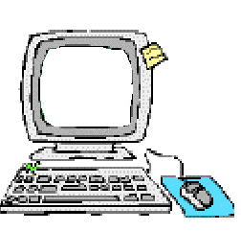
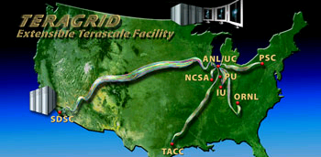

Swift Architecture
Specification
Scheduling
Execution
Provisioning
Abstract
computation
Execution Engine
(Karajan w/
Swift Runtime)
Virtual Node(s)
Dynamic
Resource
Provisioner
file1
SwiftScript
Compiler
Swift runtime
callouts
launcher
C
C
C
App
F1
C
Provenance
data
file2
Virtual Data
Catalog
Status reporting
launcher
App
F2
Amazon
EC2
Provenance
data
file3
SwiftScript
Provenance
collector
Notes:
Note that current version has not yet integrated the VDC from the VDS VDL implementation.
One advantage of this is simplicity for the user. When we integrate it back in, its likely that we’ll make it optional to retain this simplicity, especially for users less interested in provenance storage.
Explain: what is the format of the abstract workflow: Karajan program. (A VDL for of Swift source code is also generated internally)
EC2 – an example of how we could provision workflows across radically different Grids.
The dynamic provisioner is a work in progress based on the PhD work of Ioan Raicu, originally demonstrated for “image stacking” in SDSS data. A Swift/Karajan job execution provider was recently implemented by Yong Zhao, and together they have demonstrated some great results that we’ll show at the end of this talk.

Slide 39

Based on:
The Virtual Data System – a workflow toolkit for science applications
OSG Summer Grid Workshop
Lecture 8
June 29, 2006

Slide 40


Based on: Fast, Reliable, Loosely Coupled Parallel Computation
Tiberiu Stef-Praun
Computation Institute
University of Chicago & Argonne National Laboratory
tiberius@ci.uchicago.edu
www.ci.uchicago.edu/swift
Notes:
Note that we are avoiding the use of the word “workflow” here – don’t say this, but that’s a theme.
Loosely coupled: applications that share data by passing files between them

Slide 41




Based on:
Lecture 5
Grid Resources and Job Management
Jaime Frey
Condor Project,
University of Wisconsin-Madison
jfrey@cs.wisc.edu
Grid Summer Workshop
June 26-30, 2006

Slide 42


Acknowledgements
The technologies and applications described here
were made possible by the following projects and support:
GriPhyN, iVDGL, the Globus Alliance and QuarkNet, supported by
The National Science Foundation
The Globus Alliance, PPDG, and QuarkNet, supported by the US Department of Energy, Office of Science
Support was also provided by
NVO, NIH, and SCEC

