Slide 1
Installing and Using SRM-dCache
Ted Hesselroth
Fermilab

Slide 2
What is dCache?
High throughput distributed storage system
Provides
  Unix filesystem-like Namespace
  Storage Pools
  Doors to provide access to pools
  Athentication and authorization
  Local Monitoring
  Installation scripts
  HSM Interface

Slide 3
dCache Features
nfs-mountable namespace
Multiple copies of files, hotspots
Selection mechanism: by VO, read-only, rw, priority
Multiple access protocols (kerberos, CRCs)
  dcap (posix io), gsidcap
  xrootd (posix io)
  gsiftp (multiple channels)
Replica Manager
  Set min/max number of replicas

Slide 4
dCache Features (cont.)
Role-based authorization
  Selection of authorization mechanisms
Billing
Admin interface
  ssh, jython
InformationProvider
  SRM and gsiftp described in glue schema
Platform, fs independent (Java)
  32 and 64-bit linux, solaris; ext3, xfs, zfs

Slide 5
Abstraction: Site File Name
Use of namespace instead of physical file location
/pnfs/fnal.gov/data/myfile1
000175
pnfs,
postgres
Storage Node A
Client
Pool 1
Pool 2
/pnfs/...
000175
Storage Node B
door
Pool 3
000175

Slide 6
The Pool Manager
Storage Node A
Client
Pool 1
Pool 2
door
Pool 3
000175
Storage Node B
Pool 3
000175
Pool
Manager
Selects pool according to cost function
Controls which pools are available to which users

Slide 7
Local Area dCache
dcap door
  client in C
  Provides posix-like IO
  Security options: unauthenticated, x509, kerberos
  Recconnection to alternate pool on failure
dccp
  dccp /pnfs/univ.edu/data/testfile /tmp/test.tmp
  dccp dcap://oursite.univ.edu/pnfs/univ.edu/data/testfile /tmp/test.tmp

Slide 8
The dcap library and dccp
Provides posix-like open, create, read, write, lseek
  int dc_open(const char *path, int oflag, /* mode_t mode */...);
  int dc_create(const char *path, mode_t mode);
  ssize_t dc_read(int fildes, void *buf, size_t nbytes);
  ...
xrootd
  Alice authorization

Slide 9
Wide Area dCache
gsiftp
  dCache implementation
  Security options: x509, kerberos
  multi-channel
globus-url-copy
  globus-url-copy gsiftp://oursite.univ.edu:2811/data/testfile file:////tmp/test.tmp
  srmcp gsiftp://oursite.univ.edu:2811/data/testfile file:////tmp/test.tmp

Slide 10
The Gridftp Door
Client
Control channel
“Start mover”
gridftp
door
Data channels
Storage Node B
mover
Pool 3

Slide 11
Pool Selection
PoolManager.conf
  Client IP ranges
    onsite, offsite
  Area in namespace being accessed
    under a directory tagged in pnfs
    access to directory controlled by authorization
      selectable based on VO, role
  Type of transfer
    read, write, cache(from tape)
Cost function if more than one pool selectable

Slide 12
Performance, Software
ReplicaManager
  Set minimum and maximum number of replicas of files
    Uses “p2p” copying
    Saves step of dCache making replicas at transfer time
  May be applied to a part of dCache
Multiple Mover Queues
  LAN: file open during computation, multiple posix reads
  WAN: whole file, short time period
  Pools can maintain independent queues for LAN, WAN

Slide 13
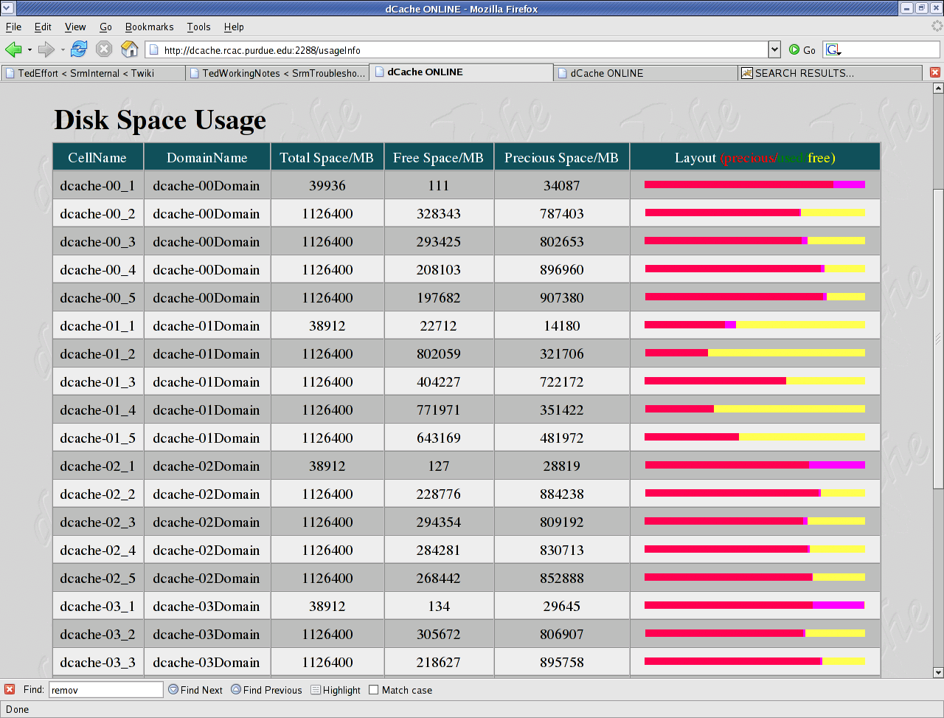
Monitoring – Disk Space Billing

Slide 14
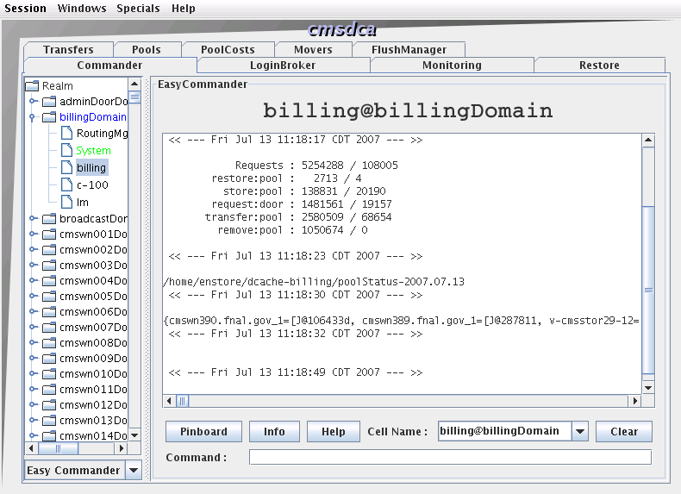
Cellspy - Commander
Status and command windows

Slide 15
Storage Resource Manager
Various Types of Doors, Storage Implementations
  gridftp, dcap, gsidcap, xrootd, etc
Need to address each service directly
SRM is middleware between client and door
  Web Service
Selects among doors according to availabilty
  Client specifies supported protocols
Provides additional services
Specified by collaboration: http://sdm.lbl.gov/srm-wg

Slide 16
SRM Features
Protocol Negotiation
Space Allocation
Checksum management
Pinning
3rd party transfers

Slide 17
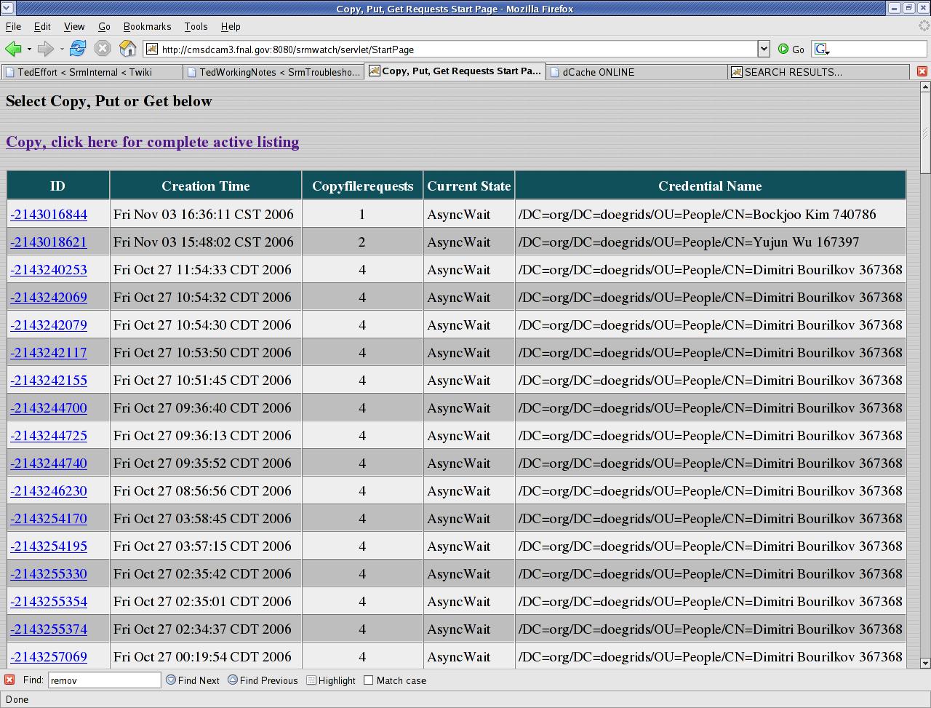
SRM Watch – Current Transfers

Slide 18
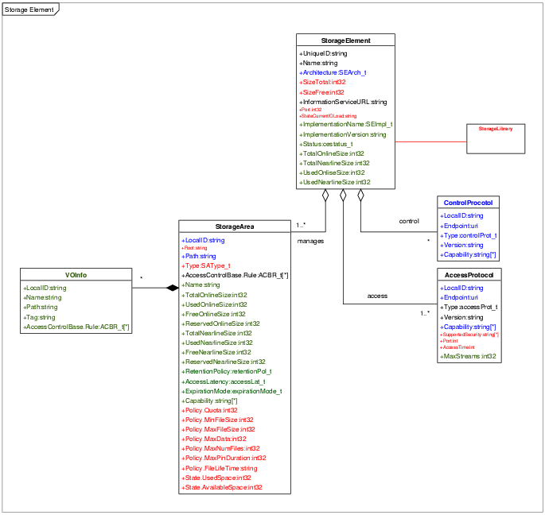
Glue Schema 1.3
Storage Element
  ControlProtocol
    SRM
  AccessProtocol
    gsiftp
  Storage Area
    Groups of Pools
    VOInfo
      Path
StorageElement
ControlProtocol
StorageArea
VOInfo
AccessProtocol

Slide 19
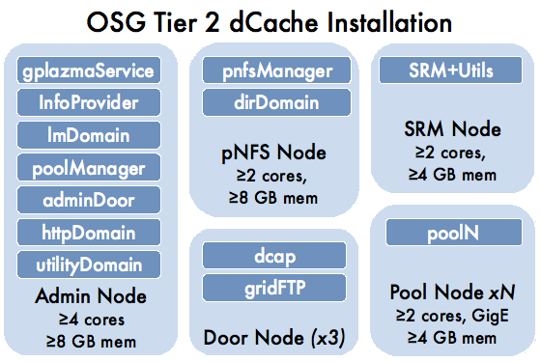
A Deployment
3 “admin” nodes
100 pool nodes
Tier-2 sized
  100 TB
  10 Gbs links
  10-15 TB/day

Slide 20
OSG Storage Activities
Support for Storage Elements on OSG
  dCache
  BestMan
Team Members (4 FTE)
  FNAL: Ted Hesselroth, Tanya Levshina, Neha Sharma
  UCSD: Abhishek Rana
  LBL: Alex Sim
  Cornell: Gregory Sharp

Slide 21
Overview of Services
Packaging and Installation Scripts
Questions, Troubleshooting
Validation
Tools
Extensions
Monitoring
Accounting
Documentation, expertise building

Slide 22
Deployment Support
Packaging and Installation Scripts
  dcache-server postgres, pnfs rpms
  dialog -> site-info.def
  install scripts
Questions, Troubleshooting
  GOC Tickets
  Mailing List
  Troubleshooting
  Laison to Developers
  Documentation

Slide 23
VDT Web Site
VDT Page
  http://vdt.cs.wisc.edu/components/dcache.html
dCache Book
  http://www.dcache.org/manuals/Book
Other Links
  srm.fnal.gov
  OSG Twiki twiki.grid.iu.edu/twiki/bin/view/ReleaseDocumentation/DCache
    Overview of dCache
    Validating an Installation

Slide 24
VDT Download Page for dCache
Downloads Web Page
  dcache
  gratia
  tools
dcache package page
  Latest version
    Associated with VDT version
  Change Log

Slide 25
The VDT Package for dCache
# wget http://vdt.cs.wisc.edu/software/dcache/server/ \
preview/2.0.1/vdt-dcache-SL4_32-2.0.1.tar.gz
# tar zxvf vdt-dcache-SL4_32-2.0.1.tar.gz
# cd vdt-dcache-SL4_32-2.0.1/preview
RPM-based
  Multi-node install

Slide 26
The Configuration Dialog
# config-node.pl
Queries
  Distribution of “admin” Services
    Up to 5 admin nodes
  Door Nodes
    Private Network
    Number of dcap doors
  Pool Nodes
    Partitions that will contain pools
Because of delegation, all nodes must have host certs.

Slide 27
The site-info.def File
# less site-info.def
“admin” Nodes
  For each service, hostname of node which is to run the service
Door Nodes
  List of nodes which will be doors
  Dcap, gsidcap, gridftp will be started on each door node
Pool nodes
  List of node, size, and directory of each pool
  Uses full size of partition for pool size

Slide 28
Customizations
# config-node.pl
DCACHE_DOOR_SRM_IGNORE_ORDER=true
SRM_SPACE_MANAGER_ENABLED=false
SRM_LINK_GROUP_AUTH_FILE
REMOTE_GSI_FTP_MAX_TRANSFERS=2000
DCACHE_LOG_DIR=/opt/d-cache/log
Copy site-info.def into install directory of package on each node.

Slide 29
The Dryrun Option
On each node of the storage system.
# ./install.sh --dryrun
Does not run commands.
Used to check conditions for install.
Produces vdt-install.log and vdt-install.err.

Slide 30
The Install
On each node of the storage system.
# ./install.sh
Checks if postgres is needed
  Installs postgres if not present
  Sets up databases and tables depending on the node type.
Checks if node is pnfs server
  Installs if not present
  Creates an export for each door node

Slide 31
The Install, continued
Unpacks dCache rpm
Modifies dCache configuration files
  node_config
  pool_path
  dCacheSetup
    If upgrade, applies previous settings to new dCacheSetup
Runs /opt/d-cache/install/install.sh
  Creates links and configuration files
  Creates pools if applicable
  Installs srm server if srm node

Slide 32
dCache Configuration Files in config and etc
“batch” files
dCacheSetup
ssh keys
`hostname`.poollist
PoolManager.conf
node_config
dcachesrm-gplazma.policy

Slide 33
Other dCache Directories
billing
  Stores records of transactions
bin
  Master startup scripts
classes
  jar files
credentials
  For srm caching
docs
  Images, stylesheets, etc used by html server

Slide 34
Other dCache Directories
external
  Tomcat and Axis packages, for srm
install
  Installation scripts
jobs
  Startup shell scripts
libexec
  Tomcat distribution for srm
srm-webapp
  Deployment of srm server

Slide 35
Customizations
Dedicated Pools
  Storage Areas
  Vos
  Volatile Space Reservations

Slide 36
Authorization - gPlazma
grid-aware PLuggable AuthoriZation MAnagement
Centralized Authorization
Selectable authorization mechanisms
Compatible with compute element authorization
Role-based

Slide 37
Authorization - gPlazma Cell
vi etc/dcachesrm-plazma.policy
If authorization fails or is denied, attempts next method
dcachesrm-gplazma.policy:
# Switches"
saml-vo-mapping="ON"
kpwd="ON"
grid-mapfile="OFF"
gplazmalite-vorole-mapping="OFF"
# Priorities
saml-vo-mapping-priority="1"
kpwd-priority="3"
grid-mapfile-priority="4"
gplazmalite-vorole-mapping-priority="2“
…
# SAML-based grid VO role mapping
mappingServiceUrl="https://gums.fnal.gov:8443/gums/services/GUMSAuthorizationServicePort"

Slide 38
The kpwd Method
The default method
Maps
  DN to username
  username to uid, gid, rw, rootpath
dcache.kpwd:
# Mappings for 'cmsprod' users
mapping "/DC=org/DC=doegrids/OU=People/CN=Ted Hesselroth 899520" cmsprod
mapping "/DC=org/DC=doegrids/OU=People/CN=Shaowen Wang 564753" cmsprod
# Login for 'cmsprod' users
login cmsprod read-write 9801 5033 / /pnfs/fnal.gov/data/cmsprod /pnfs/fnal.gov/data/cmsprod
/DC=org/DC=doegrids/OU=People/CN=Ted Hesselroth 899520
/DC=org/DC=doegrids/OU=People/CN=Shaowen Wang 564753

Slide 39
The saml-vo-mapping Method
Acts as a client to GUMS
GUMS returns a username.
Lookup in storage-authzdb follows for uid, gid, etc.
  Provides site-specific storage obligations
/etc/grid-security/storage-authzdb:
authorize cmsprod read-write 9811 5063 / /pnfs/fnal.gov/data/cms /
authorize dzero read-write 1841 5063 / /pnfs/fnal.gov/data/dzero /

Slide 40
Use Case – Roles for Reading and Writing
Write privilege for cmsprod role.
Read privilege for analysis and cmsuser roles.
/etc/grid-security/grid-vorolemap:
"*" "/cms/uscms/Role=cmsprod" cmsprod
"*" "/cms/uscms/Role=analysis" analysis
"*" "/cms/uscms/Role=cmsuser" cmsuser
/etc/grid-security/storage-authzdb:
authorize cmsprod read-write 9811 5063 / /pnfs/fnal.gov/data /
authorize analysis read-write 10822 5063 / /pnfs/fnal.gov/data /
authorize cmsuser read-only 10001 6800 / /pnfs/fnal.gov/data /

Slide 41
Use Case – Home Directories
Users can read and write only to their own directories
/etc/grid-security/grid-vorolemap:
"/DC=org/DC=doegrids/OU=People/CN=Selby Booth" cms821
"/DC=org/DC=doegrids/OU=People/CN=Kenja Kassi" cms822
"/DC=org/DC=doegrids/OU=People/CN=Ameil Fauss" cms823
/etc/grid-security/storage-authzdb for version 1.7.0:
authorize cms821 read-write 10821 7000 / /pnfs/fnal.gov/data/cms821 /
authorize cms822 read-write 10822 7000 / /pnfs/fnal.gov/data/cms822 /
authorize cms823 read-write 10823 7000 / /pnfs/fnal.gov/data/cms823 /
/etc/grid-security/storage-authzdb for version 1.8:
authorize cms(\d\d\d) read-write 10$1 7000 / /pnfs/fnal.gov/data/cms$1 /

Slide 42
Starting dCache
On each “admin” or door node.
# bin/dcache-core start
On each pool node.
# bin/dcache-core start
Starts JVM (or Tomcat, for srm).
Starts cells within JVM depending on the service.

Slide 43
Check the admin login
# ssh –l admin –c blowfish –p 22223 adminnode.oursite.edu
Can “cd” to dCache cells and run cell commands.
(local) admin > cd gPlazma
(gPlazma) admin > info
(gPlazma) admin > help
(gPlazma) admin > set LogLevel DEBUG
(gPlazma) admin > ..
(local) admin >
On each pool node.
Scriptable, also has jython interface and gui.

Slide 44
Validating the Install with VDT
On client machine with user proxy
Test a local -> srm copy, srm protocol 1 only.
$ /opt/vdt/srm-v1-client/srm/bin/srmcp –protocols=gsiftp \
–srm_protocol_version=1 file:////tmp/afile \
srm://tier2-d1.uchicago.edu:8443/srm/managerv1?SFN=\ \pnfs/uchicago.edu/data/test2

Slide 45
Validating the Install with srmcp 1.8.0
On client machine with user proxy
Install the srm client, version 1.8.0.
# wget http://www.dcache.org/downloads/1.8.0/dcache-srmclient-1.8.0-4.noarch.rpm
# rpm –Uvh dcache-srmclient-1.8.0-4.noarch.rpm
Test a local -> srm copy.
$ /opt/d-cache/srm/bin/srmcp –srm_protocol_version=2 file:////tmp/afile \
srm://tier2-d1.uchicago.edu:8443/srm/managerv2?SFN=\ \pnfs/uchicago.edu/data/test1

Slide 46
Additional Validation
See the web page
https://twiki.grid.iu.edu/twiki/bin/view/ReleaseDocumentation/ValidatingDcache
Other client commands
  srmls
  srmmv
  srmrm
  srmrmdir
  srm-reserve-space
  srm-release-space

Slide 47
Validating the Install with lcg-utils
On client machine with user proxy
$ export LD_LIBRARY_PATH=/opt/lcg/lib:/opt/vdt/globus/lib
$ lcg-cp -v --nobdii --defaultsetype srmv1 file:/home/tdh/tmp/ltest1 srm://cd-97177.fnal.gov:8443/srm/managerv1?SFN=/pnfs/fnal.gov/data/test/test/test/ltest2
3rd party transfers.
$ lcg-cp -v --nobdii --defaultsetype srmv1 srm://cd-97177.fnal.gov:8443/srm/managerv1?SFN=/pnfs/fnal.gov/data/test/test/test/ltest4 srm://cmssrm.fnal.gov:8443/srm/managerv1?SFN=tdh/ltest1

Slide 48
Installing lcg-utils
From
http://egee-jra1-data.web.cern.ch/egee-jra1-data/repository-glite-data-etics/slc4_ia32_gcc346/RPMS.glite/
Install the rpms
  GSI_gSOAP_2.7-1.2.1-2.slc4.i386.rpm
  GFAL-client-1.10.4-1.slc4.i386.rpm
  compat-openldap-2.1.30-6.4E.i386.rpm
  lcg_util-1.6.3-1.slc4.i386.rpm
  vdt_globus_essentials-VDT1.6.0x86_rhas_4-1.i386.rpm

Slide 49
Register your Storage Element
Fill out form at
http://datagrid.lbl.gov/sitereg/
View the results at
http://datagrid.lbl.gov/v22/index.html
Affiliation: OSG
Sites | Last Test | Last test runs | Archive
TTU_bestman | 11-28-2007_09_00 | 2, 5, 7, 14, 21 | Archive
NERSC_bestman | 11-28-2007_09_12 | 2, 5, 7, 14, 21 | Archive
UCSD_dcache | 11-28-2007_09_12 | 2, 5, 7, 14, 21 | Archive

Slide 50
Advanced Setup: VO-specific root paths
On node with pnfs mounted
Restrict reads/writes to a namespace.
# cd /pnfs/uchicago.edu/data
# mkdir atlas
# chmod 777 atlas
On node running gPlazma
/etc/grid-security/storage-authzdb:
authorize fermilab read-write 9811 5063 / /pnfs/fnal.gov/data/atlas /

Slide 51
Advanced Setup: Tagging Directories
To designate pools for a storage area.
Physical destination of file depends on path.
Allow space reservation within a set of pools.
# cd /pnfs/uchicago.edu/data/atlas
# echo "StoreName atlas" > ".(tag)(OSMTemplate)"
# echo “lhc" > ".(tag)(sGroup)"
# grep "" $(cat ".(tags)()")
.(tag)(OSMTemplate):StoreName atlas
.(tag)(sGroup):lhc
See https://twiki.grid.iu.edu/twiki/bin/view/Storage/OpportunisticStorageUse

Slide 52
dCache Disk Space Management
Selection
Preferences
Selection
Preferences
StorageGroup PSU
StorageGroup PSU
Network PSU
Network PSU
Protocol PSU
Protocol PSU
Link1
Read Preference=10
Link2
Write Preference=0
Read Preference=0
Cache Preference=0
Write Preference=10
Cache Preference=10
PoolGroup1
PoolGroup2
Pool1
Pool4
Pool5
Pool6
Pool2
Pool3

Slide 53
PoolManager.conf (1)
Selection Units
(match everything)
psu create unit -store *@*
psu create unit -net 0.0.0.0/0.0.0.0
psu create unit -protocol */*
psu create ugroup any-protocol
psu addto ugroup any-protocol */*
psu create ugroup world-net
psu addto ugroup world-net 0.0.0.0/0.0.0.0
psu create ugroup any-store
psu addto ugroup any-store *@*
Ugroups
Pools and
PoolGroups
psu create pool w-fnisd1-1
psu create pgroup writePools
psu addto pgroup writePools w-fnisd1-1
Link
psu create link write-link world-net any-store any-protocol
psu set link write-link -readpref=1 -cachepref=0 -writepref=10
psu add link write-link writePools

Slide 54
Advanced Setup: PoolManager.conf
On node running dCache domain
Sets rules for the selection of pools.
Example causes all writes to the tagged area to go to gwdca01_2.
psu create unit -store atlas:lcg@osm
psu create ugroup atlas-store
psu addto ugroup atlas-store atlas:lhc@osm
psu create pool gwdca01_2
psu create pgroup atlas
psu addto pgroup atlas gwdca01_2
psu create link atlas-link atlas-store world-net any-protocol
psu set link atlas-link -readpref=10 -writepref=20 -cachepref=10 -p2ppref=-1
psu add link atlas-link atlas

Slide 55
Advanced Setup: ReplicaManager
On node running dCache domain
Causes all files in ResilientPools to be replicated
Default number of copies: 2 min, 3 max
psu create pool tier2-d2_2
psu create pool tier2-d2_2
psu create pgroup ResilientPools
psu addto pgroup ResilientPools tier2-d2_1
psu addto pgroup ResilientPools tier2-d2_1
…
psu add link default-link ResilientPools

Slide 56
SRM v2.2: AccessLatency and RetentionPolicy
From SRM v2.2 WLCG MOU
  the agreed terminology is:
    TAccessLatency {ONLINE, NEARLINE}
    TRetentionPolicy {REPLICA, CUSTODIAL}
  The mapping to labels ‘TapeXDiskY’ is given by:
    Tape1Disk0: NEARLINE + CUSTODIAL
    Tape1Disk1: ONLINE + CUSTODIAL
    Tape0Disk1: ONLINE + REPLICA

Slide 57
AccessLatency support
AccessLatency = Online
  File is guaranteed to stay on a dCache disk even if it is written to tape
  Faster access but greater disk utilization
AccessLatency = Nearline
  In Taped backed system file can be removed from disk after it is written to tape
  No difference for tapeless system
Property can be specified as a parameter of space reservation, or as an argument of srmPrepareToPut or srmCopy operation

Slide 58
Link Groups
Link Group 1 (T1D0)
replicaAllowed=false
Link Group 1 (T0D1)
outputAllowed=false
custodialAllowed=true
replicaAllowed=true
onlineAllowed=false
outputAllowed=true
nearlineAllowed=true
custodialAllowed=false
onlineAllowed=true
Size= xilion Bytes
nearlineAllowed=false
Size= few Bytes
Link1
Link2
Link3
Link4
Nov 13-14, 2007, Edinburgh
SRM 2.2 Workshop

Slide 59
Space Reservation
Link Group 1
Link Group 2
Space Reservation 1
Custodial, Nearline
Token=777
Description“Lucky”
Space Reservation 2
Custodial, Nearline
Token=779
Description“Lucky”
Space Reservation 3
Replica, Online
Token=2332
Description“Disk”
Not Reserved

Slide 60
PoolManager.conf (2)
LinkGroup
psu create linkGroup write-LinkGroup
psu addto linkGroup write-LinkGroup write-link
LinkGroup attributes
For Space Manager
psu set linkGroup custodialAllowed write-LinkGroup true
psu set linkGroup outputAllowed write-LinkGroup false
psu set linkGroup replicaAllowed write-LinkGroup true
psu set linkGroup onlineAllowed write-LinkGroup true
psu set linkGroup nearlineAllowed write-LinkGroup true

Slide 61
SRM Space Manager Configuration
To reserve or not to reserve
Needed on SRM and DOORS!!!
srmSpaceManagerEnabled=yes
SRM V1 and V2
transfers
Without prior space
reservation
srmImplicitSpaceManagerEnabled=yes
SpaceManagerReserveSpaceForNonSRMTransfers=true
Gridftp without
prior srmPut
Link Groups
Authorization
SpaceManagerLinkGroupAuthorizationFileName=
"/opt/d-cache/etc/LinkGroupAuthorization.conf”
LinkGroup write-LinkGroup
/fermigrid/Role=tester
/fermigrid/Role=/production
LinkGroup freeForAll-LinkGroup
*/Role=*

Slide 62
Default Access Latency and Retention Policy
SpaceManagerDefaultRetentionPolicy=CUSTODIAL
SpaceManagerDefaultAccessLatency=NEARLINE
System Wide
Defaults
Pnfs Path specific default
[root] # cat ".(tag)(AccessLatency)"
ONLINE
[root] # cat ".(tag)(RetentionPolicy)"
CUSTODIAL
[root] # echo NEARLINE > ".(tag)(AccessLatency)"
[root] # echo REPLICA > ".(tag)(RetentionPolicy)"
Details: http://www.dcache.org/manuals/Book/cf-srm-space.shtml

Slide 63
Space Type Selection
SpaceToken
Present?
yes
Use Them
no
AL/RP
Present
yes
Make Reservation
no
Tags present
yes
Use Tags Values for Reservation
no
Use System Wide Defaults for Reservation

Slide 64
Making a space reservation
On client machine with user proxy
Space token (integer) is obtained from the output.
$ /opt/d-cache/srm/bin/srm-reserve-space --debug=true -desired_size=1000000000 -guaranteed_size=1000000000 -retention_policy=REPLICA -access_latency=ONLINE -lifetime=86400 -space_desc=workshop srm://tier2-d1.uchicago.edu:8443
/etc/LinkGroupAuthorization.conf:
LinkGroup atlas-link-group
/atlas/Role=*
/fermilab/Role=*
Can also make reservations through the ssh admin interface.

Slide 65
Using a space reservation
Use the space token in the command line.
/opt/d-cache/srm/bin/srmcp -srm_protocol_version=2 \
-space_token=21 file:////tmp/myfile \
srm://tier2-d1.uchicago.edu:8443/srm/managerv2?SFN=\
/pnfs/uchicago.edu/data/atlas/test31
Or, implicit space reservation may be used.
Command line options imply which link groups can be used.
  -retention_policy=<REPLICA|CUSTODIAL|OUTPUT>
  -access_latency=<ONLINE|NEARLINE>

