Slide 1
Grid Data Management
Notes:
Data comes from different media: sensors, analytic equipment, and ever-finer measuring tools. Patterns in these could point to new medicines and therapies, new forms of clean energy. They could help predict earthquakes. But most scientists lacked the machinery to store and sift through these digital “El Dorados”. Therefore we need mechanisms to deal with large quantities of data. In this lecture will see what tools are available for data management on the grid.

Slide 2
Data Management
Distributed community of users to access and analyze large amounts of data
Requirement arises in both simulation and experimental science
Fusion community’s International ITER project

Slide 3
Data Management
Huge raw volume of data
  Measured in terabytes, petabytes, and further …
  Data sets can be partitioned as small number of large files or large number of small files
  Store it long term in appropriate places (e.g., tape silos)
  Move input to where your job is running
  Move output data from where your job ran to where you need it (eg. your workstation, long term storage)
Notes:
What we have covered so far relates to jobs and execution.
One of the other very big areas in using the grid is dealing with large amounts of data.
We need to deal with things such as moving data around, storing it somewhere long term, keeping track of where we've stored it, for large amounts (terabytes, and heading towards petabytes) and large numbers of files.
So, like the GRAM case, we have some grid software to do this. For data movement, he standard is GridFTP.
There are various other pieces of software to deal with storing data within a site (similar to an LRM but designed for data) such as dCache, and for keeping track of where data is places (such as the Globus Replica Location Service).

Slide 4
Data Management on the Grid
Data sets replicated for reliability and faster access
Files have logical names
Service that maps logical file names to physical locations
  Replica Location Service (RLS)
  Where are the files I want?
How to move data/files to where I want?
  GridFTP

Slide 5
GridFTP
High performance, secure, and reliable data transfer protocol based on the standard FTP
  http://www.ogf.org/documents/GFD.20.pdf
Extensions include
  Strong authentication, encryption via Globus GSI
  Multiple transport protocols - TCP, UDT
  Parallel transport streams for faster transfer
  Cluster-to-cluster or striped data movement
  Multicasting and overlay routing
  Support for reliable and restartable transfers
  Server side processing, command pipelining
Notes:
GridFTP: a high performance, secure, and reliable data transfer protocol based on the standard FTP. GridFTP enhances FTP with GSI security, multiple data channels for parallel transfers, third party transfers, and authenticated reusable channels.
RFT: protocol that provides reliability and fault tolerance for file transfers.

Slide 6
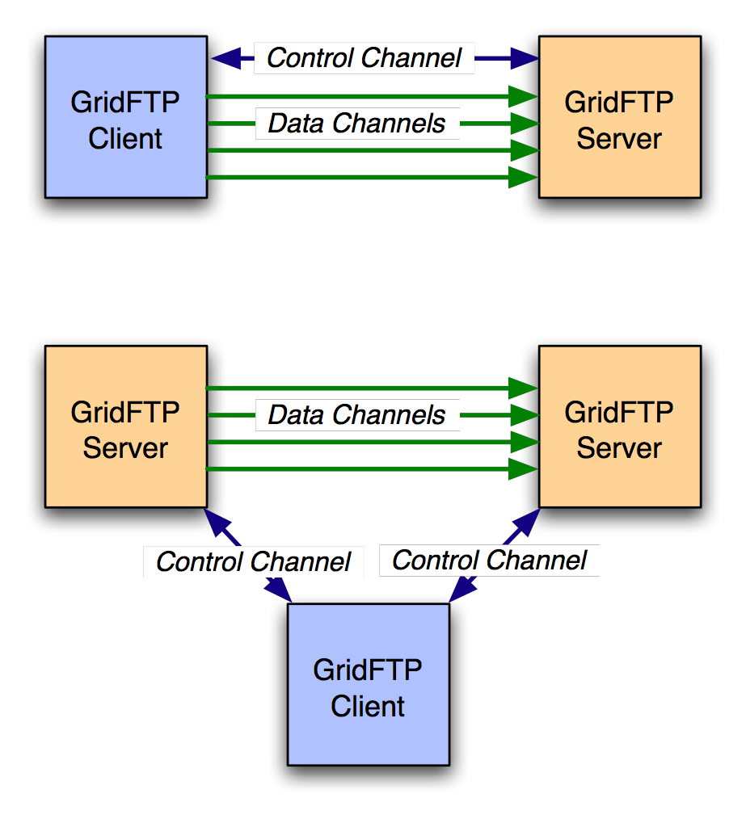
Basic Definitions
Control Channel
  TCP link over which commands and responses flow
  Low bandwidth; encrypted and integrity protected by default
Data Channel
  Communication link(s) over which the actual data of interest flows
  High Bandwidth; authenticated by default; encryption and integrity protection optional

Slide 7
Control Channel Establishment
Server listens on a well-known port (2811)
Client form a TCP Connection to server
Authentication
  Anonymous
  Clear text USER <username>/PASS <pw>
  Base 64 encoded GSI handshake

Slide 8




Data Channel Establishment
227 <IP:PORT>
GridFTP Server
PASV
AUTH
GridFTP
Client
PORT <IP:PORT>
AUTH
GridFTP Server

Slide 9
Going fast – parallel streams
Use several data channels
TCP - default transport protocol used by GridFTP
TCP has limitations on high bandwidth wide area networks
Control channel
Server
Site B
Site A
Data channels
Notes:
GridFTP has various other modes for increasing speeds.
For example, it can do 'parallel streams'. With parallel streams, we establish several data channels, and send the file in pieces across all of the connections. There are a few advantages here. The underlying network protocol, TCP, that most data transfers on the internet use, tries to share bandwidth equally between each stream. By using more streams, we can get more shares.
Some people think this is cheating, though and some people will get upset about it as a form of network abuse.
Another advantage is that if one or more of the channels do not run at full speed (for example, a single lost packet can cause massive slow down), this slowdown is ameliorated.

Slide 10
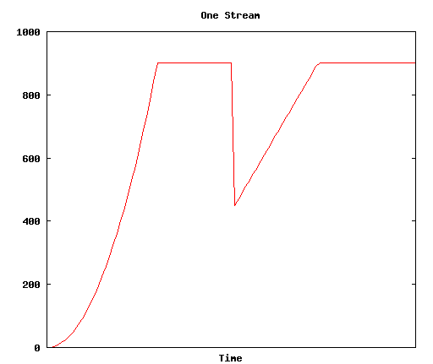
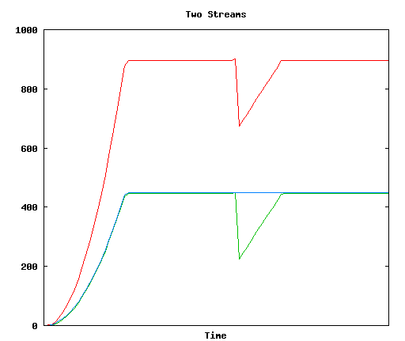
Parallel Streams
Notes:
So here are some hints for experts from the experts.
To make GridFTP go fast, you have to tune it.
You need to have some fast disks and filesystems at both ends of your connection.
You need to tune your TCP connections – TCP has many settings that can be diddled which affect performance. This is something of a black art.
There are some linux kernel patches called the web100 patches, which give more control and information about network connections on your servers.
And its important to understand what the network path between your two servers are – a big part of tuning your connections relies on knowing what the network looks like.

Slide 11
Cluster-to-cluster data transfer
GridFTP can do coordinated data transfer utilizing multiple computer nodes at source and destination
Node 1
Node 1
GridFTP
Control
node
GridFTP
Control
node
10x Gb/s
1 Gbit/s
1 Gbit/s
Node 2
Node 2
1 Gbit/s
1 Gbit/s
GridFTP
Data node
GridFTP
Data node
1 Gbit/s
1 Gbit/s
1 Gbit/s
1 Gbit/s
Node M
Node N
GridFTP
Data node
GridFTP
Data node
Cluster A
Cluster B
Notes:
If the network capacity between the source and destination clusters is greater than the data rate supported by each
computer at the clusters, GridFTP can be configured to use multiple computers at each end to drive data transfers

Slide 12
GridFTP usage
globus-url-copy - commonly used GridFTP client
  Usage: globus-url-copy [options] srcurl dsturl
Conventions on URL formats:
  file:///home/YOURLOGIN/dataex/largefile
    a file called largefile on the local file system, in directory /home/YOURLOGIN/dataex/
  gsiftp://osg-edu.cs.wisc.edu/scratch/YOURLOGIN/
    a directory accessible via gsiftp on the host called osg-edu.cs.wisc.edu in directory /scratch/YOURLOGIN.
Notes:
Please note the triple slash: file:///home/etc…

Slide 13
GridFTP transfers using globus-url-copy
globus-url-copy
file:///home/YOURLOGIN/dataex/myfile
gsiftp://osg-edu.cs.wisc.edu/nfs/osgedu/YOURLOGIN/ex1
globus-url-copy
gsiftp://osg-edu.cs.wisc.edu/nfs/osgedu/YOURLOGIN/ex2
gsiftp://tp-osg.ci.uchicago.edu/YOURLOGIN/ex3
Notes:
First command will transfer the local file “myfile” to file “ex1” on the osg-edu.cs.wisc.edu machine.
The second command is an example of 3rd party tranfer (let’s assume that the user issues this command from workshop1.ci.uchicago.edu machine).
For more exercises, see the Data Management part of the lab http://www.ci.uchicago.edu/osgedu/schools/gridlab/data.html

Slide 14
Handling failures
GridFTP server sends restart and performance markers periodically
  Restart markers are helpful if there is any failure
  No need to transfer the entire file again
  Use restart markers and transfer only the missing pieces_x000c_
GridFTP supports partial file transfers
  Globus-url-copy has a retry option
  Recover from transient server and network failures
  What if the client (globus-url-copy) fails in the middle of a transfer?

Slide 15
RFT = Reliable file transfer
GridFTP client that provides more reliability and fault tolerance for file transfers
  Part of the Globus Toolkit
RFT acts as a client to GridFTP, providing management of a large number of transfer jobs (same as Condor to GRAM)
RFT can
  keep track of the state of each job
  run several transfers at once
  deal with connection failure, network failure, failure of any of the servers involved.
Notes:
RFT: GridFTP client that provides more reliability and fault tolerance for file transfers.
Just as in the job submission section, we mentioned a facility, GRAM, for submitting jobs , and then another program, Condor, sitting on top of that that provides reliability. A similar situation in the data transfer context.
We have a component called RFT, the Reliable File Transfer service, which comes as part of the Globus Toolkit.
http://www.globus.org/toolkit/docs/4.0/data/rft/
RFT acts as a client to GridFTP, providing management of a large number of transfer jobs – RFT can keep track of the state of each job, run several transfers at once, deal with connection failure, network failure, failure of any of the servers involved.

Slide 16
RFT
Client
SOAP
Messages
Notifications
(Optional)
RFT
Persistent Store
Site A
Site B
Server
Server
Control channels
Data channel
Notes:
WS-RF compliant High Performance data transfer service
Soft state
Notifications/Query
Reliability on top of high performance provided by GridFTP
Fire and Forget
Integrated Automatic Failure Recovery
Network level failures
System level failures, etc.

Slide 17
RFT example
Use the rft command with a .xfr file
cp /soft/globus-4.0.3-r1/share/globus_wsrf_rft_client/transfer.xfr rft.xfr
Edit rft.xfr to match your needs
rft -h terminable.ci.uchicago.edu -f ./rft.xfr
Notes:
First you need to create an .xfr transfer job file which lists some RFT parameters and all of the files to transfer. You can do that from scratch or you can modify an existing one (such as above)
Then launch the transfer on the terminable.ci.uchicago.edu machine (as the 3rd line above)
Parameters that can be specified in transfer job file include:
- Source and destination URLs
- TCP buffer size
- Use of parallel streams
- Increased transfer concurrency

Slide 18
RLS -Replica Location Service
RLS
  component of the data grid architecture (Globus component)
  It provides access to mapping information from logical names to physical names of items
  Its goal is to
  reduce access latency, improve data locality, improve robustness,
  scalability and performance for distributed applications
RLS produces replica catalogs (LRCs), which represent mappings between logical and physical files scattered across the storage system.
  For better performance, the LRC can be indexed.

Slide 19
RLS -Replica Location Service
RLS maps logical filenames to physical filenames.
Logical Filenames (LFN)
  Names a file with interesting data in it
  Doesn’t refer to location (which host, or where in a host)‏
Physical Filenames (PFN)
  Refers to a file on some filesystem somewhere
  Often use gsiftp:// URLs to specify
Two RLS catalogs:
  Local Replica Catalog (LRC) and
  Replica Location Index (RLI)

Slide 20
Local Replica Catalog (LRC)‏
stores mappings from LFNs to PFNs.
Interaction:
  Q: Where can I get filename ‘experiment_result_1’?
  A: You can get it from
  gsiftp://gridlab1.ci.uchicago.edu/home/benc/r.txt
Undesirable to have one of these for whole grid
  Lots of data
  Single point of failure

Slide 21
Replica Location Index (RLI)‏
stores mappings from LFNs to LRCs.
Interaction:
  Q: Who can tell me about filename ‘experiment_result_1’.
  A: You can get more info from the LRC at gridlab1
  (Then go to ask that LRC for more info)‏
Failure of one RLI or LRC doesn’t break everything
RLI stores reduced set of information, so can cope with many more mappings

Slide 22
Globus RLS
site A
rls://serverA:39281
LRC
file1
file2
file1→ gsiftp://serverA/file1
file2→ gsiftp://serverA/file2
RLI
file3→ rls://serverB/file3
file4→ rls://serverB/file4
site B
rls://serverB:39281
LRC
file3
file4
file3→ gsiftp://serverB/file3
file4→ gsiftp://serverB/file4
RLI
file1→ rls://serverA/file1
file2→ rls://serverA/file2

Slide 23
Globus RLS
Quick Review
  LFN → logical filename (think of as simple filename)
  PFN → physical filename (think of as a URL)
  LRC → your local catalog of maps from LFNs to PFNs
    H-R-792845521-16.gwf → gsiftp://dataserver.phys.uwm.edu/LIGO/H-R-792845521-16.gwf
  RLI → your local catalog of maps from LFNs to LRCs
    H-R-792845521-16.gwf → LRCs at MIT, PSU, Caltech, and UW-M
  LRCs inform RLIs about mappings known
Can query for files is a 2-step process: find files on your Grid by
  querying RLI(s) to get LRC(s)
  then query LRC(s) to get URL(s)
Notes:
So querying for files is a 2-step process

Slide 24
Globus RLS: Server Perspective
Mappings LFNs → PFNs kept in database
  Uses generic ODBC interface to talk to any (good) RDBM
  MySQL, PostgreSQL, Oracle, DB2,...
  All RDBM details hidden from administrator and user
    well, not quite
    RDBM may need to be “tuned” for performance
    but one can start off knowing very little about RDBMs

Slide 25
Globus RLS: Server Perspective
Mappings LFNs → LRCs stored in 1 of 2 ways
table in database
  full, complete listing from LRCs that update your RLI
  requires each LRC to send your RLI full, complete list
    as number of LFNs in catalog grows, this becomes substantial
    10⁸ filenames at 64 bytes per filename ~ 6 GB
in memory in a special hash called Bloom filter
  10⁸ filenames stored in as little as 256 MB
    easy for LRC to create Bloom filter and send over network to RLIs
  can cause RLI to lie when asked if knows about a LFN
    only false-positives
    tunable error rate
    acceptable in many contexts
  Wild carding not possible with Bloom Filters

Slide 26
RLS command line tools
globus-rls-admin
  administrative tasks
    ping server
    connect RLIs and LRCs together
globus-rls-cli
  end user tasks
    query LRC and RLI
    add mappings to LRC

Slide 27
Globus RLS: Client Perspective
Two ways for clients to interact with RLS Server
globus-rls-cli simple command-line tool
  query
  create new mappings
“roll your own” client by coding against API
  Java
  C
  Python

Slide 28
Globus-rls-cli
Simple query to LRC to find a PFN for LFN
Note more then one PFN may be returned
$ globus-rls-cli query lrc lfn some-file.jpg rls://dataserver:39281
some-file.jpg : file://localhost/netdata/s001/S1/R/H/714023808-714029599/some-file.jpg
some-file.jpg : file://medusa-slave001.medusa.phys.uwm.edu/data/S1/R/H/714023808-714029599/some-file.jpg
some-file.jpg : gsiftp://dataserver.phys.uwm.edu:15000/data/gsiftp_root/cluster_storage/data/s001/S1/R/H/714023808-714029599/some-file.jpg
Server and client sane if LFN not found
$ globus-rls-cli query lrc lfn foo rls://dataserver
LFN doesn't exist: foo
$ echo $?
1
Notes:
The first globus-rls-cli command returns 3 entries for the logical file name “some-file.jpg”: first copy is a local file, whereas the other two reside on a machine in the Physics department at the University of Wisconsin-Madison (phys.uwm.edu). So the catalog returned the physical location (URL) of the sought file.
Who is rls://dataserver:39281 ? It designates the rls server location (with port number).

Slide 29
Globus-rls-cli
Wildcard searches of LRC supported
  probably a good idea to quote LFN wildcard expression
$ globus-rls-cli query wildcard lrc lfn H-R-7140242*-16.gwf rls://dataserver:39281
H-R-714024208-16.gwf: gsiftp://dataserver.phys.uwm.edu:15000/data/gsiftp_root/cluster_storage/data/s001/S1/R/H/714023808-714029599/H-R-714024208-16.gwf
H-R-714024224-16.gwf: gsiftp://dataserver.phys.uwm.edu:15000/data/gsiftp_root/cluster_storage/data/s001/S1/R/H/714023808-714029599/H-R-714024224-16.gwf
Notes:
Similar discussion -- multiple answers have been return by the query (using wildcards this time).

Slide 30
Globus-rls-cli
Bulk queries also supported
obtain PFNs for more then one LFN at a time
$ globus-rls-cli bulk query lrc lfn H-R-714024224-16.gwf H-R-714024320-16.gwf rls://dataserver
H-R-714024320-16.gwf: gsiftp://dataserver.phys.uwm.edu:15000/data/gsiftp_root/cluster_storage/data/s001/S1/R/H/714023808-714029599/H-R-714024320-16.gwf
H-R-714024224-16.gwf: gsiftp://dataserver.phys.uwm.edu:15000/data/gsiftp_root/cluster_storage/data/s001/S1/R/H/714023808-714029599/H-R-714024224-16.gwf

Slide 31
Globus-rls-cli
Simple query to RLI to locate a LFN -> LRC mapping
  then query that LRC for the PFN
$ globus-rls-cli query rli lfn example-file.gwf rls://dataserver
example-file.gwf: rls://ldas-cit.ligo.caltech.edu:39281
$ globus-rls-cli query lrc lfn example-file.gwf rls://ldas-cit.ligo.caltech.edu:39281
example-file: gsiftp://ldas-cit.ligo.caltech.edu:15000/archive/S1/L0/LHO/H-R-7140/H-R-714024224-16.gwf
Notes:
Example of the 2-step protocol to locate a file … pay attention to the arguments and results
First query gets the catalog that contains information about the specific fie name, and the second query goes to that catalog to retrieve the physical information (URL) of the file. (the output of the first query is used as input to the second query)

Slide 32
Globus-rls-cli
Bulk queries to RLI also supported
$ globus-rls-cli bulk query rli lfn H-R-714024224-16.gwf H-R-714024320-16.gwf rls://dataserver
H-R-714024320-16.gwf: rls://ldas-cit.ligo.caltech.edu:39281
H-R-714024224-16.gwf: rls://ldas-cit.ligo.caltech.edu:39281
Wildcard queries to RLI may not be supported!
  no wildcards when using Bloom filter updates
$ globus-rls-cli query wildcard rli lfn "H-R-7140242*-16.gwf" rls://dataserver
Operation is unsupported: Wildcard searches with Bloom filters

Slide 33
Globus-rls-cli
Create new LFN → PFN mappings
  use create to create 1st mapping for a LFN
  $ globus-rls-cli create file1 gsiftp://dataserver/file1 rls://dataserver
  use add to add more mappings for a LFN
  $ globus-rls-cli add file1 file://dataserver/file1 rls://dataserver
  use delete to remove a mapping for a LFN
    when last mapping is deleted for a LFN the LFN is also deleted
    cannot have LFN in LRC without a mapping
  $ globus-rls-cli delete file1 file://file1 rls://dataserver

Slide 34
Globus-rls-cli
LRC can also store attributes about LFN and PFNs
  size of LFN in bytes?
  md5 checksum for a LFN?
  ranking for a PFN or URL?
  extensible...you choose attributes to create and add
  can search catalog on the attributes
  attributes limited to
    strings
    integers
    floating point (double)
    date/time

Slide 35
Globus-rls-cli
Create attribute first then add values for LFNs
$ globus-rls-cli attribute define md5checksum lfn string rls://dataserver
$ globus-rls-cli attribute add file1 md5checksum lfn string 42947c86b8a08f067b178d56a77b2650 rls://dataserver
Then query on the attribute
$ globus-rls-cli attribute query file1 md5checksum lfn rls://dataserver
md5checksum: string: 42947c86b8a08f067b178d56a77b2650

Slide 36
Bloom filters
LRC-to-RLI flow can happen in two ways:
  LRC sends list of all its LFNs (but not PFNs) to the RLI. RLI stores whole list.
    Answer accurately: “Yes I know” / “No I don’t know”
    Expensive to move and store large list
  Bloom filters
    LRC generates a Bloom filter of all of its LFNs
    Bloom filter is a bitmap that is much smaller than whole list of LFNs
    Answers less accurately: “Maybe I know” / “No I don’t know”. Might end up querying LRCs unnecessarily (but we won’t ever get wrong answers)
    can’t do a wildcard search

Slide 37
Storage and Grid
Grid applications need to reserve and schedule
  Compute resources
  Network resources
  Storage resources
Furthermore, they need
  Monitor progress status
  Release resource usage when done
For storage resources, they need
  To put/get files into/from storage spaces
  Unlike compute/network resources, storage resources are not available when jobs are done
  files in spaces need to be managed as well
    Shared, removed, or garbage collected

Slide 38
Motivation & Requirements (1)
Suppose you want to run a job on your local machine
  Need to allocate space
  Need to bring all input files
  Need to ensure correctness of files transferred
  Need to monitor and recover from errors
  What if files don’t fit space?
    Need to manage file streaming
  Need to remove files to make space for more files

Slide 39
Motivation & Requirements (2)
Now, suppose that the machine and storage space is a shared resource
  Need to do the above for many users
  Need to enforce quotas
  Need to ensure fairness of space allocation and scheduling

Slide 40
Motivation & Requirements (3)
Now, suppose you want to run a job on a Grid
  Need to access a variety of storage systems
  mostly remote systems, need to have access permission
  Need to have special software to access mass storage systems

Slide 41
Motivation & Requirements (4)
Now, suppose you want to run distributed jobs on the Grid
  Need to allocate remote spaces
  Need to move files to remote sites
  Need to manage file outputs and their movement to destination sites

Slide 42
What is SRM?
Storage Resource Managers (SRMs) are middleware components
  whose function is to provide
    dynamic space allocation
    file management
    on shared storage resources on the Grid
  Different implementations for underlying storage systems are based on the same SRM specification
Notes:
Brief history will follow after this slide

Slide 43
SRMs role in grid
SRMs role in the data grid architecture
  Shared storage space allocation & reservation
    important for data intensive applications
  Get/put files from/into spaces
    archived files on mass storage systems
  File transfers from/to remote sites, file replication
  Negotiate transfer protocols
  Interoperate with other SRMs
  File and space management with lifetime
Notes:
Brief history will follow after this slide

Slide 44
Site URL and Transfer URL
Provide: Site URL (SURL)
  URL known externally – e.g. in Replica Catalogs
  e.g. srm://ibm.cnaf.infn.it:8444/dteam/test.10193
Get back: Transfer URL (TURL)
  Path can be different from SURL – SRM internal mapping
  Protocol chosen by SRM based on request protocol preference
  e.g. gsiftp://ibm139.cnaf.infn.it:2811//gpfs/sto1/dteam/test.10193
One SURL can have many TURLs
  Files can be replicated in multiple storage components
  Files may be in near-line and/or on-line storage
  In a light-weight SRM (a single file system on disk)
    SURL may be the same as TURL except protocol
File sharing is possible
  Same physical file, but many requests
  Needs to be managed by SRM implementation

Slide 45
Transfer protocol negotiation
Negotiation
  Client provides an ordered list of preferred transfer protocols
  SRM returns first protocol from the list it supports
  Example
    Client provided protocols list: bbftp, gridftp, ftp
    SRM returns: gridftp
Advantages
  Easy to introduce new protocols
  User controls which transfer protocol to use
How it is returned?
  The protocol of the Transfer URL (TURL)
  Example: bbftp://dm.slac.edu//temp/run11/File678.txt

Slide 46
Types of storage and spaces
Access latency
  On-line
    Storage where files are moved to before their use
  Near-line
    Requires latency before files can be accessed
Retention quality
  Custodial (High quality)
  Output (Middle quality)
  Replica (Low Quality)
Spaces can be reserved in these storage components
  Spaces can be reserved for a lifetime
  Space reference handle is returned to client – space token
  Total space of each type are subject to local SRM policy and/or VO policies
Assignment of files to spaces
  Files can be assigned to any space, provided that their lifetime is shorter than the remaining lifetime of the space

Slide 47
Managing spaces
Default spaces
  Files can be put into an SRM without explicit reservation
  Default spaces are not visible to client
Files already in the SRM can be moved to other spaces
  By srmChangeSpaceForFiles
Files already in the SRM can be pinned in spaces
  By requesting specific files (srmPrepareToGet)
  By pre-loading them into online space (srmBringOnline)
Updating space
  Resize for more space or release unused space
  Extend or shorten the lifetime of a space
Releasing files from space by a user
  Release all files that user brought into the space whose lifetime has not expired
  Move permanent and durable files to near-line storage if supported
  Release space that was used by user

Slide 48
Space reservation
Negotiation
  Client asks for space: Guaranteed_C, MaxDesired
  SRM return: Guaranteed_S <= Guaranteed_C,
  best effort <= MaxDesired
Types of spaces
  Specified during srmReserveSpace
  Access Latency (Online, Nearline)
  Retention Policy (Replica, Output, Custodial)
  Subject to limits per client (SRM or VO policies)
  Default: implementation and configuration specific
Lifetime
  Negotiated: Lifetime_C requested
  SRM return: Lifetime_S <= Lifetime_C
Reference handle
  SRM returns space reference handle (space token)
  Client can assign Description
  User can use srmGetSpaceTokens to recover handles on basis of ownership

Slide 49
Directory management
Usual unix semantics
  srmLs, srmMkdir, srmMv, srmRm, srmRmdir
A single directory for all spaces
  No directories for each file type
  File assignment to spaces is virtual

Slide 50
OSG & Data management
OSG relies on GridFTP protocol for the raw transport of the data using Globus GridFTP in all cases except where interfaces to storage management systems (rather than file systems) dictate individual implementations.
OSG supports the SRM interface to storage resources to enable management of space and data transfers to prevent unexpected errors due to running out of space, to prevent overload of the GridFTP services, and to provide capabilities for pre-staging, pinning and retention of the data files. OSG currently provides reference implementations of two storage systems the (BeStMan) and dCache

Slide 51

Credits
Bill Allcock allcock@mcs.anl.gov
Ben Clifford benc@ci.uchicago.edu
Scott Koranda skoranda@uwm.edu
Alex Sim asim@lbl.gov

