Slide 1
Workflows: from Development to Automated Production
Friday
Lauren Michael <lmichael@wisc.edu>
Research Computing Facilitator
University of Wisconsin - Madison

Slide 2
Building a Good Workflow
Draw out the general workflow
Define details (test ‘pieces’ with HTCondor jobs)
  divide or consolidate ‘pieces’
  determine resource requirements
  identify steps to be automated or checked
Build it modularly; test and optimize
Scale-up gradually
What more can you automate or error-check?
(And remember to document!)

Slide 3
To Get Here …
(special transfer)
file prep and split
(POST-RETRY)
1 GB RAM
2 GB Disk
1.5 hours
. . .
100 MB RAM
500 MB Disk
40 min
(each)
process ‘0’
(filter output)
process ‘99’
(filter output)
(POST-RETRY)
(POST-RETRY)
(PRE)
combine, transform results
(POST-RETRY)
300 MB RAM
1 GB Disk
15 min

Slide 4
start with the HTC “step” in the DAG…
. . .
process ‘0’
(filter output)
process ‘99’
(filter output)

Slide 5
… then add in another step …
. . .
process ‘0’
(filter output)
process ‘99’
(filter output)
combine, assess results

Slide 6
… and another step …
prep conditions and/or split data
. . .
process ‘0’
(filter output)
process ‘99’
(filter output)
combine, assess results

Slide 7
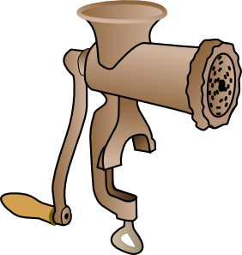

and End Up with This
DATA
Nobel

Slide 8
Building a Good Workflow
Draw out the general workflow
Define details (test ‘pieces’ with HTCondor jobs)
  divide or consolidate ‘pieces’
  determine resource requirements
  identify steps to be automated or checked
Build it modularly; test and optimize
Scale-up gradually
What more can you automate or error-check?
(And remember to document!)

Slide 9
Scaling and Optimization
Your ‘small’ DAG runs (once)! Now what?
  Need to make it run full-scale
  Need to make it run everywhere, everytime
  Need to make it run unattended
  Need to make it run when someone else tries

Slide 10
Scaling Out to OSG:
Rules of Thumb
CPU (single-threaded)
  Best jobs run between 10 min and 10 hrs
        (Upper limit somewhat soft)
Data (disk and network)
  Keep scratch working space < 20 GB
  Intermediate needs (/tmp?)
  Use alternative data transfer appropriately
Memory
  Closer to 1 GB than 8 GB

Slide 11
Testing, Testing, 1-2-3 …
ALWAYS test a subset after making changes
  How big of a change needs retesting?
Scale up gradually
Avoid making problems for others (and for yourself)

Slide 12
Scaling Up – Things to Think About
More jobs:
  100-MB per input files may be fine for 10 or 100 jobs, but not for 1000 jobs. Why?
  most submit queues will falter beyond ~10,000 total jobs
  Larger files:
  more disk space, perhaps more memory
  potentially more transfer and compute time
Be kind to your submit and execute nodes and to fellow users!

Slide 13
Scaling Solutions (More Jobs)
Use a DAG to throttle the number of idle or queued jobs (“max-idle” and/or “DAGMAN CONFIG”)
Add more resiliency measures
  “RETRY” (works per-submit file)
  “SCRIPT POST” (use $RETURN, check output)
Use SPLICE, VAR, and DIR for modularity/organization

Slide 14
Scaling Solutions (Larger Files)
File manipulations
  split input files to send minimal data with each job
  filter input and output files to transfer only essential data
  use compression/decompression
Follow file delivery methods from yesterday for files that are still “large”

Slide 15
Self-Checkpointing
(for long jobs and shish-kebabs)
Changes to your code
  Periodically save information about progress to a new file (every hour?)
  At the beginning of script:
    If progress file exists, read it and start from where the program (or script) left off
    Otherwise, start from the beginning
Change to submit file:
  when_to_transfer_output = ON_EXIT_OR_EVICT

Slide 16
Make It Run Everywhere
What does an OSG machine have?
  assume the worst
Bring as much as possible with you:
  won’t that slow me down?
Bring:
  executable
  likely, more of the “environment”

Slide 17
The expanding onion
Laptop (1 machine)
  You control everything!
Local cluster (1000 cores)
  You can ask an admin nicely
Campus (5000 cores)
  It better be important/generalizable
OSG (50,000 cores)
  Good luck finding the pool admins

Slide 18
Make It Work Everytime
What could possibly go wrong?
  Eviction
  Non-existent dependencies
  File corruption
  Performance surprises
    Network
    Disk
    …
  Maybe even a bug in your code

Slide 19
Error Checks Are Essential
If you don’t check, it will happen…
Check expected file existence, and repeat with a finite loop or number of retries
  better yet, check rough file size too
Advanced:
  RETRY for specific error codes from wrapper
  “periodic_release” for specific hold reasons

Slide 20
What to do if a check fails
Understand something about failure
Use DAG “RETRY”, when useful
Let the rescue dag continue…

Slide 21
Performance Surprises
One bad node can ruin your whole day
“Black Hole” machines
  Depending on the error, email OSG!
REALLY slow machines
  use periodic_hold / periodic_release

Slide 22
Building a Good Workflow
Draw out the general workflow
Define details (test ‘pieces’ with HTCondor jobs)
  divide or consolidate ‘pieces’
  determine resource requirements
  identify steps to be automated or checked
Build it modularly; test and optimize
Scale-up gradually
What more can you automate or error-check?
(And remember to document!)

Slide 23
Automate All The Things
well, not really, but kind of …
Really: What is the minimal number of manual steps necessary?
  even 1 might be too many; zero is perfect!
Consider what you get out of automation
  time savings (including less ‘babysitting’ time)
  reliability and reproducibility

Slide 24
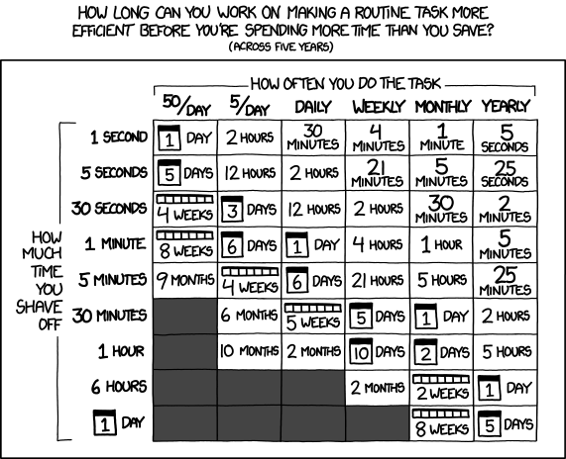
Automation Trade-offs!
http://xkcd.com/1205/

Slide 25
Make It Work Unattended
Remember the ultimate goal:
Automation! Time savings!
Things to automate:
  Data collection?
  Data preparation and staging
  Submission (condor cron)
  Analysis and verification
  LaTeX and paper submission ☺

Slide 26
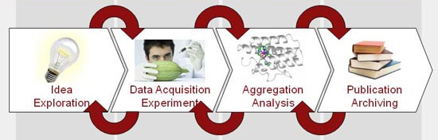
Make Science Work Unattended?
Well, maybe not, but a scientist can dream …

Slide 27
Make It Run(-able) for Someone Else
If others can’t reproduce your work, it’s NOT real science!
  Work hard to make this happen.
  It’s their throughput, too.
Only ~10% of published cancer research is reproducible!

Slide 28
Building a Good Workflow
Draw out the general workflow
Define details (test ‘pieces’ with HTCondor jobs)
  divide or consolidate ‘pieces’
  determine resource requirements
  identify steps to be automated or checked
Build it modularly; test and optimize
Scale-up gradually
What more can you automate or error-check?
(And remember to document!)

Slide 29
Documentation at Multiple Levels
In job files: comment lines
  submit files, wrapper scripts, executables
In README files
  describe file purposes
  define overall workflow, justifications
In a document!
  draw the workflow, explain the big picture

Slide 30
Make It Run Faster? Maybe.
Throughput, throughput, throughput
  Resource reductions (match more slots!)
  Wall-time reductions
    if significant per workflow
    Why not per job?
Think in orders of magnitude:
  Say you have 1000 hour-long jobs that are matched at a rate of 100 per hour …
Waste the computer’s time, not yours.

Slide 31
Maybe Not Worth The Time
Rewriting your code in a different, faster language
Targeting “faster” machines
Targeting machines that run jobs longer
Others?

Slide 32
Golden Rules for DAGs
Beware of lo-ong shish kebabs!
  (self-checkpointing)
Use PRE and POST script generously
RETRY is your friend
DIR and VAR for organization
DAGs of DAGs are good
  SPLICE
  SUB_DAG_EXTERNAL
Notes:
REDO COMPLETELY, second talk

Slide 33
If this were a test…
error
checks
&
documen-tation
20 points for finishing at all
10 points for the right answer
1 point for every error check
1 point per documentation line
Out of 100 points? 200 points?
right
finishing

Slide 34
Questions?
Feel free to contact me:
  lmichael@wisc.edu
Now: Exercises 1.3 (1.4 Bonus)
Next:
  HTC Showcase!

