Slide 1
Production Coordination
Area VO Meeting
Sep 24, 2009
Dan Fraser – Production Coordinator

Slide 2
OSG Health Monitoring
Overview
    http://t2.unl.edu/gratia/
Weekly Calls
    https://twiki.grid.iu.edu/bin/view/Production/WebHome
Failed jobs
    http://t2.unl.edu/gratia/xml/failed_dn_site_hours_bar?vo=cms&title=Daily%20CMS%20Wasted%20Hours%20By%20User%20and%20Site
Data movement
Experimental
    http://t2.unl.edu/gratia/xml/vo_wall_efficiency_summary?vo=cms&min_hours=100

Slide 3
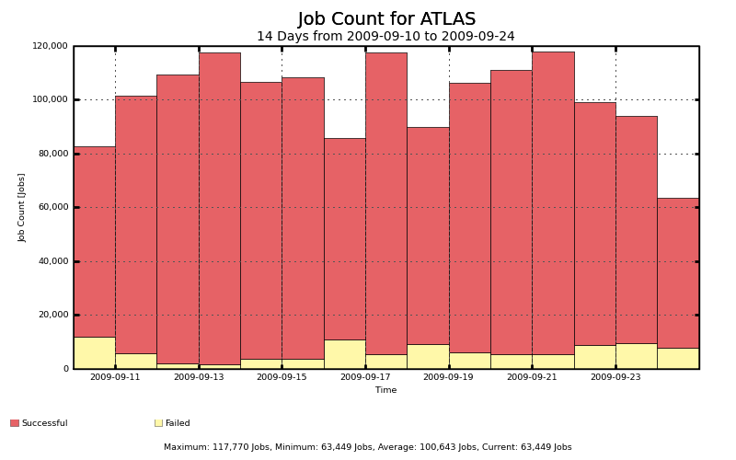
Job count (2 weeks)

Slide 4
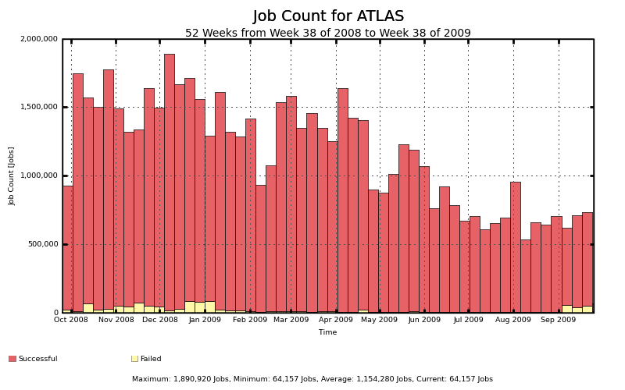

Slide 5
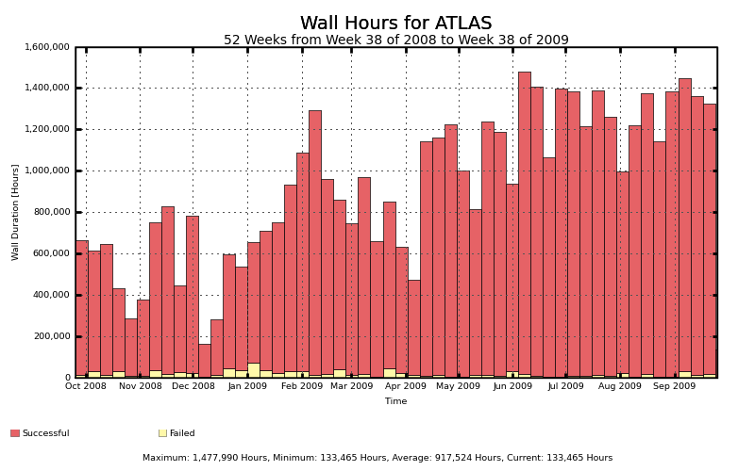
http://t2.unl.edu/gratia/xml/failed_dn_site_hours_bar?vo=atlas&title=Daily%20Atlas%20Wasted%20Hours%20By%20User%20and%20Site

Slide 6
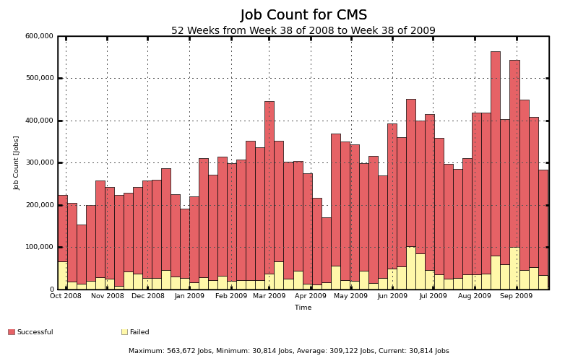

Slide 7
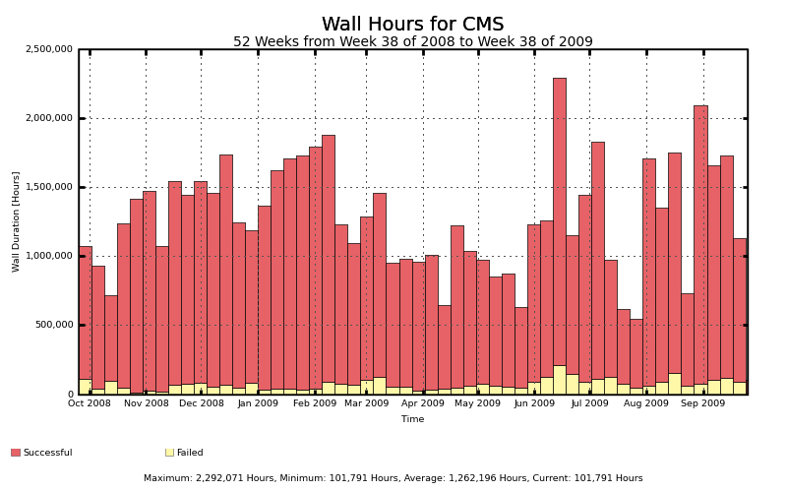
http://t2.unl.edu/gratia/xml/failed_dn_site_hours_bar?vo=cms&title=Daily%20CMS%20Wasted%20Hours%20By%20User%20and%20Site

Slide 8

Solving Production Problems
Solving problems is a TEAM sport
The weekly production call has key people from all the teams that are needed to solve problems
  CMS, Atlas, LIGO, VOs, Engage, Integration, Sites, STG, Security, Operations, Metrics
Problems channeled to the correct avenue (or sometimes solved on the call)
Forewarning to prepare for upcoming issues.

Slide 9
Example Problems
Handling of job pre-emption (LIGO / D0)
VO Package Validation probe needed
  GIP “truth in advertising”
LIGO switch to GT2 and also Condor-G job submission
Condor scaling limits in GridMon (Atlas)
Globus LSF gatekeeper bug (D0/CMS)
Security Drill successes (for T1)
Gratia probe introduction & ITB testing

Slide 10
Example Issues cont.
STEP09 monitoring (partially successful)
IceCube management of opportunistic storage
Gratia file transfer data catch up
Transition from VORS to myOSG
New location for RSV probes and ability to update from the “production” cache
  Also, ensure that config_OSG does not update the probes automatically
Root Cause Analysis of CMS BDII outage

Slide 11
Example Issues cont.
Plan to localize data transfer information and upload summary transfer packets.
Globus memory leak was causing frequent reboots at BNL.
Site name mapping problem to enable different names internal to OSG.
OIM display difference (http vs https)
Site admin meeting & materials prep to help sites upgrade to OSG 1.2.

Slide 12
Example Issues cont.
Condor problem with directory creation in a multiple gateway scenario. (Nebraska)
Gratia collector problem with handling records that accumulate faster than they can be processed.
LIGO/Pegasus transition to use BDII data instead of central probe data.

