Slide 1
Turning science problems into HTC jobs
Wednesday, July 20th 9am
Zach Miller & Greg Thain
Condor Team
University of Wisconsin-Madison

Slide 2
Random topics
HTPC
Black Holes
Leases, leases everywhere
Wrapper scripts
User level checkpointing
Finish by putting it all together into
  Real job

Slide 3
Overall theme
Reliability trumps Performance!
With 10,000 (or more) machines, some are always going to be broken…
  In the worst possible ways
  Spend much more time worrying about this than performance

Slide 4
HTPC
High Throughput of High Performance
“Full Machine” jobs
  Useful for both CPU or memory needs
Example Users: Molecular Dynamics…

Slide 5
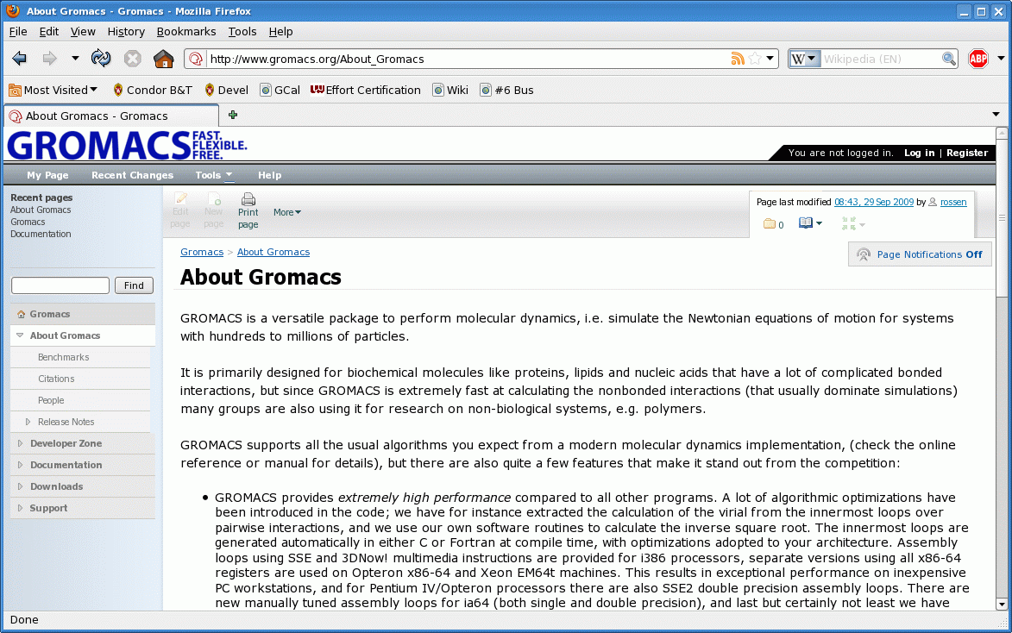
Gromacs

Slide 6
30+ day runtime
Too long, even as HTC
Step one – compile with SSE support
  10x improvement
Just a Gromac compile-time option
  Hand-coded assembly, not gcc option

Slide 7
3 days still too long…
Gromacs also support MPI
CHTC doesn’t have infiniband
What do to?

Slide 8
Whole machine jobs
Submit file magic to claim all 8 slots
universe = vanilla
requirements = (CAN_RUN_WHOLE_MACHINE =?= TRUE)
+RequiresWholeMachine=true
executable = some job
arguments = arguments
should_transfer_files = yes
when_to_transfer_output = on_exit
transfer_input_files = inputs
queue

Slide 9
MPI on Whole machine jobs
Whole machine mpi submit file
universe = vanilla
requirements = (CAN_RUN_WHOLE_MACHINE =?= TRUE)
+RequiresWholeMachine=true
executable = mpiexec
arguments = -np 8 real_exe
should_transfer_files = yes
when_to_transfer_output = on_exit
transfer_input_files = real_exe
queue
Condor Motto:
If you want it,
Bring it yourself

Slide 10
Advantages
Condor is parallel agnostic:
  MPICH, OpenMPI, pthreads, fork, etc.
High-bandwith memory transport
Easy to debug
  Ssh-to-job still works
Access to all machine’s memory

Slide 11
Disadvantages
Still need to debug parallel program
  helps if others already have
Fewer full-machine slots
  Currently 15, more coming

Slide 12
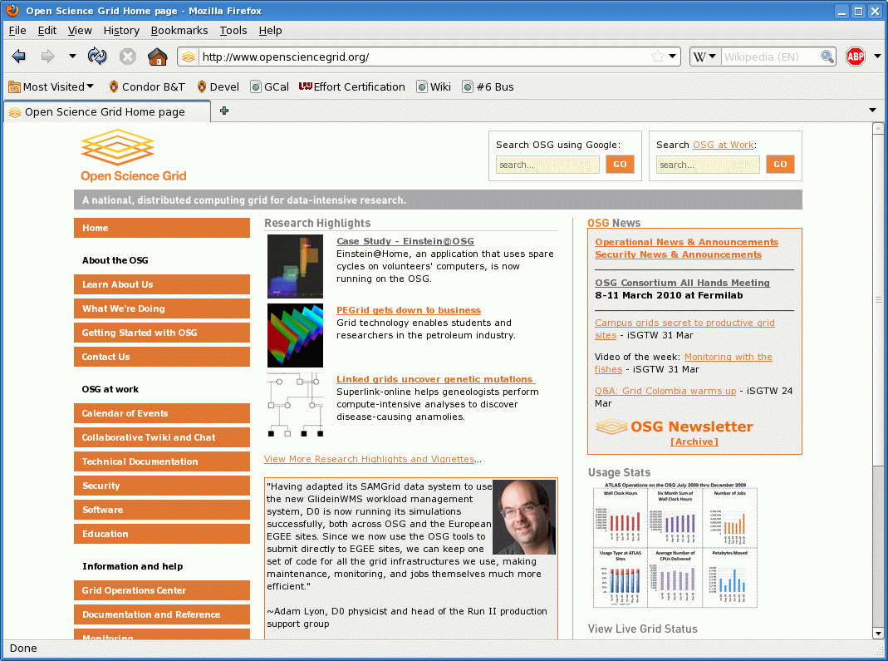
15 machines not enough: OSG to the rescue

Slide 13





JobRouting MPI to OSG
CHTC
schedd
CHTC
Pool
Job
queue
router

Slide 14
Restrictions of job-routing
More diverse hardware resources
  No prestaged, some AMD…
Must specify output file
  transfer_output_files = outputs
(touch outputs at job startup)

Slide 15
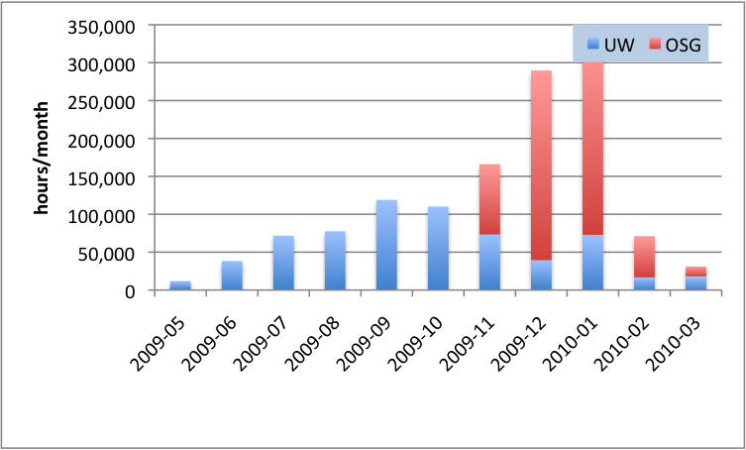
Computational Results

Slide 16
Real Results
Iron-Catalyzed Oxidation Intermediates Captured in A DNA Repair Monooxygenase, C. Yi, G. Jia, G. Hou, Q. Dai, G. Zheng, X. Jian, C. G. Yang, Q. Cui, and C. He, {\it Science}, Submitted

Slide 17
Real Results
Disruption and formation of surface salt bridges are coupled to DNA binding in integration host factor (IHF): acomputational analysis, L. Ma, M. T. Record, Jr., N. Sundlass, R. T. Raines and Q. Cui, {\it J. Mol. Biol.}, Submitted

Slide 18
Real Results
An implicit solvent model for SCC-DFTB with Charge-Dependent Radii, G. Hou, X. Zhu and Q. Cui, {\it J. Chem. Theo. Comp.}, Submitted

Slide 19
Real Results
Sequence-dependent interaction of $\beta$-peptides with membranes, J. Mondal, X. Zhu, Q. Cui and A. Yethiraj, {\it J. Am. Chem. Soc.}, Submitted

Slide 20
Real Results
A new coarse-grained model for water: The importance of electrostatic interactions, Z. Wu, Q. Cui and A. Yethiraj, {\it J. Phys. Chem. B} Submitted

Slide 21
Real Results
How does bone sialoprotein promote the nucleation of hydroxyapatite? A molecular dynamics study using model peptides of different conformations, Y. Yang, Q. Cui, and N. Sahai, {\it Langmuir}, Submitted

Slide 22
Real Results
Preferential interactions between small solutes and the protein backbone: A computational analysis, L. Ma, L. Pegram, M. T. Record, Jr., Q. Cui, {\it Biochem.}, 49, 1954-1962 (2010)

Slide 23
Real Results
Establishing effective simulation protocols for $\beta$- and$\alpha/\beta$-peptides. III. Molecular Mechanical (MM) model for a non-cyclic $\beta$-residue, X. Zhu, P. K\"onig, M. Hoffman, A. Yethiraj and Q. Cui, {\it J. Comp. Chem.}, In press (DOI: 10.1002/jcc.21493)

Slide 24
Real Results
Curvature Generation and Pressure Profile in Membrane with lysolipids: Insights from coarse-grained simulations, J. Yoo and Q. Cui, {\it Biophys. J.} 97, 2267-2276 (2009)

Slide 25
Back to Random Topics…

Slide 26
Black Hole
“Black Hole machines”
What happens if a machine eats a job?
How to avoid?
How to detect?

Slide 27
Avoiding Black Holes
Change Submit file:
Add
LastMatchListLength = 5
LastMatchName1 = “SomeMachine.foo.bar.edu”
LastMatchName2 = “AnotherMachine.cs.wisc.edu”
Requirements = (Target.Name =!= LastMatchName1) …

Slide 28
Leases, Leases everywhere
Value of leases:
  Distributed decision making without comms
Will you job get stuck in an infinite loop?
  Are you sure?
What’s the opposite of a black hole?

Slide 29
Solution: PERIODIC_HOLD
PERIODIC_HOLD puts jobs on hold, if it matches some expression
PERIODIC_RELEASE, the opposite
PERIODIC_HOLD = (JobCurrentStartDate –
CurrentTime) > SomeLargeNumber
PERIODIC_RELASE = TRUE
PERIODIC_RELEASE = HoldReasonCode =?= 9

Slide 30
Wrapper scripts
Necessary evil for OSG
“Fat Binaries”
Input re-checking
Some monitoring/

Slide 31
User level checkpointing
Turns long running jobs into short jobs
May be easy for some simulations
Certain 3rd party code already has it

Slide 32
Parallel convergence checking:
Another DAGman example
Evaluating a function at many points
Check for convergence -> retry
Particle Swarm Optimization

Slide 33
Any Guesses?
Who has thoughts?
Best to work from “inside out”

Slide 34
The job itself.
#!/bin/sh
###### random.sh
echo $RANDOM
exit 0

Slide 35
The submit file
Any guesses?

Slide 36
The submit file
# submitRandom
universe = vanilla
executable = random.sh
output = out
log = log
queue

Slide 37
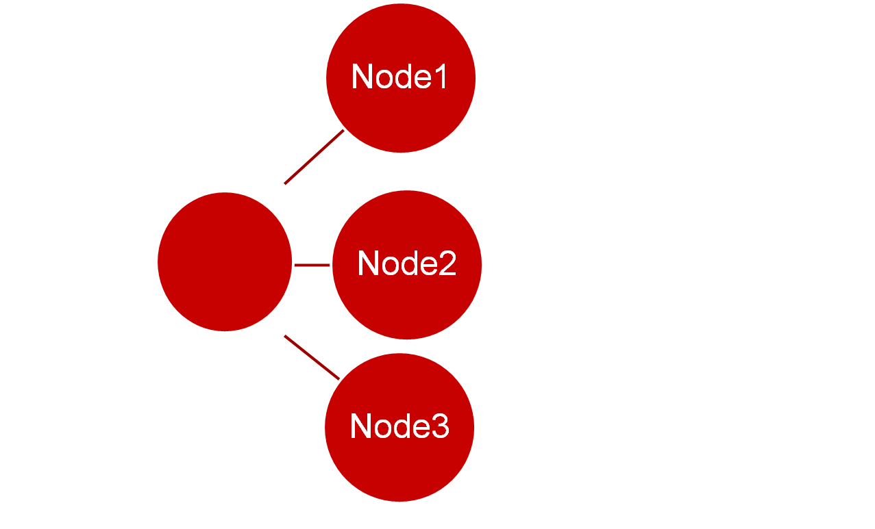
Next step: the inner DAG
First
Last Node

Slide 38
The DAG file
Any guesses?

Slide 39
The inner DAG file
Job Node0 submit_pre
Job Node1 submitRandom
Job Node2 submitRandom
Job Node3 submitRandom
PARENT Node0 CHILD Node1
PARENT Node0 CHILD Node2
PARENT Node0 CHILD Node3
Job Node11 submit_post
PARENT Node1 CHILD Node11
PARENT Node2 CHILD Node11
PARENT Node3 CHILD Node11

Slide 40
Inner DAG
Does this work?
At least one iteration?

Slide 41
How to iterate
DAGman has simple control structures
  (Makes it reliable)
Remember SUBDAGs?
Remember what happens if post fails?

Slide 42
The Outer Dag
Another Degenerate Dag
  (But Useful!)
SubDag (with retry)
Post Script (with exit value)

Slide 43
This one is easy!
Can you do it yourself?

Slide 44
The outer DAG file
####### Outer.dag #############
SUBDAG EXTERNAL A inner.dag
SCRIPT POST A converge.sh
RETRY A 10
#### converge.sh could look like
#!/bin/sh
echo "Checking convergence" >> converge
exit 1

Slide 45
Let’s run that…
condor_submit_dag outer.dag
Does it work? How can you tell?

Slide 46
DAGman a bit verbose…
$ condor_submit_dag outer.dag
-----------------------------------------------------------------------
File for submitting this DAG to Condor : submit.dag.condor.sub
Log of DAGMan debugging messages : submit.dag.dagman.out
Log of Condor library output : submit.dag.lib.out
Log of Condor library error messages : submit.dag.lib.err
Log of the life of condor_dagman itself : submit.dag.dagman.log
-no_submit given, not submitting DAG to Condor. You can do this with:
"condor_submit submit.dag.condor.sub"
-----------------------------------------------------------------------
-----------------------------------------------------------------------
File for submitting this DAG to Condor : outer.dag.condor.sub
Log of DAGMan debugging messages : outer.dag.dagman.out
Log of Condor library output : outer.dag.lib.out
Log of Condor library error messages : outer.dag.lib.err
Log of the life of condor_dagman itself : outer.dag.dagman.log
Submitting job(s).
Logging submit event(s).
1 job(s) submitted to cluster 721.
-----------------------------------------------------------------------

Slide 47
Debugging helps
Look in the user log file, “log”
Look in the DAGman debugging log
“foo”.dagman.out

Slide 48
What does converge.sh need
Note the output files?
How to make them unique?
Add DAG variables to inner dag
  And submitRandom file

Slide 49
The submit file (again)
# submitRandom
universe = vanilla
executable = random.sh
output = out
log = log
queue

Slide 50
The submit file
# submitRandom
universe = vanilla
executable = random.sh
output = out.$(NodeNumber)
log = log
queue

Slide 51
The inner DAG file (again)
Job Node0 submit_pre
Job Node1 submitRandom
Job Node2 submitRandom
Job Node3 submitRandom
PARENT Node0 CHILD Node1
PARENT Node0 CHILD Node2
PARENT Node0 CHILD Node3
Job Node11 submit_post
PARENT Node1 CHILD Node11
PARENT Node2 CHILD Node11
PARENT Node3 CHILD Node11

Slide 52
The inner DAG file (again)
Job Node0 submit_pre
Job Node1 submitRandom
Job Node2 submitRandom
Job Node3 submitRandom
…
VARS Node1 NodeNumber=“1”
VARS Node2 NodeNumber=“2”
VARS Node3 NodeNumber=“3”
…

Slide 53
Then converge.sh sees:
$ ls out.*
out.1 out.10 out.2 out.3 out.4 out.5 out.6 out.7 out.8 out.9
$
And can act accordingly…

Slide 54
Questions?
Questions? Comments?
Feel free to ask us questions

