Slide 1

glideinWMS
The OSG overlay DHTC system
Tuesday morning session
Igor Sfiligoi <isfiligoi@ucsd.edu>
University of California San Diego

Slide 2
Logistical reminder
It is OK to ask questions
  During the lecture
  During the demos
  During the exercises
  During the breaks
If I don't know the answer,
I will find someone who likely does

Slide 3
Creating a dynamic overlay sys
We can lease a subset of other's nodes
And instantiate our HTC system on them
Scheduler

Slide 4

Creating a dynamic overlay sys
We can lease a subset of other's nodes
And instantiate our HTC system on them
How do we do this?
Scheduler

Slide 5
Lecture content
Brief overview of how the glideinWMS works
  You hopefully will never need to deal with back-end details
  But knowing them will help you troubleshoot problems with your jobs
Some hands-on advise on how to use it

Slide 6
glideinWMS as an overlay sys
glideinWMS leases a subset of other's nodes
Acts as a HTC system on them
glideinWMS
Resource
provisioning
Scheduler

Slide 7
Two components
The resource provisioning

Slide 8
Two components
The resource provisioning
  Implements the logic
    Decides when more resources are needed
    Decides where to get them from
    Decides when to get rid of them
  Implements the technical bits
    Grid resources (e.g. GRAM, CREAM, ARC)
    Cloud (EC2, OpenStack, Google Engine)
    BOSCO (i.e. HTC-over-ssh)

Slide 9

Two components
The resource provisioning
  Implements the logic
    Decides when more resources are needed
    Decides where to get them from
    Decides when to get rid of them
  Implements the technical bits
    Grid resources (e.g. GRAM, CREAM, ARC)
    Cloud (EC2, OpenStack, Google Engine)
    BOSCO (i.e. HTC-over-ssh)
As users, you
don't really need
to know any more
details.
But if you are
interested in details
we do have more
training material.

Slide 10
Two components
The resource provisioning
The HTC scheduler proper

Slide 11
Two components
The resource provisioning
The HTC scheduler proper
  Which happens to be HTCondor!
  HTCondor on all the nodes
    User-facing Scheduler
    The execute processes on leased nodes
    The central manager

Slide 12

Two components
The resource provisioning
The HTC scheduler proper
  Which happens to be HTCondor!
  HTCondor on all the nodes
    User-facing Scheduler
    The execute processes on leased nodes
    The central manager
Cool!
Nothing new
to learn.

Slide 13
Two components
The resource provisioning
The HTC scheduler proper
  Which happens to be HTCondor!
  HTCondor on all the nodes
    User-facing Scheduler
    The execute processes on leased nodes
    The central manager
Almost...
Cool!
Nothing new
to learn.

Slide 14
Steering the provisioning
Your jobs will likely want to run only on a subset of possible resources, due to e.g.
  Data locality
  Platform restrictions
The usual
requirements
attribute is not good enough
  Attributes of the provisioned machines not known in advance

Slide 15
Two level matchmaking
The system has
two matchmaking points
  The glideinWMS decides
  when and where to provision resources
  The HTCondor negotiator decides
  which job runs on which node
  (after the nodes have been provisioned)
The two operate independently
  You will need to provide information to both

Slide 16
Standard convention
The glideinWMS convention is for users to just publish the list of desired properties, e.g.
  +DESIRED_Sites=”UCSD,UW”
The provisioning policy engine then does the right thing behind the scenes
Please notice that there is no “standard glideinWMS policy”
  See your local instance for details

Slide 17
Runtime limits
Resource leases often come with runtime limits associated with them
  In the Grid world, it is typical to be between 24h and 48h
glideinWMS will not start a job on a resource that needs to be returned before your job finishes
  Since it would have to kill your job on deadline, else

Slide 18

Runtime limits
Resource leases often come with runtime limits associated with them
  In the Grid world, it is typical to be between 24h and 48h
glideinWMS will not start a job on a resource that needs to be returned before your job finishes
  Since it would have to kill your job on deadline, else
And how is it
supposed to know
how long
will your job run?

Slide 19
Runtime limits
Resource leases often come with runtime limits associated with them
glideinWMS will not start a job on a resource that needs to be returned before your job finishes
You need to tell glideinWMS how long will the job run
  As close to the worst-case as you can
  But don't over-estimate
    There may be very few resources
    willing to run jobs
    with long estimated runtimes

Slide 20
Runtime limits
Resource leases often come with runtime limits associated with them
glideinWMS will not start a job on a resource that needs to be returned before your job finishes
You need to tell glideinWMS how long will the job run
  Once again, no standard way
    See your local installation instructions
Else, there is a system default
  Which may not be
  appropriate for you!

Slide 21

Runtime limits
Resource leases often come with runtime limits associated with them
glideinWMS will not start a job on a resource that needs to be returned before your job finishes
You need to tell glideinWMS how long will the job run
  Once again, no standard way
    See your local installation instructions
Else, there is a system default
But my runtimes
are all over the map!

Slide 22
Runtime limits
Resource leases often come with runtime limits associated with them
glideinWMS will not start a job on a resource that needs to be returned before your job finishes
You need to tell glideinWMS how long will the job run
  Once again, no standard way
    See your local installation instructions
Else, there is a system default
But my runtimes
are all over the map!
Indeed, it may not
be trivial.
But it is needed.

Slide 23
Using glideinWMS
Pretty much “just a HTCondor system”
Use the standard commands
  condor_submit
  condor_q
  condor_rm

Slide 24
Using glideinWMS
Pretty much “just a HTCondor system”
Use the standard commands
  condor_submit
  condor_q
  condor_rm
Monitoring the system similar
  condor_status

Slide 25

Using glideinWMS
Pretty much “just a HTCondor system”
Use the standard commands
  condor_submit
  condor_q
  condor_rm
Monitoring the system similar
  condor_status
But the
number of slots
grows and shrinks
very often.

Slide 26
Not-yet provisioned resources
There may be resources available that don't have a single node provisioned yet
  So std. condor_status will not show them

Slide 27
Not-yet provisioned resources
There may be resources available that don't have a single node provisioned yet
  So std. condor_status will not show them
glideinWMS does publish the list
  But no pretty tool available
  Requires a bit of condor_status magic
$ condor_status -any -const 'MyType=="glideresource"' -af Name \
-af GLIDEIN_Site -af GLIDEIN_Max_Walltime -af GLIDEIN_MaxMemMBs
CMS_T2_US_UCSD_gw7@osgedu.main UCSD 171000 2500
CMS_T2_US_Wisc_cms02@osgedu.main Wisconsin 114840 2500
...

Slide 28
Anything else?
Being a DHTC system, there is
no shared file system
  You will have to explicitly move files around
Being a DHTC system, different sites likely have different libraries installed
  Minimize dependencies
  Be flexible

Slide 29
Questions?
Questions? Comments?
  Feel free to ask me questions later:
  Igor Sfiligoi <isfiligoi@ucsd.edu>
Upcoming sessions
  Hands-on exercises
  How to get the needed resources
  Tour
  Security in OSG

Slide 30
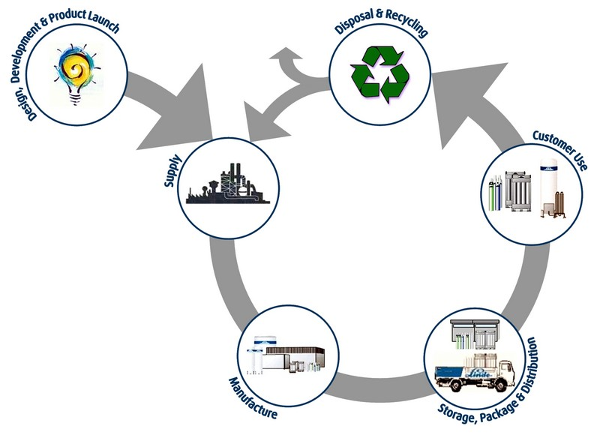
Computing mimics real life
Courtesy of peelscrapmetalrecycling.com

Slide 31
Copyright statement
Some images contained in this presentation are the copyrighted property of ToonClipart.
As such, these images are being used under a license from said entities, and may not be copied or downloaded without explicit permission from ToonClipart.

