Slide 1
The Fermilab Campus Grid
(FermiGrid)
Keith Chadwick
Fermilab
chadwick@fnal.gov
Work supported by the U.S. Department of Energy under contract No. DE-AC02-07CH11359.

Slide 2
Outline
Initial Charge
Issues & Challenges
Timeline
Stakeholders
Architecture & Performance
I/O & Storage Access
Virtualization & High Availability
Cloud Computing
Future Work
Conclusions
19-Jan-2010
Fermilab Campus Grid

Slide 3
Initial Charge
On November 10, 2004, Vicky White (Fermilab CD Head) wrote the following:
In order to better serve the entire program of the laboratory the Computing Division will place all of its production resources in a Grid infrastructure called FermiGrid. This strategy will continue to allow the large experiments who currently have dedicated resources to have first priority usage of certain resources that are purchased on their behalf. It will allow access to these dedicated resources, as well as other shared Farm and Analysis resources, for opportunistic use by various Virtual Organizations (VOs) that participate in FermiGrid (i.e. all of our lab programs) and by certain VOs that use the Open Science Grid. (Add something about prioritization and scheduling – lab/CD – new forums). The strategy will allow us:
  to optimize use of resources at Fermilab
  to make a coherent way of putting Fermilab on the Open Science Grid
  to save some effort and resources by implementing certain shared services and approaches
  to work together more coherently to move all of our applications and services to run on the Grid
  to better handle a transition from Run II to LHC (and eventually to BTeV) in a time of shrinking budgets and possibly shrinking resources for Run II worldwide
  to fully support Open Science Grid and the LHC Computing Grid and gain positive benefit from this emerging infrastructure in the US and Europe.
19-Jan-2010
Fermilab Campus Grid

Slide 4
Initial 4 components
Common Grid Services:
  Supporting common Grid services to aid in the development and deployment of Grid computing infrastructure by the supported experiments at
Stakeholder Bilateral Interoperability:
  Facilitating the shared use of central and experiment controlled computing facilities by supported experiments at FNAL – CDF, D0, CMS, GP Farms.
Deployment of OSG Interfaces for Fermilab:
  Enabling the opportunistic use of FNAL computing resources through Open Science Grid (OSG) interfaces.
Exposure of the Permanent Storage System:
  Enable the opportunistic use of FNAL storage resources (STKEN) through Open Science Grid (OSG) interfaces.
19-Jan-2010
Fermilab Campus Grid

Slide 5
Issues and Challenges
UID/GIDs:
  Coordinated site wide
Site Wide NFS:
  BlueArc NFS Server Appliance
    A good product, but it does have limitations (which we have found)!
Siloed Infrastructures (in early 2005):
  CDF – 2 clusters, condor, total 3,000 slots
  D0 – 2 clusters, pbs, total 3,000 slots
  CMS – 1 cluster, condor, 5,000 slots
  GP Farm – 1 cluster, condor, 1,000 slots
Critical services
Compute Intensive vs. I/O Intensive Analysis:
  Compute Grid vs. Data Grid.
Preemption
Planning for the Future
19-Jan-2010
Fermilab Campus Grid

Slide 6
Timeline (Past Future)
Charge from CD Head 10-Nov-2004
Equipment ordered 15-Feb-2005
1st core services (VOMS, GUMS) commissioned 1-Apr-2005
GP Cluster transitioned to Grid interface Apr-2005
D0 Clusters transitioned to GUMS May-2005
FermiGrid Web Page (http://fermigrid.fnal.gov) 25-May-2005
Metrics collection (start) 26-Aug-2005
Active service monitoring (start) 26-Jul-2006
Site Gateway ???
Site AuthoriZation (SAZ) Service 1-Oct-2006
Demonstrated full stakeholder interoperability 14-Feb-2007
High Availability (VOMS-HA, GUMS-HA, SAZ-HA) 3-Dec-2007
Virtualized Services (Squid-HA, Ganglia-HA, MyProxy-VM, Gatekeeper-VM, Condor-VM) ??Apr-Jun??-2008
Virtualized Gratia Service (VM but not HA)
Resource Selection Service (ReSS-HA) 01-Oct-2009
MyProxy-HA (est) 28-Jan-2010
Gratia-HP/HA Mar-2010
Gatekeeper-HA & NFSlite Mar-2010
FermiCloud May-2010
High I/O Intensive Cluster Design Jul-2010
High I/O Intensive Cluster Deployment Nov-2010
19-Jan-2010
Fermilab Campus Grid

Slide 7
Stakeholders (today)
Fermilab Computing Division
Collider Physics:
  CDF Experiment
    3 clusters, ~5,500 slots
  CMS T1 Facility
    1 cluster, ~8,000 slots
  D0 Experiment
    2 clusters, ~5,500 slots
  General Purpose
    1 cluster, ~2000 slots
AstroPhysics:
  Auger
  Dark Energy Survey (DES)
  Joint Dark Energy Mission (JDEM)
Neutrino Program:
  Minos
  MiniBoone
  Minerva
  Long Baseline Neutrino Experiment (LBNE)
  Argoneut
  Mu2e
Others:
  International Linear Collider
  Accelerator Physics Simulations.
  Theory
  Open Science Grid VO’s
  Grid Management
19-Jan-2010
Fermilab Campus Grid

Slide 8

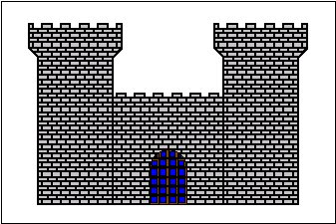
Current Architecture
VOMRS
Server
Periodic
Synchronization
VOMS
Server
VOMS
Server
Periodic
Synchronization
Step 1 - user
registers with VO
Step 2 - user issues voms-proxy-init
user receives voms signed credentials
GUMS
Server
GUMS
Server
Step 5 – Gateway requests GUMS
Mapping based on VO & Role
Site Wide
Gateway
Step 3 – user submits their grid job via
globus-job-run, globus-job-submit, or condor-g
Gratia
Step 4 – Gateway checks against
Site Authorization Service
FERMIGRID SE
(dcache SRM)
clusters send ClassAds
via CEMon
to the site wide gateway
SAZ
Server
SAZ
Server
BlueArc
Step 6 - Grid job is forwarded
to target cluster
Exterior
Interior
CMS
WC1
CMS
WC2
CMS
WC3
CDF
OSG1
CDF
OSG2
CDF
OSG3/4
D0
CAB1
D0
CAB2
GP
Farm
19-Jan-2010
Fermilab Campus Grid

Slide 9
FermiGrid-HA - Why?
The FermiGrid “core” mapping and authorization services (GUMS and/or SAZ) in early 2007 controlled access to:
  Over 2500 systems with more than 12,000 batch slots.
  Petabytes of storage (via gPlazma / GUMS).
An outage of either GUMS or SAZ can cause 5,000 to 50,000 “jobs” to fail for each hour of downtime.
Manual recovery or intervention for these services can have long recovery times (best case 30 minutes, worst case multiple hours).
Automated service recovery scripts can minimize the downtime (and impact to the Grid operations), but still can have several tens of minutes response time for failures:
  How often the scripts run,
  Scripts can only deal with failures that have known “signatures”,
  Startup time for the service,
  A script cannot fix dead hardware.
19-Jan-2010
Fermilab Campus Grid

Slide 10
Services
Service
Gatekeeper
VOMRS
VOMS
GUMS
SAZ
Squid
MyProxy
Ganglia / Nagios / Zabbix
Syslog-Ng
19-Jan-2010
Fermilab Campus Grid

Slide 11
Central Storage - Today
BlueArc:
  24+60 Tbytes (raw) = 14+48 TBytes (actual).
    About to purchase 100+ TBytes of disk expansion.
  Default Quotas/VO:
    Home – 10 GBytes, App – 30 GBytes, Data – 400 GBytes.
  More space can be made available:
    Can you “loan” us 10 TBytes for the next couple of years…
Dcache:
  Opportunistic (~7 TBytes);
  Resilient;
  Permanent.
Enstore:
  Tape backed storage;
  How much tape are you willing to buy?
19-Jan-2010
Fermilab Campus Grid

Slide 12
Central Storage - Future
We have a project to investigate additional filesystems this year:
  Lustre;
  Hadoop;
  As well as other filesystems.
Why:
  The BlueArc works very well to support Compute intensive applications;
  It does not work well when 100’s of copies of an I/O intensive application (root) attempt to randomly access files from it’s filesystems simultaneously.
Deliverables:
  Recommendations on how to build an I/O intensive analysis cluster.
  Will also look at potential mechanisms to automatically route I/O intensive jobs to this cluster.
19-Jan-2010
Fermilab Campus Grid

Slide 13
Gatekeepers / Worker Nodes
Gatekeepers
  Currently using job home areas served from the central BlueArc:
  Works well for compute intensive applications;
  Does not work well for I/O intensive applications;
  Looking at NFSlite to address this;
  Will likely be deployed coincident with Gatekeeper-HA.
Worker Nodes:
  Currently mount an NFS served copy of the OSG worker node (WN) installation;
  Good for compute intensive applications;
  Does not work as well for I/O intensive applications;
  Looking at RPM based WN install on each worker node.
19-Jan-2010
Fermilab Campus Grid

Slide 14
FermiGrid-HA - Requirements
Requirements:
  Critical services hosted on multiple systems (n ≥ 2).
  Small number of “dropped” transactions when failover required (ideally 0).
  Support the use of service aliases:
    VOMS: fermigrid2.fnal.gov -> voms.fnal.gov
    GUMS: fermigrid3.fnal.gov -> gums.fnal.gov
    SAZ: fermigrid4.fnal.gov -> saz.fnal.gov
  Implement “HA” services with services that did not include “HA” in their design.
    Without modification of the underlying service.
Desirables:
  Active-Active service configuration.
  Active-Standby if Active-Active is too difficult to implement.
  A design which can be extended to provide redundant services.
19-Jan-2010
Fermilab Campus Grid

Slide 15
FermiGrid-HA - Challenges #1
Active-Standby:
  Easier to implement,
  Can result in “lost” transactions to the backend databases,
  Lost transactions would then result in potential inconsistencies following a failover or unexpected configuration changes due to the “lost” transactions.
    GUMS Pool Account Mappings.
    SAZ Whitelist and Blacklist changes.
Active-Active:
  Significantly harder to implement (correctly!).
  Allows a greater “transparency”.
  Reduces the risk of a “lost” transaction, since any transactions which results in a change to the underlying MySQL databases are “immediately” replicated to the other service instance.
  Very low likelihood of inconsistencies.
    Any service failure is highly correlated in time with the process which performs the change.
19-Jan-2010
Fermilab Campus Grid

Slide 16
FermiGrid-HA - Challenges #2
DNS:
  Initial FermiGrid-HA design called for DNS names each of which would resolve to two (or more) IP numbers.
  If a service instance failed, the surviving service instance could restore operations by “migrating” the IP number for the failed instance to the Ethernet interface of the surviving instance.
  Unfortunately, the tool used to build the DNS configuration for the Fermilab network did not support DNS names resolving to >1 IP numbers.
    Back to the drawing board.
Linux Virtual Server (LVS):
  Route all IP connections through a system configured as a Linux virtual server.
    Direct routing
    Request goes to LVS director, LVS director redirects the packets to the real server, real server replies directly to the client.
  Increases complexity, parts and system count:
    More chances for things to fail.
  LVS director must be implemented as a HA service.
    LVS director implemented as an Active-Standby HA service.
  LVS director performs “service pings” every six (6) seconds to verify service availability.
    Custom script that uses curl for each service.
19-Jan-2010
Fermilab Campus Grid

Slide 17
FermiGrid-HA - Challenges #3
MySQL databases underlie all of the FermiGrid-HA Services (VOMS, GUMS, SAZ):
  Fortunately all of these Grid services employ relatively simple database schema,
  Utilize multi-master MySQL replication,
    Requires MySQL 5.0 (or greater).
    Databases perform circular replication.
  Currently have two (2) MySQL databases,
    MySQL 5.0 circular replication has been shown to scale up to ten (10).
    Failed databases “cut” the circle and the database circle must be “retied”.
  Transactions to either MySQL database are replicated to the other database within 1.1 milliseconds (measured),
  Tables which include auto incrementing column fields are handled with the following MySQL 5.0 configuration entries:
    auto_increment_offset (1, 2, 3, … n)
    auto_increment_increment (10, 10, 10, … )
19-Jan-2010
Fermilab Campus Grid

Slide 18
FermiGrid-HA – Technology (Dec-2007)
Xen:
  SL 5.0 + Xen 3.1.0 (from xensource community version)
    64 bit Xen Domain 0 host, 32 and 64 bit Xen VMs
  Paravirtualisation.
Linux Virtual Server (LVS 1.38):
  Shipped with Piranha V0.8.4 from Redhat.
Grid Middleware:
  Virtual Data Toolkit (VDT 1.8.1)
  VOMS V1.7.20, GUMS V1.2.10, SAZ V1.9.2
MySQL:
  MySQL V5 with multi-master database replication.
19-Jan-2010
Fermilab Campus Grid

Slide 19
FermiGrid-HA - Component Design
VOMS
Active
VOMS
Active
LVS
Active
LVS
Active
MySQL
Active
GUMS
Active
Heartbeat
Heartbeat
Replication
GUMS
Active
MySQL
Active
LVS
Standby
LVS
Standby
SAZ
Active
SAZ
Active
19-Jan-2010
Fermilab Campus Grid

Slide 20
FermiGrid-HA - Host Configuration
The fermigrid5&6 Xen hosts are Dell 2950 systems.
Each of the Dell 2950s are configured with:
  Two 3.0 GHz core 2 duo processors (total 4 cores).
  16 Gbytes of RAM.
  Raid-1 system disks (2 x 147 Gbytes, 10K RPM, SAS).
  Raid-1 non-system disks (2 x 147 Gbytes, 10K RPM, SAS).
  Dual 1 Gig-E interfaces:
    1 connected to public network,
    1 connected to private network.
System Software Configuration:
  Each Domain 0 system is configured with 5 Xen VMs.
    Previously we had 4 Xen VMs.
  Each Xen VM, dedicated to running a specific service:
    LVS Director, VOMS, GUMS, SAZ, MySQL
    Previously we were running the LVS director in the Domain-0.
19-Jan-2010
Fermilab Campus Grid

Slide 21
FermiGrid-HA - Actual Component Deployment
Xen Domain 0
Xen Domain 0
Active fg5x1
LVS
Xen VM 0
Standby fg5x1
LVS
Xen VM 0
Active fg5x1
VOMS
Xen VM 1
Active fg5x1
VOMS
Xen VM 1
GUMS
GUMS
Active fg5x2
Active fg5x2
Xen VM 2
Xen VM 2
Active fg5x3
SAZ
Xen VM 3
Active fg5x3
SAZ
Xen VM 3
Active fg5x4
MySQL
Xen VM 4
Active fg5x4
MySQL
Xen VM 4
Active
fermigrid5
Active
fermigrid6
19-Jan-2010
Fermilab Campus Grid

Slide 22
FermiGrid-HA - Performance
Stress tests of the FermiGrid-HA GUMS deployment:
  A stress test demonstrated that this configuration can support ~9.7M mappings/day.
    The load on the GUMS VMs during this stress test was ~9.5 and the CPU idle time was 15%.
    The load on the backend MySQL database VM during this stress test was under 1 and the CPU idle time was 92%.
Stress tests of the FermiGrid-HA SAZ deployment:
  The SAZ stress test demonstrated that this configuration can support ~1.1M authorizations/day.
    The load on the SAZ VMs during this stress test was ~12 and the CPU idle time was 0%.
    The load on the backend MySQL database VM during this stress test was under 1 and the CPU idle time was 98%.
Stress tests of the combined FermiGrid-HA GUMS and SAZ deployment:
  Using a GUMS:SAZ call ratio of ~7:1
  The combined GUMS-SAZ stress test that was performed on 06-Nov-2007 demonstrated that this configuration can support ~6.5 GUMS mappings/day and ~900K authorizations/day.
    The load on the SAZ VMs during this stress test was ~12 and the CPU idle time was 0%.
19-Jan-2010
Fermilab Campus Grid

Slide 23
FermiGrid-HA - Production Deployment
FermiGrid-HA was deployed in production on 03-Dec-2007.
  In order to allow an adiabatic transition for the OSG and our user community, we ran the regular FermiGrid services and FermiGrid-HA services simultaneously for a three month period (which ended on 29-Feb-2008).
We have already utilized the HA service redundancy on several occasions:
  1 operating system “wedge” of the Domain-0 hypervisor together with a “wedged” Domain-U VM that required a reboot of the hardware to resolve.
  multiple software updates.
19-Jan-2010
Fermilab Campus Grid

Slide 24
FermiGrid-HA - Future Work
Over the next three to four months we will be deploying “HA” instances of our other services:
  Squid, MyProxy (with DRDB), Syslog-Ng, Ganglia, and others.
Redundant side wide gatekeeper:
  We have a preliminary “Gatekeeper-HA” design
  Based on the “manual” procedure to keep jobs alive during OSG 0.6.0 to 0.8.0 upgrade that Steve Timm described at a previous site administrators meeting.
  We expect that this should keep Globus and Condor jobs running.
We also plan to install a test gatekeeper that will be configured to receive Xen VMs as Grid jobs and execute them:
  This a test of a possible future dynamic “VOBox” or “Edge Service” capability within FermiGrid.
19-Jan-2010
Fermilab Campus Grid

Slide 25
FermiGrid-HA - Conclusions
Virtualisation benefits:
  Significant performance increase,
  Significant reliability increase,
  Automatic service failover,
  Cost savings,
  Can be scaled as the load and the reliability needs increase,
  Can perform “live” software upgrades and patches without client impact.
Virtualisation drawbacks:
  More complex design,
  More “moving parts”,
  More opportunities for things to fail,
  More items that need to be monitored.
19-Jan-2010
Fermilab Campus Grid

Slide 26
Preemption
A key factor in allowing opportunistic use of the various FermiGrid clusters is job preemption.
Many codes running on FermiGrid will not work well with suspension / resumption.
Instead we configure the FermiGrid clusters to perform a gentle preemption - When a cluster “owner” has a job that wants to run in a slot occupied by an opportunistic job, the opportunistic job is given 24 hours to complete:
  Approximately 60% of all Grid jobs complete in 4-6 hours.
  Approximately 95% of all Grid jobs complete in less than 24 hours.
19-Jan-2010
Fermilab Campus Grid

Slide 27
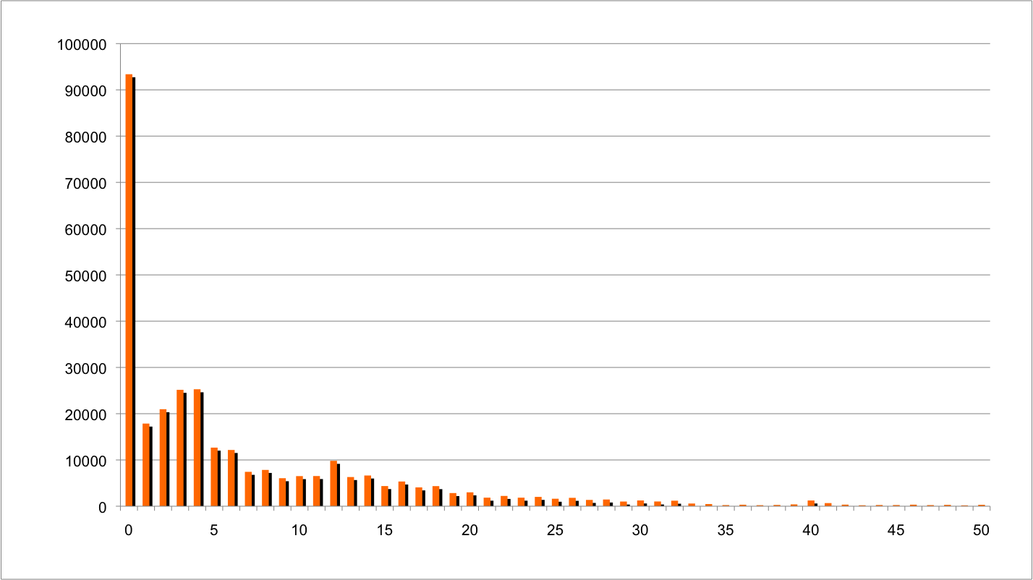
Grid Job Duration (All VOs)
Insert preemption plot here
19-Jan-2010
Fermilab Campus Grid

Slide 28
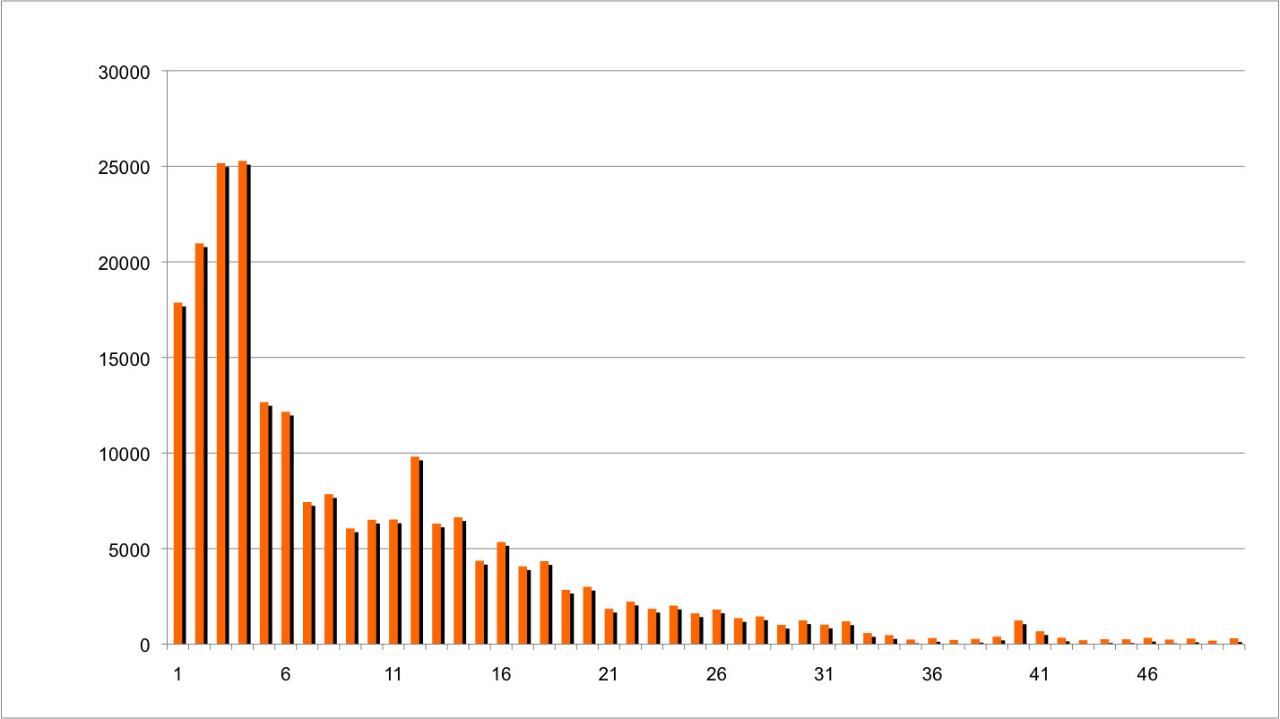
Grid Job Duration (All VOs)
19-Jan-2010
Fermilab Campus Grid

Slide 29
% Complete vs Job Duration (Hours)
VO | % complete at 6h (zero suppressed) | % complete at 12h (zero suppressed) | % complete at 18h (zero suppressed) | % complete at 24h (zero suppressed)
All | 66.06% (51.70%) | 80.12% (71.73%) | 90.01% (85.79%) | 94.40% (92.04%)
CDF | 68.74% (65.04%) | 81.22% (79.53%) | 84.94% (83.59%) | 88.61% (87.59%)
DZERO | 32.26% (28.42%) | 59.73% (57.45%) | 75.33% (73.93%) | 85.89% (85.09%)
CMS | 58.37% (30.91%) | 73.55% (56.10%) | 93.67% (89.50%) | 99.44% (99.07%)
Fermilab | 85.85% (60.93%) | 90.84% (74.70%) | 96.51% (90.37%) | 98.83% (96.76%)
ILC | 95.01% (91.22%) | 98.09% (96.63%) | 99.67% (99.42%) | 100.00% (100.00%)
OSG Opportunistic | 69.05% (37.49%) | 93.17% (86.20%) | 97.82% (95.60%) | 99.82% (99.63%)
19-Jan-2010
Fermilab Campus Grid

Slide 30
Compute vs. I/O Intensive Grid
19-Jan-2010
Fermilab Campus Grid

Slide 31
FermiCloud
19-Jan-2010
Fermilab Campus Grid

Slide 32
Future
19-Jan-2010
Fermilab Campus Grid

Slide 33
Fin
Any Questions?
19-Jan-2010
Fermilab Campus Grid

