Slide 1
Overview of Monitoring and Information Systems in OSG
MWGS08 - September 18, 2008 - Chicago
Marco Mambelli - University of Chicago
marco@hep.uchicago.edu

Slide 2
Outline
Monitoring principles and OSG Monitoring
Central monitoring at GOC
Systems synergy: CEMon and BDII
Systems evolution: VORS and RSV
Resource exploration
MWGS08 - OSG MIS - Marco Mambelli
9/18/08

Slide 3
Monitoring and IS
Producer, Consumer, Intermediaries
Schema, Presentation, Content
Monitoring at the VO level
  Panda
Monitoring at the Resource level
  Ganglia, Cactus, Nagios, Custom systems
Monitoring and IS in OSG:
https://twiki.grid.iu.edu/twiki/bin/view/MonitoringInformation/WebHome
Information scouting
MWGS08 - OSG MIS - Marco Mambelli
9/18/08

Slide 4
OSG Monitoring
Grid Site_Verify Scanner
  Test, GOC
Virtual Organization Resource Selector (VORS)
  IS display (from Site_Verify), GOC
Generic Information Provider (GIP) Validation Service
  Test, GOC
LDAP (CEMon/BDII) information display utility
  IS display (from GIP), GOC
Gratia Accounting
  Accounting, 3rdP
Resource and Service Validation
  Test, Local+GOC
Virtual Organization Membership System (VOMS) Monitor
  Test (VOMS servers), GOC
MWGS08 - OSG MIS - Marco Mambelli
9/18/08

Slide 5
Information Systems
OSG Grid Operations Center (GOC) Alerts and RSS Feed
  Info (T-Tickets), GOC
OSG GOC Ticket Metrics Reports
  T-Tickets, GOC
OSG Maintenance Scheduling Tool
  now OIM
OSG Registration DB
  now OIM
OSG Information Management (OIM) System
  Info, Sysadmins
OSG Pacman Software Caches
  Software packages, OSG
MWGS08 - OSG MIS - Marco Mambelli
9/18/08

Slide 6
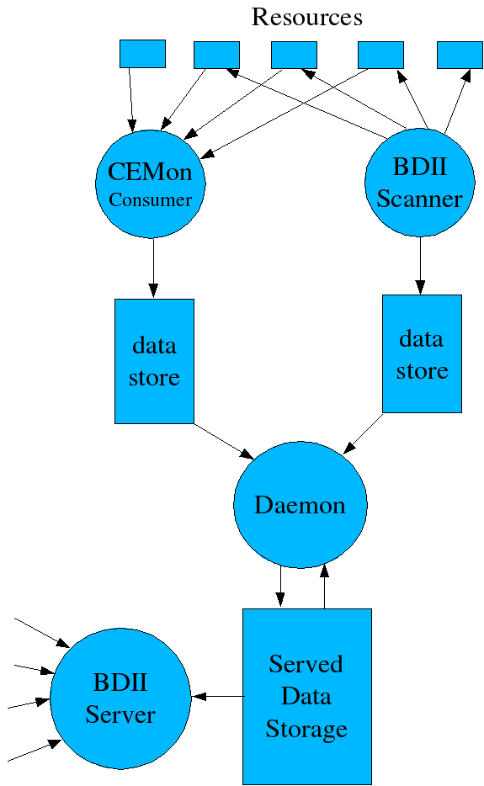
BDII/CEMon
Alternative sources (Provider)
  CEMon Consumer (passive)
  BDII Scanner (active)
Data collector, aggregator (Intermediary)
  Daemon
Storage and Server (Consumer)
  Served Data Storage
  BDII Server
http://is.grid.iu.edu/documentation.html
MWGS08 - OSG MIS - Marco Mambelli
9/18/08

Slide 7
ReSS, alternative Consumer of CEMon
https://twiki.grid.iu.edu/bin/view/ResourceSelection/WebHome
job
What Gate?
Info
Gatherer
classads
Condor
Match Maker
Condor
Scheduler
Gate 3
job
classads
classads
classads
Gate1
CEMon
Gate2
CEMon
Gate3
CEMon
jobs
info
jobs
info
jobs
info
CE
job-managers
GIP
CE
job-managers
GIP
CE
job-managers
GIP
job-managers
job-managers
job-managers
job-managers
job-managers
job-managers
CLUSTER
CLUSTER
CLUSTER
MWGS08 - OSG MIS - Marco Mambelli
9/18/08

Slide 8
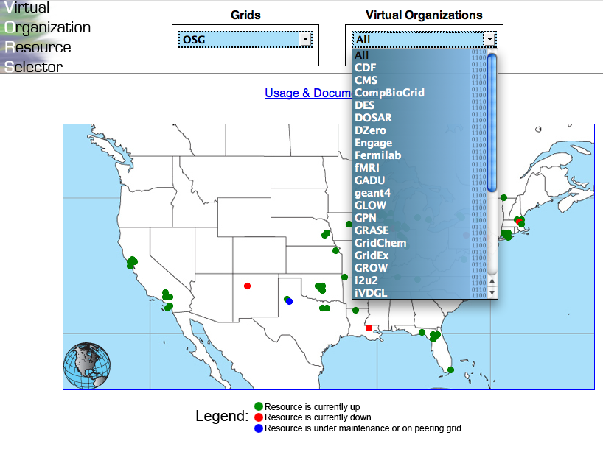
VO Resource Selector
MWGS08 - OSG MIS - Marco Mambelli
9/18/08

Slide 9
From VORS to RSV
Involve more information consumers (resource admins, users, VOs)
If possible run test locally, allowing still central collection and centralized triggering
Reduce reaction loop, removing the need for GOC’s intervention.
Allow different information nd status checks for GOC, VOs, Users, Admins
MWGS08 - OSG MIS - Marco Mambelli
9/18/08

Slide 10
Status monitors
VORS
RSV
tests collected in single probe (site_verify)
GOC running the test (grid job)
local consumers query central display
multiple probes (everyone can add probes)
runs locally
local display
GOC collects information for central display
MWGS08 - OSG MIS - Marco Mambelli
9/18/08

Slide 11
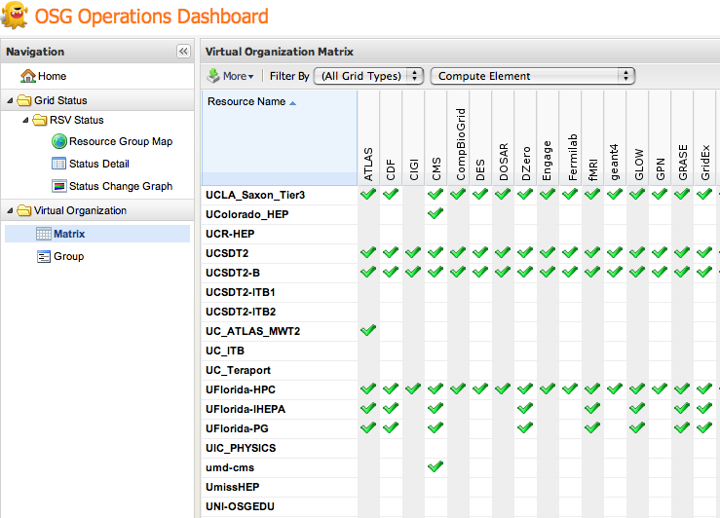
Resource and Service Validation
http://rsv.grid.iu.edu/
MWGS08 - OSG MIS - Marco Mambelli
9/18/08

Slide 12
Information scouting: OSG CE
Basic tests with Globus clients
Resource exploration
Know the resource (=read OSG and Middleware documentation):
  https://twiki.grid.iu.edu/bin/view/ReleaseDocumentation/OverviewOfServicesInOSG
  https://twiki.grid.iu.edu/bin/view/ReleaseDocumentation/StorageModels
  https://twiki.grid.iu.edu/bin/view/ReleaseDocumentation/ComputeElementInstall
Informed exploration
  OSG, Globus, …
MWGS08 - OSG MIS - Marco Mambelli
9/18/08

Slide 13
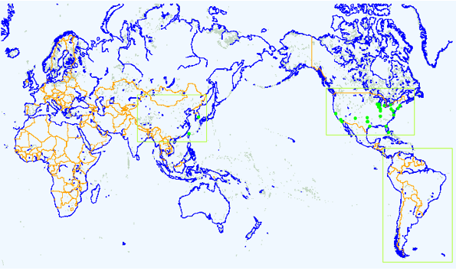
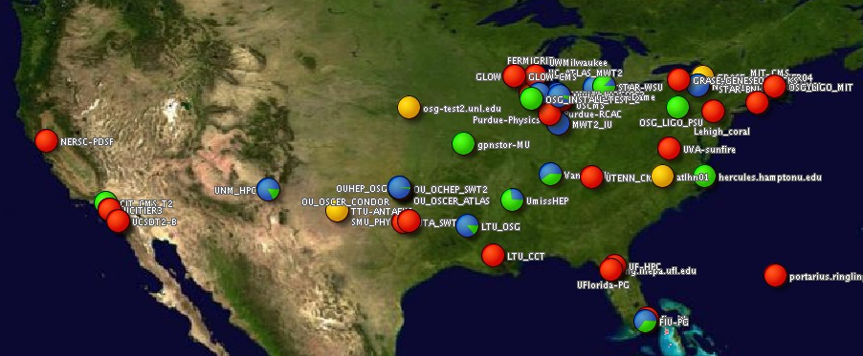
Other Systems (deprecated)
GridCat
MonALISA
MWGS08 - OSG MIS - Marco Mambelli
9/18/08

