Slide 1
Rosetta
OSG Engagement VO
Resource Selection on the Grid

Slide 2
Engagement Mission
Help new user communities from diverse scientific domains adapt their computational systems to leverage OSG
Facilitate University Campus CI deployment, and interconnect it with the national organizations

Slide 3
User Environment
All about usability
  Make it easy to run simple (but real) jobs
Engagement VO provides to its users:
  Submit host
  Resource selection system
  Site verification

Slide 4
Why resource selection?
Engagement users
  Small labs/experiments
  Grid?
  Little or no CS/IT resources
Example: Kuhlman lab at UNC
  Protein folding
  1 job run (~ 3 days)
  4 weeks in wet lab, using results from run
No knowledge / time / resources / need for a complex job handling system

Slide 5
Engagement VO Jobs
Mostly very simple jobs
  No inter job dependencies
  Simple staging requirements
    Inputs/outputs staged with job
Job independence makes it easy to spread a run across many sites
Great candidates for matchmaking

Slide 6
Condor
Quick introduction to Condor
  Representation of resources and jobs
    Class ads
  Match making
    Requirements
    Ranks

Slide 7
Condor ClassAds
“Condor's ClassAds are analogous to the classified advertising section of the newspaper. Sellers advertise specifics about what they have to sell, hoping to attract a buyer. Buyers may advertise specifics about what they wish to purchase. Both buyers and sellers list constraints that need to be satisfied. For instance, a buyer has a maximum spending limit, and a seller requires a minimum purchase price. Furthermore, both want to rank requests to their own advantage. Certainly a seller would rank one offer of $50 dollars higher than a different offer of $25. In Condor, users submitting jobs can be thought of as buyers of compute resources and machine owners are sellers.” (source: Condor documentation)

Slide 8
ClassAds (cont.)
Both resources and jobs uses the same format to describe themselves
ASCII
Key/value pairs
Simplicity of the ClassAds is good news for us, because it means they are easy to create/manipulate

Slide 9
Resource ClassAd
MyType = "Machine"
GlueSubClusterLogicalCPUs = 2
GlueCEPolicyAssignedJobSlots = 0
GlueCEInfoHostName = "antaeus.hpcc.ttu.edu"
GlueHostNetworkAdapterOutboundIP = TRUE
GlueHostArchitectureSMPSize = 2
EngageSoftware_Rosetta_v3 = TRUE
EngageMemPerCPU = 1010460
GlueSubClusterWNTmpDir = "/state/partition1"
EngageOSGAPPWriteWorkNode = TRUE
GlueCEInfoContactString = "antaeus.hpcc.ttu.edu:2119/jobmanager-lsf"
GlueHostOperatingSystemName = "CentOS"

Slide 10
Job ClassAd
FIXME

Slide 11
Job/Resource Requirements

Slide 12
Job/Resource Ranks
How is the “best” site chosen from a set of sites matching a job’s requirements?
FIXME
Engagement is using a custom resource rank (explained later)

Slide 13
ReSS Overview
CEMon
Condor ClassAds
User expresses job requirements in Condor submit file
Condor matches jobs to resources
Condor handles resubmits
Use hold/release expressions to resubmit “stuck” jobs
Post job scripts to workaround exit codes

Slide 14
Engagement ReSS Layer
Retrieve base ClassAds from ReSS
Validate the sites with probe jobs
Determine the current state of the system by looking at current job states and success rates
Merge the information, and insert into local Condor system

Slide 16
ReSS + Site Verification
ReSS information + site verification:
  The result is a set of resource classads
    Well formed
    Verified information
  Users’ can trust the information
  Increases job success rates

Slide 17
condor_grid_overview
ID Owner Resource Status Time Sta Sub
======= ====== ============== ======== ======== ===
46381 rynge (DAGMan) 1:58:54
46382 rynge GLOW Running 1:55:43 1
46384 rynge UWMilwaukee Pending 1:57:04 1
46387 rynge Nebraska Running 1:00:43 1
Site Jobs Subm Pend Run Stage Fail Rank
============ ===== ===== ===== ===== ===== ===== =====
ASGC_OSG 17 0 0 15 2 0 155
FNAL_GPFARM 14 4 0 10 0 0 720
GLOW 36 6 5 22 3 0 372
Nebraska 17 0 5 12 0 0 288
Purdue-Lear 15 4 0 10 1 0 372
TTU-ANTAEUS 15 2 0 11 2 0 372
Vanderbilt 45 4 4 37 0 0 350

Slide 18
Site Rank
Simple – but works!
Integer between 0 and 1000
Factors:
  Jobs submitting/staging/pending/running provides the baseline
  Job success rate for the site over the last 6 hours
  Ratio between matched jobs, and the max number we want on that site

Slide 19
Condor Submit File
globusscheduler = $$(GlueCEInfoContactString)
requirements = (
(TARGET.GlueCEInfoContactString =!= UNDEFINED) &&
(TARGET.Rank > 300) &&
(EngageSoftwareWget == True) &&
(TARGET.EngageCENetworkOutbound == True))
# when retrying, remember the last 4 resources tried
match_list_length = 4
Rank = (TARGET.Rank) -
((TARGET.Name =?= LastMatchName0) * 1000) -
((TARGET.Name =?= LastMatchName1) * 1000) -
((TARGET.Name =?= LastMatchName2) * 1000) -
((TARGET.Name =?= LastMatchName3) * 1000)

Slide 20
Condor Submit File (cont.)
# make sure the job is being retried and rematched
periodic_release = (NumGlobusSubmits < 10)
globusresubmit = (NumSystemHolds >= NumJobMatches)
rematch = True
globus_rematch = True
# only allow for the job to be queued or running for a while
# then try to move it
# JobStatus==1 is pending
# JobStatus==2 is running
periodic_hold = (
((JobStatus==1) && ((CurrentTime - EnteredCurrentStatus) > (5*60*60))) ||
((JobStatus==2) && ((CurrentTime - EnteredCurrentStatus) > (24*60*60))) )

Slide 21
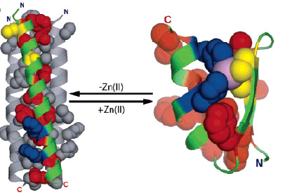
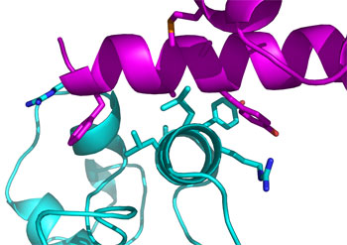
Sample Engagement: Kuhlman Lab
Using OSG to design proteins that adopt specific three dimensional structures and bind and regulate target proteins important in cell biology and pathogenesis. These designed proteins are used in experiments with living cells to detect when and where the target proteins are activated in the cells
  Sr. Rosetta Researcher and his team, little CS/IT expertise, no grid expertise. Quickly up and running with large scale jobs across OSG, >250k CPU hours
Notes:
Slide Talking Points:
Here is an example of a successful engagement. Kuhlman lab at UNC is a small research team concentrating on protein folding. The results of the research could lead to new treatments, and eventually cures, for serious diseases such as diabetes, Alzheimers, HIV/AIDS and many cancers.
The problem with smaller teams like this is that they lack CS/IT expertise. Protein folding: 1 run takes about 3 days. Then spend 4 weeks in wet lab, using the results from the run. If you only spend 3 days out of a month using the grid, you can’t maintain a full VO and infrastructure. And you do not want to spend a lot of times debugging your jobs.
We deployed one of our CI persons with the team, and within a couple of days, the Kuhlman lab was up and running large scale jobs on OSG. The lab has today used up more than 250.000 CPU hours.

Slide 22
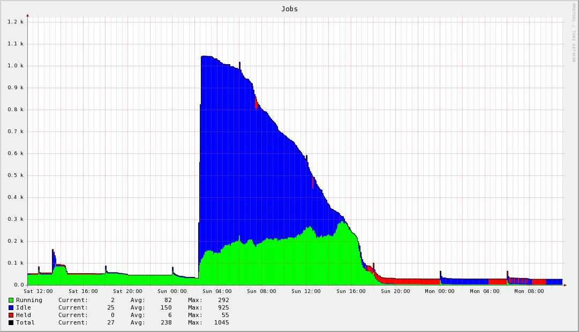
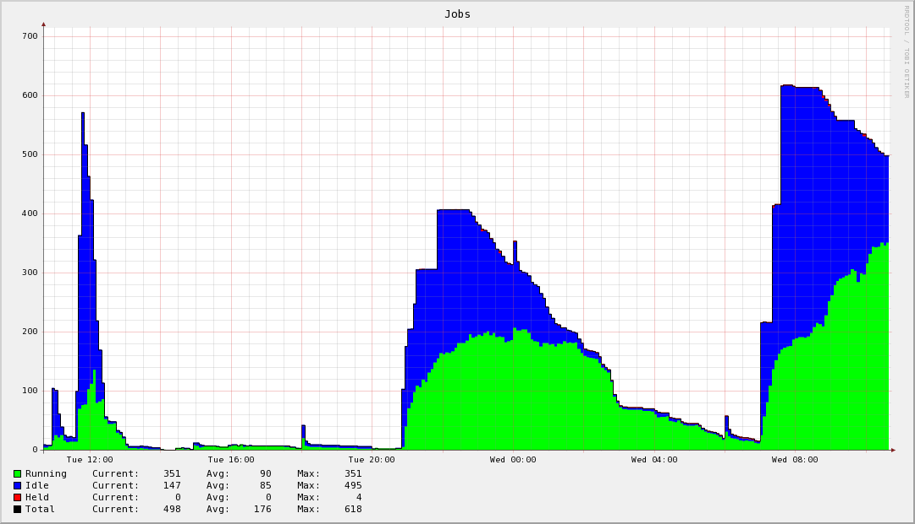
Rosetta on OSG
Good example on why resources selection is important
  Each protein design requires about 5,000 CPU hours, distributed across 1,000 individual compute jobs
Notes:
Slide Talking Points:
A typical Kuhlman job run consists of 1000 jobs, which uses up approximate 3000 CPU hours in total.
It is important that the scientist do not end up babysitting the job run. They should be able to submit, walk away and do their research, and then come back later for results. Engagement is using a resource selection system to make job management easy. The user only have to provide a job requirements description, and the resource selection system will place the jobs on appropriate grid resources, and handle failures and job resubmits automatically.
The graphs on this slide shows the Kuhlman scientists submitting a 1,000 jobs, and a day later, the system has completed them all.

Slide 23
Resource Selection
Job submission and management for small labs/experiments
Based on existing OSG infrastructure
  ReSS (Resource Selection Service), Condor-G
Component of a hosted VO infrastructure provided for users
Easy to use meta-scheduling and fault avoidance
  Site verification: sites are verified every 4 hours
  Recent performance of job throughput and job success rate per site enables:
    Job load re-balancing
    More intelligent scheduling
    As a site services Engage jobs well, it matches more, as it slows in servicing Engage jobs, it matches less
Notes:
Slide Talking Points:
Engagement hosts a VO infrastructure for VO members who do not want to run their own. Some members are small labs / experiments, and do not have the resources to host/maintain their own infrastructure. Resource selection is one piece of that infrastructure.
Important point is that most of the Engagement resource selection is only added a thin layer on top of existing OSG infrastructure, such as ReSS (Resource Selection Service from FNAL, and Condor-G from UWisc).
Point out that the bottom screen shows a visualization of the resource selection during a real Kuhlman job run.
First layer of defense against job failures: sites are verified every 4 hours. Things like environment and file system availability / free space is checked. Only sites which passes the verification tests are available in the resource selection system.
Site / job performance is monitored, stats are added to a database, and sites can be upgraded or downgraded depending on recent history. For example, if a site starts failing a lot of jobs, the site rank will be downgraded and fewer (0 for a while) jobs will match the site until it starts behaving well again.
You can also see site being downgraded because the just queue the jobs, and not run any.
Sites which starts running jobs immediately gets upgraded, and will hence receive more jobs.

Slide 24
DEMO

Slide 25
More Information
ReSS (Resource Selection Service):
https://twiki.grid.iu.edu/twiki/bin/view/ResourceSelection/WebHome
OSG Engagement VO https://twiki.grid.iu.edu/twiki/bin/view/Engagement/WebHome
Questions?
  Email: osg@renci.org

