Slide 1
Opportunistic Usage of ATLAS Resources
Michael Ernst
Brookhaven National Laboratory
OSG Council Meeting
2 August 2011, Fermilab

Slide 2
Opportunistic usage of US ATLAS Resources
US ATLAS policy
We use our resources with high efficiency and make sure that through OSG any temporarily unused resources are in general available to Science communities in the US
Implementation
Interested OSG VOs get access to resources at the facility level, not at the level of individual sites
Requires a named VO representative to present technical details associated with the application(s) (e.g. resource requirements, data access pattern) at a weekly US ATLAS computing meeting
At the facility level we work with sites to establish compliance with the requirements (may utilize ITB, if necessary)

Slide 3
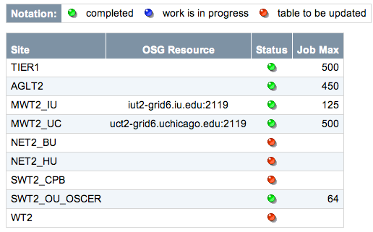
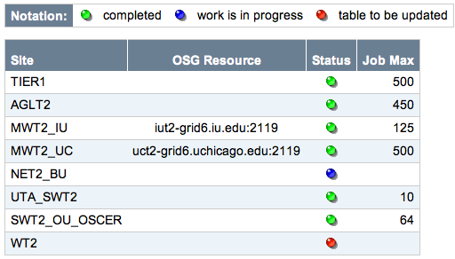
Opportunistic usage of US ATLAS Resources
Implementation
Documentation is created for each supported VO, e.g. HCC
http://www.usatlas.bnl.gov/twiki/bin/view/Admins/SupportingHCC
Info about VO contact, requirements, setup/config, status
The site status is maintained on the twiki
May 2011 July 2011

Slide 4
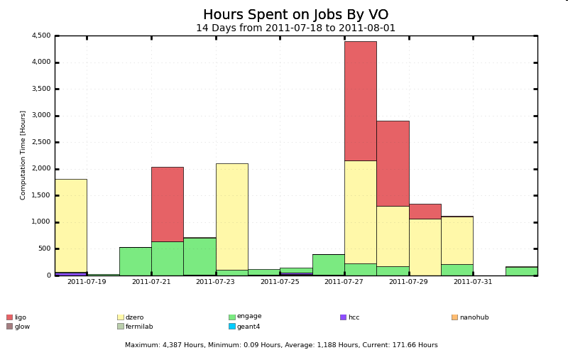
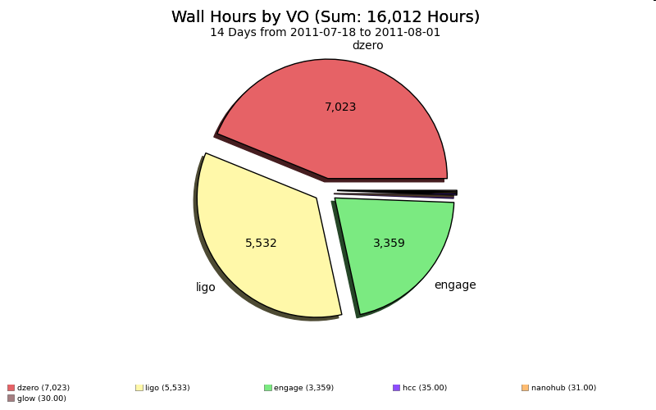
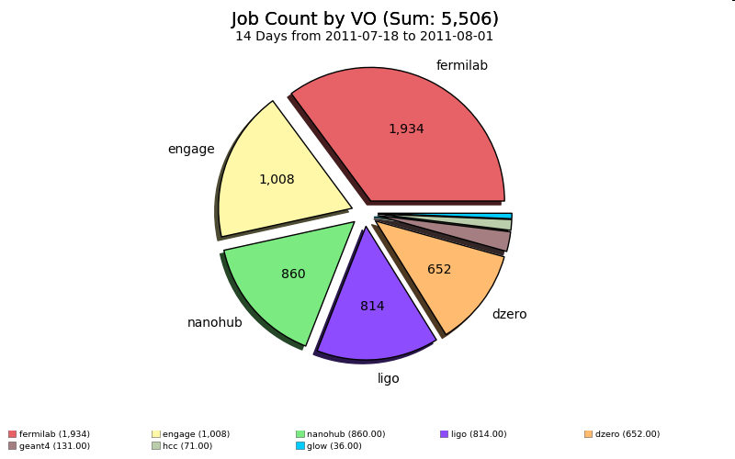
Opportunistic Usage at U.S. ATLAS Tier-1

Slide 5
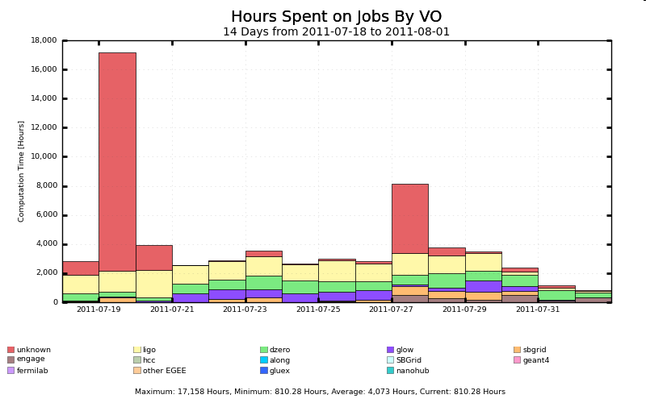
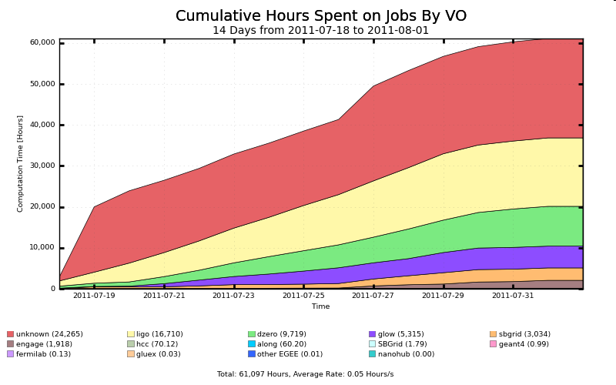
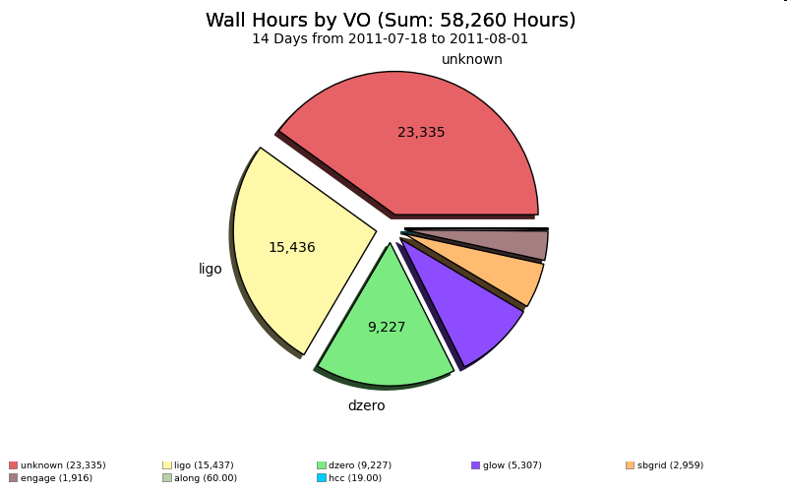
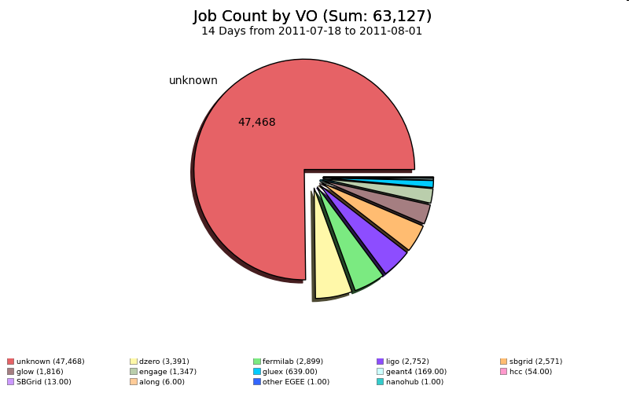
Opportunistic Usage at U.S. ATLAS Tier-2s
Local Production at
SLAC (Cavern
Background Simulation)

Slide 6
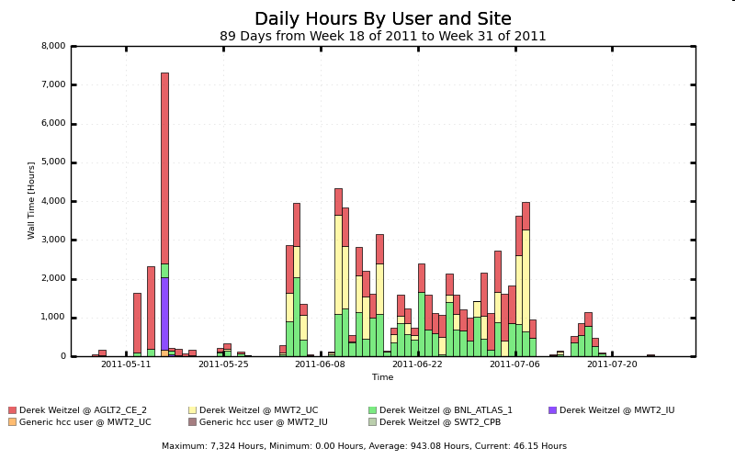
HCC

Slide 7
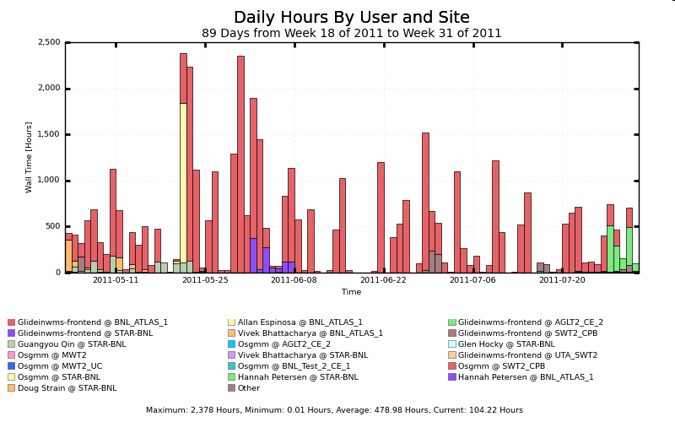
Engage

