Slide 1
VO Services Project
WBS
Dec 14, 2006
OSG Executive Board Meeting
Gabriele Garzoglio
Computing Division, Fermilab

Slide 2
Overview
VO Services Project (aka Privilege Project)
  Charter
WBS
Conclusions

Slide 3
Project Charter
The project provides an infrastructure to manage user registration and implement fine-grained authorization to access rights on computing and storage resources.
Authorization is linked to identities and extended attributes. Mapping is dynamic and supports pool accounts. Enforcement of access rights is implemented using UID/GID pairs.
The infrastructure aims at reducing administrative overhead. Authorization service is central at the site.
The project is responsible for the development and maintenance of the infrastructure and for assisting with the deployment and support on the OSG.

Slide 4
WBS
The WBS was put together in late spring
Requirements come from the stakeholders, including CMS, Fermilab, CERN
WBS reflects work on
  Internal components (PRIMA, GUMS)
  Related components (gPlazma, gLexec)
  Recent additions (VOMRS as of Sep 06)
SAZ is logically part of VO Services, but is managed by Fermigrid

Slide 5
WBS - 1
Support and deployment
(Ongoing ~25% FTE internal support)
(Support need will grow with deployment)
  Support the PRIMA and GUMS code for 32/64 bits for GT2 and GT4 for CMS Tier 1&2. Provide best effort support for all OSG VOs. (In the past 10% effort by Vikram)
  Support “stable” VOMRS release for Fermilab, CERN, and OSG stakeholders Ongoing. (In the past: 15% Tanya , 10% external (CERN) support)
  Help deploy the infrastructure to stakeholders’ sites. Ongoing (TBD)

Slide 6
WBS - 2
Improve health status reporting for key servers (Started. Remaining effort TBD)
  Better Gatekeeper / Prima error reporting for authorization failures (effort TBD)
  VOMS/GUMS health monitors (Done Aug 06)
Improve software validation (8 FTE weeks) (Started)
  Improve validation of basic functionalities (framework available in VDT)
  Implement validation of software dependencies
  Measure PRIMA / GUMS scalability (Started by John W.)
Improve integration of the infrastructure with dependent components as needed (Started)
  Improve GUMS integration with MonALISA (Started)

Slide 7
WBS - 3
Improve robustness of GUMS (Started)
  Fix GUMS memory management problems (3 FTE weeks) (Done at FNAL Sep 06)
  Improve GUMS configuration management (3 FTE weeks) (Started in Oct @ BNL)
  Investigate redundant servers configuration (2 FTE weeks – was 3 FTE days) (Started)
Improve GUMS usability (Started)
  Improve pool account management (1 FTE week) (Started in Oct @ FNAL)
  Implement history log querying interface (2 FTE week) (Not started)

Slide 8
WBS - 4
gPlazma integration with DCache and deployment (EXTERNAL) (Started)
  Integrate gPlazma-enabled authorization classes with DCache doors (Done Aug)
  Validate DCache / gPlazma integration (Done Sep 06)
  Deploy gPlazma-enabled DCache (Started Sep 06 at Tier 1- suspended in Oct for CSA 06)
Integration of gLexec with PDP (8 FTE week: Done Oct 06)

Slide 9
WBS - 5
VOMRS: implementation of “vital” features for stakeholders
Define roadmap for long-term future (TBD)
  Interact with Globus (Security model, XACML PRIMA-equivalent, CAS, etc.)
  Interact with EGEE (possible collaboration on GUMS)
  VOMRS long-term future
Outreach (Ongoing)
  Understanding Requirements from new VOs and groups (e.g. LIGO)

Slide 10
Conclusions
The privilege infrastructure provides role-based fine-grained authorization for access to grid-enabled resources.
It is used on the OSG by US CMS, US ATLAS, et al.
Our current focus is to improve operations by improving robustness, usability, and validation processes
Challenges include reliability of effort available, interactions with external groups, and defining the roadmap for the future.

Slide 11
Extra Slides

Slide 12
Deployment on OSG
The authorization system (GUMS) has been deployed at O(10) sites
  US CMS T2 centers and T1 at FNAL
  US ATLAS T2 centers and T1 at BNL
  FermiGrid (includes SAZ) et al.
US CMS and US ATLAS have defined roles that are implemented within VOMS. Sites configure GUMS (PDP) to implement local identity mapping

Slide 13
Stakeholders
Stakeholders giving requirements: US CMS and US ATLAS.
Joint Project of Fermilab, BNL, PPDG, Virginia Tech, UCSD, OSG since 2003
Different institutions are responsible for the maintenance of different components
Core software distributed via VDT

Slide 14
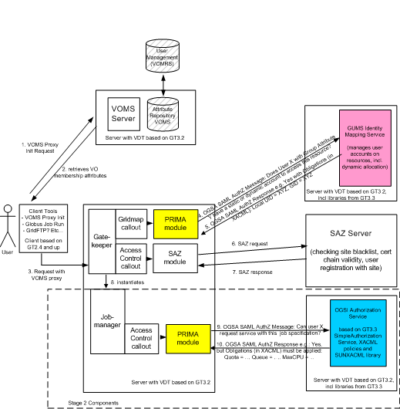
VO Services Architecture
User identity and attributes are maintained in VOMS through VOMRS
Users interact with VOMS to get attribute-enhanced credentials
Gateway software (CE and SE) performs
  identity mapping call-out through the PRIMA module
  access control call-out through the SAZ module
GUMS server maintains identity / attribute mapping for all the gateways at a site
gPlazma server (not shown) enhances UID/GID mapping with service-specific parameters (e.g. root path for SE).
SAZ checks black/white lists
Periodically, GUMS synchronizes with VOMS users/groups
synchronizes

Slide 15
Effort
Name | Expertise | Recent Effort | Projected Effort
Gabriele Garzoglio | PL (Apr 06) | 30% | 30%
Igor Sfiligoi ** | gLexec, PRIMA, GUMS | 50% | 50%
Vikram Andem | PRIMA | 50% | 0%
Tanya Levshina * | VOMRS, Roadmap | 50% | 50%
Valery Sergeev * (Fermigrid) | VOMRS support | 0% | 10%
John Hover (BNL) | GUMS | (20%) | (??) 50%
Jay Packard (BNL) | GUMS | (20%) | 20%
Ted Hesselroth (dCache) | gPlazma | 50% | 10%
John Weigand (CMS) | Testing VDT | 50% | (??) 0%
* VOMRS part of VO Services Since Sep 06 | ** Joined in Sep 06 | 320% | 220%

Slide 16
Challenges 1
Contribution from BNL on GUMS (expected to be at least 20%) has been minor from Apr to Nov 06.
  Most effort in WBS is related to GUMS.
  The issue was raised at the OSG Consortium meeting
  Work seems to have picked up in Nov (BNL has come to FNAL in mid Nov)
  Nominal % FTE for John Hover (BNL) will increase to 50%

Slide 17
Challenges 2
CERN requests for features and VOMS-Admin feature additions entail work in VOMRS. With our current responsibilities, we cannot lower our effort below 40%
Current actions:
  Working with EGEE to
    improve communication between groups
    participate in requirement gathering
  Evaluating how to lower maintenance
    Integrating new technologies (hibernate, workflow engines, shibboleth, …) in VOMRS

Slide 18
Challenges 3
With current effort level, progress on WBS was slow
  Groups are too specialized (e.g. GUMS was maintained only at BNL)
  Some internal disagreements on priorities
Vikram is leaving (was 50%) and Igor just joined (is 50%), BUT
  Vikram was maintaining PRIMA
  Igor needs to maintain PRIMA, gLexec (and “some” GUMS)
With the current effort level it is not clear that we’ll be able to accomplish our mission

Slide 19
Challenges 4
Computing Security and Authorization are fields that evolve rapidly.
  Different groups are integrating new technologies (e.g. Shibboleth) with Grid middleware.
  XACML security model (from OASIS) starts picking up (e.g. new GT4 implementation)
We need to understand how to evolve our infrastructure while service our stakeholders.
We are gathering information to define a Roadmap, meeting with Globus, EGEE, experts, etc.

