Slide 1
LIGO's Evolving Certificate Authority and Account Management Needs
Warren G. Anderson
University of Wisconsin-Milwaukee
LIGO Scientific Collaboration

Slide 2
Outline
Concerns for certificates for LIGO Data Grid (not OSG) users.
Quick revocation (obsolete/done)
Identification of LIGO certificate requests (done)
Automatic coupling of certificates to accounts (LIGO)
Persistent certificates (OSG/LIGO)
LIGO specific infrastructure (OSG/LIGO)
General RA agent issues (OSG)

Slide 3
Quick Revocation (obsolete/done)
LIGO Computing Committee (LCC) requested that LIGO CA have ability for quick (<24 hr) revocation to control account access.
Account control for LIGO data grid should be done at account level, not certificate level.
Immediate revocation available via DOEGrids certificate management web interface.

Slide 4
Identification of LIGO Certificate Requests (done)
In the past, LIGO users have received certificates through non-LIGO iVDGL channels.
  e.g. A LIGO user is at an institution who belongs to iVDGL via CMS/Atlas AND LIGO. User gets certificate through CMS/Atlas channel but wants to use it for LIGO account.
  Nothing wrong with this in principle, but it caused confusion because it was assumed that all iVDGL certs used to apply for LIGO accounts were authenticated through LIGO channels.
LIGO as OSG VO has resolved this issue. We have fixed our scripts, still need to train our users.

Slide 5
Automatic Coupling of Certificates to Accounts (LIGO)
LCC has requested that approval of certificate by LIGO CA automatically invoke creation of accounts without a second user verification step.
This can be implemented in the context of DOEGrids via the script that retrieves the signed certificate from the DOEGrids web interface.

Slide 6
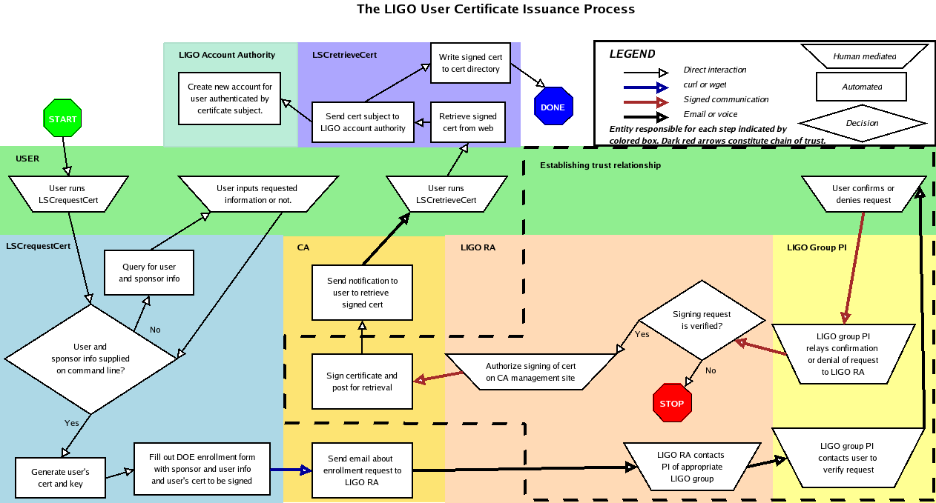
Automatic Coupling of Certificates to Accounts (LIGO)

Slide 7
Persistent Certificates (OSG/LIGO)
LIGO is starting real-time analysis of multiyear data sets.
  As data is acquired, metadata is published at intervals of minutes.
  For each astrophysical search, an instance of the Online Analysis System (onasys) runs continuously, managing data analysis.
  onasys queries metadata at regular intervals (a few minutes to a day) to determine what new data is available.
  Service certificates used for GSI-based query authentication.
  If service certificate (or CA certificate) expires before end of data-taking, data analysis halts until new certificates are acquired.

Slide 8
LIGO Specific Infrastructure (OSG/LIGO)
To reduce confusion at LIGO in dealing with certificates, LIGO requests:
  LIGO specific metadata – LIGO is a distributed effort. LIGO RA's depend on LIGO group PI's to verify user requests for certificates.
    It would be nice if the group PI information input by the user in the certificate request could be transmitted to RA agents.
  LIGO specific retrieval/renewal messages – LIGO has custom scripts for retrieving (LSCretrieveCert) and renewing (LSCrenewCert) certificates.
    We would like to replace DOE generic instructional emails with emails giving urls of our instructions for using our scripts (and DOE serial #).

Slide 9
General RA Agent Issues (OSG)
To aid in RA agent responsibilities:
  VO specific RA emails – Is there anyway that RA agents can be notified of only requests pertaining to certificates for their VO?
  Ability to change request fields – for instance, changing affiliation for users who enter iVDGL instead of OSG:LIGO.
  Certificate management documentation – is there documentation to help RA agents make more efficient use of the web interface, e.g.:
    What is the difference between “reject” and “cancel”?
    Can RA agents use the validity dates fields to grant certificates of longer/future periods of validity (valid for 2 years, or starting next year).

