Slide 1
Progress on WS GRAM Testing …
GT4 Server Resiliency Tests
Scaling tests with Condor-G
  Server performance
  Submit host performance
VO target needs & continuing work
    Thanks to: Suchandra Thapa, Terrence Martin, Stu Martin, …

Slide 2
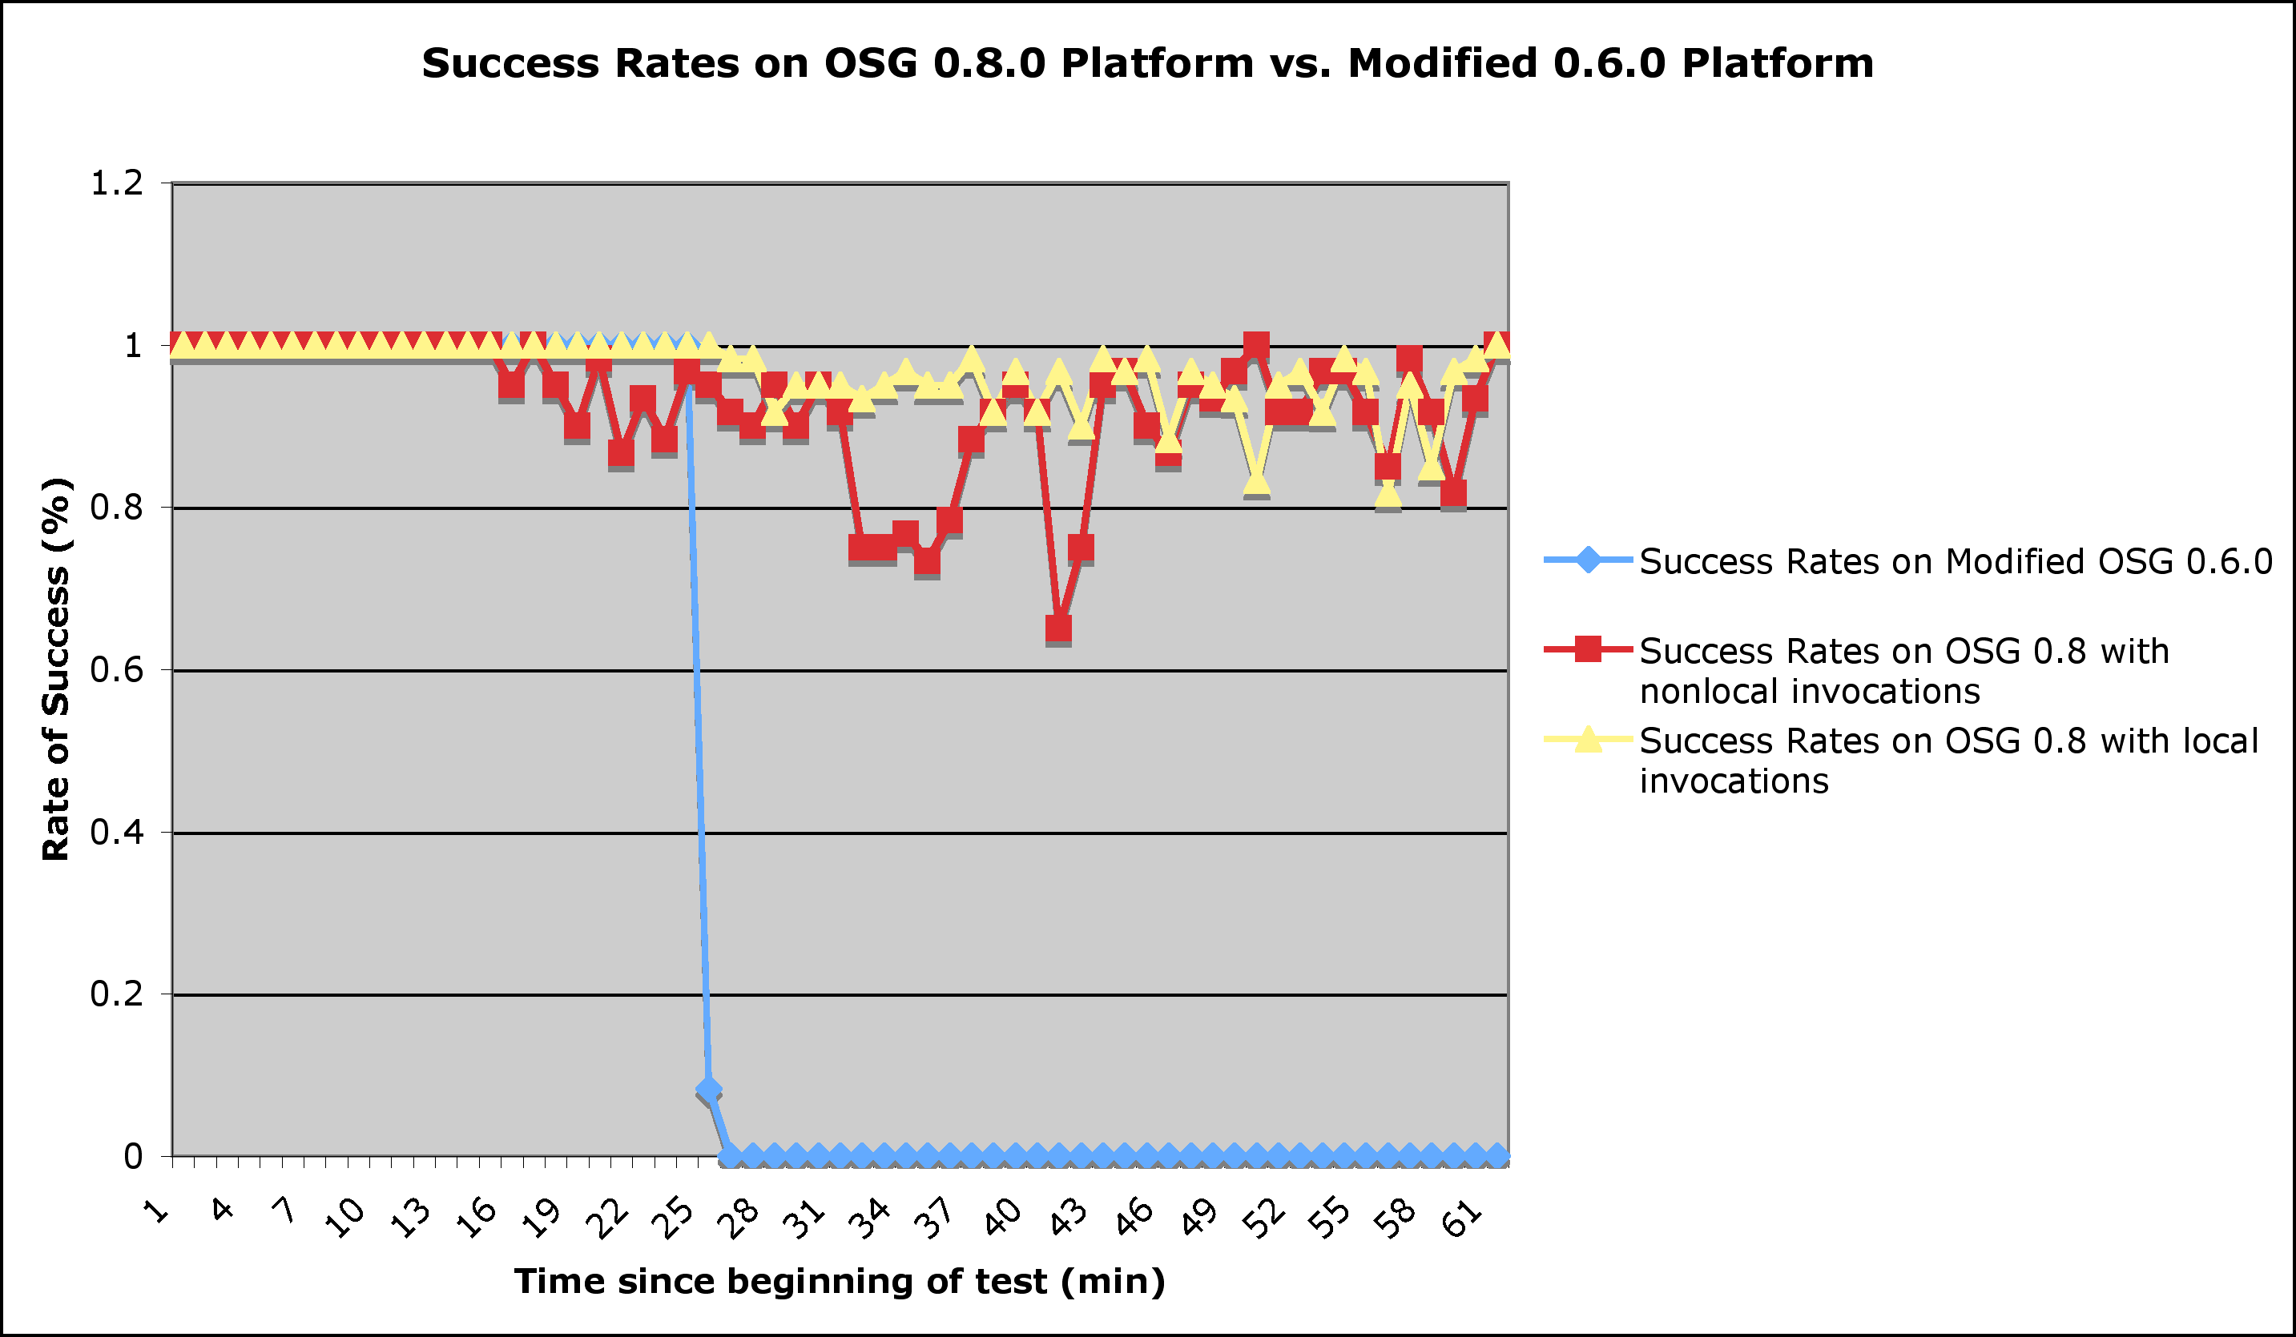
GT4 Server Resiliency Tests
globusrun-ws loop submission
  30s sleep jobs, 1 Hz submit rate for 1 hr
  OSG-0.6 vs OSG-0.8
  w/ local invocations
Observations:
  0.6 crashed, 0.8 remained responsive
  Local invocations improves success rate
  2 Hz submits can kill 0.8 server
globusrun-ws bulk submission
  300-500 jobs submitted at once
  Vary job types w/ & w/o data movement
  Evaluate failure modes for tuning
Observations:
  Server never failed/crashed – but jobs failed
  Increased container & remote gridftp server timeouts → Globus had already changed rec.
  New configurations allowed 500 jobs submitted to small server

Slide 3
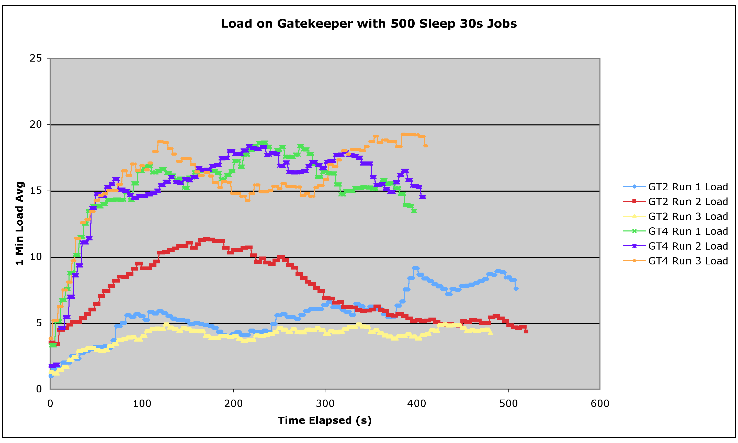
Server Performance with Condor-G
Condor-G submissions
  Simple (sleep) jobs, vary job length
  Monitor loads
  + previous improvements
  Compare directly with GT2
Observations on Server :
  GT4 Container never crashed and remained responsive
  Server loads were modestly (2x-3x) higher with GT4 compared to GT2
    On one test site without NFS lite, GT2 loads were larger
  short (30s) jobs vs long (600s) jobs
    GT4 loads didn’t vary significantly ; GT2 loads dropped slightly with longer jobs
    Individual short jobs took longer with GT4 than GT2; no difference for long jobs
    Throughput appears faster with GT4 than GT2

Slide 4
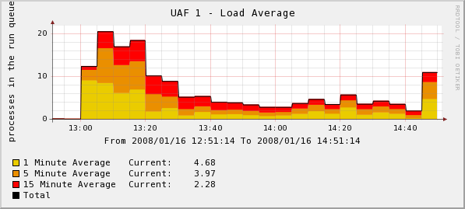
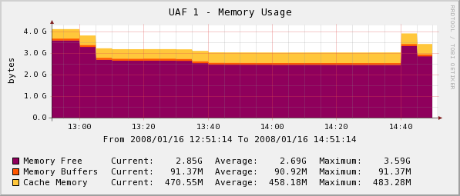
Submit Host Performance w/ Condor-G
Observations on Client :
  Large loads with GT4 not seen with GT2
    Load appears to spike early
  Large memory use with GT4 not seen with GT2
  Submission rates >1k produced job failures/holds at rates of about 2-5%
    Jobs would complete after condor_release
  Failure modes lead to Condor-G tuning → container memory + timeout periods
  Failure modes changed and failure rates were reduced but not eliminated

Slide 5
VO Target Needs and Continuing Efforts
Rough Sketch of VO Production Needs:
  Client to handle ~10k simultaneous jobs on single submit host
  Jobs spread over many servers but server should also be able to handle 5-10k jobs
  >99% success rate from service infrastructure
Our Findings:
  Client limited by load and memory to ~1k simultaneous submissions
  Server was not pushed to its limits in these tests, even at ~4k submissions
  Unacceptable failure/hold rates at client at or above ~1k simultaneous submissions
Continuing Work:
  Globus and Condor Teams working on Condor-G logic to reduce memory and load
  Tests will continue, including greater server stress tests using multiple clients
  Will recommend configuration parameter settings for OSG deployments

