Slide 1
OSG User Group
August 14, 2008

Slide 2
Progress since last meeting
OSG Users meeting at BNL (Jun 16-17)
  Core Discussions on:
    Workload Management; Security and Policy; Storage
    OSG web portal, email lists - new ideas; Troubleshooting
  LIGO presentation on WS-GRAM usage experience.
  ATLAS, CDF, nanoHUB, SBGrid presented on OSG experience.
  OSG Engagement (potential new entrant: NJ State Grid), OSG Education, OSG VO.
  http://indico.fnal.gov/conferenceOtherViews.py?view=standard&confId=1683
‘Site testing package’ for VOs
  Goal is to fill the gap in VO understanding of site capabilities.
  Integration team has expressed interest in using it for rapid ITB validation purposes.
Attempts at Improving Efficiency of Utilization for D0
  Work is in progress. Efficiency improved, but not sustained.
  http://www-d0.fnal.gov/~snow/jobscan/effs.html
Platform for OSG Storage team for advancing ‘Opportunistic Storage’
  Got mandate from USCMS to facilitate deployment on select Tier-2 sites.
  Recommendations provided: http://datagrid.ucsd.edu/opportunistic
  D0 using it in production; CDF, DES, SBGrid, SDSS expected in future.
Activities and Focus Areas in User Group
  https://twiki.grid.iu.edu/twiki/bin/view/UserGroup/WebHome#Activities_Focus_Areas

Slide 3
Progress since last meeting
VO Security and Policy matters
  First ‘VO Security contacts’ meeting organized with Mine/OSG Security, at BNL.
  Input requested by Security and Sites on OSG_APP/etc/grid3-locations.txt
  Informal survey conducted for all Science stakeholders including ATLAS, CMS, LIGO.
  Reports provided to Security, Sites, and Blueprint.
    1: Science Application Software Install, Advertisement and Discovery on OSG Facility: Technical Models in Usage.
    2: grid3-locations.txt and related Security matters.
OSG Technology related matters
  Input requested by GIP team on stakeholder requirements.
    Work is in progress.
    Fermilab-VO/FermiGrid has provided detailed input.
    LIGO has expressed interest in evaluating GIP.
MPI resource Advertisement & Provisioning
  Coordinating effort for Engagement team, with ReSS, GIP, GOC.
  Attribute ‘filter’ deployed by GOC on production OSG.
  Purdue deploying the schema changes with custom attributes.
  Need to engage MPI users to start validating it (Engagement team).
Formal Stakeholder Survey
  Dropped, or stalled. Insufficient input from EB.

Slide 4
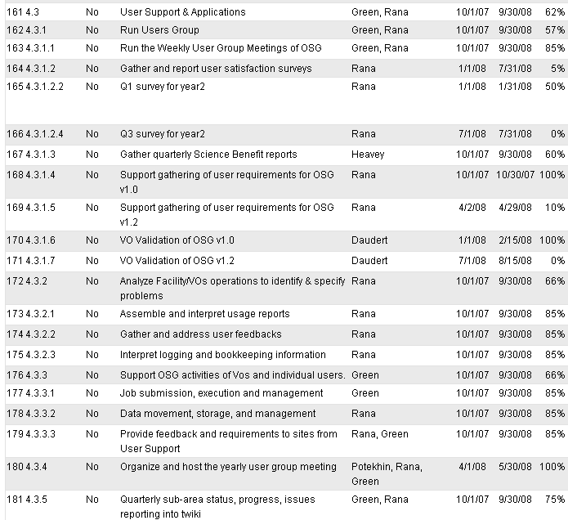
WBS
In lieu, several informal
surveys conducted.

