Slide 1
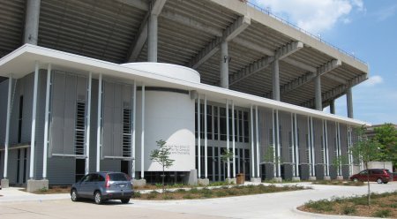
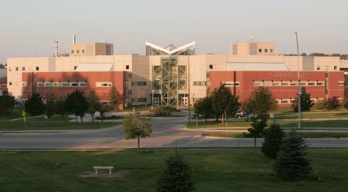
Grid Operations at the
Holland Computing Center
Derek Weitzel & Brian Bockelman

Slide 2
Introduction – HCC
University of Nebraska
Holland Computing Center – 2009
162 Research groups
  Not all are active every day or able to use the grid, but grid provides benefit to a sizeable group.

Slide 3
Introduction – HCC Clusters
Firefly
  5500 cores
  Infiniband interconnect
Prairiefire
  500 Cores
  Infiniband interconnect
CMS T2 – Red
  2100 Cores

Slide 4
Introduction – HCC Grid
8,100 Cores, all opportunistic for grid
HCC’s Use of the Open Science Grid
  13.1 Million hours in 2010
HTC jobs are based on Condor, and exported to OSG using GlideinWMS

Slide 5
HCC Engagement
  Having cores isn’t enough – having users is more important!
  2 Fulltime Application specialists + 1 graduate student (ME).
  Actively seek out on-campus researchers
Goal: Enable Nebraska researchers to run computational science.
  Only one aspect is enabling grid usage.

Slide 6
HCC Engagement
Engagement starts by categorizing users – local or grid?
  MPI or very large data (O(10GB)+) to local machines.
  Single core to Condor and eventually the OSG.
OSG acts as another, sometimes large, cluster in our arsenal._x0010_

Slide 7
HCC Engagement - Jobs
GlideinWMS has been key
  Allows for smooth transition from local resources to OSG.
  Grid problems are handled by OSG factory support.
  Simple debugging for us.

Slide 8
HCC Engagement - Data
Data movement is kept simple, 2 options:
Condor file transfer
  If input or output is less than 10MB, transfer files with the job.
Large files (10MB – 1GB)
  Stage files to Nebraska T2. Each job will pull/push the files using SRM.
  If neither work, the jobs probably should stay on campus.

Slide 9
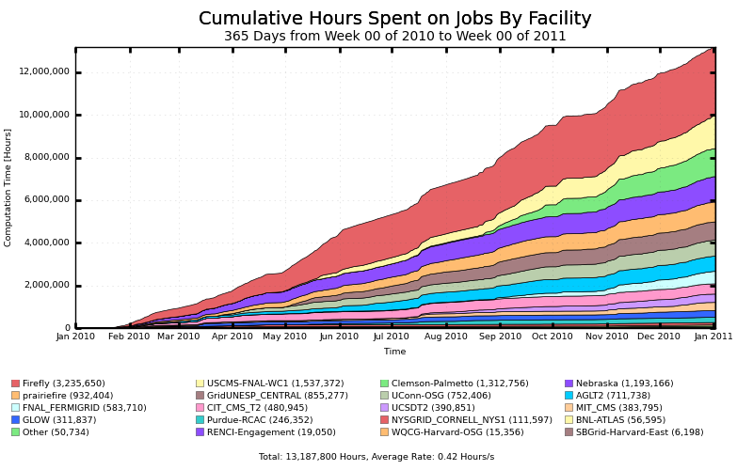
HCC Usage by Site

Slide 10
Building Relationships with Sites
Notice we run on many sites outside our own.
Built partnerships with sites such as MWT2, NERSC, Oklahoma.
  Goal was to enable opportunistic usage of the site.
  We’re the guinea pigs, but get cycles in return.

Slide 11
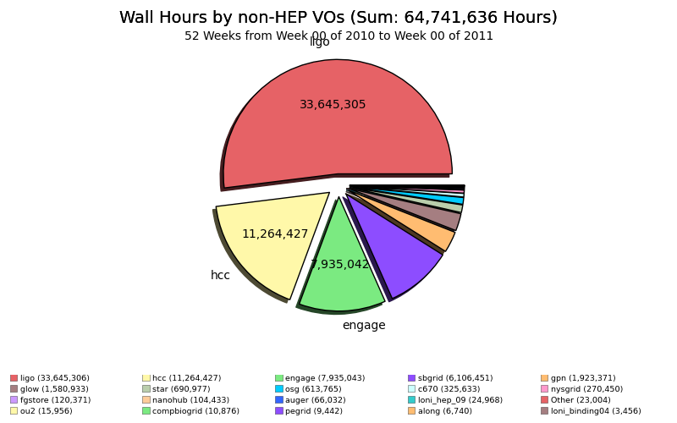
Open Science Non-HEP Grid Usage
GPN = HCC

Slide 12
Take-Home Messages
The grid is a great tool, but know when to not use it.
Local Engagement.
GlideinWMS.
Build relationships with sites.

