Slide 1
What’s Different About Overlay Systems?
Brian Lin
OSG Software Team
University of Wisconsin - Madison
blin@cs.wisc.edu

Slide 2
Overlay Systems are Awesome!
Free resources when you need them? With the OSG doing the hard work? Yes, please!

Slide 3
What’s the Catch?
Requires more infrastructure, software, set-up, management, troubleshooting...

Slide 4
“You know you have a distributed system when the crash of a computer you’ve never heard of stops you from getting any work done.” - Leslie Lamport

Slide 5
i.
Heterogenous Resources
Accounting for differences between the OSG and your local cluster

Slide 6
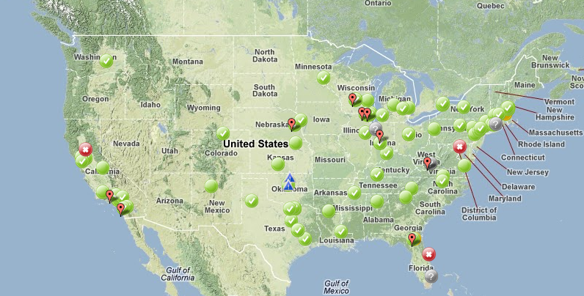
Sites of the OSG
Source: https://hcc-docs.unl.edu/display/HCCDOC/HTCondor+on+the+OSG

Slide 7
Heterogeneous Resources — Software
Different operating systems (all Red Hat based)
Varying software versions
Varying software availability
Solution: Make your jobs more portable (more in Wednesday’s talks)

Slide 8
Heterogeneous Resources — Hardware
CPU: Mostly single core
RAM: Mostly < 8GB
Disk: No shared file system (more in Thursday’s talks)
Solution: Split up your workflow to make your jobs more high throughput

Slide 9
ii.
Slower Ramp Up
Leasing resources takes time!

Slide 10
Slower Ramp Up
Adding slots: pilot process in the OSG vs slots already in your local pool
Not a lot of time compared to most job runtimes
Small trade-off for increased availability

Slide 11
iii.
With Great Power Comes Great Responsibility
How to be a good netizen

Slide 12
Resources That You Don’t Own
Primary resource owners can kick you off for any reason
No local sys admins
No sensitive data (e.g. HIPAA)

Slide 13
Be a Good Citizen!
Use of shared resources is a privilege
Only use the resources that you request
Be nice to your submit nodes
Solution: Test jobs locally and when you’re done test them some more

Slide 14
Credits
Special thanks to all the people who made and released these awesome resources for free:
Presentation template by SlidesCarnival
Photographs by Unsplash & Death to the Stock Photo (license)

Slide 15
Thanks!
Any questions?

