Slide 1
Partnerships & Interoperability -
SciDAC Centers, Campus Grids, TeraGrid, EGEE, NorduGrid,DISUN
Ruth Pordes
Fermilab
Open Science Grid Joint Oversight Team Meeting
February 20th 2007
(note _ means there is a link to OSG information on the web)

Slide 2
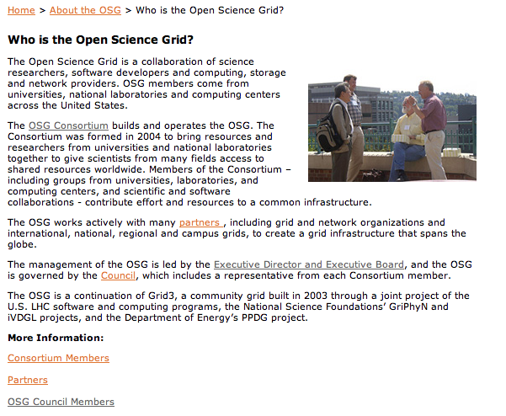
Who is the Open Science Grid ?

Slide 3
Setting the Scene:
Members, Partnership, External Projects
OSG Consortium Membership occurs through completed registration of a resource, VO, or other organization with the OSG through the Operations Registration process. OSG Consortium Members contribute to and/or benefit directly from the resources, use, operations and/ or other activities of the OSG.
OSG Consortium Partners collaborate with the OSG as peer organizations. Their representatives have ex-officio status on any of the management boards in which they participate. The OSG Executive Board develops agreements with the management of the partner organizations to define the expectations and activities of the collaboration. OSG by-laws (proposed) Dec 2007
To extend the capacity and capability of the OSG infrastructure we depend crucially on a mix of effort that is internal and external to the OSG. As internal, we refer to effort that is directly under the fiscal control of the Executive Team. External effort is generally embedded into organizations whose scope extends well beyond the OSG, …These contributions are organized as part of the OSG program of work via the set of projects, with the list of projects changing over time. Each project has a member on the Executive Board, participating as part of the management of the overall OSG program of work. OSG Management Plan (proposed) May 2006

Slide 4
External Projects, Feb 2007
Members of the Executive Board including External Projects
Community Driven Improvement of Globus Software (CDIGS)/Globus | Dan Fraser
Center for Enabling Distributed Petascale Science (CEDPS) | Jenny Schopf
Condor | Todd Tannenbaum
SRM/dCache | Patrick Fuhrmann
Data Intensive Science University Network(DISUN) | Frank Würthwein
Disk Resource Manager (DRM) | Alex Sim
(LIGO) Physics and the Information Frontier | Patrick Brady
OSG Accounting | Philippe Canal
OSG Privilege/Authorization | Gabriele Garzoglio
Security for Open Science (TBA) | Deb Agarwal
UltraLight/advanced networks | Frank Lingen
U.S. LHC + US representation to the WLCG | Michael Ernst, Ian Fisk,
Member of OSG management team also part of management of the External Project

Slide 5
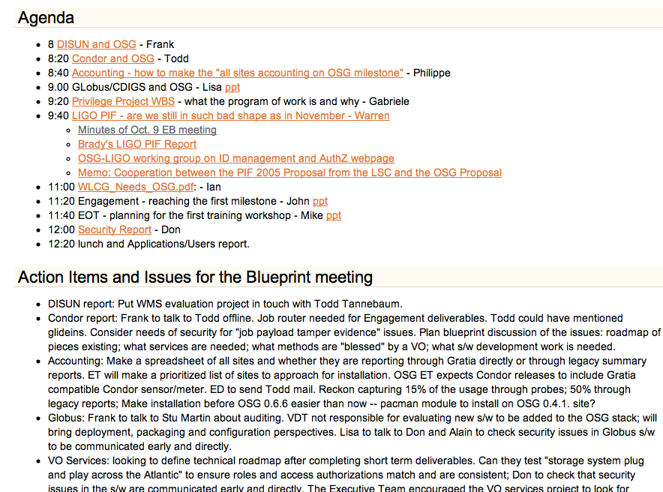
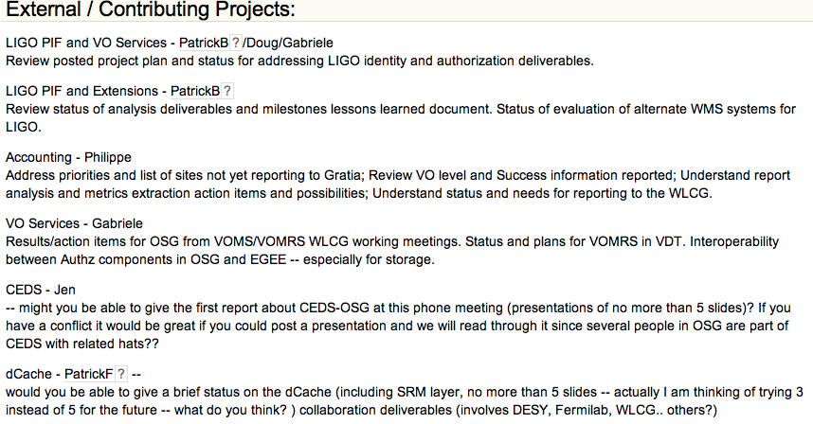
External Projects on the Executive Board
Every six weeks. Offline followup afterwards:
Dec 14: Caltech
Feb 15: phone/video
April 25 is the next one.
Action item from Feb 15: Write up OSG requirements for CEDPS deliverables
for the project meetings in March.

Slide 6
Collaboration with SciDAC Centers - CEPDS
Overlap in management people: Ian Foster, Miron, Don Petravick
3 areas of CEDPS work all needed by OSG stakeholders and facility.
  Data Area: Managed Object Placement Service (MOPS: Likely to be of use to small OSG VOs;
  Troubleshooting: OSG requirements are part of CEDPS planning; Weekly interaction between OSG and CEDPS teams.
  Scalable Services: CMS and STAR both already working with Globus workspaces/Virtual Environments team.
Early deployments/ testing planned on OSG Integration Testbed.

Slide 7
Other Centers and Institutes:
Petascale data storage: NFS V4/dCache connection already in place.
Performance Enhancement: already working with HEP accelerator modelling; potential for US LHC frameworks/codes?
Chemistry/UC Davis: interested in first Joint Campus Cyberinfrastructure (CI) day.
Scientific Data Management SDM:

Slide 8
3 SciDAC Grid Projects planning closer cooperation: Earth System Grid (ESG), CEDPS, OSG
Met between projects & with ASCR, HEP at SciDAC kickoff meeting.
Joint position paper in progress.
Plan follow up meeting at OSG all hands & then propose visit to Washington to discuss.
Initial technical work:
  Access ESG data from OSG site;
  ESG become OSG VO?
  Planning for MOPS deliverables.

Slide 9
DISUN
DISUN is a well integrated external project with shared people.
US CMS do advance testing and validation on their Community Grid - targetted towards OSG and the general case.
Technical Work documented in DISUN semi-annual report and OSG status report are examples of joint work:
  Job submission and execution (processing head-node) performance and robustness.
  LIGO-OSG analysis deliverables.
  DISUN centrally maintains CMS application software installations on all of OSG.

Slide 10
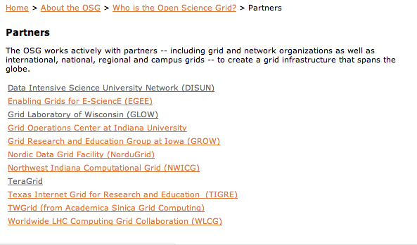
Partnerships, Feb 2007
Agreements.
  One in place: NWICG.
  2 more in progress: Australian Partnership for Advanced Computing (APAC); New York State Grid (NYSGrid)

Slide 11
Partnership with EGEE
OSG-EGEE are partners delivering to the WLCG requirements and schedule.
OSG-EGEE are peer distributed infrastructures supporting many communities:
  Common architectural model with “VOs” as an important tier.
  EGEE dependent on OSG - common underlying middleware supplied by VDT.
  OSG dependent on EGEE - many VDT components are from EGEE.
Current activities:
  VDT representation at EGEE Middleware Testbed (EMT) meetings to communicate issues in both directions.
  WLCG storage, VO and monitoring working groups.
  membership of gLite design team (EGEE blueprint group).
  Middleware Security Working Group joint meeting before OSG all hands.
  Joint weekly operations meetings
Current deliverables: New Grid Site Agreement; Deployment of CEMON information service on OSG.

Slide 12
Collaboration with Nordic Data Grid Facility (NDGF)
Interoperable/common Service Discovery & Information Schema.
Testing of job and data transport.
NDGF now part of dCache collaboration, developing software with DESY and Fermilab.
IceCube collaboration plans only just now starting to get more concrete.

Slide 13
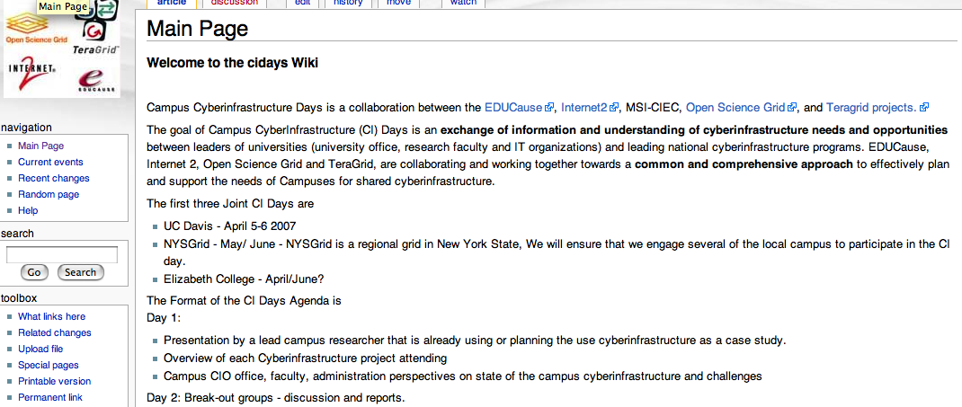
Partnership with TeraGrid
Management meetings: In fall 2006 weekly phone meetings to develop aligned strategies for Campus’, software, education.
Software Stacks: moving towards common packaging/releases of Condor, Globus, MyProxy etc. Pacman used by both OSG and TeraGrid for software packaging and distribution.
Campus Cyberinfrastructure days: Joint Educause, Internet2, OSG, TeraGrid visits to interested Campus’, sponsored by CIOs.

Slide 14
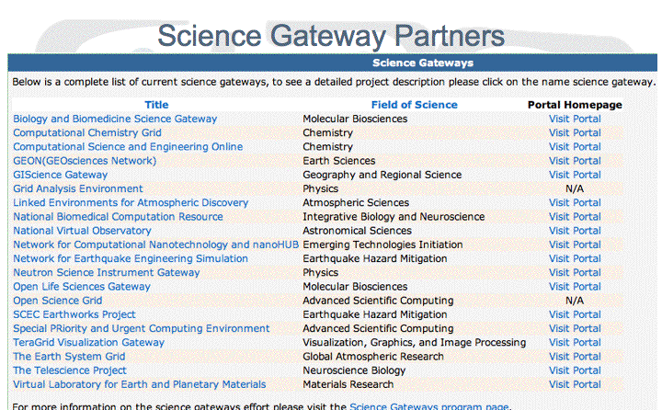
TeraGrid Science Gateways

Slide 15

Partnerships with Campus Grids
Community
OSG:
An integrating framework:
Supporting end-to-end applications across multiple infrastructures; training, education, documentation etc.
Campus
National

Slide 16
Federated Model: Adaptors and Bridges
VO or User that acts across grids
OSG
A(nother)
Grid
e.g. FermiGrid
Interface to
Service-X
Service-X
Adaptor between
OSG-X and AGrid-X
Service-X

Slide 17
Campus Grid Collaborations
Grid Laboratory Of Wisconsin (GLOW): Locally submitted jobs automatically “uploaded” to remote OSG resources.
FermiGrid: Single OSG gateway then schedules jobs/data across distributed local resources.
Purdue: TeraGrid, OSG, Local gateways to common set of computing resources.

Slide 18
Grid Interoperability Now (GIN)
Joint initiative of 9 grids now under Open Grid Forum (OGF). Most activities seem to be “single point test”.
OSG SRM Tester used to demonstrate ongoing storage service interoperability.
OSG contributions mainly with applications:
  OSG <-> EGEE demonstrated by LHC, D0:
  OSG <-> Pragma applications in test at UCSD, Fermilab.
  OSG <-> NDGF waiting for a driving application (expect it to be IceCube)
  OSG <-> TeraGrid:
    currently done through the science gateway portals.
    Working towards common Client package for Campus’.

