Slide 1
Joining OSG
Suchandra Thapa
Computation Institute
University of Chicago

Slide 2
Introduction to OSG
Introduction to OSG
Joining as an user
Joining as a site
Joining as a VO
Q&A time

Slide 3
Introduction to OSG
OSG stands for Open Science Grid
Provides high-throughput computing across US
Currently more than 75 sites
Recent stats:
282,912 jobs for 433,051 hours
Used 75 sites
Jobs by ~20 different virtual organizations
92% of jobs succeeded
Underestimate: 4 sites didn’t report anything
Provides opportunistic computing for VOs
Focus on high-throughput computing rather than high performance computing

Slide 4
Overriding principle: Autonomy
Sites and VOs are autonomous
Admins are free to make decisions about site
OSG provides software and recommendations about configuration
Admins are allowed to decided when and if to upgrade
Admins are responsible for site but OSG provides operational support
VOs run and maintain own membership lists (on VOMS server)

Slide 5
Joining OSG as an user
Introduction to OSG
Joining as an user
Joining as a site
Joining as a VO
Q&A time

Slide 6
Starting out
Everyone using OSG gets a personal certificate because it is required to do any activity on an OSG resource
Will need to know or contact someone with DOEGrids certificate in order to obtain a personal certificate
As a new user, you can contact the engage team to get assistance with obtaining a personal certificate and in getting started in OSG

Slide 7
Two Types of New Users
Users coming in as a member of an existing VO
VOs have existing infrastructure and support centers to help
VO will help in getting started: applications, data sets, etc.
Users coming in as a completely new user
Will typically come join through the auspices of the engage VO

Slide 8
Completely new users
Will typically become members of the engage VO
The Engage team will provide assistance with:
Getting applications and workflows running on OSG
An existing framework to help with selecting resources
Contacts to software providers that can help with moving forward (getting resources on the OSG, becoming a VO)

Slide 9
Issues that may arise
Getting jobs running on the grid is difficult:
Grids are still being worked on so things may break
No logins so troubleshooting is difficult
Sites may go down, sites may have misconfigurations that affect you
The grid paradigm is not for everyone
Jobs should be relatively independent
Large MPI type jobs not really suitable
Jobs should have fairly low overhead in relation to computation time

Slide 10
Getting Further Assistance
Contact engage team (engage-team@opensciencegrid.org)
John McGee
Mats Rynge (rynge@renci.org)
Other local engage contact
osg users mailing list
osg-users@opensciencegrid.org

Slide 11
Joining OSG as a Site
Introduction to OSG
Joining as an user
Joining as a site
Joining as a VO
Q&A time

Slide 12
Your role as an admin
As a site admin, you should:
Keep in touch with OSG (downtime, security, etc.)
Respond to trouble tickets or inquiries from GOC
Plan your site’s layout
Update software as needed (within limits)
Participate and be a good community member

Slide 13
Support provided for admins
OSG provides:
Software and ancillary information (configuration tools, documentation, recommendations)
Assistance in keeping site running smoothly
Help in troubleshooting and installing software
Users for your site

Slide 14
Site Registration using OIM
Done using OIM at https://oim.grid.iu.edu/
Will need to register first,
After GOC approves registration :
Registrations > Resources > Add New Resource

Slide 15
Site Operations Policy: how to be a good citizen
https://osg-docdb.opensciencegrid.org:440/cgi-bin/RetrieveFile?docid=676,
Must support at least one VO: MIS
We are doing drills, tests are coming up – not perfect but getting there
Update your gums template
Let us know if you suspend a VO
Apply security patches announced asap
Let us know if you cannot
Make sure published site info is accurate

Slide 16
Policies
Site Registration Database
OSG Information Management – site manager, site security, site operations, site incident response
Names, email, address, phone
Old stale info needs to be uptaded
OIM is maintained at GOC
We currently check once year, but will the frequency increase once OIM sends automated emails

Slide 17
Further Assistance
osg-sites@opensciencegrid.org mailing list
Weekly operations teleconference:
Operations Group Meetings are held on each Monday at 1PM EST/EDT. Phone: +1 510 665-5437 ID: 786999
Campfire chat:
http://integrationcloud.campfirenow.com/6e62e
Grid operations center
http://www.grid.iu.edu/
goc@opensciencegrid.org
+1 317-278-9699

Slide 18
Joining as a VO
Introduction to OSG
Joining as an user
Joining as a site
Joining as a VO
Q&A time

Slide 19
OSG Organization: Virtual Organizations (VO)
OSG is organized by Virtual Organizations
A VO allows members of a collaboration or group to retain that same grouping on the OSG
Each VO has different policies as to group membership and runs a VOMS server to track membership
VOs are typically the owner of the various resources found on the OSG

Slide 20
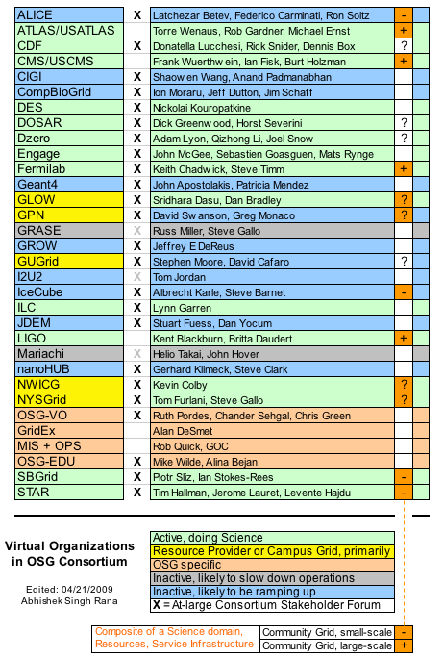
VOs on OSG
Some of the VOs currently running on OSG

Slide 21
VO Requirements
Need to have a VO Support Center to provide support for VO members
Need to provide a VOMS server to allow resources to get information on VO membership
You must communicate your minimal group/role-to-privilege requirements to the Grid Operations Center (GOC) in order for the appropriate privileges to be honored
Need to register VO with GOC using OIM

Slide 22
What OSG expects from a Support Center
Register your Support Center with OSG.
Join the osg-operations@opensciencegrid.org mailing list. (Instructions)
Send a representative to the weekly operations telephone conference call . Ops Meeting Notes and Agendas
Add information or links to VO specific information page? to document your support-related policies and practices for your users
Create an account on the Footprints OSG ticket system. (Optional)
Respond to problem reports or problems identified by the Grid Operations Center and assigned to you for resolution.
Track your problems in the Footprints ticket system.

Slide 23
VOMS Server
Need a voms server to host and manage VO membership list
GOC may be able to host VOMS server initially
Fairly low resources needed
Can use a VM
Will need one or more VO admins to approve VO membership requests and personal certificate requests

Slide 24
VO Input
Through VO representatives, VOs can participate following areas:
Provide feedback on software available in the default OSG software stacks
Participate in validation of new software releases
Provide feedback and requests for incorporation of new features and capabilities that resources should provide (mpi support/advertisement, opportunistic storage, etc.)

Slide 25
Further Assistance
Weekly forum:
Thursdays 1:30 PM Central, Phone: 510-665-5437, ID: 1111
Email list:
osg-vo-forum@opensciencegrid.org
VO Representatives
Abhishek Rana (rana@fnal.gov)
Britta Daudert (bdaudert@ligo.caltech.edu)
Chris Green (greenc@fnal.gov)

Slide 26
Q&A Time
Joining as an user
Joining as a site
Joining as a VO
Q&A time

Slide 27
Acknowledgements
Alain Roy
Terrence Martin

