Slide 1
OSG Area Coordinators
Network Monitoring Update: June 14, 2017
Shawn McKee

Slide 2
OSG Network Services Update
Since the last meeting ALL VMs running OSG network services have been updated to use the most recent perfSONAR v4 RPMs
The postgresql DB (part of ESmond) was also updated to use 9.6 instead of 9.4
No significant issues discovered and all services are running well after the update.

Slide 3
Virtualization Resource Balancing
Once all VMs were update in terms of software we let them run for a few days to get a baseline of resource use
We had a number of cases where we had mismatches in CPU or RAM for VMs.
Fortunately it was roughly balanced so that systems need more CPUs could use the ones released from others and similarly for memory.
The check_mk monitoring was really important for identifying the right resource requirements
One small tweak (adding back some “stolen” memory) was needed on a couple VMs
System now seems balanced for the current workload
Have to watch over time and adjust as required.

Slide 4
Updating Documentation
Our existing documentation at https://twiki.opensciencegrid.org/bin/view/Documentation/NetworkingInOSG needs:
Streamlining
Updating for v4.0
Migration to GitHub? (What is the new location?)
The perfSONAR developers provide excellent documentation on installation and configuration of perfSONAR
We need to point to that and provide details on the few specific things we need to worry about for OSG/WLCG installations
Firewalls configured allowing our access to the data
Configuration for auto-mesh and information about MCA
Information about OSG network services
Information about OSG and WLCG support
Timeline: STILL guessing about 2 weeks to get to final version once things settle down.
This work has been lagging because of other issues; waiting for other work to converge and gaining some feedback/experience on v4.0 so documentation reflects identified “best practices”

Slide 5
Hardware Update / Data loss
Since the beginning of the year we have been waiting to update the storage (disks) in use for the network datastore
8TB replacements for 4TB disks have been on-hand for months
At the end of April we attempted to do incremental updates to RAID-10 (4-disk) sections of the hardware
PROBLEM: VMs running Postgresql and Cassandra were not shutdown while the storage was changed and we lost/corrupted the postgres DB
Attempted recovery (3 days of work) only recovered 5-7% of the Postgres metadata.
Consulted experts but nothing to be done
Cassandra retained all the data but “index” for it missing in postgres
Two changes: Postgresql DB should now have daily backups (need to confirm this is in place with Scott) and future procedures will shutdown VMs if their storage is modified

Slide 6
OSG Network Data Distribution
Since early May our OSG network data is also being replicated to FNAL where it goes to tape (a little late to help with the data loss but great to have for the future)
Given that many perfSONAR nodes have local copies of data for up to 1-year, Edgar is also running “long-term” query out to toolkits to capture any data still available.
Updates to production perfSONAR RSV yesterday now support posting data to CERN’s ActiveMQ, the OSG RabbitMQ (goes to FNAL) and to ESmond
Concern: may need to modify how RSV perfSONAR probe gathers data. Need to do “small” requests or risk time-outs when gathering a large time-span of data
Have issue with FNAL perfSONAR (psonar3/4.fnal.gov) that needs debugging: psetf can get data but psds0 (RSV) can’t

Slide 7
Standalone Mesh-config (MCA)
We (OSG networking/Soichi) have finally finished the standalone mesh config administrator (GUI)!
As of May 31, 2017 the code and responsibility for maintenance and future upgrades was give to the perfSONAR developers team.
Documentation at http://docs.perfsonar.net/mca and at https://github.com/soichih/meshconfig-admin
Issues tracked at https://github.com/soichih/meshconfig-admin/issues (14 open, 17 closed)
OSG ITB instance running at https://meshconfig-itb.grid.iu.edu/ (create an account to play with this)
Production instance is operational https://meshconfig.grid.iu.edu/
Old URLs using my
Some small issues (see issue tracker) but it is working well

Slide 8
Updated Net Service Monitoring
We have been using OMD/Check_mk to monitor both perfSONAR services and host status.
WLCG has built an improved system (ETF=Experiments Testing Framework) which we have leveraged to create a perfSONAR specific implementation of.
It is distributed as a Docker image and requires a CentOS 7.x base OS with Docker to use.
We requested a new VM (psetf.grid.iu.edu) and ‘root’ access for Marian and I
We deployed Marian’s etf_ps docker instance and tested and tweaked
Once working we requested the psomd.grid.iu.edu DNS alias be switched to psetf.grid.iu.edu from perfsonar1.grid.iu.edu
We then had Tom shutdown perfsonar1.grid.iu.edu (we want to keep the VM image for 6 months in case we need any data off from it)
Have a look https://psomd.grid.iu.edu/etf/check_mk/
NOTE: Apache redirect requested for (ticket #34087) https://psomd.grid.iu.edu/WLCGperfSONAR/check_mk but not yet in place
Docs and details at: https://gitlab.cern.ch/etf/docker/blob/master/README.md

Slide 9
Network Alerting Reminder
We have a longer term goal of alerting and alarming on network issues.
Milestone completed: technical design of a suitable analysis system based upon existing time-series technologies
Current operating implementation gathers all perfSONAR data OSG sends to CERN and puts it in ElasticSearch.
Jupyter instance regularly runs cron tasks to analyze data
Anyone can subscribe to simple alert-emails.
http://tiny.cc/RegATLASAlarm
Needs “tuning” of text and user-interface for end-user use.

Slide 10
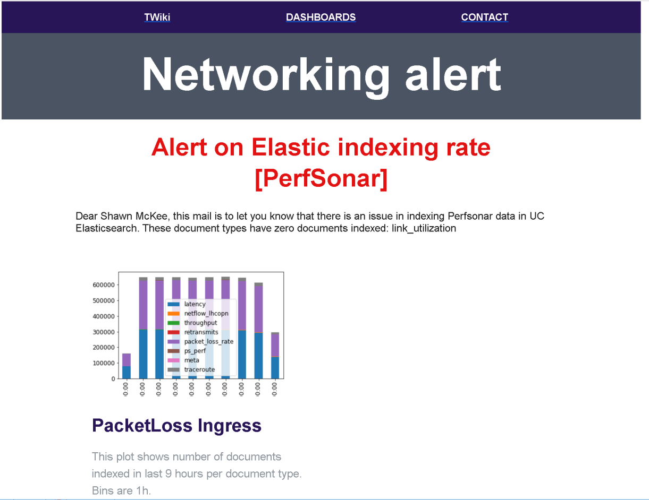
Current Example Alerting Email
Last time I showed an text example email
We updated the format:
Working to customize by alert type

Slide 11
Network Analytics
Because our perfSONAR data is published to CERN and gets to the U Chicago Elasticsearch analytics platform we have a number of nice dashboards constructed to see the (meta)data
In the next few slides I will flip through a few of them showing what we currently have
The dashboards are only available right now on development systems (hidden behind user/pw credentials) but we are working to publish (readonly) versions of them for general use

Slide 12
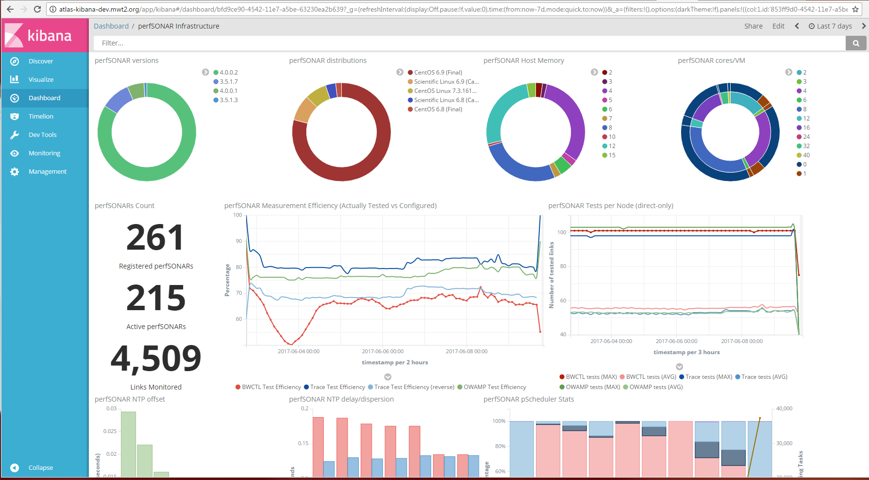
Kibana perfSONAR Infrastructure

Slide 13
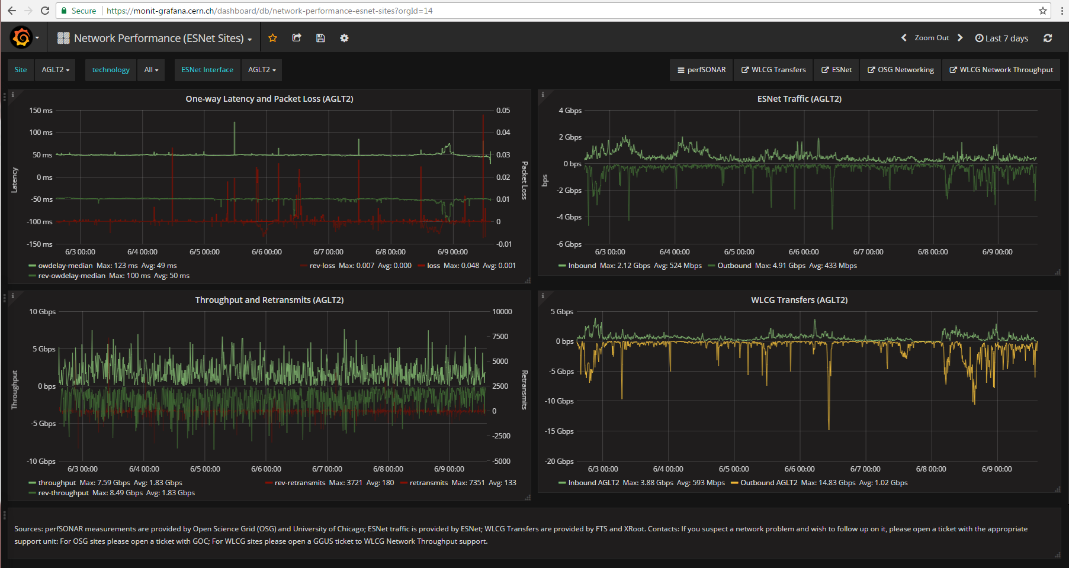
Grafana Dashboard (ESnet sites)

Slide 14
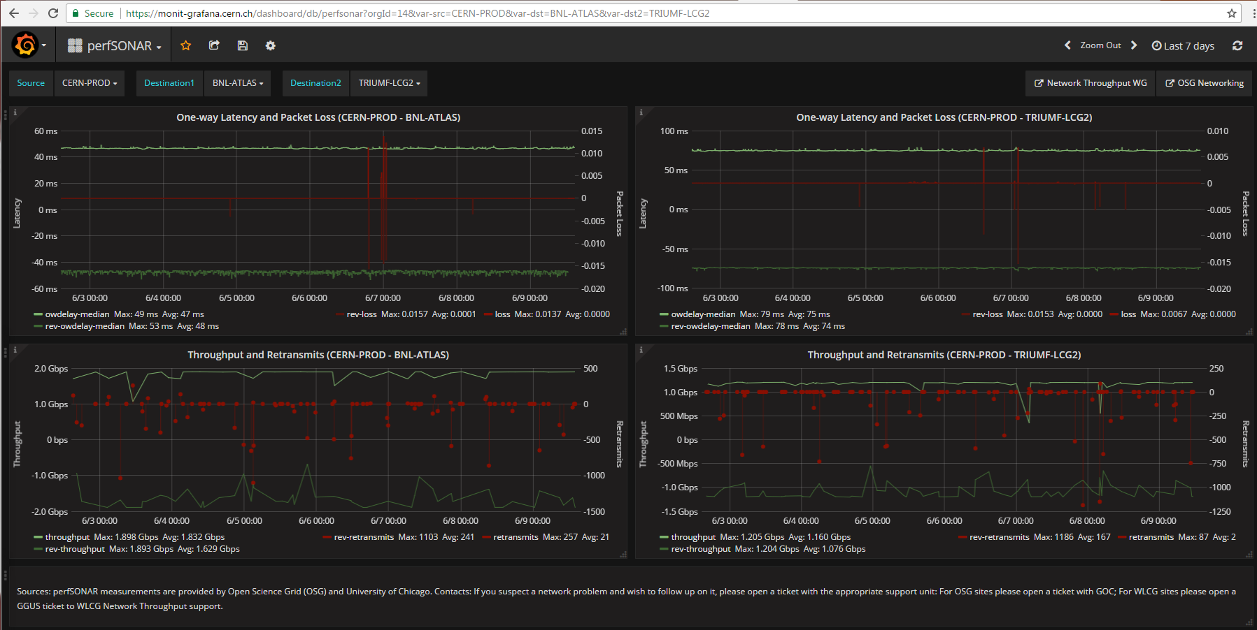
Grafana (Site to 2 Destinations) (CERN to BNL and TRIUMF)

Slide 15
Concerns
While we have made very good progress in updating things there is still much to do
Need updated documentation reflecting the right best practices
Need to include public version of dashboards
Must recruit additional non-WLCG sites using our developing capabilities as a “carrot”
Some services need minor fixes (perfSONAR RSV, MCA) and host admins may need to do some work to fix toolkit issues we are seeing with their sites

Slide 16
Questions or Comments?
Thanks!

Slide 17
URLs for Reference
OSG Network Datastore Documents
Operations https://docs.google.com/document/d/1l144BSo-88M0cLMMjKcKMIE-Q5s21X-w3lYl-0Pn_08/edit#
SLA https://twiki.grid.iu.edu/bin/view/Operations/PSServiceLevelAgreement
Data lifecycle https://docs.google.com/document/d/1mJ1kf43nZf6gvKoNtiTOc0g0MYDv_wSfSm7YdiMs3Lo/edit#
Current OSG network documentation https://www.opensciencegrid.org/bin/view/Documentation/NetworkingInOSG
OSG networking year-5 goals and milestones: https://docs.google.com/document/d/1FzmXZinO4Pb8NAfd5SWUzaAFYOL23dt66hQsDmaP-WI/edit
perfSONAR adoption tracking: http://grid-monitoring.cern.ch/perfsonar_coverage.txt
Deployment documentation for both OSG and WLCG hosted in OSG (migrated from CERN)
https://twiki.opensciencegrid.org/bin/view/Documentation/DeployperfSONAR
ATLAS Analytics:
Packet-loss: http://tiny.cc/PktLossNoUnknown (6 month view)
perfSONAR dashboard: http://tiny.cc/pSDash
perfSONAR link details: http://tiny.cc/pSLink
Mesh-config in OSG https://meshconfig.grid.iu.edu/
Pre-Production Meshconfig https://meshconfig-itb.grid.iu.edu/
perfSONAR homepage: http://www.perfsonar.net/

