Slide 1
The OSG Stakeholders’ Request System Oct 9, 2012
Gabriele Garzoglio
for the Project Office

Slide 2
Goals of the System
Record and track requests from the OSG stakeholders (communities, internal offices, etc.) and provide updates to the requesters.
Inform and influence the OSG project – All requests are discussed by the area coordinators and project office.
Define a process for the area coordinators and the project office to follow up on requests.
Generate discussion about “red flags” (delays, conflicts, priorities, …) for the project office and the ET
Provide statistics and insight on community interests
Council members are encouraged to create requests for their communities / sites / projects on the web or via a GOC ticket.

Slide 3
Request Handling Process
Any stakeholder (or designee) can enter a request in the system
Requests are discussed weekly at the area coordinators’ meeting
All new requests are discussed among AC and project office for acceptance / assignment.
AC takes decisions by consensus
“accept” / “reject” new requests
“cancel” / mark as “delivered” existing requests
AC inform ET of decisions. Requesters can appeal the decisions to the ET.
An accepted request generally spawns additional linked working items for the area coordinators’ project tracking systems

Slide 4
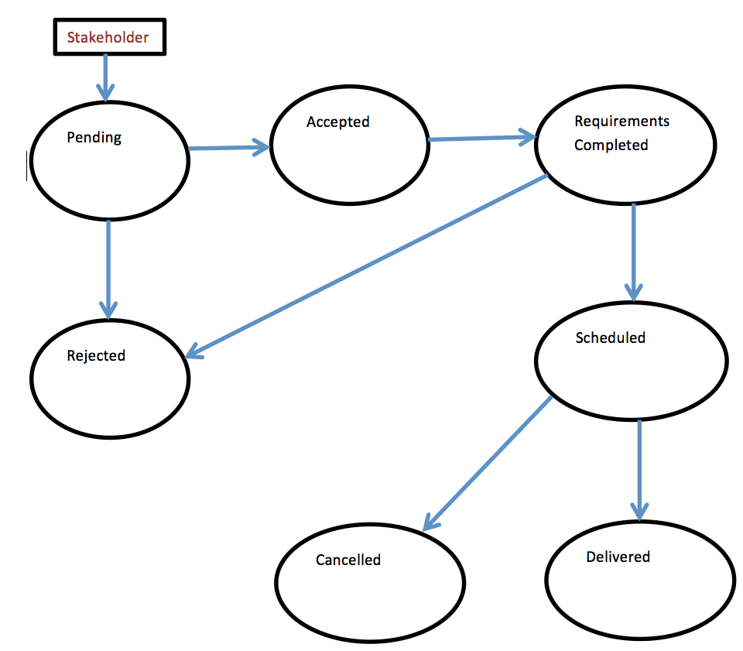
Request attributes and workflow
REQUEST ATTRIBUTES
Summary / Description
Requester / Requester VO(s)
Responsible OSG member / Assignee
OSG Functional Area (Software, Tech., …)
Requirement URL
Schedule URL / Due date
Status / Workflow

Slide 5
Implementation: OSG JIRA
JIRA Project: “Stakeholder Requests”
Requests are tickets
Requester can “watch” them
Provide automatic triggers / filters to generate the agenda for the AC meeting
Allows creation of a dashboard to keep track of request status (“Accepted older then 8 wks”, “’Complete Requirements’ unchanged for 1 month”, “Due in 4 wks / past due”, “Pending”, …)
To create a request…
Open a GOC ticket to get a JIRA account
Email: goc@opensciencegrid.org | Wed: http://ticket.grid.iu.edu/goc/submit
Log on JIRA at http://jira.opensciencegrid.org/browse/REQUESTS
Click create “Request” (top-right)
Definitions: https://osg-docdb.opensciencegrid.org:440/cgi-bin/ShowDocument?docid=1061
Request system: http://jira.opensciencegrid.org/secure/Dashboard.jspa?selectPageId=10030

Slide 6
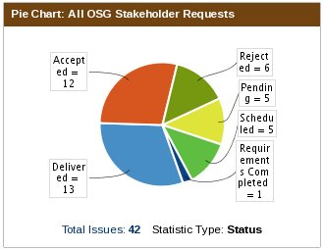
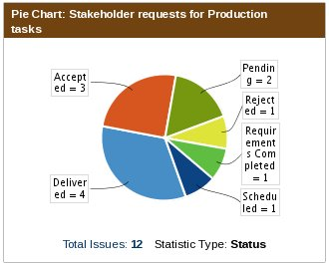
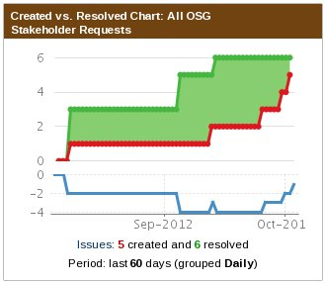
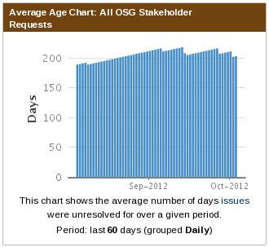
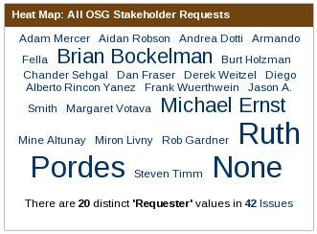
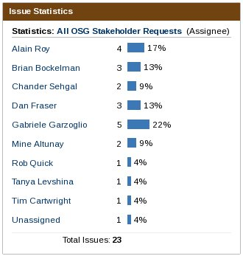
Statistics
Acknowledgments: Rob Gardner – Stakeholders Request Assessment http://jira.opensciencegrid.org/secure/Dashboard.jspa?selectPageId=10340

