Slide 1
Just-in-time WMS Meeting – March 9th, 2007
Glidein Factory Monitoring
by Igor Sfiligoi

Slide 2
glideinWMS overview
Job Schedd
Job Schedd
Grid site
Glidein Factory
Submit glideins
Job Schedd
VO frontend
Publish available
glidein entries
Grid site
Job Schedd
Request glideins
Submit glideins
Submit
glideins
Publish available
glidein entries
Glidein Factory
Grid site
VO frontend
Request glideins
Collector
Submit glideins
Request
glideins
Publish available
glidein entries
Grid site
VO frontend
Glidein Factory
Submit glideins
Submit glideins
Grid site
Grid site
Job Schedd
Job Schedd

Slide 3
Glidein Factory internals
Many Entry Points x Glidein Factory
  Many frontend requests x Entry Point
Frontend requests
Frontend requests
Frontend requests
Collector
Entry Point Ad
Entry Point Ad
Entry Point Ad
Entry point
Entry Point
Entry Point
Glidein Factory

Slide 4
Factory Monitoring
There is no factory wide monitoring right now!
  Each entry point independent
Most probably one such thing needed
  Listing of active entry points
  Entry point summary?
Last point-in-time or also historical?
Let first see what IS implemented

Slide 5
Entry Point Monitoring
Implemented:
  Summary file with all requests and current statuses
    xml format
  Historical data for each request
    rrd databases (one x attribute, 2 granularities)
    xml files (one x attribute, 3 granularities)
      output of 'rrdtool xport'

Slide 6
Request format
Published classad
MyType=”glideclient”
Name=”reqX@client”
ClientName=”client”
ReqName=”reqX”
ReqGlidein=”entry@factory”
ReqIdleGlideins=nr
ReqMaxRun=nr
ReqMaxSubmitXHour=nr
GlideinParamWWW=”val1”
...
GlideinParamZZZ=”valY”
Trying to keep a steady stream
of glideins starting
Due to Condor limitations,
define also GlideinMyType
Limits on the amount of
glideins submitted envisioned
but not yet implemented
GlideParamXXX must match the names
published by the factory

Slide 7
Entry Point Monitor Data
Named “schedd_status.xml”
When last updated
List of all served requests, and for each request
  What attributes were requested
  What is the status of the requested attributes
  Other attributes can be present, but not required
Requested parameters not included
  Should they be?

Slide 8
Entry Point Static Example
<frontends updated="1173376587">
<frontend name="G1_v9_ultralight8@cmssrv13.fnal.gov@cms11_20">
<Status Held="2" Idle="100" Running="1440"/>
<Requested Idle="100"/>
</frontend>
<frontend name="G1_v9_ultralight8@cmssrv13.fnal.gov@cms11_21">
<Status Held="0" Idle="100" Running="0"/>
<Requested Idle="100"/>
</frontend>
<frontend name="G1_v9_ultralight8@cmssrv13.fnal.gov@cms11_22">
<Status Held="0" Idle="100" Running="0"/>
<Requested Idle="100"/>
</frontend>
</frontends>

Slide 9
Dynamic data
The current implementation has
  RRDs
    long: 5 min*2days + 30min*45days + 2hours*1year = 57k
    short: 6min*6hours + 30min*2days + 2hours*45days=6k
  xml files
    hour: 5 min = 1k
    day: 5min = 16k
    month: 30 min = 16k

Slide 10
Dynamic example
Status_Attribute_Running.hour.xml
<?xml version="1.0" encoding="ISO-8859-1"?>
<xport>
<meta>
<start>1173373200</start>
<step>300</step>
<end>1173376800</end>
<rows>13</rows>
<columns>1</columns>
<legend>
<entry>Running</entry>
</legend>
</meta>
<data>
<row><t>1173373200</t><v>1.4400000000e+03</v></row>
<row><t>1173373500</t><v>1.4300000000e+03</v></row>
<row><t>1173373800</t><v>1.4200000000e+03</v></row>
<row><t>1173374100</t><v>1.4150000000e+03</v></row>
<row><t>1173374400</t><v>1.4200000000e+03</v></row>
<row><t>1173374700</t><v>1.4100000000e+03</v></row>
<row><t>1173375000</t><v>1.4300000000e+03</v></row>
<row><t>1173375300</t><v>1.4400000000e+03</v></row>
<row><t>1173375600</t><v>1.4400000000e+03</v></row>
<row><t>1173375900</t><v>1.4300000000e+03</v></row>
<row><t>1173376200</t><v>1.4250000000e+03</v></row>
<row><t>1173376500</t><v>1.4300000000e+03</v></row>
<row><t>1173376800</t><v>NaN</v></row>
</data>
</xport>

Slide 11
Optional attributes
Implemented everywhere
  Held
Partially implemented
  Submission/termination rates
  Missmatches between condor_q and actual state

Slide 12
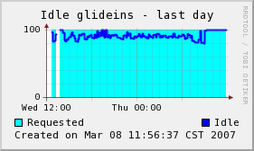
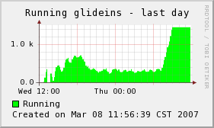
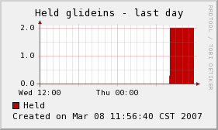
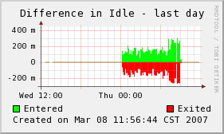
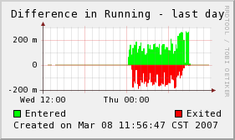
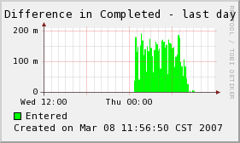
Graphs also created
Absolute Values
Rates

Slide 13
Monitoring status
Entry Point monitoring in reasonable shape
  Maybe should add requested parameters
  Need to harmonize optional attributes
  Explicit glidein error checking missing
Factory monitoring needs to be implemented
Is the format acceptable?
What about naming conventions?
Do we need more info?

