Slide 1

Where to get the needed computing
Tuesday morning
Igor Sfiligoi <isfiligoi@ucsd.edu>
University of California San Diego

Slide 2
Logistical reminder
It is OK to ask questions
  During the lecture
  During the demos
  During the exercises
  During the breaks
If I don't know the answer,
I will find someone who likely does

Slide 3

Introduction
So, you have a problem that needs many CPUs to get solved in a reasonable amount of time
Where do you get the needed resources?
Discovery is just
around the corner!

Slide 4


Available options
You either:
Buy CPUs
Get a computing grant
Use leftover CPU cycles
  i.e. opportunistic use
  of other's resources
https://www.flickr.com/photos/15203028@N00/5692453121/
http://www.cattytown.com/

Slide 5
Available options
You either:
Buy CPUs
  Your own hardware
  (e.g. a cluster)
  Contribute hardware to a common pool
  Lease machines on monthly/yearly basis
  Rent machines on a per hour basis
Get a computing grant
Use leftover CPU cycles
  On friends' hardware
  At your home institution
  On a large-scale scientific infrastructure

Slide 6
Available options
You either:
Buy CPUs
  Your own hardware
  (e.g. a cluster)
  Contribute hardware to a common pool
  Lease machines on monthly/yearly basis
  Rent machines on a per hour basis
Get a computing grant
Use leftover CPU cycles
  On friends' hardware
  At your home institution
  On a large-scale scientific infrastructure

Slide 7


Which way to go?
Buying is more reliable
  You can plan on how much computing
  you will be able to do
  But not always an option
    We all have a limited budget
How much did you
say it will cost???
My results are
already back!

Slide 8
Which way to go?
Buying is more reliable
  You can plan on how much computing
  you will be able to do
  But not always an option
  (We all have a limited budget)
Grants are similar in nature
  But may be harder to get than money!

Slide 9

Which way to go?
Buying is more reliable
Grants are similar in nature
Opportunistic use can give you vastly more
  But there is
  no guarantee
  you will get
  what you hope for
  And you will have to be flexible
Sure, it's a rough ride
but it's worth it.
Nasdaq

Slide 10

Don't assume flat usage
Most people have spiky compute needs, e.g.
  You come up with a great idea...
  need a gazillion CPUs now to verify it!
  Then nothing for a month or more
  while you look for the next great one.
  Everybody wants to run a last computing pass
  just before that important conference
If you think you are the rare exception,
please bear with me anyhow.

Slide 11
Impact on planning
You likely cannot afford to buy enough dedicated resources to cover the peaks
You should always plan on using opportunistic resources
  At least for part of the year
  But owning something still a good idea
Make sure you choose tools that allow you to do DHTC

Slide 12

Buying dedicated hardware
Buying your own hardware is the most straightforward approach
But you must also budget for
  Floor space
  Electricity
  Cooling
  Personnel costs
And install your own HTC system
  Which requires significant expertise
Often more than the HW itself

Slide 13


Server hosting
You can lease hardware from
commercial entities
  Typically 3-12 months leases
  Popular vendor: Rackspace
Great for shorter projects
  Likely gives you lower Total Cost of Ownership
    May cost less than buying the HW itself
    And you save on the infrastructure costs
  But still requires you to operate an HTC system

Slide 14

Cloud computing
Similar to server hosting
  But you pay by the hour
Most famous is Amazon EC2
(but not the only one)
Great for spike leveling
  Can get a lot of resources on short notice,
  if you have the needed money
  But can be quite expensive
  if used over an extended period of time

Slide 15
Cloud computing
Similar to server hosting
  But you pay by the hour
Most famous is Amazon EC2
(but not the only one)
Great for spike leveling
  Can get a lot of resources on short notice,
  if you have the needed money
  But can be expensive
You may hear talking
about “Scientific Clouds”.
That's really just another name for
VM-based HTC systems
(so not what I call Cloud here)

Slide 16


Contributing to a common pool
If you have an existing HTC system
at your institution/campus, it is
likely cheaper to contribute to it
  Economies of scale
  Better expertise
You will likely not get all of “your” resources on moment's notice
  But getting them within 24h very realistic

Slide 17
Contributing to a common pool
The HTC system
may also be located
at a different location,
if they allow remote access.
See Condor-G and BOSCO talks later today
If you have an existing HTC system
at your institution/campus, it is
likely cheaper to contribute to it
  Economies of scale
  Better expertise

Slide 18

Computing Grants
Some of the US large-scale computing infrastructures are grant based
  e.g. XSEDE
You make a proposal, and if you make a good case, you can get a substantial CPU allocation on their HTC/HPC system
Initial effort comparable to buying HW
  A lot of paperwork needed
  And long lead times

Slide 19
Going for opportunistic resources
All the methods described so far
give you dedicated resources
  i.e. you can count on them being there
  when you need them
  (at least, after the initial setup period)
  But that may not be enough for your needs
    And you cannot afford more
Opportunistic resources
may came to the rescue
  Just remember there are no guarantees here

Slide 20
Opportunistic resources
The opportunistic resources are essentially machines that are currently not needed by the owner
  e.g. owners are in the low part of a curve
Reasons why they may allow you to use them (instead of turning them off)
  Connections – e.g. Friend's desktop
  Politics – e.g. Funding agency requirement
  Money – e.g. Amazon's spot instances

Slide 21
Free HTC resources
You should first look close by
  The HTC system at your home institution may frequently have spare capacity
  They are likely happy to share
Once that is not enough,
remote HTC clusters
may provide substantial
additional free resources as well
  e.g. Sites on OSG
More on OSG
this afternoon

Slide 22

Beggars can't be choosers
Remember, when you scout for free resources, you have very few rights
  You are effectively “a beggar”
You will have to adapt
  Don't expect
  to get it your way
    Even though
    some sysadmins
    may be willing to help
  The more flexible you are, the more free resources you will be able to use
I hope I didn't
forget any
dependencies!

Slide 23
Consider contributing back
If you buy hardware, consider contributing back
  i.e. give unused CPU cycles to others
A modest amount of gifted CPU can buy you a lot of good will
  For when you need
  to level your own spikes
  Likely not a quid-pro-quo
  but don't underestimate
  good will
You want me
to do what???

Slide 24

Opportunistic Cloud Resources
Here opportunistic means cheap(er)
  Not free
Basically one bids (real money) for resources
  The highest bidder gets the resources
  Until someone else bids higher
    At which point your jobs are killed!
  e.g. Amazon EC2 Spot Instances
Can get a lot for relatively little money
  But not always

Slide 25
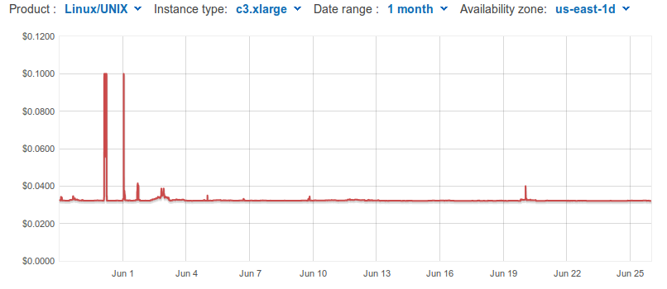
Example
For Amazon EC2 c3.xlarge (4 cores)
  Full price: $0.21/hour (about $35/core/month)
  Spot price: $0.03/hour - $0.04/hour (about $6/core/month)
    Many periods when you could get those prices

Slide 26
Putting everything together
You will get most work done if you mix owned, leased and opportunistic resources
  Spread over many location
  i.e. DHTC
Plan on using an overlay system early on
  So you don't have to use N different tools
  to use N different resource types
  Searching for/Learning about new tools
  when you are close to a deadline is no fun

Slide 27
Questions?
Questions? Comments?
  Feel free to ask me questions later:
  Igor Sfiligoi <isfiligoi@ucsd.edu>
Upcoming sessions
  glideinWMS – the OSG overlay software
  Hands-on exercises
  Tour

Slide 28

Automation to the rescue
Courtesy bancaynegocios.com

Slide 29
Copyright statement
Some images contained in this presentation are the copyrighted property of ToonClipart.
As such, these images are being used under a license from said entities, and may not be copied or downloaded without explicit permission from ToonClipart.

