Slide 1
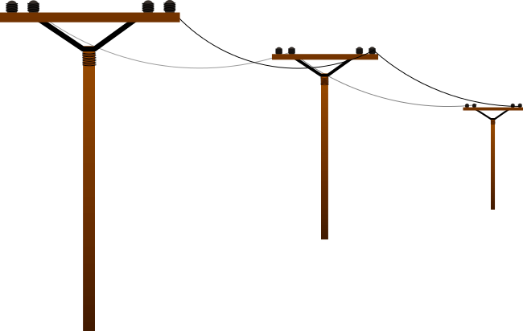


2011 OSG Summer School
Comparing
Grids to Clouds
by Igor Sfiligoi
University of California San Diego

Slide 2
Cloud computing
(as described this morning)
A mix between hosted computing and Grids
Job-based like a Grid
  But “jobs” are Virtual Machines, not just processes
You get your own machines like in hosted cmp.
  They just happen to be VMs
  You install whatever you want in them
  There is an economic factor
  (although there is a push for scientific clouds
  as well)

Slide 3
Cloud computing vs Grids
Jobs are whole system images
  You configure your own virtual machine
  Grid nodes come with site-installed OS
You pay in $$ to use them
  In Grids (and local HTC) systems you
  typically pay just in priority
Instantaneous access
  You get the resource within minutes of asking
  In Grids you may wait a long time

Slide 4
Pay to use
Amazon EC2 made Cloud computing popular by defining a price in $$/hour
A major selling point is also the fact that you will get the resources the moment you ask
Amazon can do this
by always having unused machines
lying around

Slide 5
Even clouds have priorities
Amazon EC2 now has “spot pricing”
You bid for “unused resources”
  If a higher bid comes in, you loose your machine
Comparable to the
Grid/HTC priority model
(just $$ based)

Slide 6
The VM business
Amazon EC2 success arguably lies in
the fact that they allow customers to provide
their own system image
  Most customers are not running compute jobs
  They want to install a Web server and a database!
This is less important for scientific users
  Most scientific jobs don't need root/admin access!
  Although it can make
  life easier
  (more homogeneous)
Mostly a
nice-to-have
feature for scientists.

Slide 7
Using Cloud resources
The problem is similar to using Grid resources
  Find a client and submit the job
If your job is not a system image, you need someone to create the OS image for you
  You, if you submit directly
  The pilot will do it automatically,
  if you use an overlay system
OS
Job

Slide 8
Cloud clients
Direct submission
  Cloud provider clients
  (EC2, Eucalyptus, OpenStack, …)
  Condor-G
Overlay systems
  glideinWMS (in prototype stage for now)
  CycleCloud

Slide 9

CycleCloud
Starts a whole Condor cluster on Amazon EC2
  A service run by Cycle Computing
  Just give them the money
Once the submit VM is started
  log in and submit
Schedd
Startd
Collector
Startd
CycleCloud
Amazon EC2

Slide 10
Get your hands dirty
This is all the theory you need to know for now
Demo/Exercise time
Feel free to ask questions

