Slide 1

dCache “Intro” a layperson perspective
Frank Würthwein
UCSD

Slide 2
dCache docs
“The Book”
http://www.dcache.org/manuals/Book
By far the most useful
documentation on dcache!!!

Slide 3
dCache Goal (T2 perspective)
“Virtualize” many disks into a single namespace.
  Allow for seemingly arbitrary growth in disk space!
“Virtualize” many IO channels via a single entry point.
  Allow for seemingly arbitrary growth in aggregate IO!
  Manage flows by scheduling Xfer queues.
  Allow for replication to improve data availability and avoid hotspots among disk hardware.

Slide 4
Techniques to meet goals
Separate physical and logical namespace.
  PNFS = namespace mapper
Separate “file request” from “file open”
  Doors manage requests.
  Pools manage Xfer.
Fundamental Problem:
  Access costs for:
    LFN - PFN translation: max of ~50Hz (?)
    SRM request handling: max of ~1Hz (?)
Need large files for decent performance!

Slide 5
Xfer Protocols
“Streaming”, i.e. put & get but not seek
  Gftp, dccp
Random access
  dcap, xrootd (alpha version ?)
Where does SRM fit in?
Provides single entry point for many gftp
  => spreads the load.
Implements higher level functionality
  Retries
  Space reservation (more on this later)

Slide 6
Performance Conclusions
(so far)
PNFS server wants its own hardware
  … and be stingy with pnfs mounts to minimize risk of fools killing pnfs with find!!!
  … and avoid more than a few hundred files per directory!!!
SRM wants its own hardware
  … and be “reasonable” with the # of files per srmcp.
    There’s a per file overhead and a per srmcp latency!
… but many dcap doors on same node ok!

Slide 7
dCache Basic Design
Components involved in Data Storage and Data Access
Provides specific end point for client connection
Exists as long as client process is alive
Client’s proxy used within dCache
Interface to a file system name space
Maps dCache name space operations to
filesystem operations
Stores extended file metadata
Performs pool selection
Data repository handler (i.e. has the physical files)
Launches requested data transfer protocols
Data transfer handler
(gsi)dCap, (Grid)FTP, http, HSM hooks
Door
Name Space Provider
Pool Manager
Pool
Mover
(concept by P. Fuhrmann)

Slide 8
Places to queue …
(details in ASR’s talk)
SRM = “site global queuing”
  Queuing of requests
  Algorithm to pick gftp door to handle requests
PoolManager = select “best” pool or replicate
  Hard policy (e.g. dir-tree fixed to pools)
  # of requests / max. allowed
  Space available
Local queuing @ pool
  Multiple queues for multiple purposes

Slide 9
PoolManager Selection
Determine which pools are allowed to perform request.
  Static decision based on configuration.
  Pools may be assigned to IP & Path
Ask all allowed pools to provide cost of performing request.
  Cost is configurable per pool.
Decide if cost is low enough
  Cost too high => replicate file onto lower cost pool
  … otherwise assign lowest cost pool to service request.

Slide 10
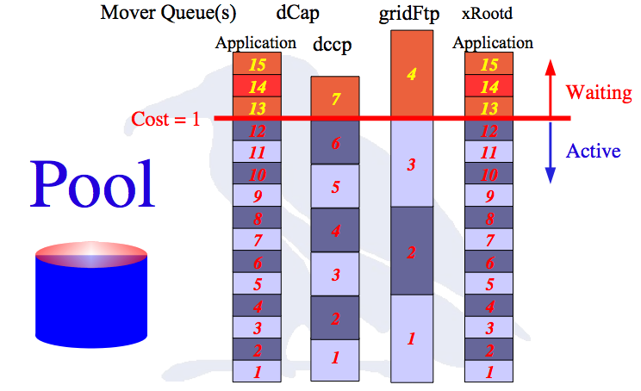
Different Queues for different Protocols
because typical IO differs between protocols.
Courtesy: P.Fuhrmann

Slide 11
Advanced Topics
Private/Public network boundaries
Replica Manager
Implicit Space Reservation
Overwriting files
Uid’s and file access management

Slide 12
All public network
Each pool may dynamically instantiate a gftp server as needed.
No need for SRM to pick the gftp door because its determined by the pool selection mechanism alone.

Slide 13
All pools on private network
Need dual homed gftp doors as “application level proxy servers”.
SRM selects gftp door independent of pool selection.
Gftp door flows data from WAN into memory buffer and from memory buffer onto LAN onto pool, or vice versa.
3rd party Xfer between sites w. private pools is not possible!
You design your IO by the # of gftp servers you provision.

Slide 14
Replica Manager
Allows specification of # of replicas of files within boundaries.
  More performance
  More robustness against failure
Guarantees replica count via lazy replication
Wants to sit on its own hardware!

Slide 15
Implicit Space Reservation
SRM guarantees that only pools are selected that have enough space for the file that is to be written.
This is a feature that is turned on by default.

Slide 16
Overwriting of files
You can NOT modify a file after it is closed!
Reason:
  File may be replicated, and dCache has no means to guarantee that all replicas are modified.
  Different replicas of a file may be accessed simultaneously by different clients.
No “cache coherence” in dCache.

Slide 17
UID’s and file access
UID space in dCache and compute cluster does not have to be the same!
Instead, it is possible to require all accesses to be “cert” based (x509 or krb5), and thus have arbitrary map between dCache and compute cluster!!!

Slide 18
Questions ?

Slide 19
Two example deployments
FNAL
  110TB across 23 pool nodes with 2Gbps each.
  LAN & WAN queue per pool.
Core: LM, PM, HSM
Dcap: 3 doors
2nd dcap: 4 dcap, 1 gftp
SRM node
Pnfs node
RM: RM, 1 gftp
InfoSys: Billing, Spy, httpd, infoProvider
Management: CM, dcap, gftp
UCSD
  38TB across 70+ pool nodes.
  LAN & WAN queue per pool
Core: LM, PM, Spy, httpd, billing
Dcap: 5 doors
SRM node
PNFS node
RM: RM, admin door
6 gftp nodes

