Slide 1
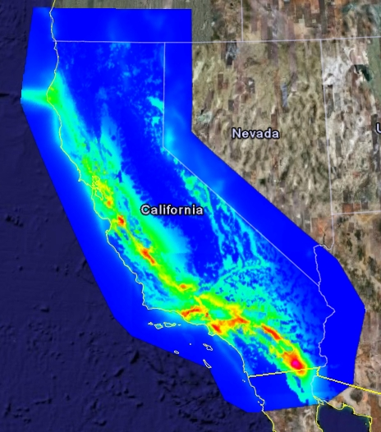
SCEC using gateway to produce hazard map
PSHA hazard map for California using newly released Earthquake Rupture Forecast (UCERF2.0) calculated using SCEC Science Gateway
Warm colors indicate regions with a high probability of experiencing strong ground motion in the next 50 years.
High resolution map, significant CPU use

Slide 2
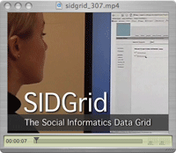
Social Informatics Data Grid
Heavy use of “multimodal” data.
  Subject might be viewing a video, while a researcher collects heart rate and eye movement data.
Events must be synchronized for analysis, large datasets result
Extensive analysis capabilities are not something that each researcher should have to create for themselves.
http://www.ci.uchicago.edu/research/files/sidgrid.mov

Slide 3
Social scientists have traditionally worked in isolated labs without the capability to share data or insights with others.
SIDGrid enables a number of capabilities.
  Data that is expensive to collect can now be shared with others, increasing the potential for scientific impact.
  Geographically distant researchers can collaborate on the analysis of the same data set.
  Complex analysis tools and workflows are now available for all to use, rather than having each lab duplicate efforts.
  All researchers now have access to the highest quality computational resources
    SIDGrid uses TeraGrid resources for computationally-intensive tasks such as media transcoding algorithms for pitch analysis of audio tracks and fMRI image analysis
SIDGrid is unique among social science data archive projects
  Focused on streaming data which change over time
  Provides the ability to investigate multiple datasets, collected at different time scales, simultaneously
Active users of the SIDGrid system include a human neuroscience group and linguistic research groups from the University of Chicago and the University of Nottingham, UK

Slide 4
CY2007 Usage by Discipline
Advanced Scientific
All 19 Others
Atmospheric
Computing
4%
Sciences
2%
3.95B SUs delivered in CY2007
3%
Earth Sciences
3%
Molecular
Chemical, Thermal
Biosciences
Systems
31%
5%
Materials Research
6%
Astronomical
Sciences
12%
Chemistry
Physics
17%
17%

Slide 5
TeraGrid Menu (Resources and Services)
Computing – over a petaflop of computing power and growing
Data
  Data storage facilities
  Scientific data collections
Over 30 Science Gateways
Remote visualization servers and software
Technical Support
  Central point of contact for support of all systems
  Advanced Support for TeraGrid Applications (ASTA)
Education and training events and resources
  K-12 Education
  Pathways
  Campus Champions
Notes:
TeraGrid'06
June 2006
Charlie Catlett (cec@uchicago.edu)

Slide 6
Human Connection: Your Campus Champion
The Campus Champions program supports campus representatives as the local source of knowledge about high-performance computing opportunities and resources.
Knowledge plus assistance will empower campus researchers, educators, and students to advance scientific discovery.
Your campus will benefit by having direct access to the TeraGrid and input to its staff, resource allocations awarded for their use, and assistance in using those resources.
TeraGrid will support the Campus Champion. See
  http://www.teragrid.org/eot/campuschamps.html
  To join the Campus Champions program, contact the TeraGrid Campus Champions Program Coordinator, at tgcc-help@teragrid.org.

Slide 7
Online Resources
Online resources at www.teragrid.org
TeraGrid User Portal for managing allocations and job flow
Documentation
  Knowledge Base for quick answers to FAQ’s
  HPC University to increase general HPC knowledge
Calendar of events including upcoming workshops and training
  Annual conference - TG09
    Arlington, VA
    June 22-26, 2009

Slide 8
TeraGrid: greater than the sum of its parts…
Leadership in cyberinfrastructure development, deployment and support
Expertise in building national computing and data resources
Leveraging extensive resources, expertise, R&D, and EOT
  Leveraging activities at other participant sites
  Learning from each other improves expertise of all TG staff
  Shared training, education, and outreach resources benefit all
Simplified access to high end resources
  Single unified allocations process
  Single point of contact for problem reporting
  Coordinated software environments
  Uniform access to heterogeneous resources to solve a single scientific problem

Slide 9
Do you want to know more about TeraGrid allocations today ?
Yes
Not today

Slide 10
How does the Allocations process work?
Startup allocations: for code development, experimentation with TeraGrid platforms, and application testing. Startup requests may total up to 200,000 service units (SUs) of computation, up to 5TB on disk and 25TB on tape of storage.
Education allocations: for use in classroom instruction or training activities,
with the same SU and storage limits as Startup allocations.
Research allocations: requires a detailed justification of resource usage. Requests are reviewed four times a year by the Resource Allocations Committee.
  National peer-review process
    allocates computational and data resources
    makes recommendations on allocation of advanced direct support services
    Currently awarding >1B Normalized Units of resources
  Principal investigator (PI) must be a researcher, educator, or postdoctoral researcher at a US academic or non-profit research institution.

Slide 11
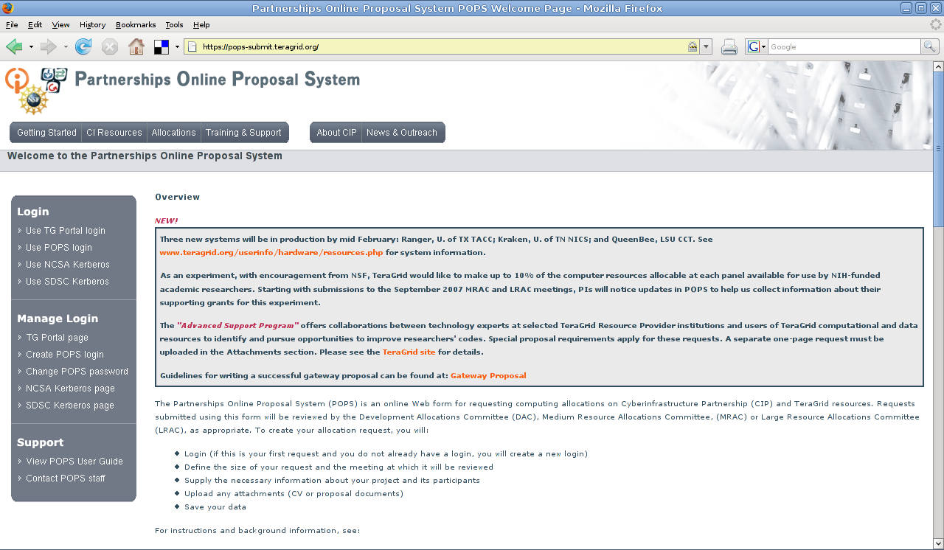
Go to the POPS page - https://pops-submit.teragrid.org

Slide 12
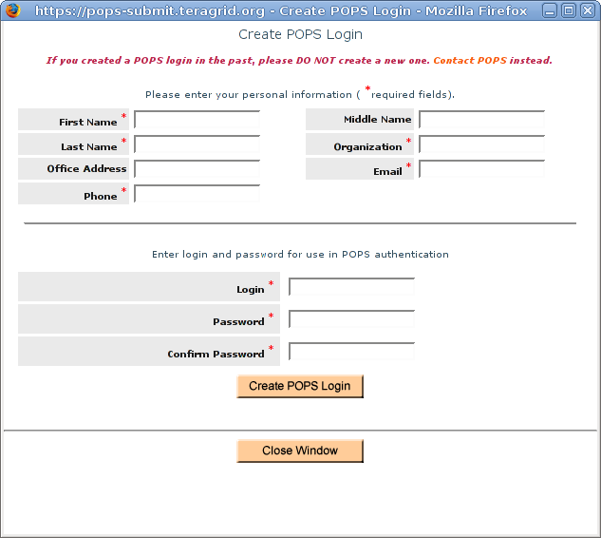
Create a POPS Login

Slide 13
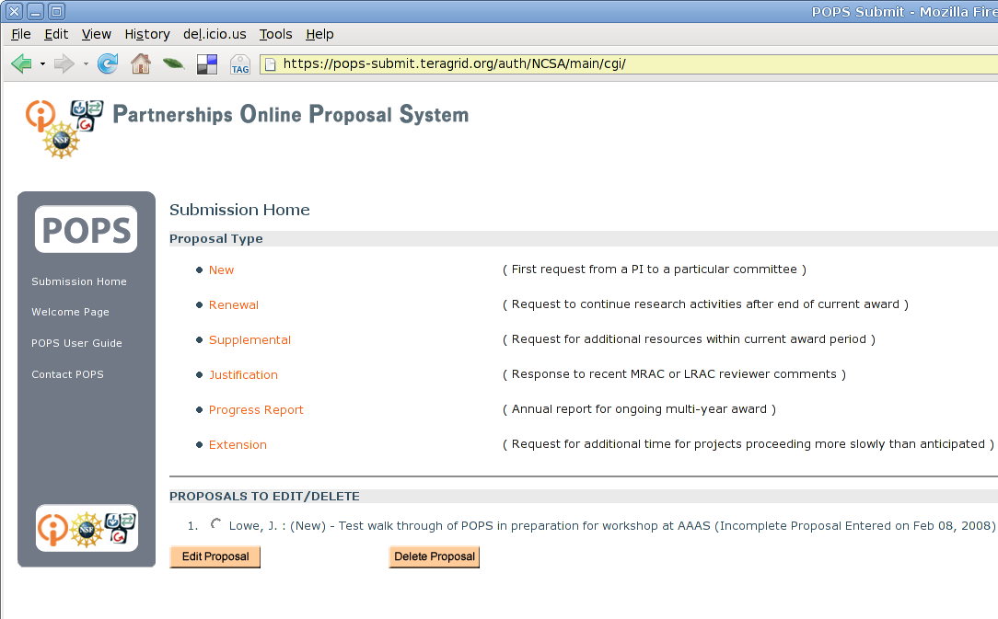
Indicate that you are “New” to the Teragrid

Slide 14
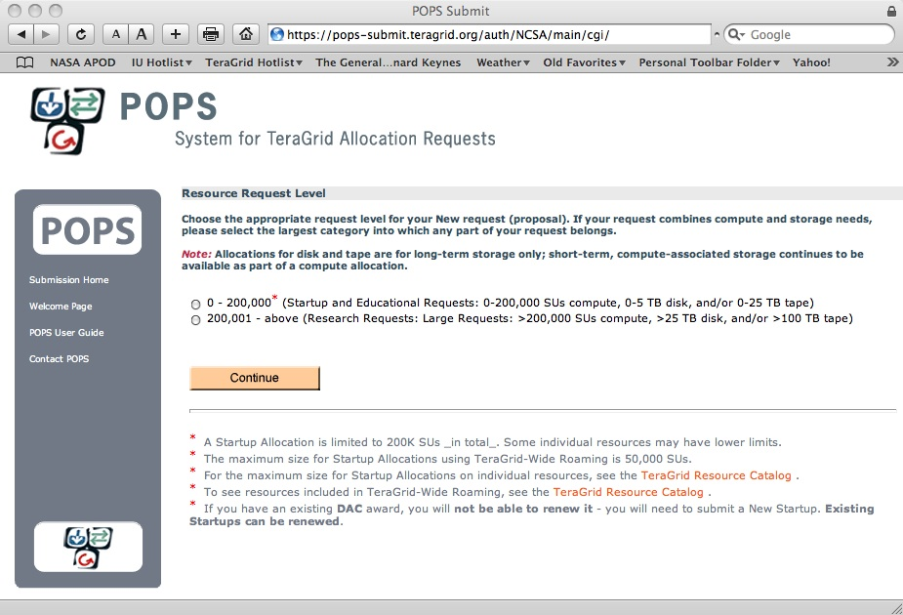
Indicate this is a “Start-up” Request

Slide 15
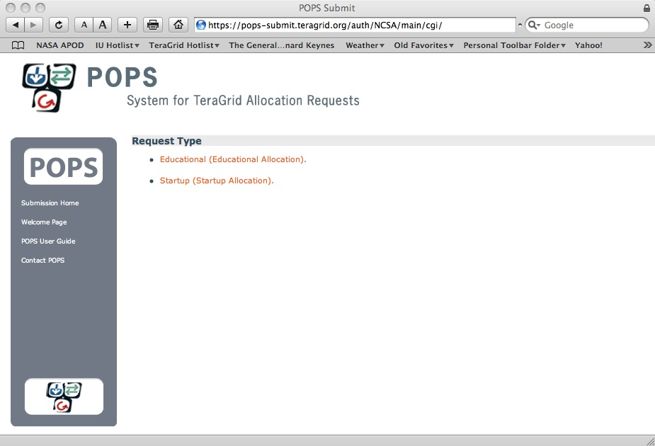
Select Startup or Educational

Slide 16
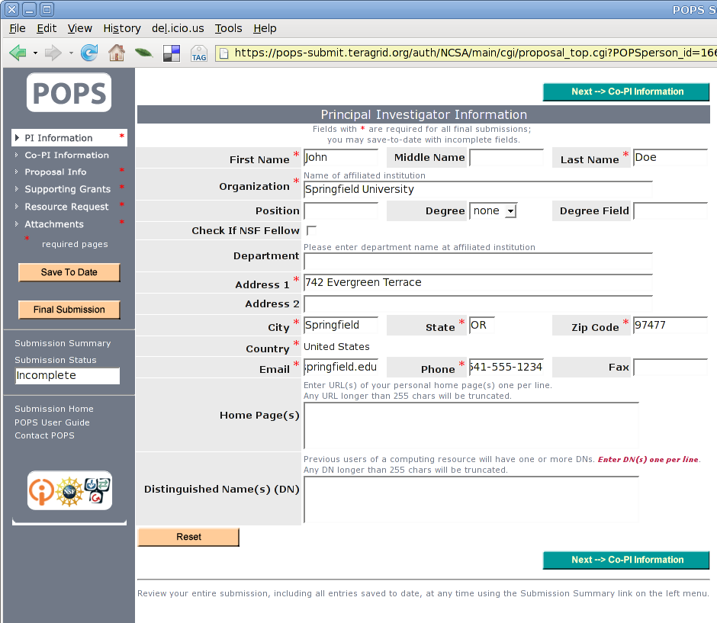
Fill out PI information

Slide 17
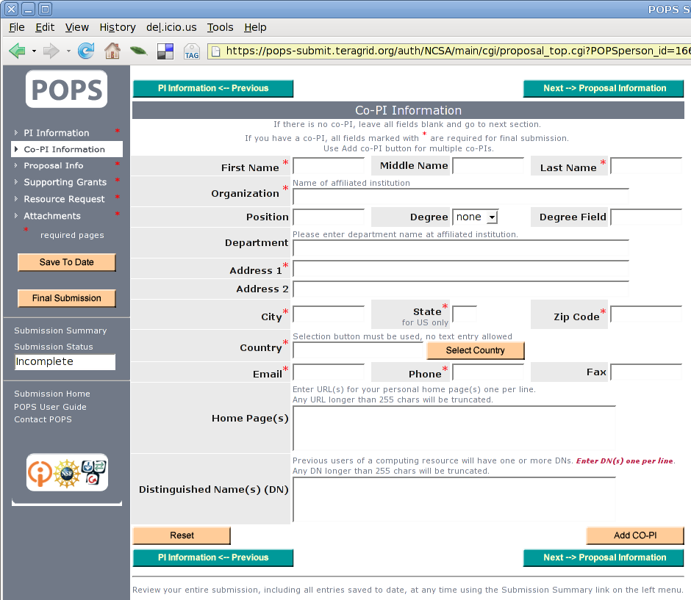
Skip Co-PIs info

Slide 18
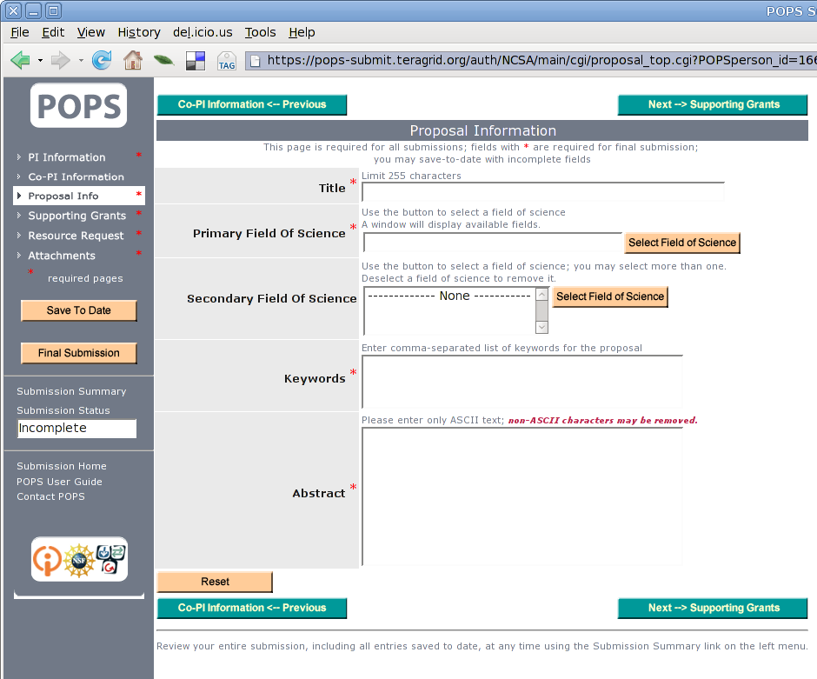
Fill out info on your project

Slide 19
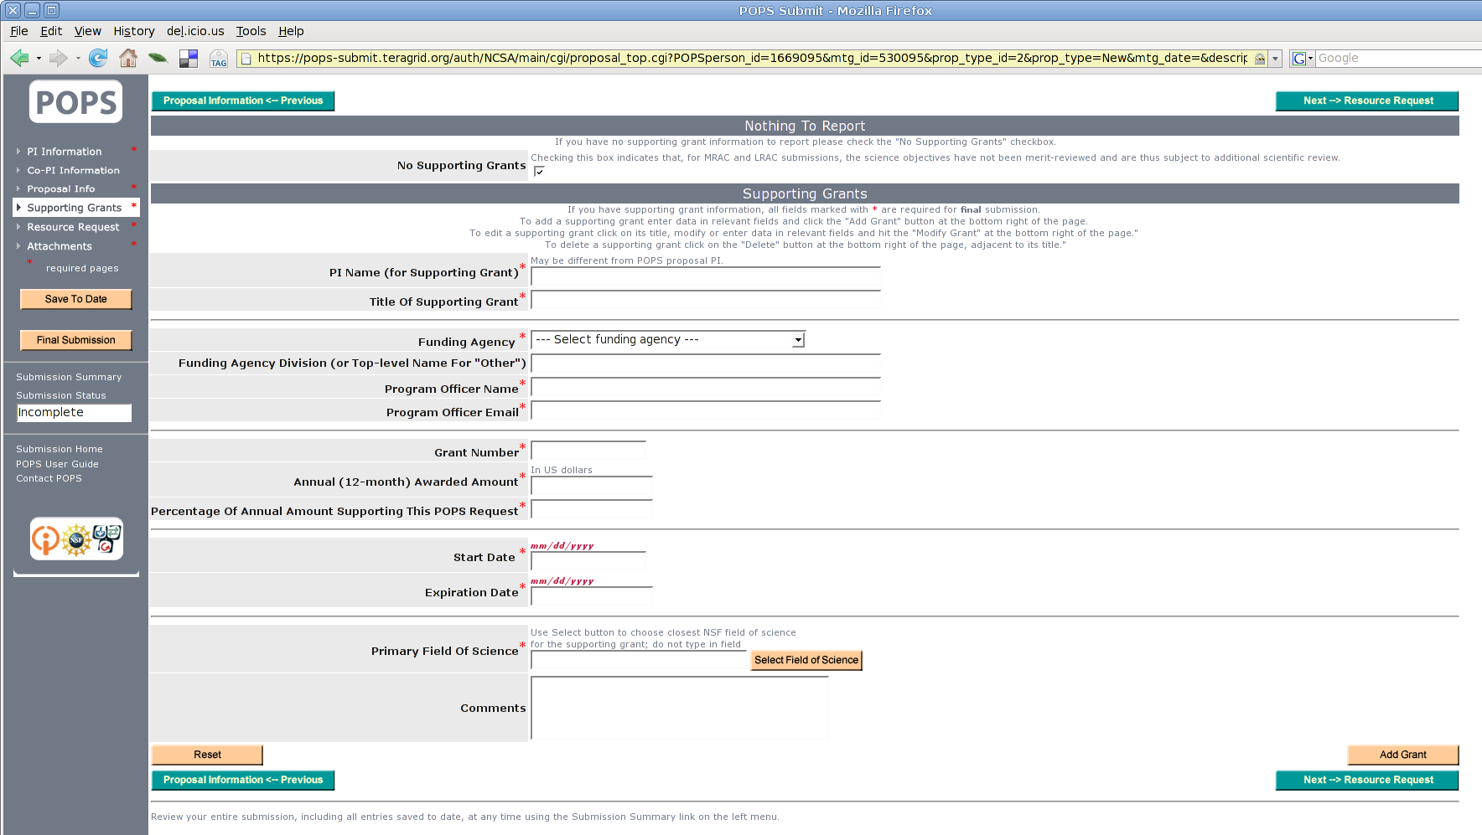
Fill out info on your funding

Slide 20
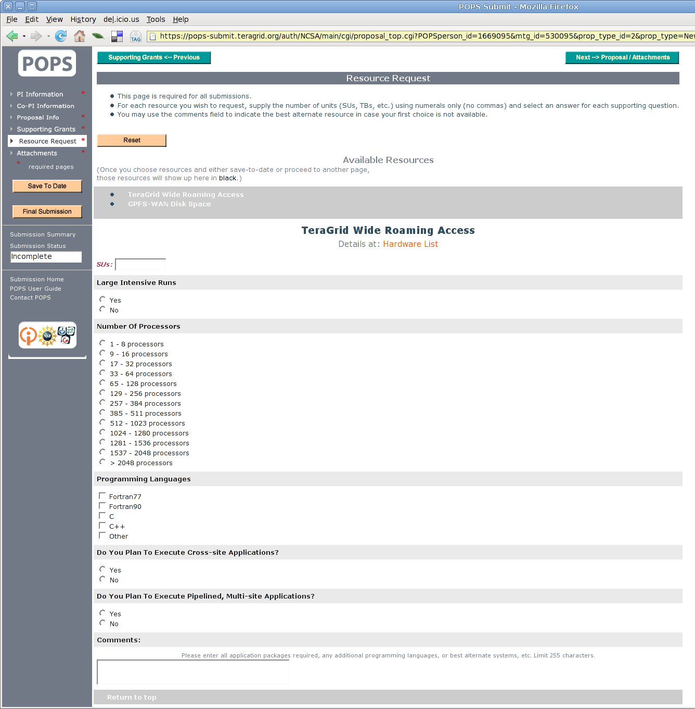
Estimate your computing need (reasonably)

Slide 21
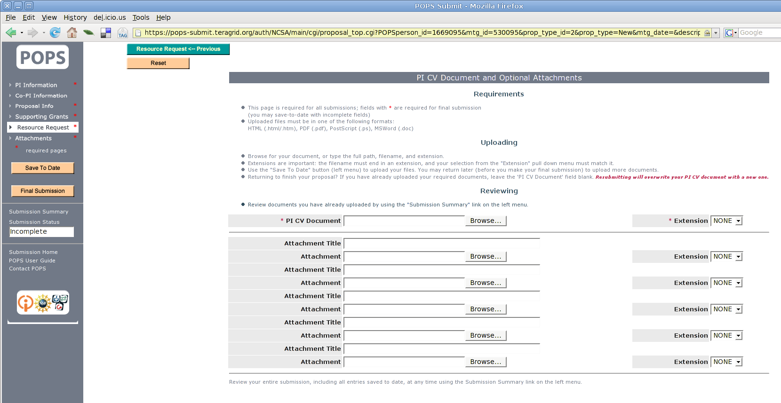
Upload your CV and Submit!
when ready

Slide 22
Acknowledgements
This work is made possible by the dedicated efforts of the TeraGrid staff. In particular, slides came from Scott Lathrop, Craig Stewart, John Towns, Dane Skow, Daphne Siefert-Herron, Vickie Lynch, David Hart (Indiana Dave); David Hart (California Dave), Fran Berman, Nancy Wilkins-Diehr, Laura McGinnis and probably others.
The Grid Infrastructure Group management of the TeraGrid is funded by NSF grant 0503697.
The LEAD portal is developed under the leadership of IU Professors Dr. Dennis Gannon and Dr. Beth Plale, and supported by NSF grant 331480. Marcus Christie and Surresh Marru of the Extreme! Computing Lab contributed the LEAD graphics
The ChemBioGrid Portal is developed under the leadership of IU Professor Dr. Geoffrey C. Fox and Dr. Marlon Pierce and funded via the Pervasive Technology Labs (supported by the Lilly Endowment, Inc.) and the National Institutes of Health grant P20 HG003894-01.
Any opinions, findings and conclusions or recommendations expressed in this material are those of the author and do not necessarily reflect the views of the National Science Foundation (NSF), National Institutes of Health (NIH), Lilly Endowment, Inc., or any other funding agency.

Slide 23
Thank you!
Questions?

Slide 24

More Gateway Examples

Slide 25
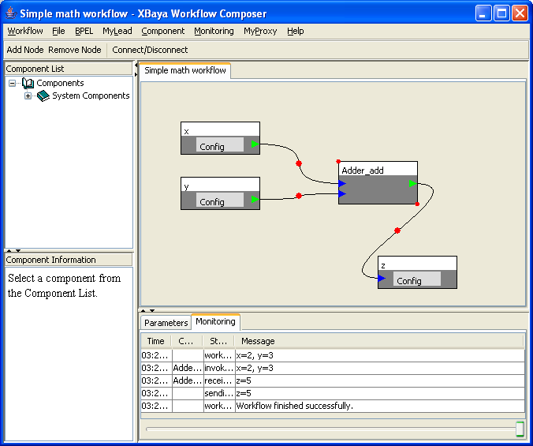
LEAD (portal.leadproject.org/)
Simple enough an undergraduate can use it! http://wxchallenge.com/
National Center for Supercomputing Applications (NCSA) and IU teamed up to support WxChallenge weather forecast competition. 64 teams, 1000 students, ~16,000 CPU hours on Big Red
XBaya is available from http://www.collab-ogce.org/

Slide 26
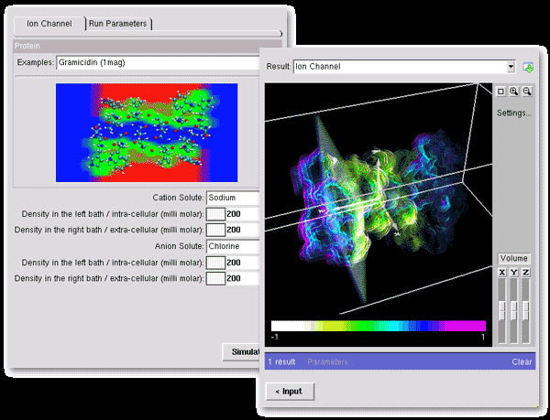
NanoHub Harnesses TeraGrid for Education
Nanotechnology education
Used in dozens of courses at many universities
Teaching materials
Collaboration space
Research seminars
Modeling tools
Access to cutting edge research software
Notes:
While addressing challenges in nanotechnology, NCN researchers produce new algorithms, approaches, and software with capabilities not yet available commercially. As part of the NSF's infrastructure for the National Nanotechnology Initiative (NNI), the NCN engages the community through workshops, seminars and novel educational resources. The nanoHUB is a source of on-line resources including a unique web-based computational user facility that puts research-grade software in the hands of users across the globe.
was created in 2000 and relies on middleware developed at Purdue called PUNCH (Purdue University Network Computing Hub). In the year 2003, the nanoHUB has served 1000 users and ran 86,000 jobs
The applications already available on the nanoHUB range from single cpu jobs to parallel jobs. Some are well suited to run on a Condor pool, whereas more compute intensive application will run on the TeraGrid.

Slide 27
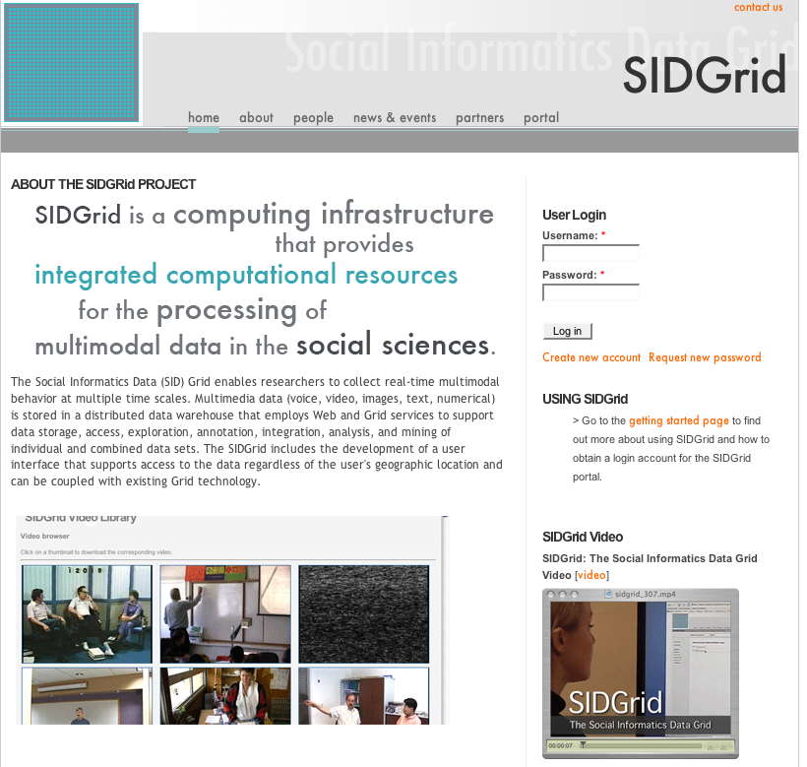
SIDGrid sidgrid.ci.uchicago.edu
Notes:
Social Informatics Data Grid

