Slide 1


ED Report Council Meeting March 11th 2010 Ruth Pordes OSG Executive Director

Slide 2
OSG Project Structure August 2009
Joint Oversight Team
DOE & NSF
OSG PI: Miron Livny
OSG Co-PIs: Paul Avery, Kent Blackburn, Ruth Pordes
OSG Council
Chairs: Paul Avery, Kent Blackburn,
Executive Team
Executive Director: Ruth Pordes,
Technical Director: Miron Livny,
Project Manager: Chander Sehgal,
Major Account Managers to
US ATLAS, US CMS, LIGO
Extensions /Applications
Torre Wenaus, Frank Würthwein
Metrics: Brian Bockelman
Comm. & iSGTW: David Ritchie
Proj Mgmt: Chander Sehgal
Software Tools
Alain Roy, Mine Altunay
Production Coordinator Dan Fraser, tbd?
Software + VDT : Alain Roy, (Storage: Tanya Levshina)
Scalability: Frank Wuerthwein
WMS: Maxim Potekhin
Storage: Matt Crawford
Internet2: Rich Carlson
Security Officer: Mine Altunay; Deputy: Doug Olson
Integration : Rob Gardner : Site Coordination
Operations: Rob Quick
User Communities:
VOs,
Site Administrators
VOs : Abhishek Rana, Britta Daudert
Education, Training: Alina Bejan
E4CI
CI-Team
Project
Engagement: John McGee; Campus Grids: Sebastien Goasguen
Production Facility
Feb 2009
Notes:
2

Slide 3
OSG Project Structure
March 2010
Joint Oversight Team
DOE & NSF
OSG PI: Miron Livny
OSG Co-PIs: Paul Avery, Kent Blackburn, Ruth Pordes
OSG Council
Chairs: Paul Avery, Kent Blackburn,
Executive Team
Executive Director: Ruth Pordes,
Technical Director: Miron Livny,
Project Manager: Chander Sehgal,
Major Account Managers to
US ATLAS, US CMS, LIGO
Extensions /Applications
Michael Ernst, Frank Würthwein
Metrics: Brian Bockelman
Comm.,Edu & iSGTW: David Ritchie
Proj Mgmt: Chander Sehgal
Software Tools
Alain Roy, Mine Altunay
Production Coordinator Dan Fraser
Software + VDT : Alain Roy, & Storage: Tanya Levshina
Scalability:Igor Sfiligoi
WMS: Maxim Potekhin
Internet2: Jeff Boote
Security Officer: Mine Altunay; Deputy: Doug Olson
Integration : Rob Gardner : Site Coordination
Operations: Rob Quick
User Communities:
VOs,
Site Administrators
VOs : Abhishek Rana
Training Jim Weichel & Documentation: Robert Engel
E4CI
CI-Team
Project
Engagement: John McGee; Campus Grids
Production Facility
Notes:
3

Slide 4
New OSG organo-gram
Open Science Grid
Services and
Infrastructure
Support for End-to-End Distributed Research Community systems.
Contributions
Executive
Board
OSG does not own processing, storage, networking and does not develop software.
Science
Community
$
DOE
Software
Provider
Consortium
Project
$
NSF
Resource
Provider
..
..
Satellite - Partner
Project
Satellite
Project

Slide 5
NSF
ARRA satellite GlideinWMS
Recent SDCI solicitations resulted in 2 Executive Director letters of commitment: Globus continued support, TG/BIRN IIS with MyOSG presentation layer.
Condor + ??
Software sustainability Report
SDCI/STCI PI meeting
CyberGIS
Participation in NEES – ED chair of Community Collaboration Taskforce.

Slide 6
DOE
Here from ATLAS/CMS this afternoon.
Requested from ASCR phone meetings with Miron and myself.
Allocations on Magellan resources at ANL and NERSC. First detailed technical meeting tomorrow morning. ASCR will attend.

Slide 7
Blueprint Meetings
October: Incremental Software Updates in OSG, Tier-3 program of work effort needs,storage accounting issues (size), review of FY11 SOWs.
November: technology group
December: joint WLCG-EGEE-OSG meeting at CERN. Discussions of transition to EGI/EMI, storage next generation ideas at CERN.
February: Shared storage, NEES proof of concept.
May at BNL proposed: Configuration Management, Middleware and Advanced Networking

Slide 8
Storage Appliance
VO can use public storage without prior arrangements
No per- VO limit is necessary: community space
It is crucial that the space is correctly advertised in the OSG information systems
File cleanup could be done at any time (the VO notification is desirable)
What is the priority? No effort available/allocated at present.
OSG supply h/w to site in exchange for running OSG s/w to implement the above. Possibility of Cornell being a first test here?

Slide 9
Network for Earthquake Engineering Simulation - NEES
Miron, Technical Director andRudi Eigenmann, head of NEES-IT, at Purdue propose proof-of-concept archival of NEES data through OSG to tape. Stepping stone to technical support for “upload of data from 14 NEES sites to Purdue”.
Fermilab offer tape archival resource accessible to OSG.
NEES need tape archive by April 1 2010.
Work in progress. Besides software development, integration and execution will prototype agreements and use of new kind of resource.
Once proof-of-concept in place NEES looking for incremental archives weekly. Will need ongoing commitment and SLAs.

Slide 10
Planning for the Future
Plan to ramp up my effort with process support from Chander, Jim Weichel and others on this over the next few months. There is always a challenge to find the time with the number of immediate issues to address.
We (will) appreciate the activity and engagement from Council and VO members.

Slide 11
OSG Futures - Goals https://twiki.grid.iu.edu/twiki/pub/Council/Agenda2009Aug11/OSG_Future_Requirements_v1.docx
OSG will provide the LHC and LIGO communities with a common virtual facility…
OSG will provide a common, shared distributed computing infrastructure which can be used, ..by all members of the Consortium...
OSG will continue as a grass-roots hands-on collaboratory…
OSG will play a leadership role in the US National Cyberinfrastructure...
OSG aims to have recognized responsibilities in partnership with the NSF XD…
OSG aims to have recognized responsibilities as part of the next round of the DOE SciDAC program….

Slide 12
Are there Satellite Projects we should encourage?
Security Infrastructure enhancements/revamp?
Campus Infrastructures?
Storage and Data management?
…
No progress I can report here….

Slide 13
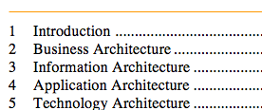
Technology Group and Architecture Document
Architecture document help for ED from sub-set of Technology Group to date:
Diagram existing VO and OSG architectures.
Points to master documents if exist.
Address high level “Enterprise” aspects of the architecture as well as technology/technical

Slide 14
Extend mission/scope?
Current: The Open Science Grid aims to promote discovery and collaboration in data-intensive research by providing a computing facility and services that integrate distributed, reliable and shared resources to support computation at all scales.
Target? The Open Science Grid aims to promote discovery and collaboration in data-intensive research by providing computing services, software and support that integrate cross-domain, self-managed, nationally distributed cyber-infrastructures that bring together campus, community, national and commercial resources to meet the needs of communities at all scales.

Slide 15
If We are Successful More Communities Rely on us
The architecture and targets of the OSG are driven by its’ stakeholders – current and potential. The (three) major accounts that drive the OSG are the US LHC Collaborations (US ATLAS and US CMS) and LIGO.
Our future target is to increase the number of major accounts depending on the OSG.
Do we have communities at the table who would commit to this for the proposal next year?

Slide 16
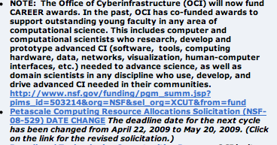
Where can we be Innovative?
CF21?
http://www.nsf.gov/dir/index.jsp?org=oci
Cloud Computing and Microsoft?
Career Awards (satellites)?

Slide 17
National Cyberinfrastructure
Clearly more than OSG-TG
collaboration listed here?
Task Mission/Goals | Stage
OSG & TG Joint Activity Tracking and Reporting | Active
iSGTW continuation and joint support plan; proposal for US based contributions | Planning
Resource Allocation Analysis and Recommendations | Planning
Resource Accounting Inter-operation and Convergence Recommendations | Planning
Explore how campus outreach and activities can be coordinated | Active
SCEC Application to use both OSG & TG | Active
Joint Middleware Distributions (Client side) | Active
Security Incidence Response | Active
Workforce Development | Planning
Joint Student Activities | Active
Infrastructure Policy Group | Active

Slide 18
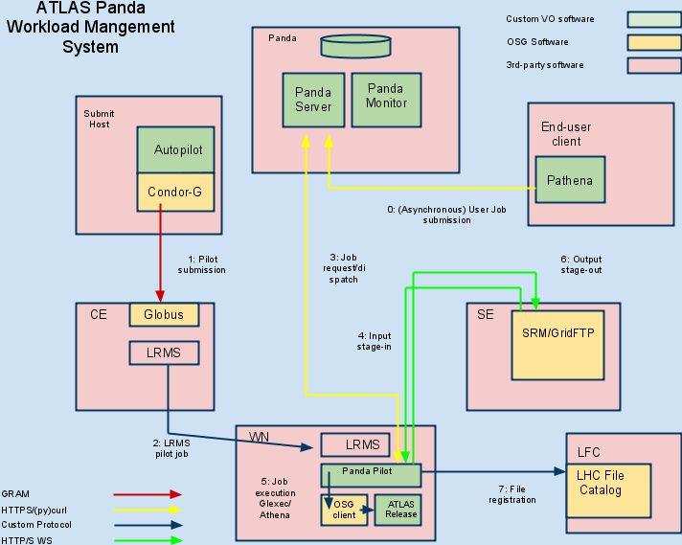
Architectures documented – ATLAS

Slide 19
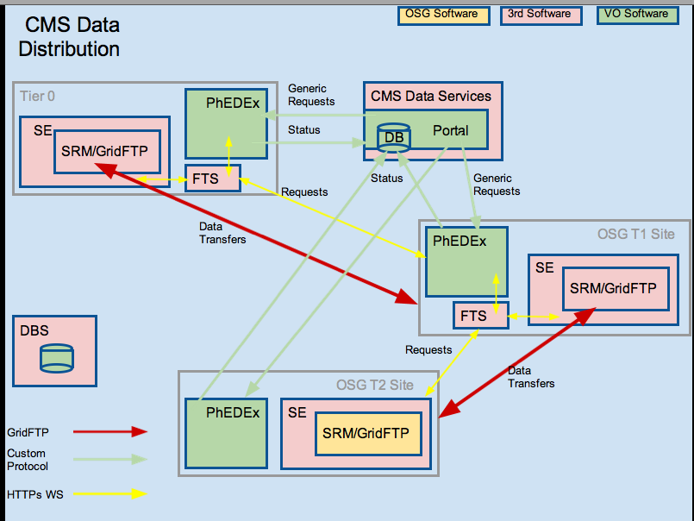
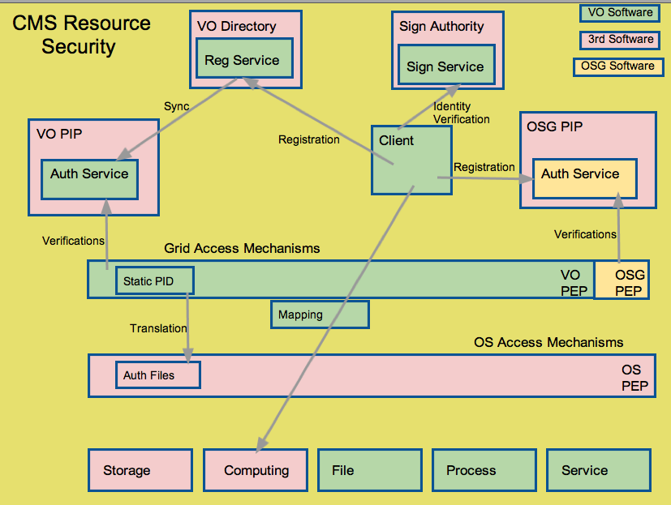
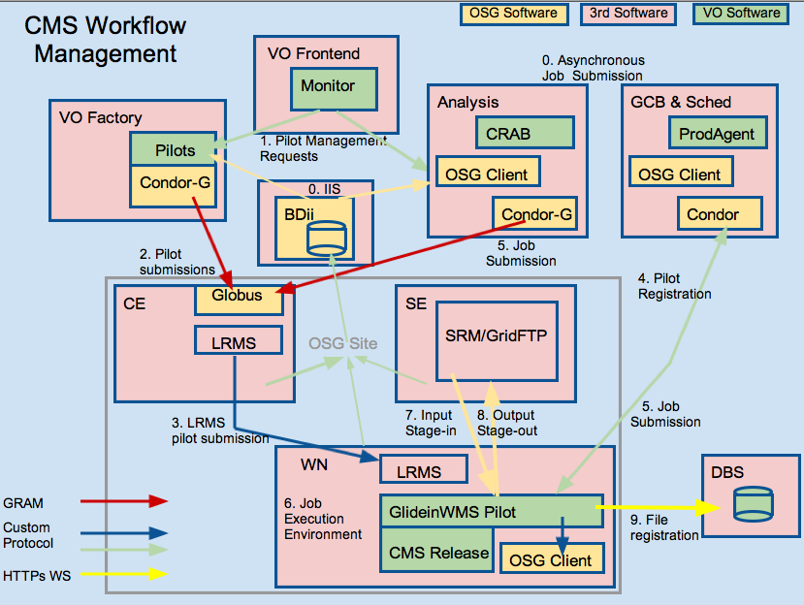
CMS

Slide 20
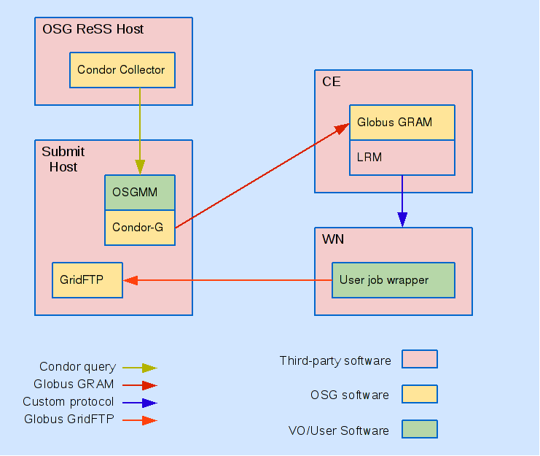
Engage

Slide 21
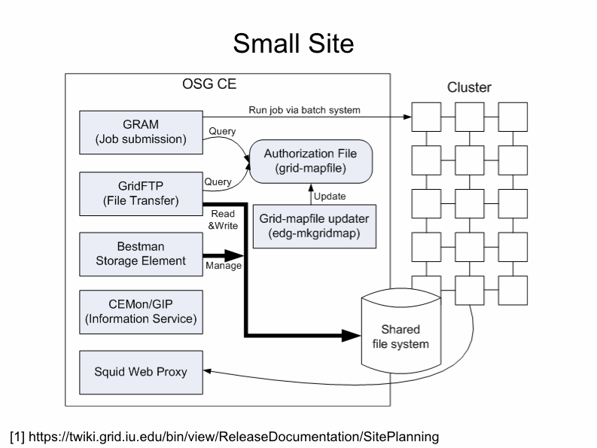
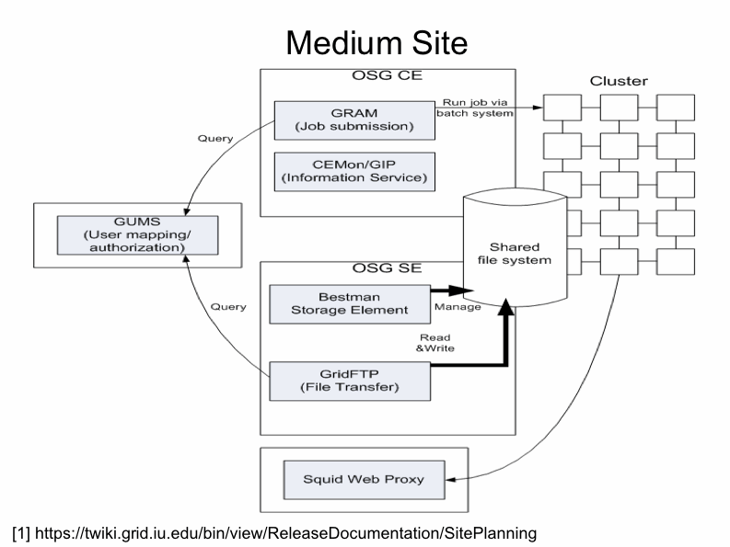
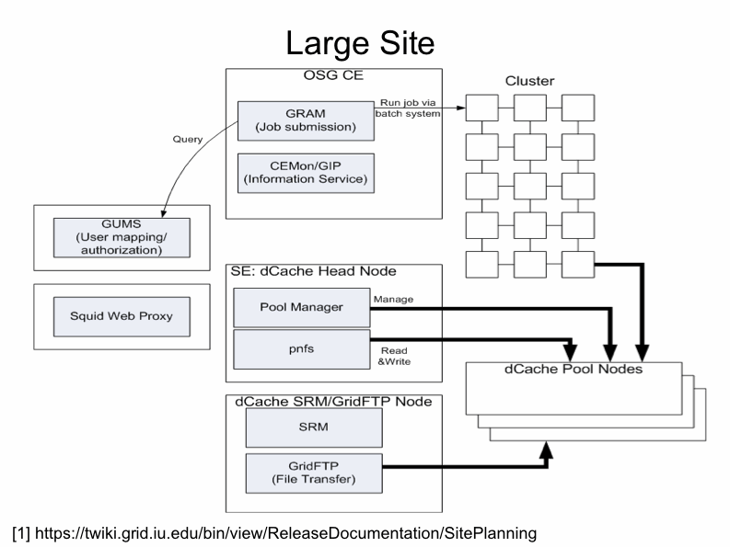
Hardware Architecture

Slide 22
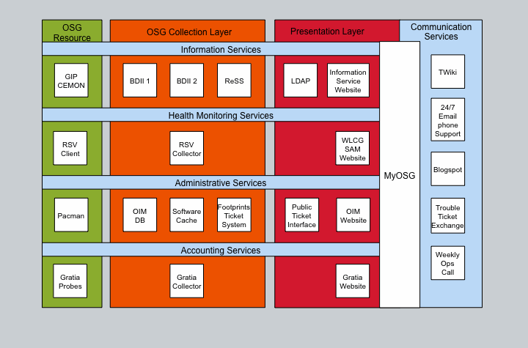
Operations Services

Slide 23
One Proposal or Many?
Based on Council and Executive Team guidance I am saying we plan OSG’ as a single unsolicited proposal to DOE and NSF.
Do we still believe this?

Slide 24
Executive Director-ship
I understand Council Action Item 7 as saying “ED candidates + deputy come forward in May 2010 and election is March 2011”.
I know the OSG budget cannot currently sustain additional staff in March 2011 – ie cannot fund a Deputy as an addition.
Management plan says ED candidates propose their full Executive Team.
I think 3? 5? ED candidates in May 2010 without resolution before March 2011 makes preparing for OSG’ difficult.
I have previously stated I am prepared to continue as ED through new proposal funding + 1 year. I hope that means March/September 2012 at the latest. At last August’s Council meeting I understood a Deputy was a “ED in waiting”.

Slide 25
Recap

Slide 26
Recap: Currently Allocated OSG Budget

Slide 27
Recap Planning for the Future
OSG Funding – Key dates
OSG DOE funding ends 3/15/2011
OSG NSF funding ends 8/31/2011
OSG Fiscal Year5 ends 9/30/2011
We need a plan beyond the currently allocated budget to maintain stakeholder confidence and continue
Support for evolving needs of Stakeholders
Ongoing support for US-LHC & LIGO
Retention of Staff and Expertise

Slide 28
OSG Future Planning Schedule Update - Recap (Planning started at 2009 Council Mtg)
Phase 3 by Dec 2009
Analysis => outline for proposal Not Done. Decided this was premature. Started exploring options.
Document Architecture In progress. See later slides.
Identify particpating senior personnel (and institutions) Not Done
September 2009 submitted joint satellite proposal with TG personnel. Waiting for results of the reviews.
Phase 4 at March 2010 All Hands Meeting
Endorsement of proposal by stakeholders Not Done
Core US LHC/OSG management group met to discuss needs for OSG’ in January 2010.
US LHC response to “dependence on OSG services” sent to DOE/NSF in February – report from them this afternoon.

Slide 29
Oversight
JOT held at Germantown in early December, joint with TeraGrid. Miron, Paul, Ruth. Presentation from Magellan.
Winter 2010: 3 phone meetings from Susan, Rich in ASCR with Miron, Ruth to discuss various topics
Possible review in fall 2010??

