Slide 1

GriPhyN Virtual Data System
Grid Execution of Virtual Data Workflows
Summer Grid 2004
UT Brownsville South Padre Island Center
24 June 2004
Mike Wilde
Argonne National Laboratory
Mathematics and Computer Science Division

Slide 2
Acknowledgements:
Virtual Data is a Large Team Effort
The Pegasus Planner is the work of Ewa Deelman, Gaurang Mehta, and Karan Vahi
The Chimera Virtual Data System
is the work of Ian Foster, Jens Voeckler, Mike Wilde and Yong Zhao
Applications described are the work of many people, including: James Annis, Rick Cavanaugh, Dan Engh, Rob Gardner, Albert Lazzarini, Natalia Maltsev, Marge Bardeen, and their wonderful teams

Slide 3


Acknowledgements
GriPhyN, iVDGL, and QuarkNet
(in part) are supported by the National Science Foundation
The Globus Alliance, PPDG, and QuarkNet are supported in part by the US Department of Energy, Office of Science; by the NASA Information Power Grid program; and by IBM

Slide 4
Functional View of Virtual
Data Management
Application
Location based on
metadata attributes
Metadata Service
Planner:
Data location,
Replica selection,
Selection of compute
and storage
resources
Replica Location
Service
Location of one or
more physical replicas
State of grid resources,
performance measurements
and predictions
Information Services
Security and Policy
Executor:
Initiates
data transfers and
computations
Data Movement
Data Access
Compute Resources
Storage Resources

Slide 5
Outline
Pegasus Introduction
Pegasus and Other Globus Components
Pegasus’ Concrete Planner
Future Improvements

Slide 6
Grid Applications
Increasing in the level of complexity
Use of individual application components
Reuse of individual intermediate data products
Description of Data Products using Metadata Attributes
Execution environment is complex and very dynamic
  Resources come and go
  Data is replicated
  Components can be found at various locations or staged in on demand
Separation between
  the application description
  the actual execution description

Slide 7
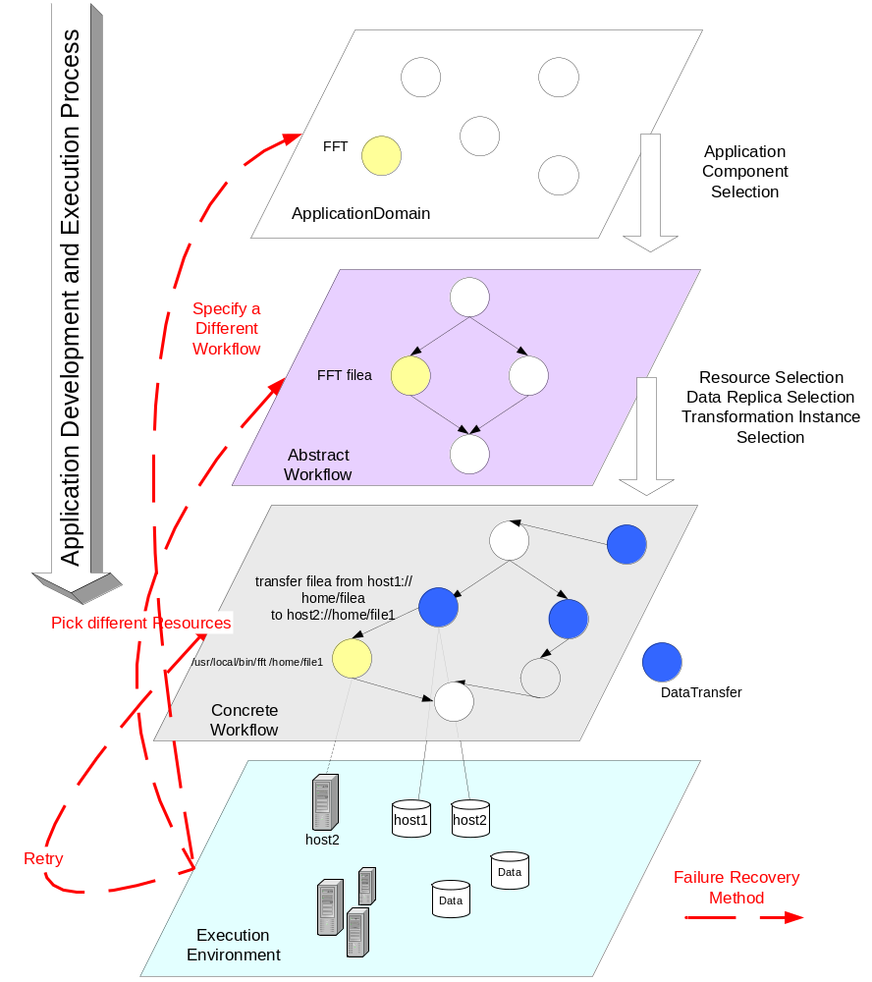
Abstract Workflow Generation
Concrete
Workflow Generation

Slide 8
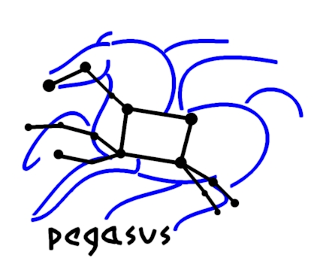
Pegasus:
Planning for Execution in Grids
Maps from abstract to concrete workflow
  Algorithmic and AI based techniques
Automatically locates physical locations for both components (transformations and data)
  Use Globus Replica Location Service and the Transformation Catalog
find appropriate resources to execute
  Via Globus Monitoring and Discovery Serivce
Reuse existing data products where applicable
Publishes newly derived data products
  RLS, Chimera virtual data catalog

Slide 9
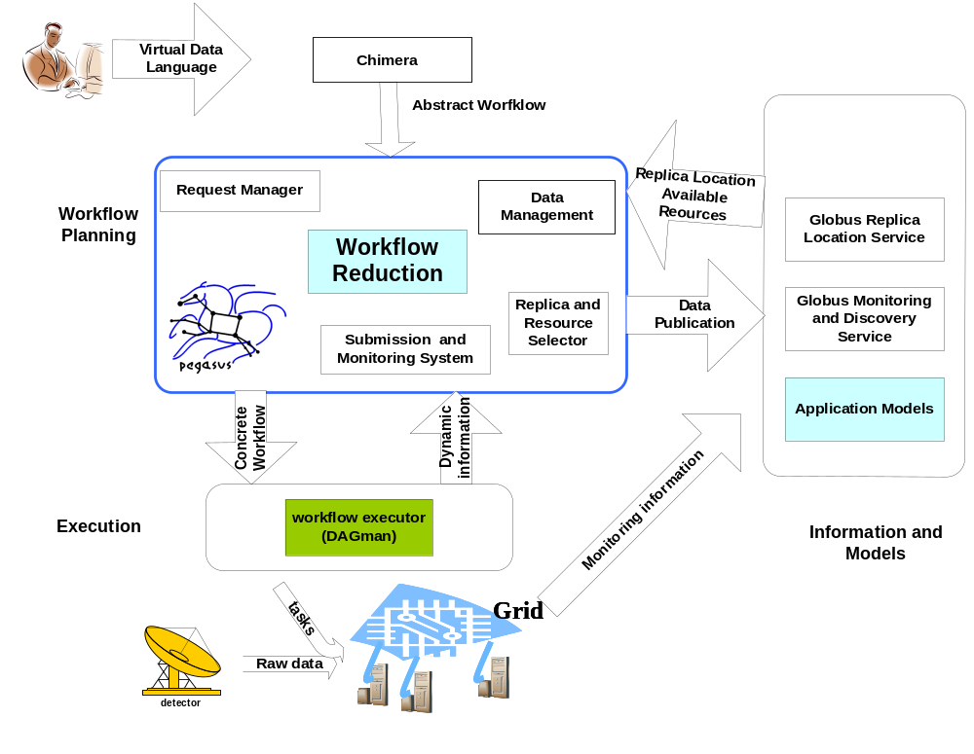

Slide 10
Replica Location Service
Pegasus uses the RLS to find input data
RLI
Computation
LRC
LRC
LRC
Pegasus uses the RLS to register new data products

Slide 11
Use of MDS in Pegasus
MDS provides up-to-date Grid state information
  Total and idle job queues length on a pool of resources (condor)
  Total and available memory on the pool
  Disk space on the pools
  Number of jobs running on a job manager
Can be used for resource discovery and selection
  Developing various task to resource mapping heuristics
Can be used to publish information necessary for replica selection
  Developing replica selection components

Slide 12
Abstract Workflow Reduction
Job c
Job a
Job b
Job f
KEY
The original node
Input transfer node
Registration node
Output transfer node
Node deleted by Reduction algorithm
Job d
Job e
Job g
Job h
Job i
The output jobs for the Dag are all the leaf nodes
  i.e. f, h, I
Each job requires 2 input files and generates 2 output files.
The user specifies the output location.

Slide 13
Optimizing from the point of view of Virtual Data
Job c
Job a
Job b
Job f
KEY
The original node
Input transfer node
Registration node
Output transfer node
Node deleted by Reduction algorithm
Job d
Job e
Job g
Job h
Job i
Jobs d, e, f have output files that have been found in the Replica Location Service.
Additional jobs are deleted.
All jobs (a, b, c, d, e, f) are removed from the DAG.

Slide 14
Planner picks execution and replica locations
Plans for staging data in
Job c
adding transfer nodes for the input files for the root nodes
Job a
Job b
Job f
Job d
Job e
Job g
Job h
KEY
The original node
Input transfer node
Registration node
Output transfer node
Node deleted by Reduction algorithm
Job i

Slide 15
Staging data out and registering
new derived products in the RLS
Job c
Job a
Job b
transferring the output files of the leaf job (f) to the output location
Job f
Job d
Job e
Job g
Job h
Staging and registering for each job that materializes data (g, h, i ).
Job i
KEY
The original node
Input transfer node
Registration node
Output transfer node
Node deleted by Reduction algorithm

Slide 16
The final executable DAG
Input DAG
Job g
Job h
Job c
Job a
Job b
Job i
Job f
Job d
Job e
KEY
The original node
Input transfer node
Registration node
Output transfer node
Job g
Job h
Job i

Slide 17
Pegasus Components
Concrete Planner and Submit file generator (gencdag)
  The Concrete Planner of the VDS makes the logical to physical mapping of the DAX taking into account the pool where the jobs are to be executed (execution pool) and the final output location (output pool).
Java Replica Location Service Client (rls-client & rls-query-client)
  Used to populate and query the globus replica location service.

Slide 18
Pegasus Components (cont’d)
XML Pool Config generator (genpoolconfig)
  The Pool Config generator queries the MDS as well as local pool config files to generate a XML pool config which is used by Pegasus.
  MDS is preferred for generation pool configuration as it provides a much richer information about the pool including the queue statistics, available memory etc.
The following catalogs are looked up to make the translation
  Transformation Catalog (tc.data)
  Pool Config File
  Replica Location Services
  Monitoring and Discovery Services

Slide 19
Transformation Catalog (Demo)
Consists of a simple text file.
  Contains Mappings of Logical Transformations to Physical Transformations.
Format of the tc.data file
  #poolid logical tr physical tr env
  isi preprocess /usr/vds/bin/preprocess VDS_HOME=/usr/vds/;
All the physical transformations are absolute path names.
Environment string contains all the environment variables required in order for the transformation to run on the execution pool.
DB based TC in testing phase.

Slide 20
Pool Config (Demo)
Pool Config is an XML file which contains information about various pools on which DAGs may execute.
Some of the information contained in the Pool Config file is
  Specifies the various job-managers that are available on the pool for the different types of condor universes.
  Specifies the GridFtp storage servers associated with each pool.
  Specifies the Local Replica Catalogs where data residing in the pool has to be cataloged.
  Contains profiles like environment hints which are common site-wide.
  Contains the working and storage directories to be used on the pool.

Slide 21
Pool config
Two Ways to construct the Pool Config File.
  Monitoring and Discovery Service
  Local Pool Config File (Text Based)
Client tool to generate Pool Config File
  The tool genpoolconfig is used to query the MDS and/or the local pool config file/s to generate the XML Pool Config file.

Slide 22
Gvds.Pool.Config (Demo)
This file is read by the information provider and published into MDS.
Format
  gvds.pool.id : <POOL ID>
  gvds.pool.lrc : <LRC URL>
  gvds.pool.gridftp : <GSIFTP URL>@<GLOBUS VERSION>
  gvds.pool.gridftp : gsiftp://sukhna.isi.edu/nfs/asd2/gmehta@2.4.0
  gvds.pool.universe : <UNIVERSE>@<JOBMANAGER URL>@< GLOBUS VERSION>
  gvds.pool.universe : transfer@columbus.isi.edu/jobmanager-fork@2.2.4
  gvds.pool.gridlaunch : <Path to Kickstart executable>
  gvds.pool.workdir : <Path to Working Dir>
  gvds.pool.profile : <namespace>@<key>@<value>
  gvds.pool.profile : env@GLOBUS_LOCATION@/smarty/gt2.2.4
  gvds.pool.profile : vds@VDS_HOME@/nfs/asd2/gmehta/vds

Slide 23
Properties (Demo)
Properties file define and modify the behavior of Pegasus.
Properties set in the $VDS_HOME/properties can be overridden by defining them either in $HOME/.chimerarc or by giving them on the command line of any executable.
  eg. Gendax –Dvds.home=path to vds home……
Some examples follow but for more details please read the sample.properties file in $VDS_HOME/etc directory.
Basic Required Properties
  vds.home : This is auto set by the clients from the environment variable $VDS_HOME
  vds.properties : Path to the default properties file
    Default : ${vds.home}/etc/properties

Slide 24
Concrete Planner Gencdag (Demo)
The Concrete planner takes the DAX produced by Chimera and converts into a set of condor dag and submit files.
Usage : gencdag --dax <dax file> --p <list of execution pools> [--dir <dir for o/p files>] [--o <outputpool>] [--force]
You can specify more than one execution pool. Execution will take place on the pools on which the executable exists. If the executable exists on more then one pool then the pool on which the executable will run is selected randomly.
Output pool is the pool where you want all the output products to be transferred to. If not specified the materialized data stays on the execution pool

Slide 25
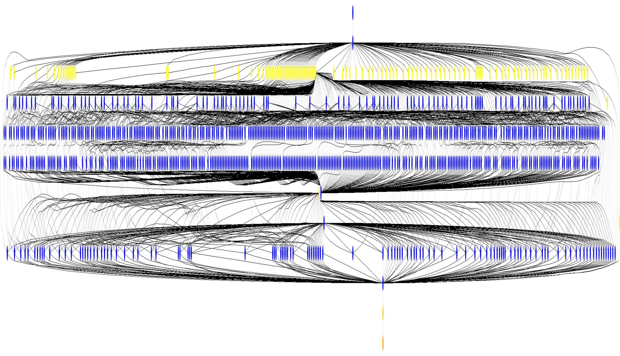
Montage Workflow
1202 nodes

Slide 26
Future Improvements
A sophisticated concrete planner with AI technology
A sophisticated transformation catalog with a DB backend
Smarter scheduling of workflows by deciding whether the workflow is compute intensive or data intensive.
In-time planning.
Using resource queue information and network bandwidth information to make a smarter choice of resources.
Reservation of Disk Space on remote machines

Slide 27
Summary:
GriPhyN Virtual Data System
Using Virtual Data helps in reducing time and cost of computation.
Services in the Virtual Data Toolkit
  Chimera. Constructs a virtual plan
  Pegasus. Constructs a concrete grid plan from this virtual plan.
Some current applications of the virtual data toolkit -

Slide 28
For further information
Globus Project: www.globus.org
Pegasus: pegasus.isi.edu
MCS: www.isi.edu/~deelman/MCS
Chimera : www.griphyn.org/chimera

