Slide 1


Introduction to the
Virtual Desktop Pilot
at Fermilab

Slide 2
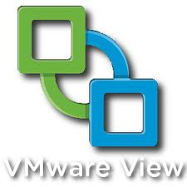

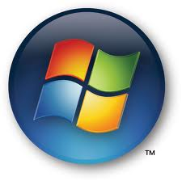
Who are the Major Players?
VMWare View
Citrix XenDesktop
Windows Desktop Virtualization

Slide 3
Why did we choose VMWare View for the Pilot?
VMWare is a market leader in Virtualization, providing commercial support and services for their virtual desktop software.
It is a complete package from a single vendor
View can integrate with our existing Virtualization infrastructure.
We are currently staffed by VMWare certified professionals, reducing the need for additional training or consulting services.
We inherited VMWare View licenses from TD.

Slide 4
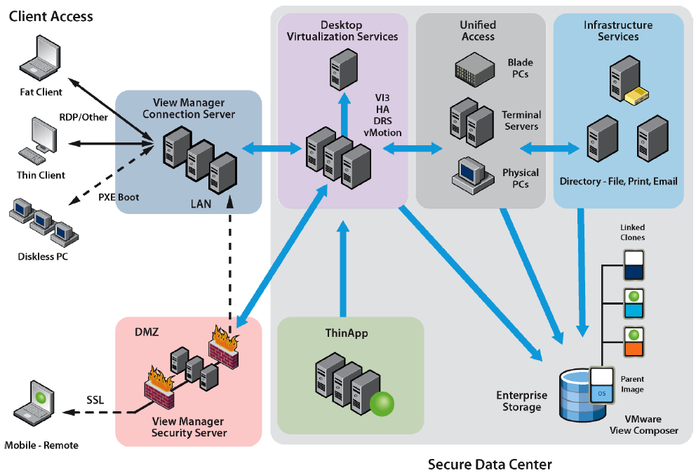
Key Components of VDI
VDI is more than just a Windows desktop OS in a VM!
Virtualization Platform
Connection Protocol
Management Platform
Connection Broker
Application Virtualization
User Profile Management
Client Devices

Slide 5
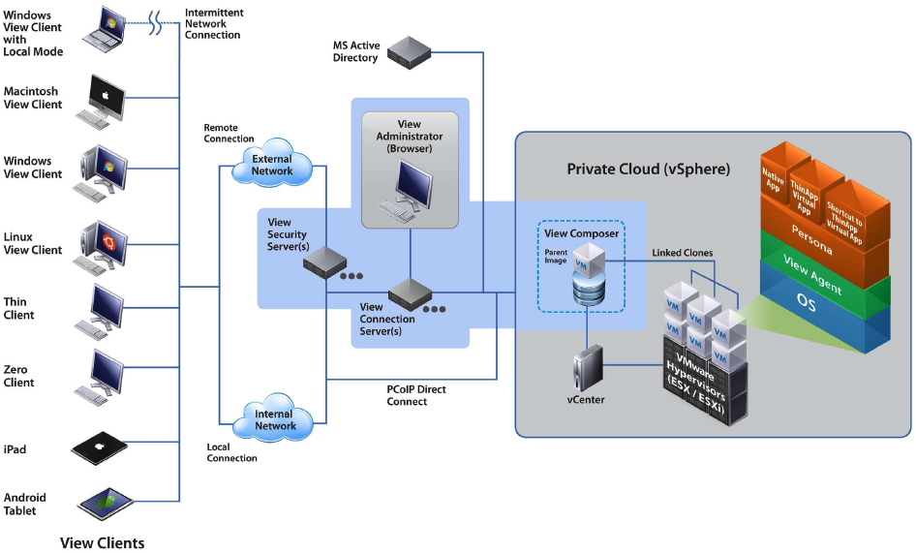
VMWare View Architecture

Slide 6
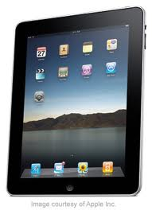

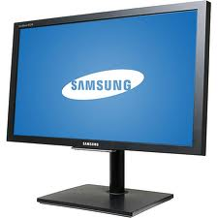
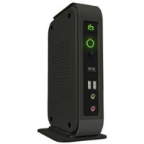
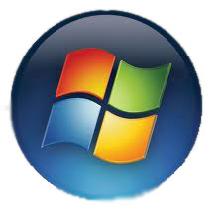
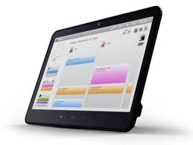
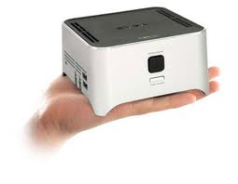

What Devices Does View Support?
Windows Desktops
Mac OS X
Ubuntu Linux
iPad
Android Tablet
PCOIP Zero clients
Thin clients by HP, Wyse, Dell, 10Zig, etc..

Slide 7
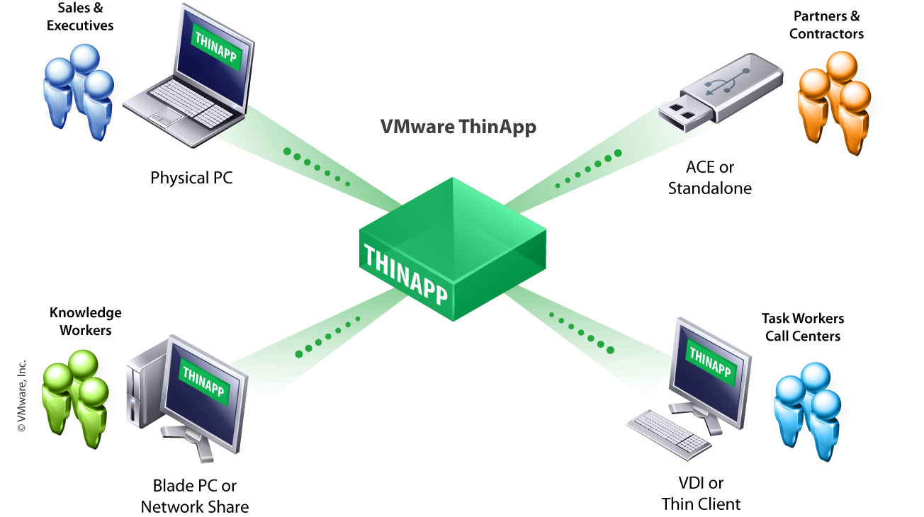
VMWare ThinApp
Application files and registry are encapsulated into a single package that can be run locally, or from a network share.
Thinapp packages can be deployed, managed and updated independently from the OS.
Virtualized applications are not “installed”, and thus make no change to the OS.

Slide 8
Benefits of VDI
Centralized Management
Better Scalability - Increase or decrease VM’s as needed.
Security
Disaster Recovery
BYOD & Remote Office Computing
Better Service Delivery Model
Fits with DOE Virtualization/Green objectives
Pools of VM’s can be deployed, entitled and administered from a central location. Virtual Desktops can be enabled for self-provisioning and user-initiated OS refresh.
New VM’s can be provisioned ‘on the fly’. VM’s are suspended when not in use, saving host resources.
Data is located in the secure datacenter rather than on the user’s desk.
Provision a replacement VM in just a few mouse clicks.
Users can access the same Virtual Desktop whether they are on site, at home, or traveling. VM’s can even be used “offline” with VMWare’s “Offline Desktop” feature.
No more worrying about physical desktop hardware being compatible with the latest Windows OS.

Slide 9
Some Initial Use Cases
Summer Students (BYOD)
Email Kiosk
Training
“Loaner” while primary PC is diagnosed.
“Hot-desk” or multi-workstation users.
Application testing.

