Slide 1
The ATLAS Experiment on the Grid
MWGS08 - September 18, 2008 - Chicago
Marco Mambelli - University of Chicago
marco@hep.uchicago.edu

Slide 2
Outline
The ATLAS VO
ATLAS and the LHC
Computing model
Panda
Panda monitor and ARDA Dashboard
Distributed Data Management
Operation Shifts
Production and Analysis overview
MWGS08 - ATLAS on the Grid - Marco Mambelli
9/18/08

Slide 3
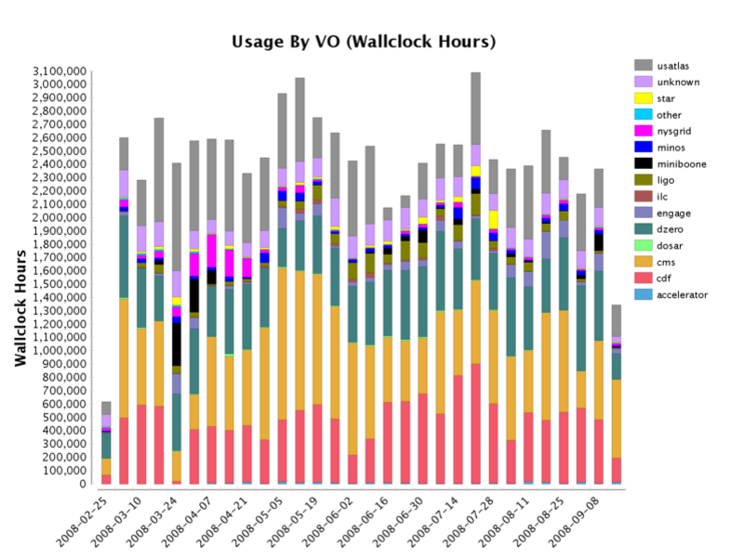
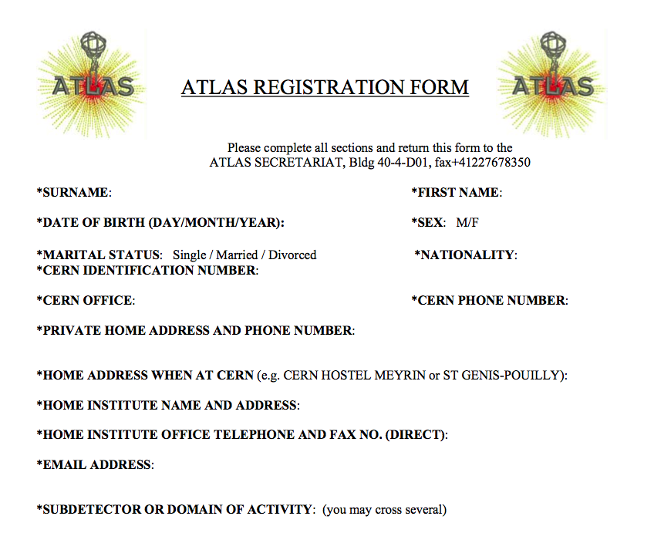
The ATLAS VO
Virtual Organization in OSG (and other Grids)
  In OSG since the beginning
  https://twiki.grid.iu.edu/bin/view/VO/ATLAS
  https://lcg-voms.cern.ch:8443/vo/atlas/vomrs
Collaboration for the ATLAS experiment in the LHC at CERN
  http://atlas.ch/
  http://atlas.web.cern.ch/Atlas/ATLASreg_form.pdf
MWGS08 - ATLAS on the Grid - Marco Mambelli
9/18/08

Slide 4
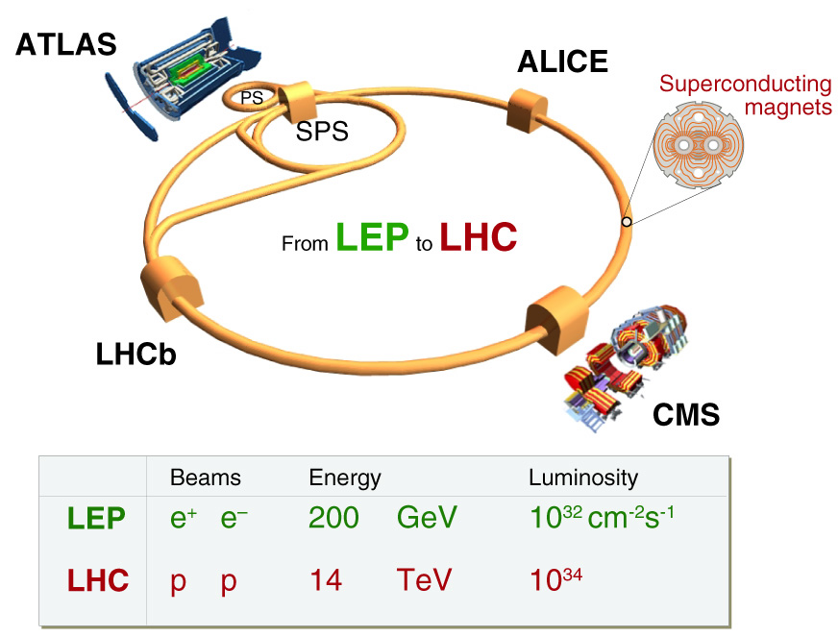
LHC experiment at CERN
http://public.web.cern.ch/public/
http://www.youtube.com/watch?v=j50ZssEojtM
MWGS08 - ATLAS on the Grid - Marco Mambelli
9/18/08

Slide 5
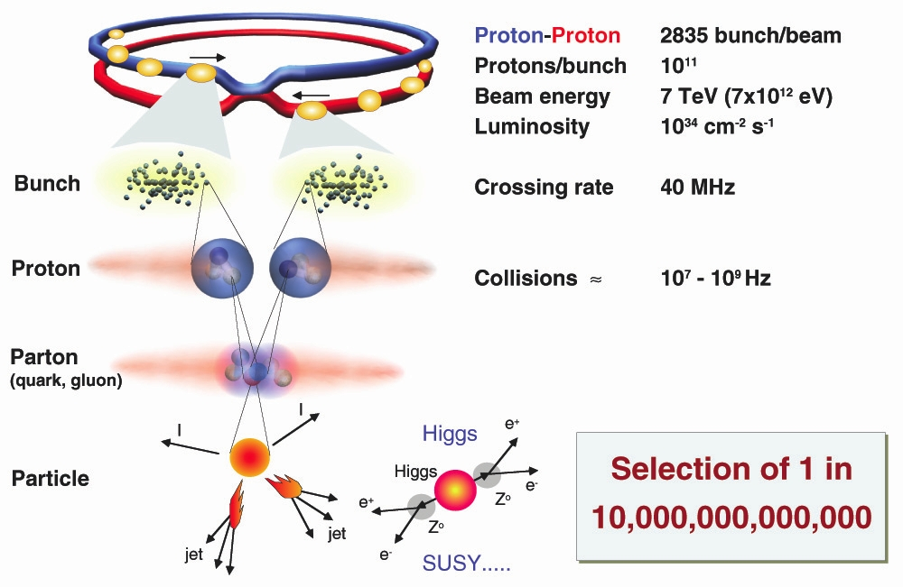
proton-proton collision
Real-time data selection process reduces event rate to 100~200 events/s ➔ 10⁹ events/yr
First beam on
September 10 2008
MWGS08 - ATLAS on the Grid - Marco Mambelli
9/18/08

Slide 6
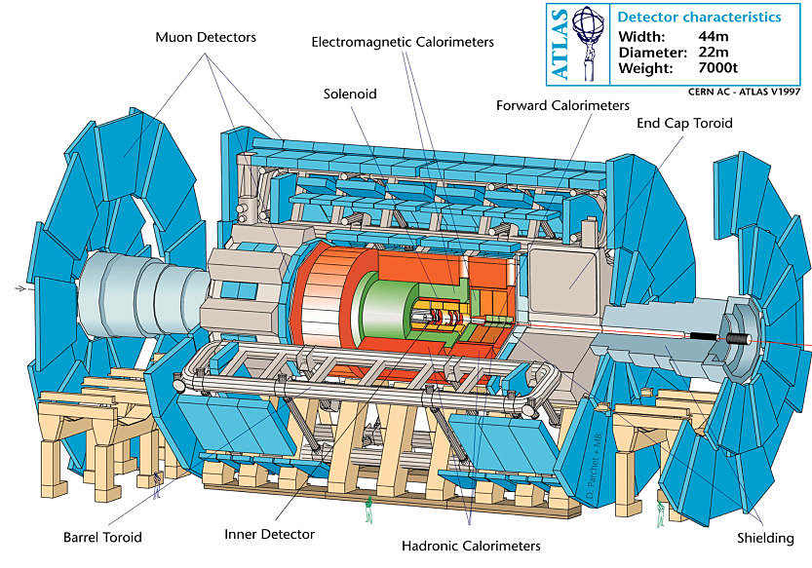
The ATLAS experiment
37 Countries
167 Institutes
~2000 Collaborators
MWGS08 - ATLAS on the Grid - Marco Mambelli
9/18/08

Slide 7
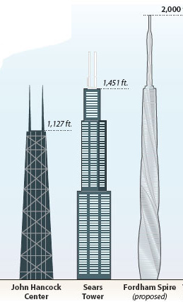
Data produced
2x109 events/yr and 1 event ~ 1.6 MB
ATLAS will record about 3.2 Petabytes of data per year (3.2 million GB)
plus 2-3 times as much simulated data
invites comparisons like “if we wrote one year’s data on DVDs it would make a stack taller than the Sears Tower (1451 feet = 442.3m)”
DVD thickness: 1.2 mm
DVD capacity: 8.5 GB (1-side, 2-layer)
3.2 PB/8.5 GB = 376470 discs = 452 m
MWGS08 - ATLAS on the Grid - Marco Mambelli
9/18/08

Slide 8
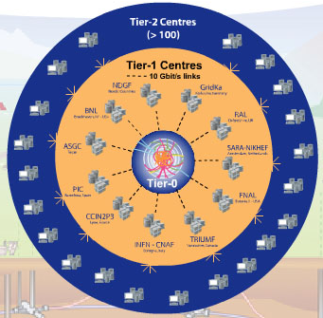
LHC Computing Grid
3 major Grid Environments
  WLCG/EGEE (Enabling Grids for E-sciencE)
  OSG (Open Science Grid)
  NG (NorduGrid)
Grids have differences in
  Middle-ware
  Replica catalogs to store data
  Software tools to submit jobs
MWGS08 - ATLAS on the Grid - Marco Mambelli
9/18/08

Slide 9
Computing hierarchy: the US Cloud
BNL T1
MW T2
UC, IU
NE T2
BU, HU
SW T2
UTA, OU
NW T2
GL T2
UM, MSU
UC T3
UTA DPCC
OU Oscer
Tier 3’s
Wisconsin
UIUC
UTD
LTU
SMU
MWGS08 - ATLAS on the Grid - Marco Mambelli
9/18/08

Slide 10
PANDA
PANDA = Production ANd Distributed Analysis system
  Designed for analysis as well as production
  Project started Aug 2005, prototype Sep 2005, production Dec 2005
  Works both with OSG and EGEE middleware
A single task queue and pilots
  Apache-based Central Server
  Pilots retrieve jobs from the server as soon as CPU is available  late scheduling
Highly automated, has an integrated monitoring system
Integrated with ATLAS Distributed Data Management (DDM) system
Not exclusively ATLAS: has its first OSG user CHARMM
MWGS08 - ATLAS on the Grid - Marco Mambelli
9/18/08

Slide 11

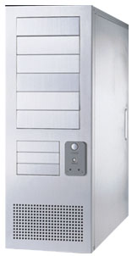

Panda System
DQ2
Panda server
ProdDB
LRC/LFC
bamboo
job
send log
logger
pull
http
https
site B
job
job
pilot
https
submit
site A
submit
pilot
condor-g
Autopilot
End-user
Worker Nodes
MWGS08 - ATLAS on the Grid - Marco Mambelli
9/18/08

Slide 12
Panda Server
clients
DQ2
https
Panda server
LRC/LFC
PandaDB
Apache + gridsite
logger
pilot
Central queue for all kinds of jobs
Assign jobs to sites (brokerage)
Setup input/output datasets
  Create them when jobs are submitted
  Add files to output datasets when jobs are finished
Dispatch jobs
MWGS08 - ATLAS on the Grid - Marco Mambelli
9/18/08

Slide 13
Bamboo
prodDB
Bamboo
Panda server
cx_Oracle
https
Apache + gridsite
cron
https
Get jobs from prodDB to submit them to Panda
Update job status in prodDB
Assign tasks to clouds dynamically
Kill TOBEABORTED jobs
A cron triggers the above procedures every 10 min
MWGS08 - ATLAS on the Grid - Marco Mambelli
9/18/08

Slide 14
Client-Server Communication
HTTP/S-based communication (curl+grid proxy+python)
GSI authentication via mod_gridsite
Most of communications are asynchronous
  Panda server runs python threads as soon as it receives
  HTTP requests, and then sends responses back immediately. Threads do heavy procedures (e.g., DB access) in background  better throughput
  Some are synchronous
Panda Server
Pilot/Client
UserIF
Request
mod_python
Python
obj
serialize
(cPickle)
HTTPS
(x-www-form
-urlencode)
mod_deflate
Python
obj
deserialize
(cPickle)
Python
obj
Response
MWGS08 - ATLAS on the Grid - Marco Mambelli
9/18/08

Slide 15
Panda Job Timeline
Panda
DQ2
submitter
Rely on ATLAS DDM
  Panda sends requests to DDM
  DDM moves files and sends notifications back to Panda
  Panda and DDM work asynchronously
Dispatch input files to T2s and aggregate output files to T1
Jobs get ‘activated’ when all input files are copied, and pilots pick them up
  Pilots don’t have to transfer data (asynchronous)
  Data-transfers and Job-executions can run in parallel
submit Job
subscribe T2 for disp dataset
data transfer
callback
pilot
get Job
run job
finish Job
add files to dest datasets
data transfer
callback
MWGS08 - ATLAS on the Grid - Marco Mambelli
9/18/08

Slide 16
How the pilot works
Sends the several parameters to Panda server for job matching (HTTP request)
  CPU speed
  Available memory size on the WN
  List of available ATLAS releases at the site
Retrieves an `activated’ job (HTTP response of the above request)
  activated  running
Runs the job immediately because all input files should be already available at the site
Sends heartbeat every 30min
Copy output files to local SE and register them to Local Replica Catalogue
MWGS08 - ATLAS on the Grid - Marco Mambelli
9/18/08

Slide 17
Pilot vs ATLAS Job
Pilot
ATLAS Job
Submitted by factories
  autopilot
  cluster factories
Managed by factories
Python code to support ATLAS Job execution
Submitted continuously
Partially accounted
  no big deal if some fail
Submitted by users or production managers (Bamboo)
Managed by Panda Server
Runs Athena software (ATLAS libraries)
Submitted when needed
Fully accounted
  error statistics
MWGS08 - ATLAS on the Grid - Marco Mambelli
9/18/08

Slide 18
Some monitoring resources
The following pages present some monitoring example
Screenshots are just example pages, actual content varies
URLs are one of the possible URLs providing a similar page
  e.g. queries may vary the actual Site or Time interval
Main URLs:
  DDM Dashboard: http://dashb-atlas-data-test.cern.ch/dashboard/request.py/site
  Panda Monitor: http://pandamon.usatlas.bnl.gov:25880/ or http://panda.atlascomp.org/?redirect=pandamon
  (hostname may change since there are multiple servers)
Take time to navigate Panda Monitor and the Dashboard
MWGS08 - ATLAS on the Grid - Marco Mambelli
9/18/08

Slide 19
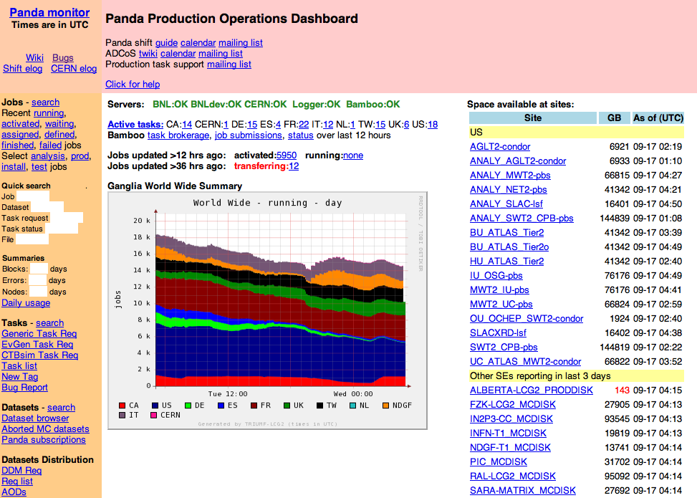
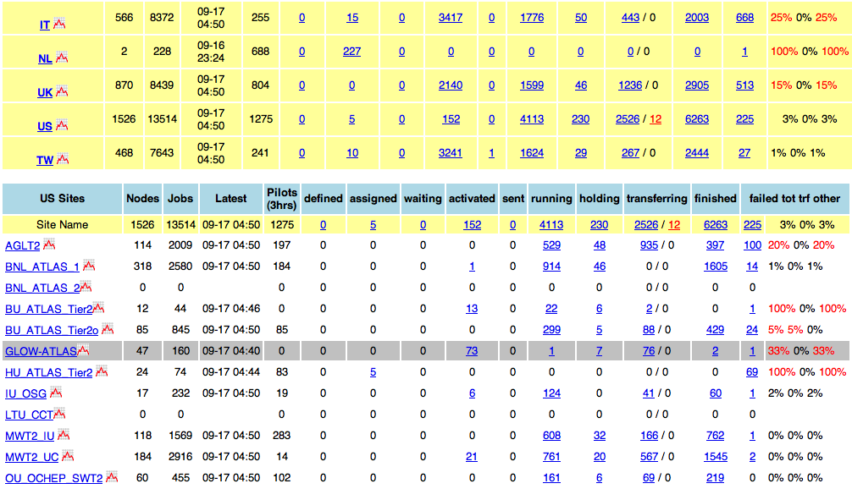
Panda Monitor: production dashboard
http://pandamon.usatlas.bnl.gov:25880/server/pandamon/query?dash=prod
MWGS08 - ATLAS on the Grid - Marco Mambelli
9/18/08

Slide 20
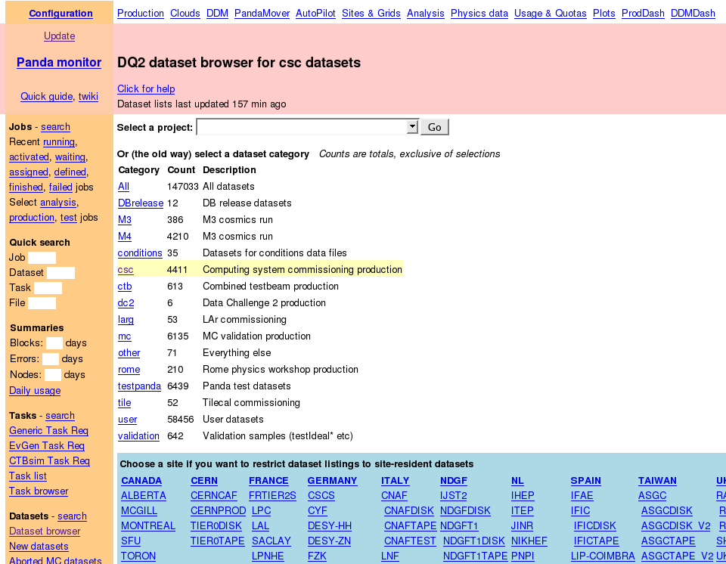
Panda Monitor: Dataset browser
http://pandamon.usatlas.bnl.gov:25880/server/pandamon/query?overview=dslist
MWGS08 - ATLAS on the Grid - Marco Mambelli
9/18/08

Slide 21
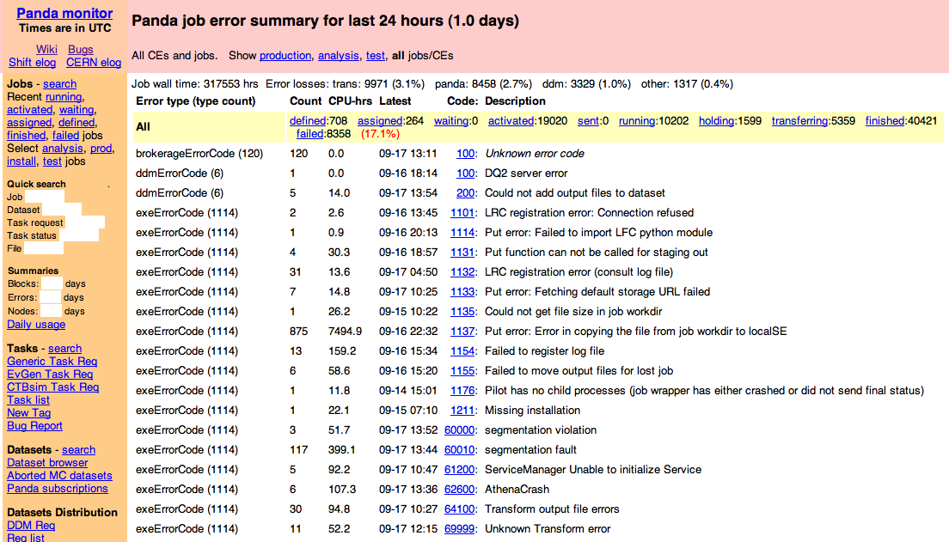
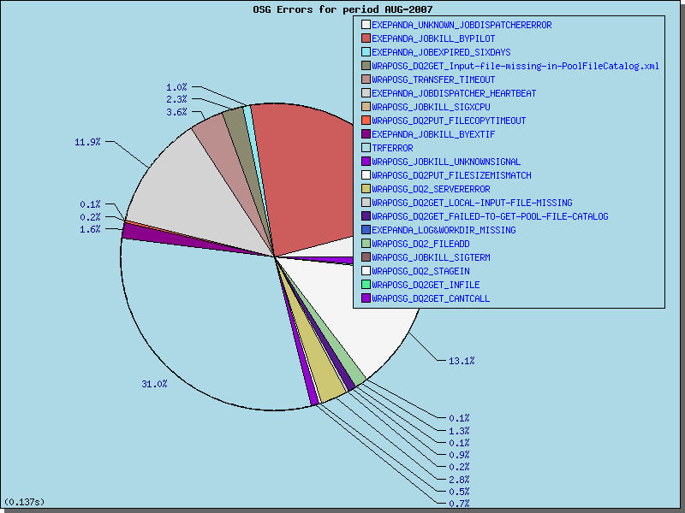
Panda Monitor: error reporting
http://pandamon.usatlas.bnl.gov:25880/server/pandamon/query?days=1&overview=errorlist
MWGS08 - ATLAS on the Grid - Marco Mambelli
9/18/08

Slide 22
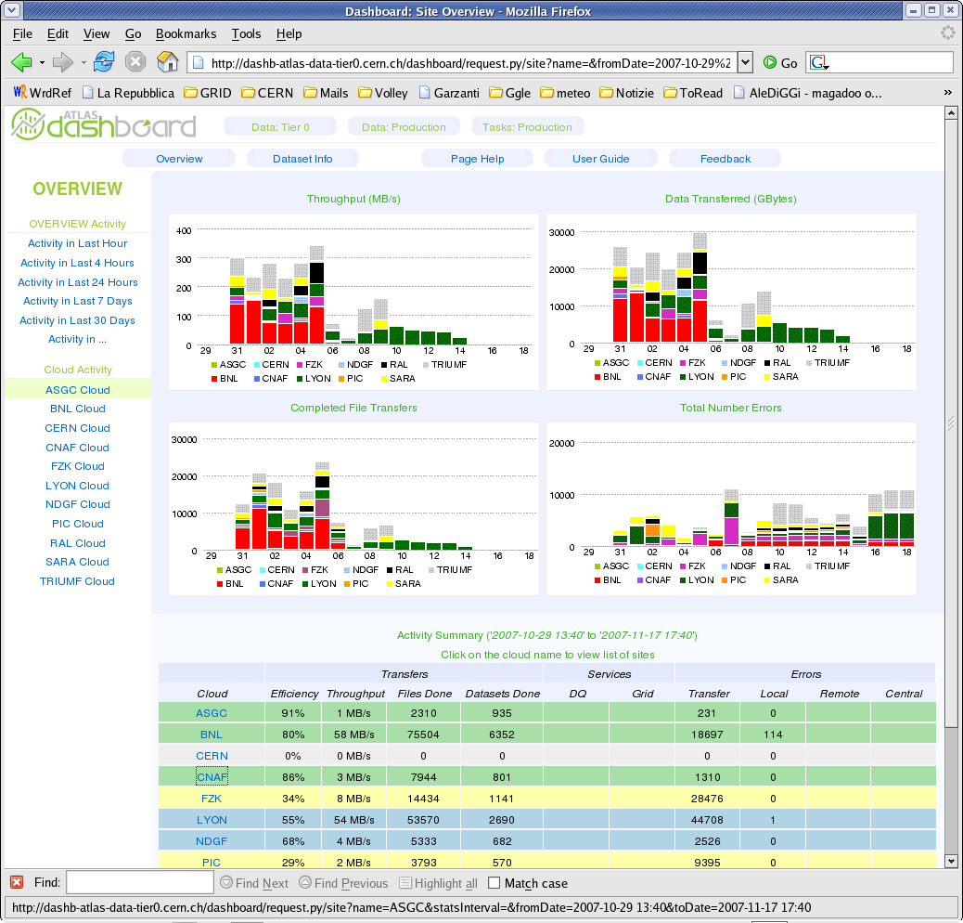
DDM Dashboard: overview
http://dashb-atlas-data-test.cern.ch/dashboard/request.py/site
MWGS08 - ATLAS on the Grid - Marco Mambelli
9/18/08

Slide 23
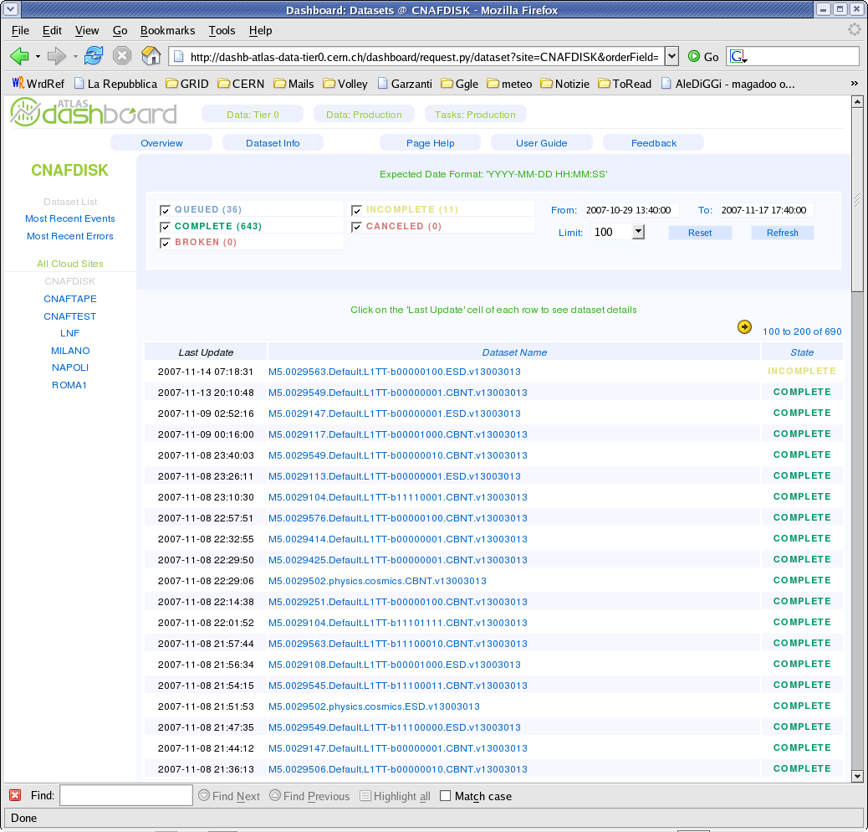
DDM Dashboard: Dataset detail
http://dashb-atlas-data-test.cern.ch/dashboard/request.py/dataset?site=AGLT2_DATADISK
MWGS08 - ATLAS on the Grid - Marco Mambelli
9/18/08

Slide 24
ATLAS Data Management Software:
Don Quijote
DQ2 - Don Quijote (second release)
DQ2 is built on top of Grid data transfer tools
  Dataset based approach
    Datasets : an aggregation of files plus associated DDM metadata
      Open: latest version is open, so new files may be added or existing files may be removed
      Closed: latest version is closed, no changes can be done, but a new version may be created
      Frozen: latest version is closed, No versions may be added
    Datasets is a unit of storage and replication
    Automatic data transfer mechanisms using distributed site services
      Subscription system
      Notification system
  Hierarchical structure
    Sites subdivided in ‘clouds’
    Topology in TiersOfATLASCache.py
MWGS08 - ATLAS on the Grid - Marco Mambelli
9/18/08

Slide 25
Cloud Structure
All Tier-1s have predefined (software) channel with CERN
and with each other.
Tier-2s are associated with one Tier-1 and form the cloud
Tier-2s have predefined channel with the parent Tier-1 only.
NG
PIC
RAL
CNAF
SARA
TWT2
T3
CERN
grif
ASGC Cloud
LYON Cloud
lpc
ASGC
LYON
Melbourne
Tokyo
Beijing
FZK
TRIUMF
lapp
Romania
BNL
BNL Cloud
T1-T1 and T1-T2 associations according to GP ATLAS Tiers associations.
NET2
GLT2
wisc
T1
WT2
MWT2
T2
T3
VO box, dedicated computer
to run DDM services
SWT2
MWGS08 - ATLAS on the Grid - Marco Mambelli
9/18/08

Slide 26
Simplified DDM Schema and interactions
Part of DQ2
DQ2 dataset
catalogs
Not part of DQ2
Not part of DQ2
File
Transfer
Service
DQ2
“Queued
Transfers”
Local
File
Catalog
DQ2
Subscription
Agents
MWGS08 - ATLAS on the Grid - Marco Mambelli
9/18/08

Slide 27
Subscriptions
Subscription
  Request for the full replication of a dataset (or dataset version) at a given site
Requests are collected by the centralized subscription catalog
And are then served by a site of agents – the site services
Subscription on a dataset version
  One time only replication
Subscription on a dataset
  Replication triggered on every new version detected
  Subscription closed when dataset is frozen
MWGS08 - ATLAS on the Grid - Marco Mambelli
9/18/08

Slide 28
Site Services
Agent based framework
Goal: Satisfy subscriptions
Each agent serves a specific part of a request
  Fetcher: fetches up new subscription from the subscription catalog
  Subscription Resolver: checks if subscription is still active, new dataset versions, new files to transfer, …
  Splitter: Create smaller chunks from the initial requests, identifies files requiring transfer
  Replica Resolver: Selects a valid replica to use as source
  Partitioner: Creates chunks of files to be submitted as a single request to the FTS
  Submitter/PendingHandler: Submit/manage the FTS requests
  Verifier: Check validity of file at destination
  Replica Register: Registers new replica in the local replica catalog
  …
MWGS08 - ATLAS on the Grid - Marco Mambelli
9/18/08

Slide 29
Interaction with the grid middleware
File Transfer Services (FTS)
  One deployed per Tier0 / Tier1 (matches typical site services deployment)
  Triggers the third party transfer by contacting the SRM or Gridftp servers, needs to be constantly monitored
LCG File Catalog (LFC)
  One deployed per Tier0 / Tier1 (matches typical site services deployment)
  Keeps track of local file replicas at a site
  Main source of replica information by the site services
  Currently is deployed as LRC (alternative version)
Storage Resource Manager (SRM)
  Extra level of abstraction on top of file transfers (e.g. gridftp)
  Allows operations like pinning and space reservation
MWGS08 - ATLAS on the Grid - Marco Mambelli
9/18/08

Slide 30
ADC Operations Shifts
ATLAS Distributed Computing Operations Shifts (ADCoS)
  World-wide shifts
  24h coverage (Asia, EU, USA)
  To monitor all ATLAS distributed computing resources
  To provide Quality of Service (QoS) for all data processing
  Shifters receive official ATLAS service credit (OTSMoU)
MWGS08 - ATLAS on the Grid - Marco Mambelli
9/18/08

Slide 31
Typical Shift Plan
Browse recent shift history
Check performance of all sites
  File tickets for new issues
  Continue interactions about old issues
Check status of current tasks
  Check all central processing tasks
  Monitor analysis flow (not individual tasks)
  Overall data movement
File software (validation) bug reports
Check Panda, DDM health
Maintain elog of shift activities
MWGS08 - ATLAS on the Grid - Marco Mambelli
9/18/08

Slide 32
Shift Structure
Shifter on call
  Two consecutive days
  Monitor – escalate – follow up
  Basic manual interventions (site – on/off)
Expert on call
  One week duration
  Global monitoring
  Advice shifter on call
  Major interventions (service - on/off)
  Interact with other ADC operations teams
  Provide feed-back to ADC development teams
Tier 1 expert on call
  Very important
MWGS08 - ATLAS on the Grid - Marco Mambelli
9/18/08

Slide 33
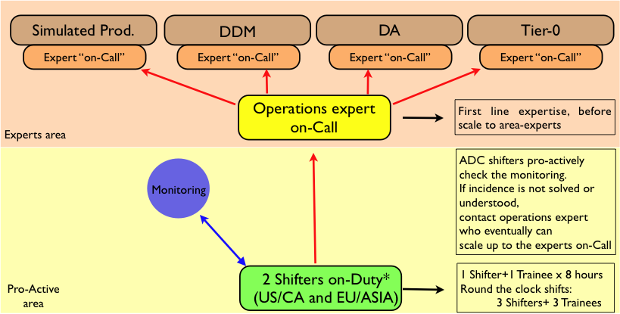
Shift Structure Schematic
MWGS08 - ATLAS on the Grid - Marco Mambelli
9/18/08

Slide 34
Production and Analysis jobs
[Managed] Production
Analysis
Panda
Production queues
MC simulation, FDR, Detector data processing
Centrally managed
Bamboo
Triggers data transfer (DDM, FTS channels)
Panda
Analysis queues
Varies, Data Analysis, Plot generation
User driven
Pathena
Does not trigger data transfer (active staging)
MWGS08 - ATLAS on the Grid - Marco Mambelli
9/18/08

Slide 35
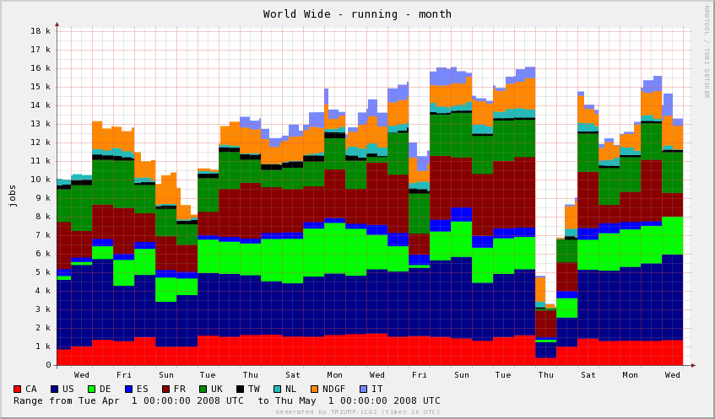
Monthly production overview
http://gridinfo.triumf.ca/panglia/
MWGS08 - ATLAS on the Grid - Marco Mambelli
9/18/08

Slide 36
For more information
Panda twiki:
https://twiki.cern.ch/twiki/bin/view/Atlas/PanDA
Panda development portal:
https://savannah.cern.ch/projects/panda/
Panda software repositories:
  http://atlas-sw.cern.ch/cgi-bin/viewcvs-atlas.cgi/offline/Production/panda/
  http://www.usatlas.bnl.gov/svn/panda/
DDM (DQ2):
https://twiki.cern.ch/twiki/bin/view/Atlas/DistributedDataManagement
ATLAS:
http://atlas.ch/
MWGS08 - ATLAS on the Grid - Marco Mambelli
9/18/08

Slide 37
Acknowledgement
The content presented is based on material provided by the Panda development team or the ATLAS shift team
Specially I’d like to thank:
  Kaushik De
  Tadashi Maeno
  Xavier Espinal
MWGS08 - ATLAS on the Grid - Marco Mambelli
9/18/08

