Slide 1
OSG as an XSEDE SP
XSEDE Has started.
Dan & Marco at the XSEDE Campus Champions discussion and tutorial sessions in Salt Lake City. At least one new application engagement as a result.
Kim’s slides include OSG. John clear that OSG a partner.
DanK presented ExTENCI application across OSG and XSEDE – looking for next application to show case in the fall.
John & Miron started to talk about how the allocation process might work.
Derek & Jim prototyping showing OSG and other XSEDE SP usage for ExTENCI.
Next steps with Kim being defined.

Slide 2
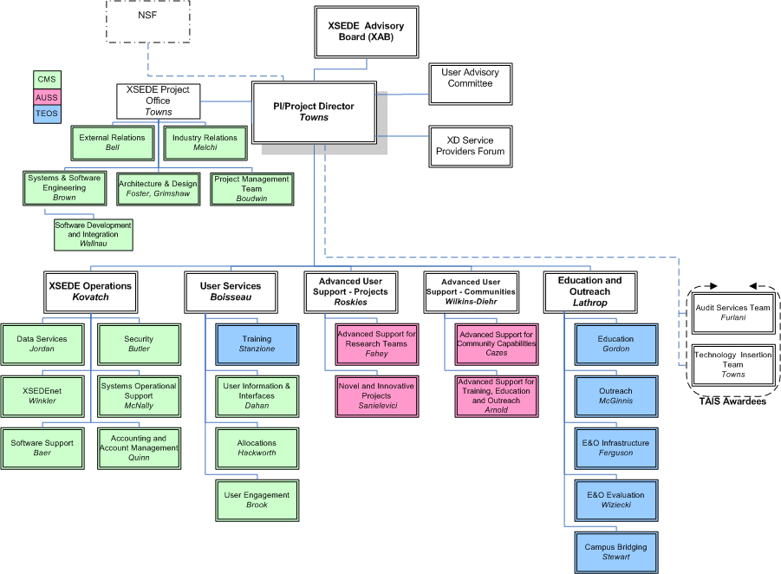
XSEDE Org Chart

