Slide 1





Open Science Grid
Collaborative Science
On a National Cyberinfrastructure
part of the Wordwide Federated Grids
Ruth Pordes, OSG Executive Director, Fermilab
Globus World March 2nd 2010
Project supported by the Department of Energy Office of Science SciDAC-2 program from the High Energy Physics, Nuclear Physics and Advanced Software and Computing Research programs, and the National Science Foundation Math and Physical Sciences, Office of CyberInfrastructure and Office of International Science and Engineering Directorates.

Slide 2
Open Science Grid
Services and
Infrastructure
End-to-End
Community
Systems
“Local to
Global”
Contributions
OSG does not own processing, storage, networking and does not develop software.
Executive
Board
Science
Community
$
DOE
Software
Provider
Consortium
Project
$
NSF
Resource
Provider
..
..
Satellite
Project
Satellite
Project

Slide 3
We take the “P” and “M” seriously
Project Management Process, Planning and Goal Setting
Staff at 16 institutions & about 3, 4 FTE of effort by about 50 staff members organized into functional work areas (e.g. Operations, Security, Education, etc.) each of which is led by an Area Coordinator
Project year starts in October and ends in September, program planned one year at a time starting in June preceding the start of each project year. five sub-processes Strategic Planning and Goal Setting
WBS and Staffing Plan, Budget Allocation and Statements of Work , Execution Management , Closure and Feedback
Also mid-year corrections and updates to the plan as warranted by changes in staffing or needs of key stakeholders. OSG Council provides high-level input from the science stakeholders for the goal setting process.
June of each year, develop high level strategic initiatives to drive each of the functional area of work. Inputs from the original work proposal, plans of the key science stakeholders, evolution in technologies, feedback from the progress made and specific inputs from funding agency stakeholders. Area Coordinators develop high level goals describing their major work items; e.g. Recruit and develop three new science communities in achieving production
Reviewed to insure alignment; shared across the Area Coordinators then we proceed to WBS and staff planning.
3. WBS and Staffing Plan, Budget Allocation & SOWs
Transform these goals into a WBS with tasks and dates. Can move staff from one functional area to another (assuming a match in technical capability) as required by the work program. OSG staff retreat, provides peer review and ensure alignment of work
Budget plan reviewed and approved by the OSG Executive team and then concurred to by the OSG Council. The Statements of Work Overview of the work and responsibilities with high-level goals,
Specific tasks directly extracted from the WBS.Specific staffing commitments along with percent FTE and responsibilities.Specific budget allocations spanning NSF and DOE sources (directly extracted from the budget plan), and a set of common operating guidelines, terms and conditions, and principles that define the relationship between OSG and each participating institution.
The Statements of Work are then routed for approval
Status updates are solicited from the WBS owners on a monthly basis and, as needed, issues are discussed and managed. Each functional area presents their status every 6-8 weeks at a teleconference meeting.
St the end of September, a final WBS status update is undertaken. A set of metrics show what parts of the project were completed and which WBS items remain incomplete.

Slide 4
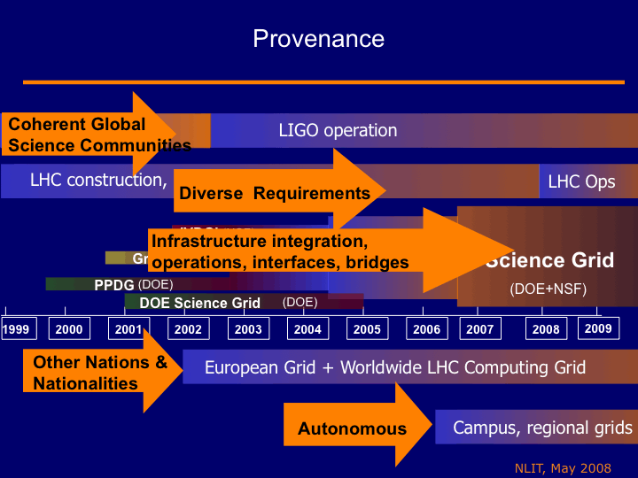
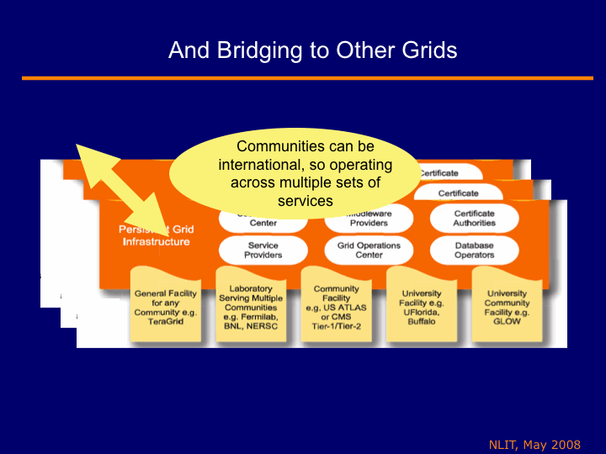
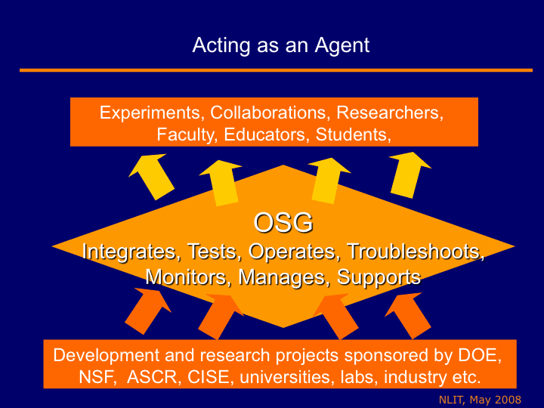
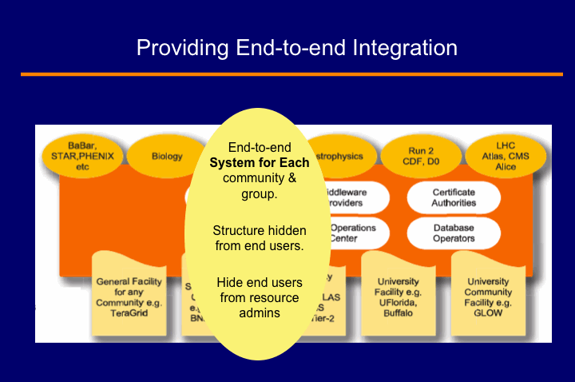

Slide 5
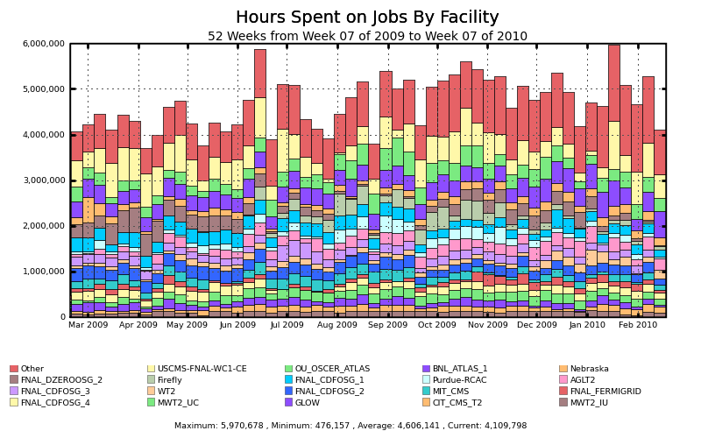
Use by Site
4,000,000 a week
20 Sites represented explicitly. Largest contribution is “other”.
Peak doubled, average more than doubled, in 2 years;

Slide 6
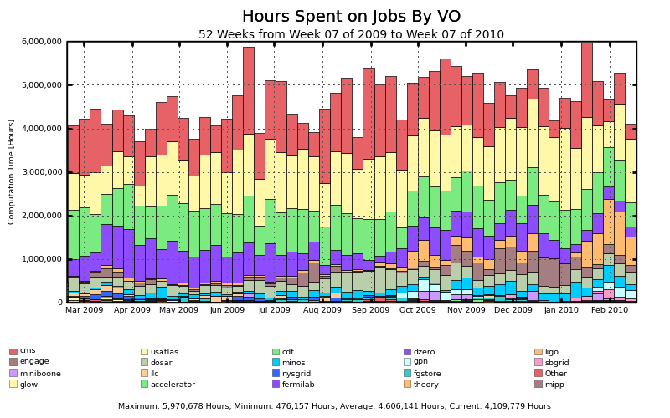
Use by Community
Curve shows “not-big 4” also ~doubled

Slide 7
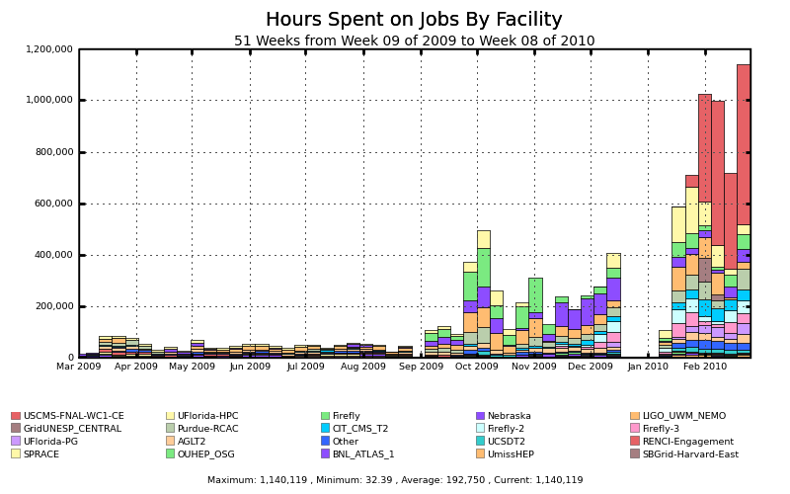
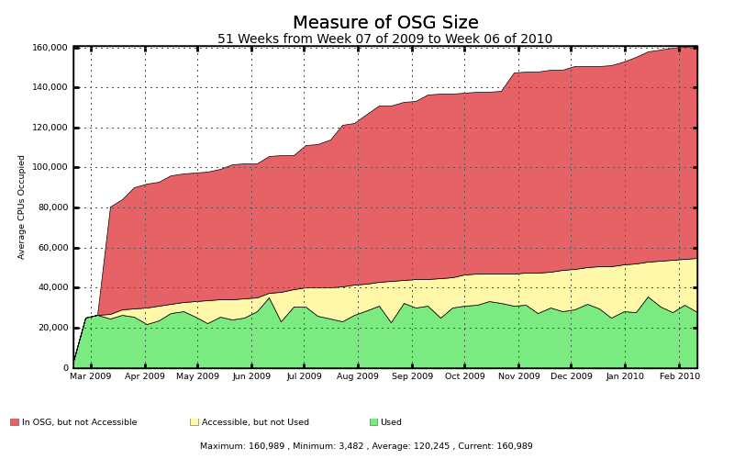
“Site Filler” – not there yet!! LIGO BOINC based Einstein@home
We determine the approximate size of the OSG by measuring how many compute hours per day are being reported, then dividing by 24. This establishes a good minimum bar for the size of the OSG, but is an under-estimate because not all resources are used every day.
For each site, we calculate the accessible cores by looking at the maximum usage over the past year. This assumes that the site has been utilized at its maximum capacity at some point in the last year.. This metric is based on actual usage.
The total cores of the OSG. This is the number of cores the site has in its batch system. Due to the fact that many sites have a batch system configuration which limits the number of grid jobs that can run, this metric is usually an over-estimate.

Slide 8
LHC Core Stakeholder
Global single "sign-on" system used by >1k physicists to
o understand the experimental apparatus
o develop & refine software to process the "raw" data
o develop & refine software to analyze the refined data and derive scientific results
Tiered Structure
o globally distributed archival storage: National Labs in US, Germany, Italy, France, Spain, UK, Taiwan
Live archive & primary processing
o globally distributed analysis infrastructure: ~50 clusters of 0.1-10k cores and 0.1-1 Petabyte disk
- analysis to derive scientific results

Slide 9
Multi-Layered VOs
The Experiments
CMS
ATLAS
US CMS
US ATLAS
Common Aspects
of LHC Experiments
WLCG
The Grids
EGEE
OSG

Slide 10
Engagement - our word for immersive, embedded help and training
Bring the power of the OSG to scientists, educators, and campus beyond the physics domain…
and to use these experiences with new users and domains to drive new requirements to evolve the OSG.

Slide 11
Support and Sharing of Software and Knowledge
Virtual Data Toolkit – many different collections for sites, users, managers, grids
OSG specific configurations and tools.
Only required service is Accounting!

Slide 12








Architecture of S/W
e.g.
OSG
Users, User Applications,
Community Wide Common Software and Support
Software, Services & People to help
(~60 modules)
Processing, Storage, Data and Administrators,
(at ~75 US Labs and Universities)

Slide 13
Using Federated Infrastructures
Users, User Applications, Communities
Science, Research, Education, Training
Software Toolkit 1
Software Toolkit 2
Infrastructure A
Infrastructure B
Bridging Software

Slide 14
OSG and Globus
Core use and support of GSI, GridFTP, GRAM 2,
Common/interoperable Authz call-out protocols.
Starting to integrate with scientific cloud frameworks.
Commonality of stakeholders and therefore commonality of needs.
Every 6 weeks Collaboration phone-cons cover issues, testing, new releases, futures… more on this from later speakers.

Slide 15
OSG & TeraGrid(XD)?
Joint Statement of Agreed Upon Principles between OSG and TeraGrid, July 30th 2009 https://osg-docdb.opensciencegrid.org:440/cgi-bin/RetrieveFile?docid=882&version=1&filename=OSG_TG_SharedPrinciples_v4.pdf
OSG works with all XD teams equivalenty.
Task Mission/Goals | TG Owner | OSG Owner | Stage
OSG & TG Joint Activity Tracking and Reporting | Tim Cockerill | Chander Sehgal | Active
iSGTW continuation and joint support plan; proposal for US based contributions | Elizabeth Leake | Judy Jackson | Planning
Resource Allocation Analysis and Recommendations | Kent Milfeld | Miron Livny, Chander Sehgal | Planning
Resource Accounting Inter-operation and Convergence Recommendations | Kent Milfeld, David Hart | Phillip Canal, Brian Bockelman | Planning
Explore how campus outreach and activities can be coordinated | Kay Hunt, Scott Lathrop | John McGee, Ruth Pordes | Active
SCEC Application to use both OSG & TG | Dan Katz | John McGee, Mats Rynge | Active
Joint Middleware Distributions (Client side) | Lee Liming, J.P. Navarro | Alain Roy, ? | Active
Security Incidence Response | Jim Marsteller, Randy Butler | Mine Altunay, Jim Barlow | Active
Workforce Development | John Towns, Scott Lathrop | Ruth Pordes, Miron Livny | Planning
Joint Student Activities | Scott Lathrop, Laura McGiness | David Ritchie, Jim Weichel | Active
Infrastructure Policy Group | J.P. Navarro, Phil Andrews | Ruth Pordes, Miron Livny | Active

Slide 16
Communications & Outreach
International Science Grid This Week (iSGTW).
International Grid Summer Schools – now one in the US
Monthly OSG newsletter.
Grid schools in Colombia and collaboration with Sao Paolo State Grid in Brazil.
EGEE, EGI, EMI: 17 points of contact once count all the working groups, security and operations, software activities.
Goal to integrate into OSG program of work and increase collaboration with others.

Slide 17
Happening “now”
LHC data taking and Analysis.
Increased usage by a number of communities.
Start to look to integrate commercial and scientific clouds, support “small-scale parallelism” applications, interface to Magellan/FutureGrid/
Try and improve Usability and lower the threshold to sustained use.

