Slide 1
Introduction to High Throughput Computing and HTCondor
Monday AM, Lecture 1
Ian Ross
Center for High Throughput Computing
University of Wisconsin-Madison

Slide 2
Keys to Success
Work hard
Ask questions!
…during lectures
...during exercises
...during breaks
...during meals
If we do not know an answer, we will try to find the person who does.

Slide 3
Goals for this Session
Understand the basics of High Throughput Computing (HTC)
Understand a few things about HTCondor, which is one kind of HTC system
Use basic HTCondor commands
Run a job locally

Slide 4
Serial Computing
What most
programs look like:
time
Serial execution, running on one processor at a time
Overall compute time grows significantly as individual tasks get more complicated and number of tasks in a workflow increase
How can you speed things up?

Slide 5
Parallelized Computing
Parallelize!
Use more processors to break up the work!

Slide 6
High Throughput Computing (HTC)
Independent tasks
“Embarrassingly” parallel
n cores
time

Slide 7
High Throughput Computing (HTC)
Scheduling: Only need to find 1 CPU at a time (shorter wait)
Easy recovery from failure
No special programming required
Number of concurrently running jobs is more important
CPU speed and homogeneity are less important
n cores
time

Slide 8
High Performance Computing (HPC)
Interdependent sub-tasks
n cores
…
time
…
…
…

Slide 9
High Performance Computing (HPC)
Benefits greatly from:
Shared filesystems
Fast networking (e.g. Infiniband)
CPU speed + homegeneity
Scheduling: Must wait for (and reserve) multiple processors for full duration
Often requires special code
Focus on biggest, fastest systems (supercomputers)
n cores
time
…
…
…
…

Slide 10

HPC vs HTC: An Analogy

Slide 11


HPC vs HTC: An Analogy

Slide 12
High Throughput vs High Performance
HTC
HPC
Focus: Workflows with many small, largely independent compute tasks
CPU speed and homogeneity are less important
Focus: Workflows with large, highly coupled tasks
Supercomputers, highly specialized code, benefit from shared filesystems and fast networks

Slide 13
Research Computing
When considering a strategy for your research computing, there are two key considerations:
Is your problem HTC-able?
Which available resources are best?

Slide 14
Is your research HTC-able?
Can it be broken into fairly small, independent pieces?
Easy to ask, harder to answer!
Think about your research! Can you think of a good high throughput candidate task? Talk to your neighbor!

Slide 15
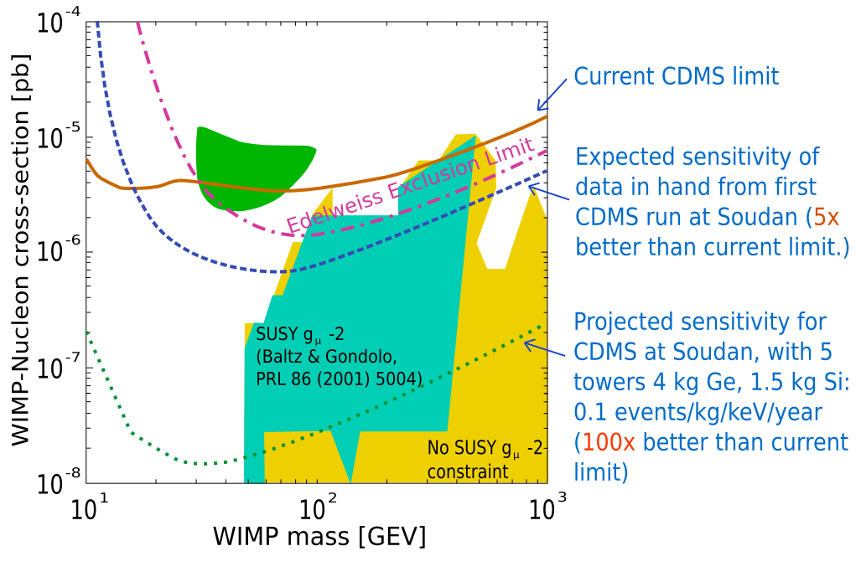
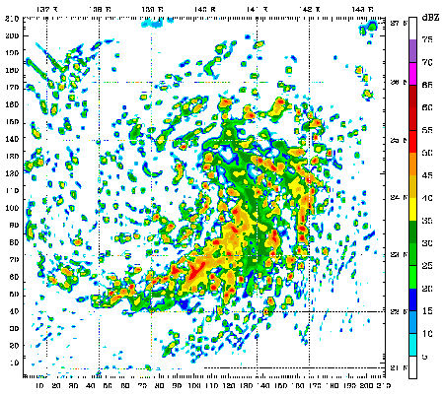
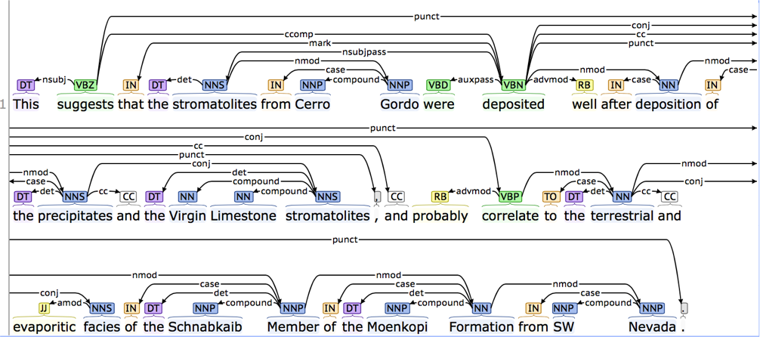
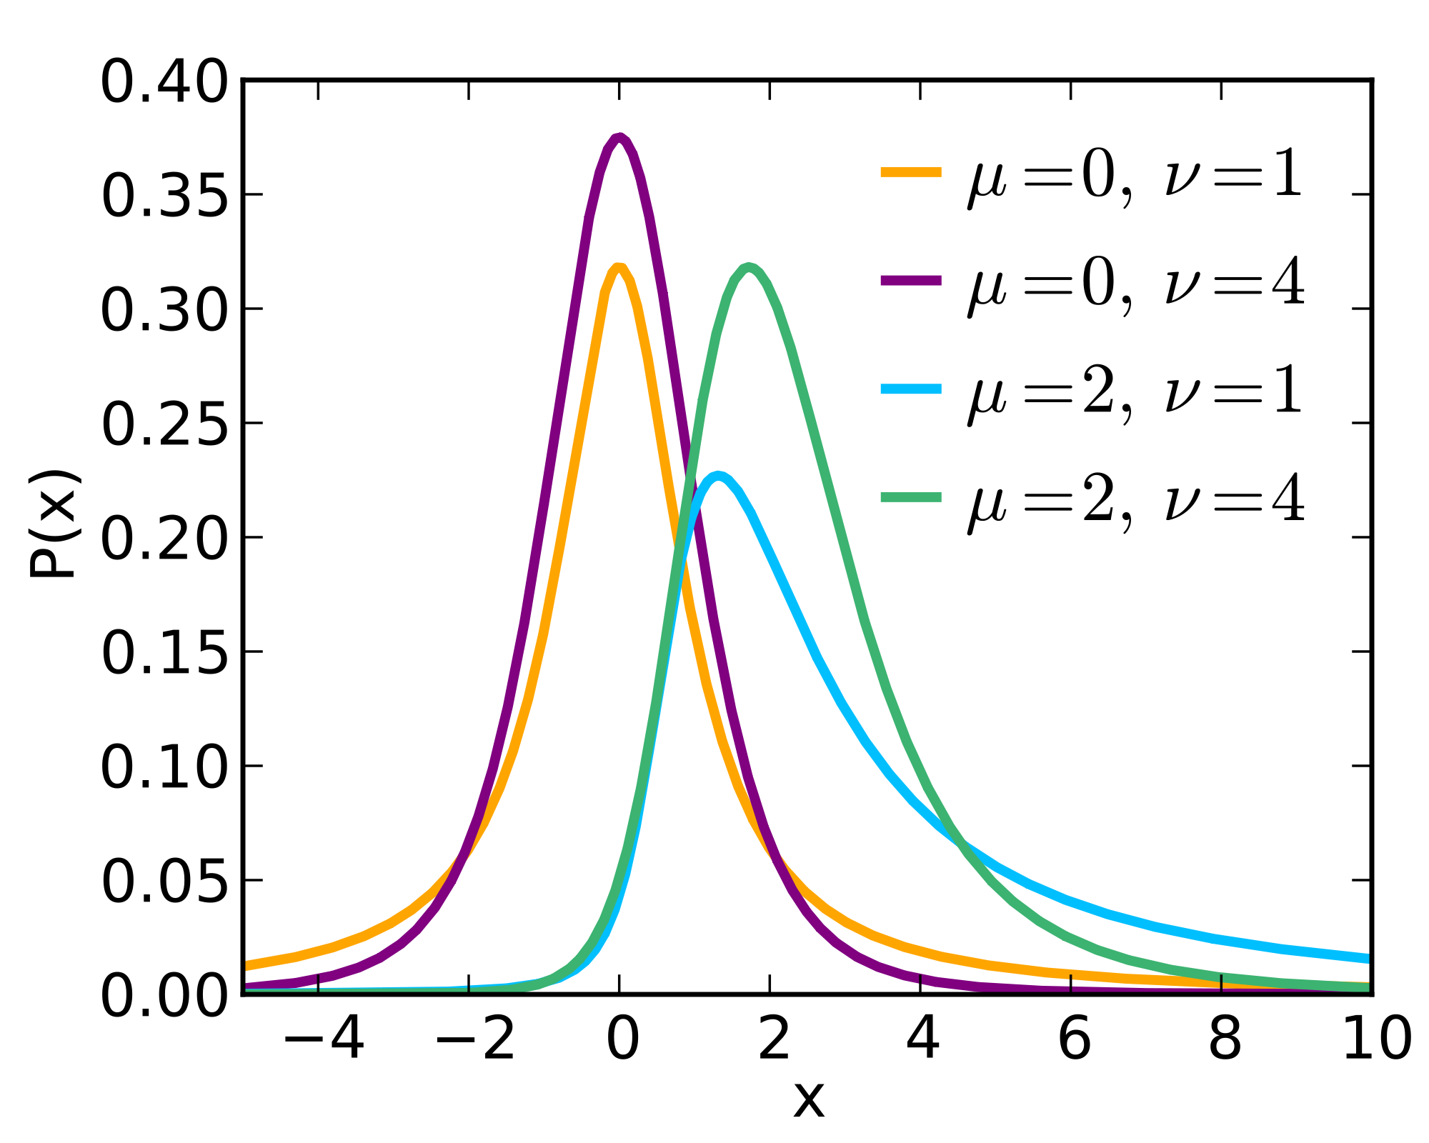
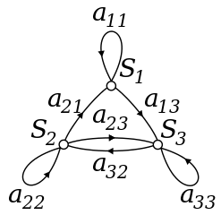
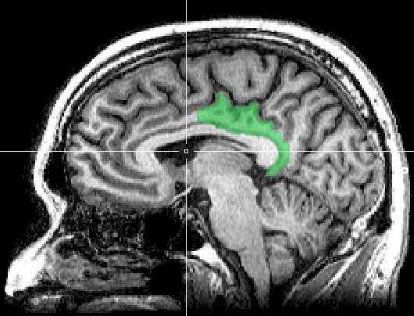
HTC Examples
parameter sweeps
text analysis
multi-start simulations
Statistical model optimization
(MCMC, numerical methods, etc.)
image or data analysis

Slide 16
What computing resources are available to you?
A single computer?
A local cluster?
Consider: What kind of cluster is it? Clusters tuned for HPC jobs typically aren’t appropriate for HTC workflows!
Open Science Grid (OSG)
Other
European Grid Infrastructure
Other national and regional grids
Commercial cloud systems used to augment grids

Slide 17
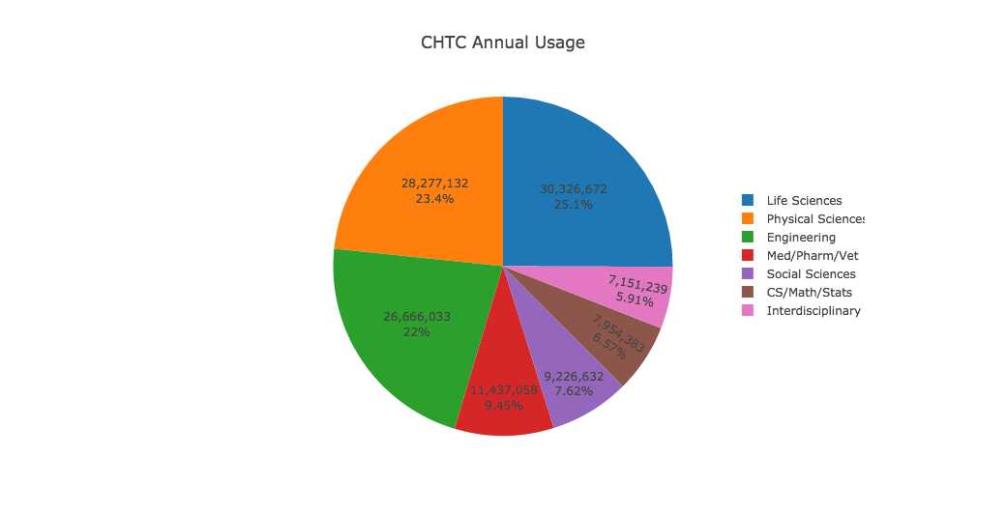
Example Local Cluster
Wisconsin’s Center for High Throughput Computing (CHTC)
Local pool recent CPU hours:
~360,000/day
~10 million/month
~120 million/year

Slide 18
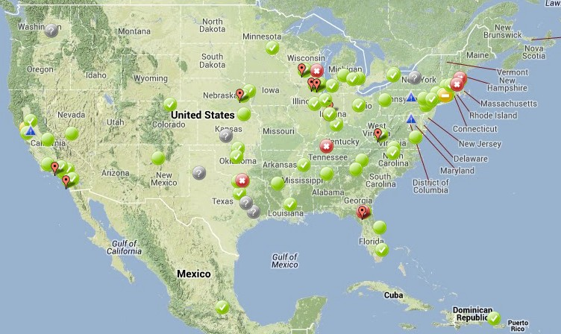
Open Science Grid
HTC Scaled Way up
Over 120 sites
Past year:
~180 million jobs
~1.2 billion CPU hours
~243 petabytes transferred
Can submit jobs locally, move to OSG
http://www.opensciencegrid.org/

Slide 19
Computing tasks that are easy to break up are easy to scale up.
To truly grow your computing capabilities, you need a system appropriate for your computing task!

Slide 20
Example Challenge
You have a program that optimizes traffic signals in intersections.
Your input is the number of cars passing through a stoplight in an hour.
You have 100 days of data, from 4 different stoplights
Each run of your program takes about 1 hour
4 x 24 x 100 x 1 hour = 9600 hours ~= 1.1 years running nonstop!
Conference is next week

Slide 21
Distributed Computing
Use many computers, each running one instance of our program
Example:
2 computers => 4,800 hours ~= ½ year
8 computers => 1,200 hours ~= 2 months
100 computers => 96 hours ~= 4 days
9,600 computers => 1 hour! (but…)
In HTC, these machines are no faster than your laptop!

Slide 22



How It Works
Submit tasks to a queue (on a submit point)
Tasks are scheduled to run on computers (execute points)
queue
execute
execute
execute

Slide 23
Distributed Computing Systems
HTCondor (much, much more to come!)
Other systems to manage a local cluster:
PBS/Torque
LSF
Sun Grid Engine/Oracle Grid Engine
SLURM

Slide 24
HTCondor

Slide 25
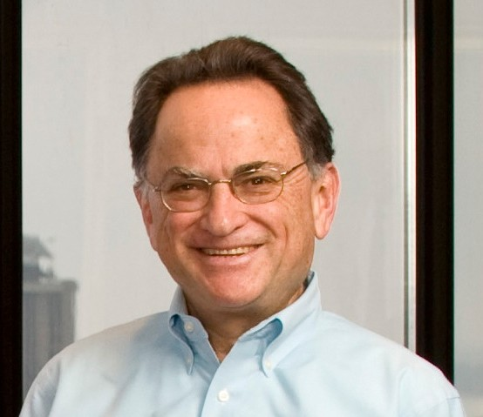
HTCondor History and Status
History
Started in 1988 as a “cycle scavenger”
Protected interests of users and machine owners
Today
Expanded to become CHTC team: 20+ full-time staff
Current production release: HTCondor 8.4.8
HTCondor software: ~700,000 lines of C/C++ code
Miron Livny
Professor, UW-Madison CompSci
Director, CHTC
Dir. Of Core Comp. Tech., WID/MIR
Tech. Director & PI, OSG

Slide 26

HTCondor -- How It Works
Submit tasks to a queue (on a submit point)
HTCondor schedules them to run on computers (execute points)
submit point
execute
execute
execute

Slide 27
Roles in an HTCondor System
Users
Define jobs, their requirements, and preferences
Submit and cancel jobs
Check on the state of a job
Administrators
Configure and control the HTCondor system
Implement policies
Check on the state of the machines
HTCondor Software
Match jobs to machines (enforcing all policies)
Track and manage machines
Track and run jobs

Slide 28
Terminology: job
Job: A computer program or one run of it
Not interactive, no graphic interface (e.g. not Word or email)
How would you interact with 1,000 programs running at once?
Three main pieces
1. Input: Command-line arguments and/or files
2. Executable: the program to run
3. Output: standard output & error and/or files
Scheduling
User decides when to submit job to be run
System decides when to run job, based on policy

Slide 29
Terminology: Machine, Slot
Machine
A machine is a physical computer (typically)
May have multiple processors (computer chips)
One processor may have multiple cores (CPUs)
HTCondor: Slot
One assignable unit of a machine (i.e. 1 job per slot)
Most often, corresponds to one core
Thus, typical machines today have 4-40 slots
Advanced HTCondor features: Can get 1 slot with many cores on one machine for multicore jobs

Slide 30
Terminology: Matchmaking
Two-way process of finding a slot for a job
Jobs have requirements and preferences
E.g.: I need Red Hat Linux 6 and 100 GB of disk space, and prefer to get as much memory as possible
Machines have requirements and preferences
E.g.: I run jobs only from users in the Comp. Sci. dept., and prefer to run ones that ask for a lot of memory
Important jobs may replace less important ones
Thus: Not as simple as waiting in a line!

Slide 31
Basic Job Submission

Slide 32
Job Example
For our example, we will be using an imaginary program called “compare_states”, which compares two data files and produces a single output file.
wi.dat
compare_
states
wi.dat.out
us.dat
$ compare_states wi.dat us.dat wi.dat.out

Slide 33
Job Translation
Submit file: communicates everything about your job(s) to HTCondor
executable = compare_states
arguments = wi.dat us.dat wi.dat.out
should_transfer_files = YES
transfer_input_files = us.dat, wi.dat
when_to_transfer_output = ON_EXIT
log = job.log
output = job.out
error = job.err
request_cpus = 1
request_disk = 20MB
request_memory = 20MB
queue 1

Slide 34
Basic Submit File
executable = compare_states
arguments = wi.dat us.dat wi.dat.out
should_transfer_files = YES
transfer_input_files = us.dat, wi.dat
when_to_transfer_output = ON_EXIT
log = job.log
output = job.out
error = job.err
request_cpus = 1
request_disk = 20MB
request_memory = 20MB
queue 1
List your executable and any arguments it takes
Arguments are any options passed to the executable from the command line
compare_
states
$ compare_states wi.dat us.dat wi.dat.out

Slide 35
Basic Submit File
executable = compare_states
arguments = wi.dat us.dat wi.dat.out
should_transfer_files = YES
transfer_input_files = us.dat, wi.dat
when_to_transfer_output = ON_EXIT
log = job.log
output = job.out
error = job.err
request_cpus = 1
request_disk = 20MB
request_memory = 20MB
queue 1
Comma separated list of input files to transfer to the machine
wi.dat
us.dat

Slide 36
Basic Submit File
executable = compare_states
arguments = wi.dat us.dat wi.dat.out
should_transfer_files = YES
transfer_input_files = us.dat, wi.dat
when_to_transfer_output = ON_EXIT
log = job.log
output = job.out
error = job.err
request_cpus = 1
request_disk = 20MB
request_memory = 20MB
queue 1
HTCondor will transfer back all new and changed files (usually output) from the job.
wi.dat.out

Slide 37
Basic Submit File
executable = compare_states
arguments = wi.dat us.dat wi.dat.out
should_transfer_files = YES
transfer_input_files = us.dat, wi.dat
when_to_transfer_output = ON_EXIT
log = job.log
output = job.out
error = job.err
request_cpus = 1
request_disk = 20MB
request_memory = 20MB
queue 1
log: File created by HTCondor to track job progress
Explored in exercises!
output/error: Captures stdout and stderr from your program

Slide 38
Basic Submit File
executable = compare_states
arguments = wi.dat us.dat wi.dat.out
should_transfer_files = YES
transfer_input_files = us.dat, wi.dat
when_to_transfer_output = ON_EXIT
log = job.log
output = job.out
error = job.err
request_cpus = 1
request_disk = 20MB
request_memory = 20MB
queue 1
Request the appropriate resources for your job to run.
More on this later!
queue: keyword indicating “create a job”

Slide 39
Basic HTCondor commands

Slide 40
Submit a Job
condor_submit submit-file
Submits job to local submit machine
Use condor_q to track
Submitting job(s).
1 job(s) submitted to cluster NNN.
Each condor_submit creates one Cluster
A job ID is written as cluster.process (e.g. 8.0)
We will see how to make multiple processes later

Slide 41
Viewing Jobs
condor_q
With no arguments, lists all of your* jobs waiting or running here
For more info: exercises, -h, manual, next lecture
-- Schedd: learn.chtc.wisc.edu : <...> : ...
ID OWNER SUBMITTED RUN_TIME ST PRI SIZE CMD
8.0 cat 11/12 09:30 0+00:00:00 I 0 0.0 compare_states
1 jobs; 0 completed, 0 removed, 1 idle, 0 running, 0 held, 0 suspended
* As of version 8.5. Earlier versions show all jobs submitted from that machine.

Slide 42
Remove a job
condor_rm cluster [...]
condor_rm cluster.process [...]
condor_rm userid
Removes one or more jobs from the queue
Identify jobs by username, cluster ID, or single job ID
Only you (or an admin) can remove your jobs
Cluster NNN has been marked for removal.

Slide 43
Viewing Slots
condor_status
With no arguments, lists all slots currently in pool
Summary info is printed at the end of the list
For more info: exercises, -h, manual, next lecture
slot6@opt-a001.cht LINUX X86_64 Claimed Busy 1.000 1024 0+19:09:32
slot7@opt-a001.cht LINUX X86_64 Claimed Busy 1.000 1024 0+19:09:31
slot8@opt-a001.cht LINUX X86_64 Unclaimed Idle 1.000 1024 0+17:37:54
slot9@opt-a001.cht LINUX X86_64 Claimed Busy 1.000 1024 0+19:09:32
slot10@opt-a002.ch LINUX X86_64 Unclaimed Idle 0.000 1024 0+17:55:15
slot11@opt-a002.ch LINUX X86_64 Unclaimed Idle 0.000 1024 0+17:55:16
Total Owner Claimed Unclaimed Matched Preempting Backfill
NTEL/WINNT51 2 0 0 2 0 0 0
INTEL/WINNT61 52 2 0 50 0 0 0
X86_64/LINUX 2086 544 1258 284 0 0 0
Total 2140 546 1258 336

Slide 44
Your turn!

Slide 45
Thoughts on Exercises
Copy-and-paste is quick, but you may learn more by typing out commands yourself
Experiment!
Try your own variations on the exercises
If you have time, try to apply your own work
If you do not finish, that’s OK – You can make up work later or during evenings, if you like
If you finish early, try any extra challenges or optional sections, or move ahead to the next section if you are brave

Slide 46
Sometime today
Sometime today, sign up for OSG Connect
https://twiki.opensciencegrid.org/bin/view/Education/UserSchool16Connect
It is not required today
It will be required tomorrow afternoon
It is best to start the process early

Slide 47
Exercises!
Ask questions!
Lots of instructors around
Coming next:
Now – 10:30 Hands-on Exercises
10:30 – 10:45 Break
10:45 – 11:15 Lecture
11:15 – 12:15 Hands-on Exercises

Slide 48
Backup Slides

Slide 49
Log File
000 (128.000.000) 05/09 11:09:08 Job submitted from host: <128.104.101.92&sock=6423_b881_3>
...
001 (128.000.000) 05/09 11:10:46 Job executing on host: <128.104.101.128:9618&sock=5053_3126_3>
...
006 (128.000.000) 05/09 11:10:54 Image size of job updated: 220
1 - MemoryUsage of job (MB)
220 - ResidentSetSize of job (KB)
...
005 (128.000.000) 05/09 11:12:48 Job terminated.
(1) Normal termination (return value 0)
Usr 0 00:00:00, Sys 0 00:00:00 - Run Remote Usage
Usr 0 00:00:00, Sys 0 00:00:00 - Run Local Usage
Usr 0 00:00:00, Sys 0 00:00:00 - Total Remote Usage
Usr 0 00:00:00, Sys 0 00:00:00 - Total Local Usage
0 - Run Bytes Sent By Job
33 - Run Bytes Received By Job
0 - Total Bytes Sent By Job
33 - Total Bytes Received By Job
Partitionable Resources : Usage Request Allocated
Cpus : 1 1
Disk (KB) : 14 20480 17203728
Memory (MB) : 1 20 20

