Slide 1
Intermediate Condor: DAGMan
Monday, July 19th, 1:15pm
Alain Roy <roy@cs.wisc.edu>
OSG Software Coordinator
UW-Wisconsin-Madison

Slide 2
DAGMan
Directed
Acyclic
Graph
Manager
DAGMan allows you to specify the dependencies between your Condor jobs, so it can manage them automatically for you.
Example: “Don’t run job B until job A has completed successfully.”
Recall LIGO DAG from Miron’s talk?
  250,000+ jobs in a DAG
Notes:
In the simplest case…

Slide 3
What is a DAG?
A
A DAG is the data structure used by DAGMan to represent these dependencies.
Each job is a node in the DAG.
Each node can have any number of “parent” or “children” nodes – as long as there are no loops!
OK:
B
C
D
Not OK:
A
B
C
Notes:
a DAG is the best data structure to represent a workflow of jobs with dependencies
children may not run until their parents have finished – this is why the graph is a directed graph … there’s a direction to the flow of work
In this example, called a “diamond” dag, job A must run first; when it finishes, jobs B and C can run together; when they are both finished, D can run; when D is finished the DAG is finished
Loops, where two jobs are both descended from one another, are prohibited because they would lead to deadlock – in a loop, neither node could run until the other finished, and so neither would start – this restriction is what makes the graph acyclic

Slide 4
Defining a DAG
A DAG is defined by a .dag file, listing each of its nodes and their dependencies:
  Job A a.sub
  Job B b.sub
  Job C c.sub
  Job D d.sub
  Parent A Child B C
  Parent B C Child D
Job A
Job B
Job C
Job D
Notes:
This is all it takes to specify the example “diamond” dag

Slide 5
DAG Files….
The complete DAG is five files
One DAG File:
Four Submit Files:
  Job A a.sub
  Job B b.sub
  Job C c.sub
  Job D d.sub
  Parent A Child B C
  Parent B C Child D
Universe = Vanilla
Executable = analysis…

Slide 6
Submitting a DAG
To start your DAG, just run condor_submit_dag with your .dag file, and Condor will start a personal DAGMan process which to begin running your jobs:
  % condor_submit_dag diamond.dag
condor_submit_dag submits a Scheduler Universe job with DAGMan as the executable.
Thus the DAGMan daemon itself runs as a Condor job, so you don’t have to baby-sit it.
Notes:
Just like any other Condor job, you get fault tolerance in case the machine crashes or reboots, or if there’s a network outage
And you’re notified when it’s done, and whether it succeeded or failed
% condor_q
-- Submitter: foo.bar.edu : <128.105.175.133:1027> : foo.bar.edu
ID OWNER SUBMITTED RUN_TIME ST PRI SIZE CMD
2456.0 user 3/8 19:22 0+00:00:02 R 0 3.2 condor_dagman -f -

Slide 7
Running a DAG
DAGMan acts as a scheduler, managing the submission of your jobs to Condor based on the DAG dependencies.
A
.dag
File
Condor
Job
Queue
A
B
C
D
DAGMan
Notes:
First, job A will be submitted alone…

Slide 8
Running a DAG (cont’d)
DAGMan holds & submits jobs to the Condor queue at the appropriate times.
A
Condor
Job
Queue
B
B
C
C
DAGMan
D
Notes:
Once job A completes successfully, jobs B and C will be submitted at the same time…

Slide 9
Running a DAG (cont’d)
In case of a job failure, DAGMan continues until it can no longer make progress, and then creates a “rescue” file with the current state of the DAG.
A
Condor
Job
Queue
Rescue
File
B
X
DAGMan
D
Notes:
If job C fails, DAGMan will wait until job B completes, and then will exit, creating a rescue file. Job D will not run.
In its log, DAGMan will provide additional details of which node failed and why.

Slide 10
Recovering a DAG
Once the failed job is ready to be re-run, the rescue file can be used to restore the prior state of the DAG.
A
Condor
Job
Queue
Rescue
File
B
C
C
DAGMan
D
Notes:
Since jobs A and B have already completed, DAGMan will start by re-submitting job C

Slide 11
Recovering a DAG (cont’d)
Once that job completes, DAGMan will continue the DAG as if the failure never happened.
A
Condor
Job
Queue
B
C
D
DAGMan
D

Slide 12
Finishing a DAG
Once the DAG is complete, the DAGMan job itself is finished, and exits.
A
Condor
Job
Queue
B
C
DAGMan
D
Notes:
If job C fails, DAGMan will wait until job B completes, and then will exit, creating a rescue file.

Slide 13


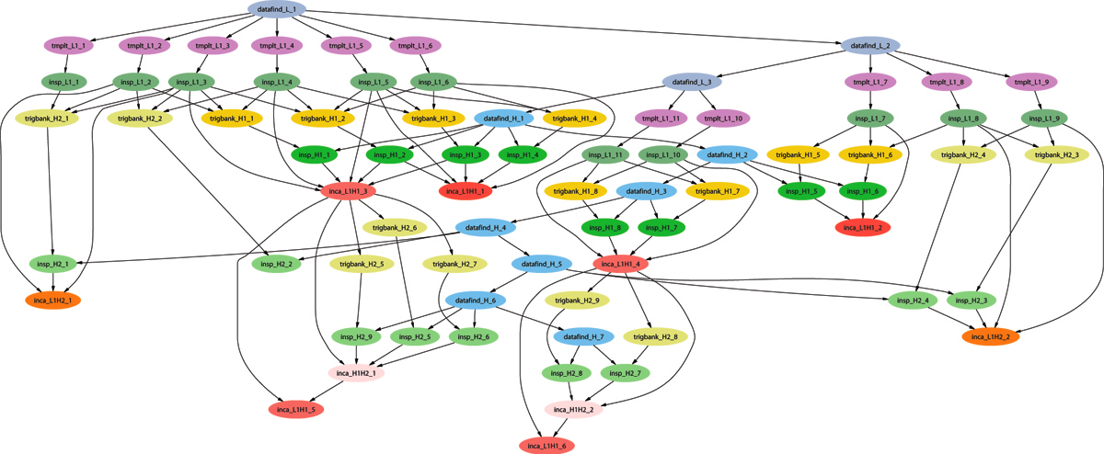
Example of a LIGO Inspiral DAG

Slide 14
Use of Condor by the LIGO Scientific Collaboration
Condor handles 10’s of millions of jobs per year running on the LDG, and up to 500k jobs per DAG.
Condor standard universe check pointing widely used, saving us from having to manage this.
At Caltech, 30 million jobs processed using 22.8 million CPU hrs. on 1324 CPUs in last 30 months.
For example, to search 1 yr. of data for GWs from the inspiral of binary neutron star and black hole systems takes ~2 million jobs, and months to run on several thousand ~2.6 GHz nodes.

Slide 15
DAGMan & Fancy Features
DAGMan doesn’t have a lot of “fancy features”
  No loops
  Not much assistance in writing very large DAGs (script it yourself)
Focus is on solid core
  Add the features people need in order to run large DAGs well.
  People build systems on top of DAGMan

Slide 16
DAGMan & Log Files
For each job, Condor generates a log file
DAGMan reads this log to see what has happened
If DAGMan dies (crash, power failure, etc…)
  Condor will restart DAGMan
  DAGMan re-reads log file
  DAGMan knows everything it needs to know

Slide 17
Advanced DAGMan Tricks
Throttles and degenerative DAGs
Sub-DAGs
Pre and Post scripts: editing your DAG

Slide 18
Throttles
Failed nodes can be automatically retried a configurable number of times
  Can retry N times
  Can retry N times, unless a node returns specific exit code
Throttles to control job submissions
  Max jobs submitted
  Max scripts running

Slide 19
Degenerative DAG
Submit DAG with:
  200,000 nodes
  No dependencies
Use DAGMan to throttle the jobs
  Condor is scalable, but it will have problems if you submit 200,000 jobs simultaneously
  DAGMan can help you get scalability even if you don’t have dependencies
A₁
A₂
A₃
…

Slide 20
Sub-DAG
Idea: any given DAG node can be another DAG
  SUBDAG External Name DAG-file
DAG node will not complete until recursive DAG finishes,
Interesting idea: A previous node could generate this DAG node
Why?
  Simpler DAG structure
  Implement a fixed-length loop
  Modify behavior on the fly

Slide 21
Sub-DAG
A
B
C
V
W
X
Y
D
Z

Slide 22
DAGMan scripts
DAGMan allows pre & post scripts
  Don’t have to be scripts: any executable
  Run before (pre) or after (post) job
  Run on the same computer you submitted from
Syntax:
  JOB A a.sub
  SCRIPT PRE A before-script $JOB
  SCRIPT POST A after-script $JOB $RETURN

Slide 23
So What?
Pre script can make decisions
  Where should my job run? (Particularly useful to make job run in same place as last job.)
  Generate Sub-DAG
  Should I pass different arguments to the job?
  Lazy decision making
    Noop jobs
Post script can change return value
  DAGMan decides job failed in non-zero return value
  Post-script can look at {error code, output files, etc} and return zero or non-zero based on deeper knowledge.

Slide 24
Questions?
Questions? Comments?
Feel free to ask me questions later:
  Alain Roy <roy@cs.wisc.edu>
Upcoming sessions
  Now – 3:15pm
    Hands-on exercises
  3:15pm – 3:30pm
    Break
  3:30pm – 5:00pm
    Final Condor session

