Slide 1
OSG Documentation Workshop
June 24-25, 2009
The chance to develop improvement plans

Slide 2
Workshop Background
Rob Gardner & Ruth Pordes Initiated a “Documentation Alignment” Project the end of February
Established a Set of Goals
Jim Asked to Lead a Project to Improve Documentation
He Established a Project Plan that Included Convening this Team to Refine the Results of his Study
Members Chosen to Represent many Key Areas of the Documentation Environment

Slide 3
Logistics/Roles

Slide 4
Workshop Plan - Thursday
8:00 Breakfast
8:30 Workshop Plan
8:50 Introductions and Homework - All
Team members introduce themselves & present their slide (2 min)
9:20 Documentation Study - Jim
10:00 Break
10:20 Review and Discuss Recommendations - Jim & All
12:00 Lunch
1:00 Break into Affinity Groups to Prioritize Improvements
3:00 Break
3:15 Team presentations (5-7 min presentations)
4:30 Wrapup / Planning for Day 2
5:00 Adjourn
Group Dinner for Those Interested

Slide 5
Workshop Plan - Friday
8:00 Breakfast
9:00 Overnight Thoughts?
9:30 Plan for the Day
9:40 Reorganizing Improvements
10:00 Implementation Planning Task
10:15 Break
10:30 Teams work on Implementation Planning
12:00 Lunch
1:00 Team Presentations (5-7 min presentations)
2:15 Break
2:30 Establish Next Steps/Action Items
3:30 Wrap-up / Closure
4:00 Adjourn

Slide 6
Tim Cartwright: VDT
VDT Developer (+ some docs)
Two Things that I really like about OSG Documentation
  Contains contributions from many people in many roles, including those who administer or use the OSG daily
  Is implemented in a wiki, so that users can view docs and contribute from anywhere
Two Things that I Would Most Like to See Improved in OSG Documentation
  Have an editor responsible for ensuring that procedural documentation is written in a consistent, usable style
  Rework the information architecture of the TWiki to be more usable, especially for new users

Slide 7
Kyle Gross: OSG GOC
OSG Twiki Administrator
Two Things that I really like about OSG Documentation
  While not perfect, it has improved over the past few years
  We are now making even more of an effort to find areas that can be improved.
Two Things that I Would Most Like to See Improved in OSG Documentation
  Organization of General Docs and Twiki Web Structure
  Improved documentation processes. (Ownership, etc)

Slide 8
Rob Gardner: University of Chicago
Δ OSG Documentation
Two Things that I really like about OSG Documentation
  Community commitments initially were very good
  Lots of good content
Two Things that I Would Most Like to See Improved in OSG Documentation
  Better certification of content
  Okay, more than two things:
    Easy creation of manuals, tutorials, derived from existing content
    Uniformity of content across OSG areas (users, sites, EOT)
    Easy system to volunteer and assume ownership, responsibility
    An incentives & reward system, so people are recognized for creating quality OSG documentation
    An organizational system for coordination of documentation projects across the OSG information environment

Slide 9
Alina Bejan: OSG
OSGEDU manager
Two Things that I really like about OSG Documentation
  Structure
  Quality of the present information
Two Things that I Would Most Like to See Improved in OSG Documentation
  The Search mechanism on the twiki (which is not quite reliable)
  Hard to find the answer to “How to join OSG” (in particular how to join the OSG VO)

Slide 10

Robert Engel
Integration Project
California Institute of Technology
One Thing that I really like about OSG Documentation
  http://www.opensciencegrid.org
  ...
Two Things that I Would Most Like to See Improved in OSG Documentation
  https://twiki.grid.iu.edu/twiki/bin/view/Documentation/WebHome
  better navigation
  separation between user and administrator documentation.

Slide 11

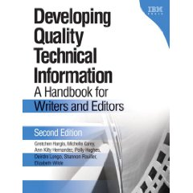
Robert Engel
Integration Project
California Institute of Technology
- explains how to find and reduce the 'clutter' in non-fiction and how to write texts that are more readable.
- very enjoyable to read on its own.
- technical introduction to the subject.

Slide 12
Marco Mambelli: University of Chicago
OSG Site Coordinator (doc user and contributor)
Two Things that I really like about OSG Documentation
  I can find everything: from step-by-step instructions to tips to summaries to examples
  It is indexed by Google (Twikis of other collaborations I’m in don’t get indexed)
Two Things that I Would Most Like to See Improved in OSG Documentation
  A 2 level documentation: more formal, organic and uniform official documentation (reviewed by an editor), together with more informal and free user comments/experiences
  (1 is already a lot anyway) allow modules that can be used in different places (to ease consistency)

Slide 13
Marcia Teckenbrock: Fermilab
OSG Webmaster, DocDB Admin
Two Things that I really like about OSG Documentation
  Ease of updates via Twiki
  Enthusiasm of some folks towards documenting processes
Two Things that I Would Most Like to See Improved in OSG Documentation
  Organization of documentation
  Commitment of ownership

Slide 14
Mine Altunay: FNAL
Security
Two Things that I really like about OSG Documentation
  Breadth of coverage
  Ability to collaboratively edit (not to be mixed with twiki, which I find very difficult to use)
Two Things that I Would Most Like to See Improved in OSG Documentation
  Up-to-date correct info. Even I get incorrect information
  There is no site map. There are circular links, old links, too many links. I am not sure if I am following the right direction.

Slide 15
Workshop Charge
Identify high priority improvements for OSG documentation
  Based on Documentation Study Results
  Based on your Expertise in the System
  Prioritized by Workshop Participants
Develop a high-level Implementation Plan

Slide 16
Goals of Project
Identify areas to make consistent, complete, aligned information
Improve structure & maintenance of the TWiki
Provide readers immediate comment & editing
Create process descriptions & policies
Remodel documentation web
Define system for tagging “certified” documents
Create common framework to align certified documents
Define a process to encourage & verify keeping documents up-to-date
Define a plan for removing stale documents
Define policies or rules about removing stale documents
Develop a migration plan to implement the above

Slide 17
Project Plan
Define Current System (March 1-15)
Interview Users (March 15 - May 15)
Interview Providers (May 15 - June 7)
Review Literature on wikis (May 7-30)
Convene Team to Develop Documentation Structure & Processes (June 25-26)
Develop Project for Migration (July 1-20)

Slide 18
Interviews
End Users | 3
System Administrators | 6
Students | 2
Potential OSG Members | 1
VO Application Developers | 2
VO Managers | 3
Providers | 12
Total | 29

Slide 19
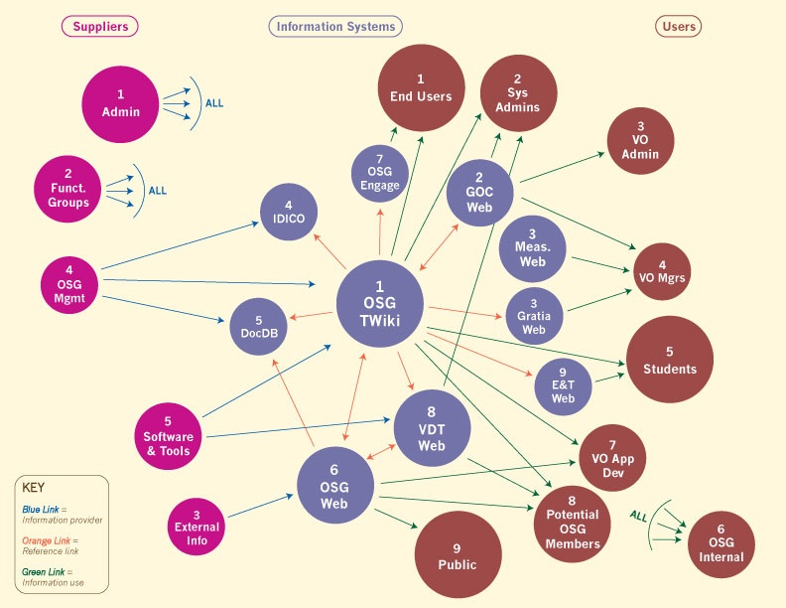
The Documentation Environment
Website
Website
Website

Slide 20
User Stories
Even outspoken users are not unhappy
Quality of documentation makes a BIG difference to OSG growth
People want information presented from their perspective
People have trouble deriving the technical architecture from the documentation
Need information for better decision making
Security issues dominate
Can’t tell who owns a document or how to give feedback

Slide 21
User Stories - Continued
Context needs to be maintained
Information differs depending upon entry point
Inconsistencies in format cause errors
Many use Google to find pages
Assumptions/preparation not always listed
Document structure can serve new & experienced
Resolving problems is a major issue

Slide 22
Questions
Other Issues?

Slide 23
Break

Slide 24
Recommendations - Ownership
Establish true ownership and policies
  Documentation system needs an owner
  Need a documentation architect
  Each page needs an stated owner
  Need written processes, procedures, responsibilities

Slide 25
The Documentation Environment
Website
Website
Website

Slide 26
Recommendations - Guidelines
Provide guidelines for organizing, presenting, and searching information
  Provide views by user role
  Present overall OSG technology architecture
  Provide engineering information for decision making with suggestions
  Better document errors and troubleshooting information
  Procedure documents - Mainline flow inline, reference docs for prep steps, checklist of environment setup, decision info, first time steps
  Establish page standards with TWiki templates
  Make search boxes work as one would expect

Slide 27
Recommendation - Review
Create cyclic review process & technology that provides better incentives
  Pair programming model for writer/reviewer
  Expand standard review process now used for release documentation - do 6 month to 1 year reviews of docs outside of installation
  Use annotation plug-in that allows anyone to comment on document without registration
  Provide feedback evaluation at end of documents, celebrate good documents and documenters

Slide 28
Discussion

Slide 29
Lunch

Slide 30
Improvements & Priorities
Improvement Items Steps | User Impact | Provider Impact | Effort | Priority
Example Improvement Key Step 1 Key Step 2 | H, M, L | H, M, L | L = <1 wk M = 1-4 wks H = >4 wks | H, M, L

Slide 31
Break into Teams

Slide 32
Sample Implementation Planning
Improvement | Steps | Date | Effort

Slide 33
Break into Teams

Slide 34
Sample WBS

