Slide 1
The CMS Top 5 Issues/Concerns wrt. WLCG services
WLCG-MB April 3, 2007
Matthias Kasemann CERN/DESY

Slide 2
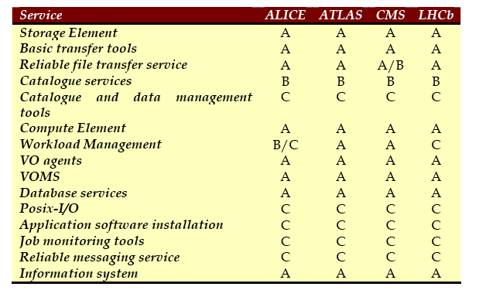
Baselines Services (Rep. 24.6.05):
CMS Priority A:
high priority and mandatory:
1) Storage Element
  Interfaces: SRM, gridFTP,
  POSIX-I/O, authentication/
  authorization/ accounting
2) Basic data transfer tools
  gridftp and srmCopy
3) Reliable file transfer service
  Wrapping basic gridFTP
  or srmCopy
  Providing overall scheduling, control, monitoring as well as reliability
6) Compute Element
  Defined set of interfaces to local resources,
_x0003__x0016_
_x0003__x0016_
_x0003__x0016_

Slide 3
Baselines Services (Rep. 24.6.05):
CMS Priority A:
high priority and mandatory:
7) Workload Management
  Overall WLMS essential
  for some experiments,
  but not all
8) VO agents
9) VOMS
  VO management system
  providing extended proxies
  describing roles, groups, and sub-groups
10) Database services
  For catalogues, VOMS, FTS, as well as experiment-specific components
15) Information system
_x0003__x0016_
_x0003__x0016_
_x0003__x0016_

Slide 4
Baselines Services (Rep. 24.6.05):
CMS Priority B:
Standard solutions required,
but experiments could select
different implementations:
3) Reliable file transfer service
  Wrapping basic gridFTP or srmCopy
  Providing overall scheduling, control, monitoring as well as reliability
4) Catalogue services
  Interfaces: POOL, DLI/SI, POSIX-I/O
  including a reliable asynchronous update service

Slide 5
Baselines Services (Rep. 24.6.05):
CMS Priority C:
Desirable to have common
solutions, but not essential:
5) Catalogue and data management tools
11) Posix-like I/O service
12) Application software installation
13) Job Monitoring tools
14) Reliable messaging/information transfer service

Slide 6
The CMS Top 5 Issues &Concerns
1) Storage Element: CASTOR functionality and performance
Issues & Concerns are:
    The single CASTOR request queue is a potential bottleneck
    Under the stress of data taking the global priorities must work and there is sufficient capacity in the system
    Performance for use-cases at CERN and at Tier-1 sites
    Disk mover limitations, use of xrootd tbd._x0013_
2) Storage Element: SRM interface with functionality and performance
CMS especially interested in:
    Name space interaction will allow CMS to alleviate the need for local VO services for data management (if can be made to scale)
    SRM explicit delete
    good support for SRM copy in push mode
    capability to control access rights consistently across different SE's using VOMS

Slide 7
The CMS Top 5 Issues/Concerns
3) FTS servers
  transfers and queues monitor
  backup servers
  heartbeat and similar ”service-is-up" monitoring
4) Workload Management
  Capable of fully utilizing available compute resources
    Scaling to 200k jobs / day
  Strategy to converge on few (2-3) submission tools to be used as best fit
    Candidates: gLite RB, Condor-G submission
  We need to improve the transparency of job submission and diagnosis for the users
5) Scalability, reliability and redundancy of information system.
  mitigate the dependency from central CERN BDII

