Slide 1
APF Summary
Oct 2013
John Hover <jhover@bnl.gov>
APF Summary
October 2013

Slide 2
Overview
AutoPyFactory (APF) is a job factory.
  It monitors amount of work ready to perform in a source system.
  It monitors the jobs already submitted to a destination system (running or pending).
  Each cycle (typically 6 minutes) APF:
    Calculates the proper number of jobs to submit
    Submits them.
    Optionally posts info to external monitoring system.
For the ATLAS Panda pilot-based Workload Management System:
  It queries for activated jobs, by WMS queue.
  Submits pilot wrappers to sites.
  One APF queue per Panda queue/site.
For virtual cluster management:
  Queries local batch for idle jobs.
  Submits VM requests to Cloud platform.
  VM connects back to local cluster to run job.
APF Summary
October 2013

Slide 3
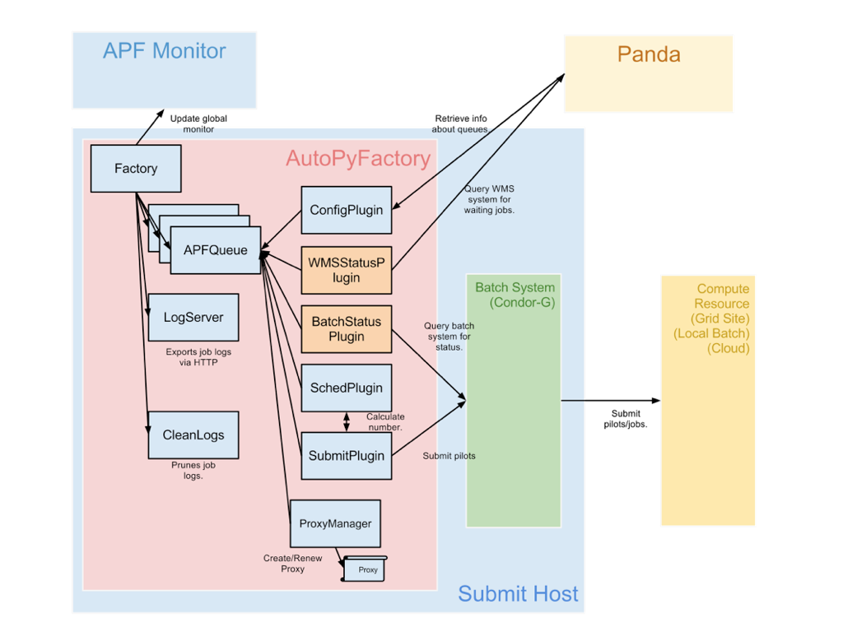
General Design
APF Summary
October 2013

Slide 4
Features
Scalable and Robust
  Single-process, multi-threaded daemon. Written in Python with proper error handling.
  Most core plugins built on HTCondor, a well-known batch/scheduling platform.
Extensible
  Plugin architecture allows future expansion. Already being used for purposes not originally forseen.
Flexible
  Highly configurable. All components are designed to be mixed to serve future purposes.
Easily Deployable
  Cleanly packaged (RPM) and integrated as a typical Linux service. Upgradeable via simple package update. Conforms to systems administrator expectations.
APF Summary
October 2013

Slide 5
Internals
Heavily multi-threaded
  Failures/timeouts in one section should not affect others. Each APF internal queue works independently.
  A single process simplfies global coordination.
Fully modular
  All functionality handled by self-contained object with defined interface for usage by other objects.
  Overall system now candidate for embedding, i.e. we run it as a daemon from init now, but it could also be instantiated as a web service with a web GUI.
Plugin architecture
  Allows easy configuration, extension, and customization.
John Hover USATLAS Workshop
11 Oct 2011

Slide 6
Plugins
WMS Status (Panda) Plugin
  Queries WMS for its queue config and current state, e.g. how many jobs activated? Running?
  E.g. Panda, LocalCondor
Batch Status Plugin
  Queries local batch system (e.g. Condor-G or Condor) for submitted job state info (pending, failed, submitted, etc.)
Batch Submit Plugin
  Creates the submit file and issues batch submit command(s).
  E.g. CondorGT2, CondorLocal, EC2
Sched Plugins
  Decides exactly how many pilots to submit each cycle.
  E.g. Fixed, Activated, NQueue, KeepNRunning, Scale, MinPerCycle
John Hover USATLAS Workshop
11 Oct 2011

Slide 7
Modular algorithms
APF provides fine-grained, scheduling plugins
  Used to calculate how many jobs to submit/retire each cycle.
  Output of earlier fed into later. Answer from last.
  E.g.:
    schedplugin = Ready, Scale, StatusTest, MaxPerCycle, MinPerCycle, MaxPending, MaxTorun, StatusOffline
    sched.ready.offset = 100
    sched.scale.factor = .25
    sched.minpercycle.minimum = 0
    sched.maxpercycle.maximum = 100
    sched.maxpending.maximum = 25
    sched.maxtorun.maximum = 250
  Mix-and-matchable with any set of status/submit plugins (grid, local, EC2).
S&C
13 June 2013

Slide 8
Self-Contained
Built-in web server for batch log export
  No more separate Apache setup.
  Allows other information to be exported for public view.
Built-in in-process batch log cleanup
  Configurable by time and/or disk % usage.
Integrated Proxy Management
  Allows for multiple proxy types, with each queue specifying which to use.
  Allows specification of a list of certificates for fail-over. If one has expired, it generates a proxy with the next.
  Allows for use of long-lived base vanilla proxy. No requirement for clear text passwords on system.
John Hover USATLAS Workshop
11 Oct 2011

Slide 9
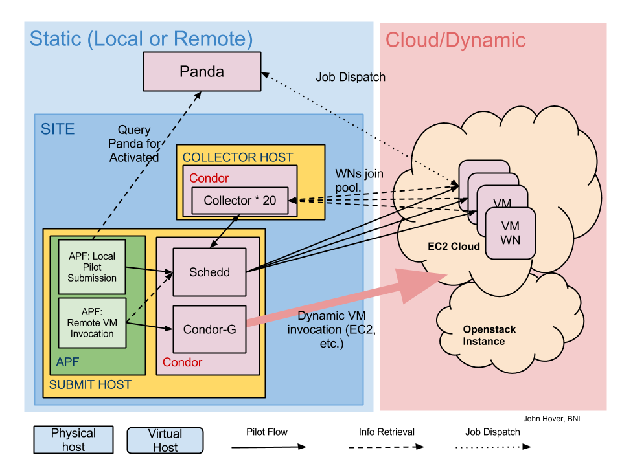
Usable to provision Cloud-based clusters
John Hover USATLAS Workshop
11 Oct 2011

Slide 10
VM Lifecycle
Instantiation
  When we want to expand the resource, a VM is instantiated, for as long as there is sufficient work to keep it busy.
Association
  In order to manage the lifecycle, we track the association between a particular VM and a particular batch cluster machine. (I.e. We cannot tell which VMs are running jobs from the Cloud API.)
  This is done via embedded DB (with Euca tools) or a ClassAd attribute (Condor-G)
Retirement
  When we want to contract the cluster. APF tells each batch slot on a VM to retire, i.e. finish its current job but accept no more.
Termination
  Once all batch slots on a VM are idle. The VM is terminated.
John Hover
13 Nov 2012

Slide 11
Cloud interactions
APF uses a plugin architecture to use the Cloud APIs on EC2 and Openstack.
  Condor plugin supports both EC2 and Openstack via Condor-G.
APF supports hierarchies and weighting
  We can establish multiple Cloud resources in order of preference, and expand and contract preferentially, e.g.,
    Local Openstack (free, local)
    Another ATLAS facility Openstack (free, remote)
    Academic cloud at another institution (free, remote)
    Amazon EC2 via spot pricing. (cheap, remote)
    Amazon EC2 via guaranteed instance. (costly, remote)
  Weighting means supporting a scaling factor between number of waiting jobs and number of slots created.
    E.g. create 1 VM for every 10 Activated jobs waiting.
John Hover
13 Nov 2012

Slide 12
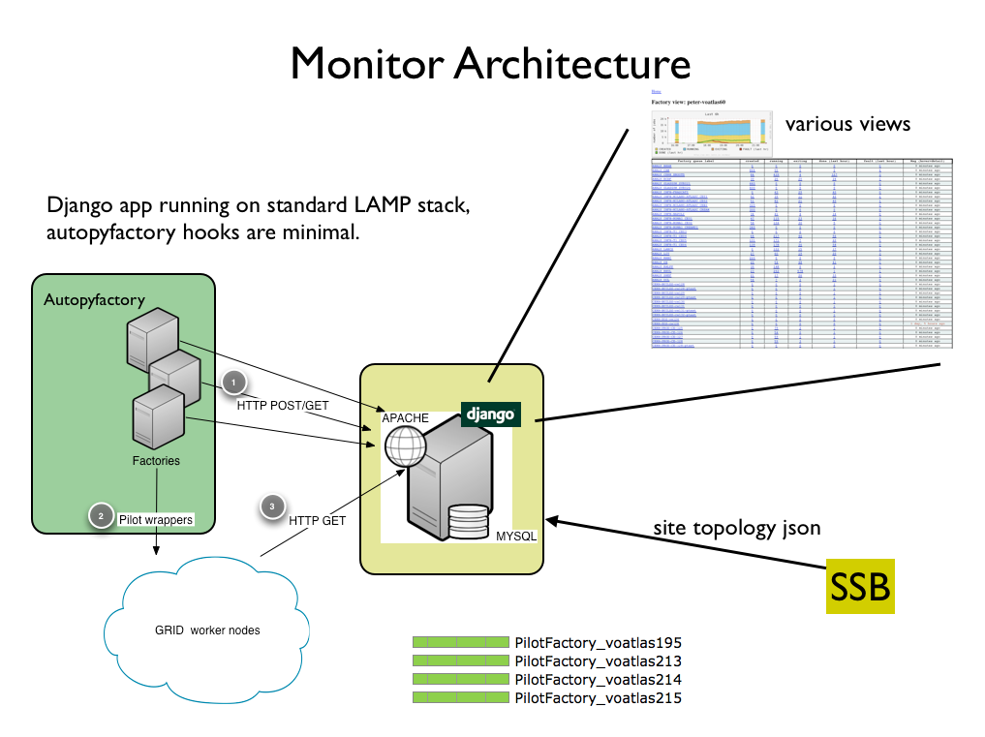

External Monitor Project:
APF Summary
October 2013

