Slide 1
Deploying dCache with ROCKS
Jorge L. Rodriguez
July 17, 2006

Slide 2
Introduction
What?
  Put entire dCache installation on ROCKS
  Factorized dCache: deployment of services on N+M pieces of hardware
    N = admin nodes
    M = dcache pools
Why?
  At UF we deploy as much of the infrastructure as we can with ROCKS
    Have a permanent record of how things are deployed
    Can easily reconfigure servers using already existing configuration (OOsysAdmin)
    Disaster recovery – easy to redeploys on new hardware
    …
Status
  Almost complete:

Slide 3
Status
Have a semi-complete working deployment
  Services deployed
    All domains and cells running but the gridftp and srm
    Deployed on multiple servers
  Can write file into dCache with dCap
    Haven’t tested gsiDcap
    Haven’t deployed gridftp nor srm yet
    Hope to complete this week

Slide 4
Status, cont.
  Servers deployed
    pnfs-server: ROCKS complete
      pnfsDomain
    dcache-admin: ROCKS complete
      dCacheDomain, lmDomain, dirDomain, httpDomain, utilityDomain, gsidcapDomain
    dcapN: ROCKS complete
      Can deploy multiple servers through ROCKS
      doorNDomian
    admindoor: ROCKS complete but not tested
      admindoorDomain
    gridftpN: ROCKS complete but not tested
      gridftpDomain

Slide 5
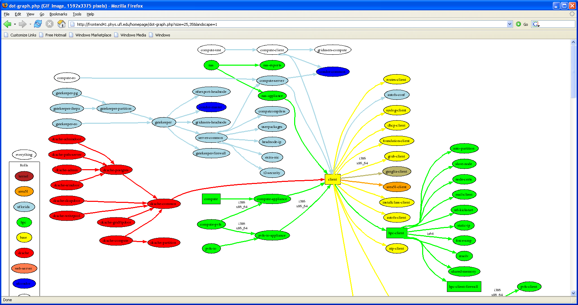
ROCKS XML Graps
ROCKS graphs on one of UF’s dev frontend, ROCKS version 4.1 for (RHEL 4 x32)
pnfs-server
dcache-admin
dcapN
dcap1
dcap1
writepoolN
writepool2
writepool1
gridftpN
gridftp2
gridftp1

Slide 6
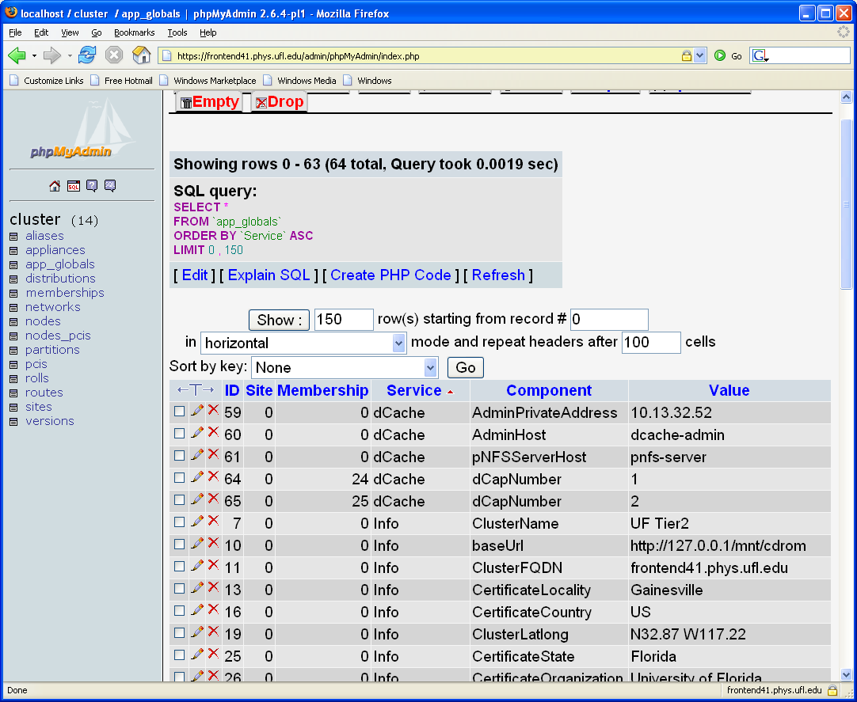
ROCKS database

Slide 7
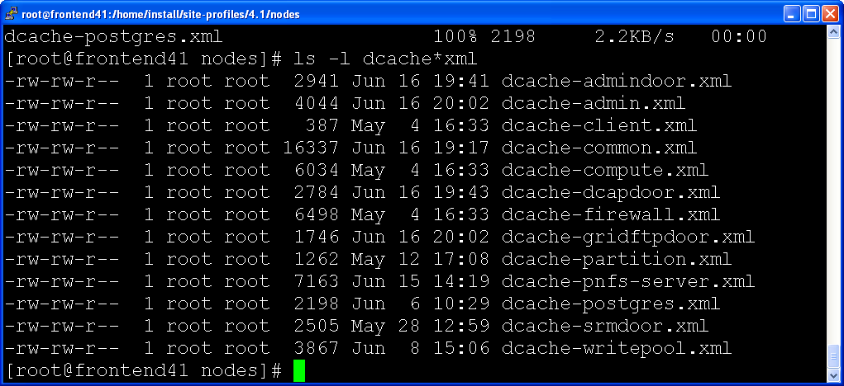
ROCKS XML Example
www.phys.ufl.edu/~jorge/MSpowerpoint/dCache-workshop/dcache-postgres.xml

