Slide 1
Intermediate Condor: Workflows
Rob Quick <rquick@iu.edu>
Open Science Grid
Indiana University

Slide 2

Before we begin…
Any questions on the lectures or exercises up to this point?

Slide 3
Workflows
What if you have a complex set of programs to run for your science?
For example:
  You want to analyze a set of images
  Each image needs to be pre-processed
  Each image needs to be analyzed
  You need to summarize the results of all the analyses
  Each of these is a separate program

Slide 4
Workflows
One Image:
Three Images:
Pre-process
Pre-process
Pre-process
Pre-process
Analyze
Analyze
Analyze
Analyze
Summarize

Slide 5
Workflows: definition
Definition 1:
A set of steps to complete a complex task
Definition 2:
A graph of jobs to run: some jobs need to run before others while other jobs can run in parallel

Slide 6


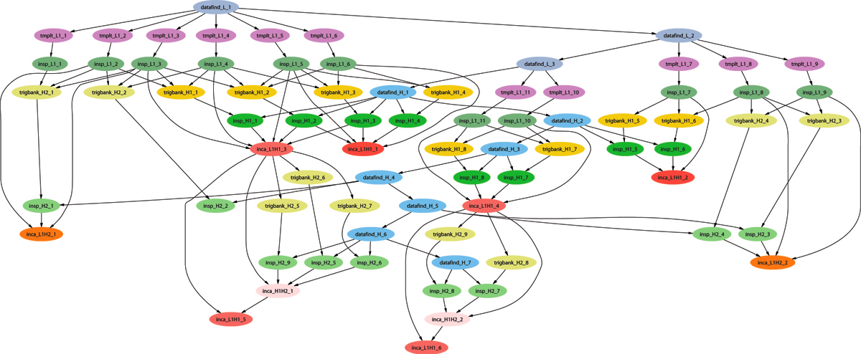
Example of a LIGO Inspiral DAG

Slide 7
Use of Condor by the LIGO Scientific Collaboration
Condor handles 10’s of millions of jobs per year running on the LDG, and up to 500k jobs per DAG.
Condor standard universe check pointing widely used, saving us from having to manage this.
At Caltech, 30 million jobs processed using 22.8 million CPU hrs. on 1324 CPUs in last 30 months.
For example, to search 1 yr. of data for GWs from the inspiral of binary neutron star and black hole systems takes ~2 million jobs, and months to run on several thousand ~2.6 GHz nodes.
(Statement from 2010—”last 30 months” isn’t from now. Also, I think they do up to 1 million jobs per DAG now.)

Slide 8
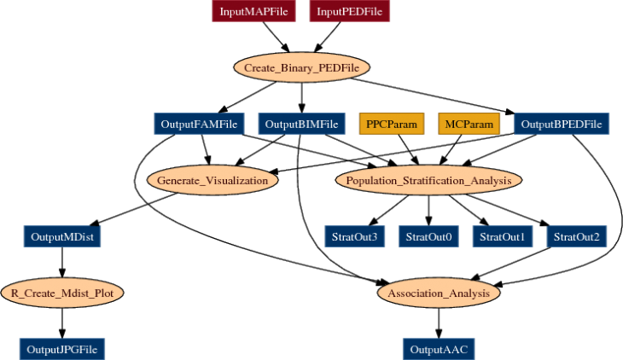
Example workflow: Bioinformatics
From Mason, Sanders, State (Yale)
http://pegasus.isi.edu/applications/association_test

Slide 9
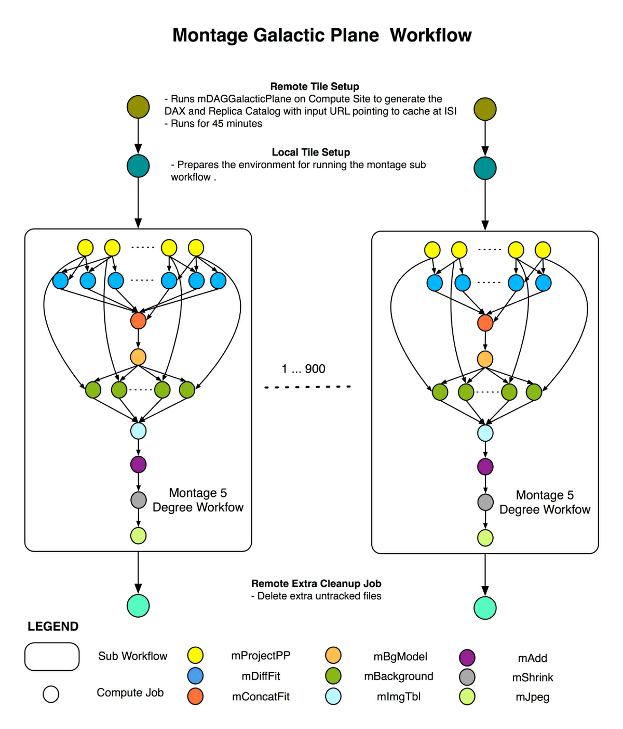
Example workflow: Astronomy
From Berriman & Good (JPAC)
http://pegasus.isi.edu/applications/galactic-plane

Slide 10
DAGMan
DAGMan:
  Directed Acyclic Graph (DAG)
  Manager (Man)
Allows you to specify the dependencies between your Condor jobs
Manages the jobs and their dependencies
That is, it manages a workflow of Condor jobs
Notes:
In the simplest case…

Slide 11
What is a DAG?
A DAG is the structure used by DAGMan to represent these dependencies.
Each job is a node in the DAG.
Each node can have any number of “parent” or “children” nodes – as long as there are no loops!
A
OK:
B
C
D
Not OK:
A
B
C
Notes:
a DAG is the best data structure to represent a workflow of jobs with dependencies
children may not run until their parents have finished – this is why the graph is a directed graph … there’s a direction to the flow of work
In this example, called a “diamond” dag, job A must run first; when it finishes, jobs B and C can run together; when they are both finished, D can run; when D is finished the DAG is finished
Loops, where two jobs are both descended from one another, are prohibited because they would lead to deadlock – in a loop, neither node could run until the other finished, and so neither would start – this restriction is what makes the graph acyclic

Slide 12
Defining a DAG
A DAG is defined by a .dag file, listing each of its nodes and their dependencies. For example:
  Job A a.sub
  Job B b.sub
  Job C c.sub
  Job D d.sub
  Parent A Child B C
  Parent B C Child D
Job A
Job B
Job C
Job D
Notes:
This is all it takes to specify the example “diamond” dag

Slide 13
DAG Files….
This complete DAG has five files
One DAG File:
Four Submit Files:
  Job A a.sub
  Job B b.sub
  Job C c.sub
  Job D d.sub
  Parent A Child B C
  Parent B C Child D
Universe = Vanilla
Executable = analysis…
Universe = …

Slide 14
Submitting a DAG
To start your DAG, just run condor_submit_dag with your .dag file, and Condor will start a DAGMan process to manage your jobs:
  % condor_submit_dag diamond.dag
condor_submit_dag submits a Scheduler Universe job with DAGMan as the executable
Thus the DAGMan daemon itself runs as a Condor job, so you don’t have to baby-sit it
Notes:
Just like any other Condor job, you get fault tolerance in case the machine crashes or reboots, or if there’s a network outage
And you’re notified when it’s done, and whether it succeeded or failed
% condor_q
-- Submitter: foo.bar.edu : <128.105.175.133:1027> : foo.bar.edu
ID OWNER SUBMITTED RUN_TIME ST PRI SIZE CMD
2456.0 user 3/8 19:22 0+00:00:02 R 0 3.2 condor_dagman -f -

Slide 15
Running a DAG
DAGMan acts as a scheduler, managing the submission of your jobs to Condor based on the DAG dependencies
A
.dag
File
Condor
Job
Queue
A
B
C
D
DAGMan
Notes:
First, job A will be submitted alone…

Slide 16
Running a DAG (cont’d)
DAGMan submits jobs to Condor at the appropriate times
For example, after A finishes, it submits B & C
A
Condor
Job
Queue
B
B
C
C
DAGMan
D
Notes:
Once job A completes successfully, jobs B and C will be submitted at the same time…

Slide 17
Running a DAG (cont’d)
A job fails if it exits with a non-zero exit code
In case of a job failure, DAGMan runs other jobs until it can no longer make progress, and then creates a “rescue” file with the current state of the DAG
A
Condor
Job
Queue
Rescue
File
B
X
DAGMan
D
Notes:
If job C fails, DAGMan will wait until job B completes, and then will exit, creating a rescue file. Job D will not run.
In its log, DAGMan will provide additional details of which node failed and why.

Slide 18
Recovering a DAG
Once the failed job is ready to be re-run, the rescue file can be used to restore the prior state of the DAG
  Another example of reliability for HTC!
A
Condor
Job
Queue
Rescue
File
B
C
C
DAGMan
D
Notes:
Since jobs A and B have already completed, DAGMan will start by re-submitting job C

Slide 19
Recovering a DAG (cont’d)
Once that job completes, DAGMan will continue the DAG as if the failure never happened
A
Condor
Job
Queue
B
C
D
DAGMan
D

Slide 20
Finishing a DAG
Once the DAG is complete, the DAGMan job itself is finished, and exits
A
Condor
Job
Queue
B
C
DAGMan
D
Notes:
If job C fails, DAGMan will wait until job B completes, and then will exit, creating a rescue file.

Slide 21
DAGMan & Fancy Features
DAGMan doesn’t have a lot of “fancy features”
  No loops
  Not much assistance in writing very large DAGs (script it yourself)
Focus is on solid core
  Add the features people need in order to run large DAGs well
  People build systems on top of DAGMan

Slide 22
Related Software
Pegasus: http://pegasus.isi.edu/
  Writes DAGs based on abstract description
  Runs DAG on appropriate resource (Condor, OSG, EC2…)
  Locates data, coordinates execution
  Uses DAGMan, works with large workflows
Makeflow: http://nd.edu/~ccl/software/makeflow/
  User writes make file, not DAG
  Works with Condor, SGE, Work Queue…
  Handles data transfers to remote systems
  Does not use DAGMan

Slide 23
DAGMan: Reliability
For each job, Condor generates a log file
DAGMan reads this log to see what has happened
If DAGMan dies (crash, power failure, etc…)
  Condor will restart DAGMan
  DAGMan re-reads log file
  DAGMan knows everything it needs to know
  Principle: DAGMan can recover state from files and without relying on a service (Condor queue, database…)
Recall: HTC requires reliability!

Slide 24
Advanced DAGMan Tricks
Throttles
DAGs without dependencies
Sub-DAGs
Pre and Post scripts: editing your DAG

Slide 25
Throttles
Failed nodes can be automatically retried a configurable number of times
  Helps recover from jobs that crash some percentage of the time
Throttles to control job submissions
  Max jobs submitted
  Max scripts running
  These are important when working with large DAGs

Slide 26
DAGs without dependencies
Submit DAG with:
  200,000 nodes
  No dependencies
Use DAGMan to throttle the job submissions:
  Condor is scalable, but it will have problems if you submit 200,000 jobs simultaneously
  DAGMan can help you with scalability even if you don’t have dependencies
A₁
A₂
A₃
…

Slide 27
Sub-DAG
Idea: any given DAG node can be another DAG
  SUBDAG External Name DAG-file
DAG node will not complete until sub-dag finishes
Interesting idea: A previous node could generate this DAG node
Why?
  Simpler DAG structure
  Implement a fixed-length loop
  Modify behavior on the fly

Slide 28
Sub-DAG
A
B
C
V
W
X
Y
D
Z

Slide 29
DAGMan scripts
DAGMan allows pre & post scripts
  Run before (pre) or after (post) job
  Run on the same computer you submitted from
  Don’t have to be scripts: any executable
Syntax:
  JOB A a.sub
  SCRIPT PRE A before-script $JOB
  SCRIPT POST A after-script $JOB $RETURN

Slide 30
So What?
Pre script can make decisions
  Where should my job run? (Particularly useful to make job run in same place as last job.)
  What should my job do?
  Generate Sub-DAG
Post script can change return value
  DAGMan decides job failed in non-zero return value
  Post-script can look at {error code, output files, etc} and return zero or non-zero based on deeper knowledge.

Slide 31

Let’s try it out!
Exercises with DAGMan.

Slide 32
Questions?
Questions? Comments?
Feel free to ask me questions later:
  Rob Quick - rquick@iu.edu

