Slide 1

The Grid according to
OSG and XSEDE
Tuesday afternoon, 1:30pm
Igor Sfiligoi <isfiligoi@ucsd.edu>
OSG Staff
University of California San Diego

Slide 2
Logistical reminder
It is OK to ask questions
  During the lecture
  During the demos
  During the exercises
  During the breaks
If I don't know the answer,
I will find someone who likely does

Slide 3

What is a Grid?
The “Grid computing” concept was coined around year 2000
It was supposed to be DHTC with
  Uniform security mechanism, and
  Uniform access mechanism
i.e. using DHTC should be as easy as using the electricity

Slide 4
We ended with many Grids
The world could not agree on a single “Grid standard”
  Mostly due to politics
  But there were also legitimate technical reasons why different technologies are better for different use cases
Three major Grid infrastructures
  OSG (Open Science Grid)
  XSEDE
  EGI
Mostly USA
Mostly Europe

Slide 5
We ended with many Grids
There were some attempts
by commercial entities to create
“Commercial Grid Infrastructures”
but they did not catch up
(instead, the Cloud was born)
The world could not agree on a single “Grid standard”
  Mostly due to politics
  But there were also legitimate technical reasons why different technologies are better for different use cases
Three major Grid infrastructures
  OSG (Open Science Grid)
  XSEDE
  EGI
Mostly USA
Scientific
Grids
Mostly Europe

Slide 6
OSG type Grid
For now, let's focus on the Grid
as defined by the Open Science Grid
  Although EGI is very similar from the user point of view
Will describe XSEDE later in the lecture
https://www.opensciencegrid.org/

Slide 7

Grid and DHTC
Grid is a form of DHTC, it is computing on more than one cluster
Scheduler
Scheduler
Scheduler

Slide 8



Distributed ownership
Each cluster has its owners
  Who are free to set their own rules
Scheduler
Scheduler
Scheduler

Slide 9
Abstraction layer
The Grid adds an abstraction layer
  So sites can use their preferred technology
In OSG it is called a CE (Compute Element)
  Operated by the site
CE
CE
PBS
Condor
CE
LSF

Slide 10
The CE
The CE performs a few roles
  Does user authentication and authorization
  Converts submission and monitoring requests into site-specific commands
  Provides accounting information to OSG
Sites thus can manage their local clusters (mostly) ignoring the Grid part
  Without affecting the way users interact with them

Slide 11

Storage Elements
Similarly, a site will have a SE (Storage Element)
to handle their storage arrays
  So users
  can store data
But more on this
tomorrow
Example
Grid site
CE
SE
Condor
HDFS

Slide 12
OSG as an organization
OSG does not own hardware
  With very limited exceptions
OSG provides
  Grid software distribution
    For both users and sites to install and use
  Common services
    e.g. security team, meta-schedulers, accounting
OSG does not write software, instead
  Selects and packages existing software
  Provides guidance to software providers

Slide 13
OSG structure
OSG is organized as a Consortium
  With scientific communities as main stakeholders
The hardware is thus provided by the scientific communities themselves
  Often through partnerships, e.g. universities
OSG does employ some staff
  But it is only a small number of people

Slide 14
OSG vision and goals
OSG vision is to create a persistent, production quality DHTC infrastructure for use by its stakeholders
OSG goals are
  Facilitate sharing of resources for resource providers, and
  Facilitate access to participating sites by the scientific users

Slide 15
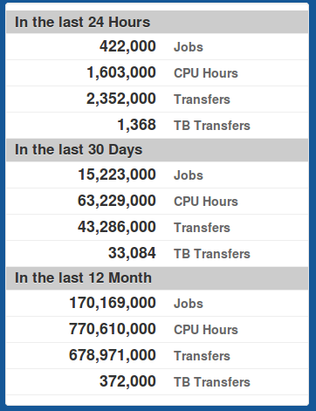
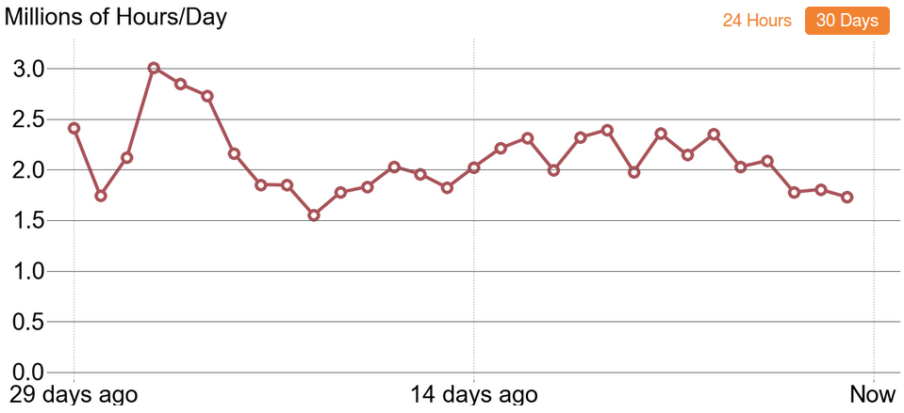
OSG in numbers
~120 participating sites
~100k CPU cores
From the OSG Display
http://display.grid.iu.edu/

Slide 16
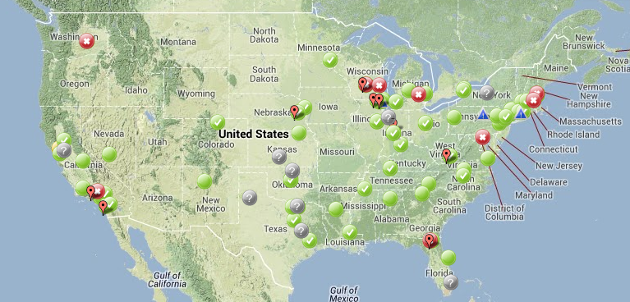
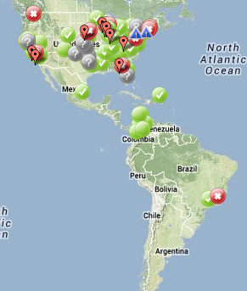
OSG on the map
Most of the USA covered
  And we even have some abroad

Slide 17
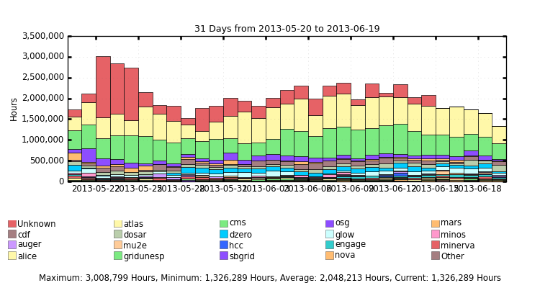
OSG Communities
Dominated by ATLAS and CMS (HEP)
  But almost a third used by a significant number of smaller groups
From http://myosg.grid.iu.edu

Slide 18
About OSG resources
OSG standardized on
Red Hat Enterprise Linux (and alike, e.g. CentOS) on x86_64 CPUs
  Versions 5 and 6
  In theory other Linux distributions an option, but not supported out of the box
Users thus should plan on building their software for this platform
  At least in the short term

Slide 19
About OSG resources
Each OSG job will be running on a single node
  e.g. no multi-node MPI
Most of the sites schedule
one job per CPU core
  So you don't even get a full node
Typical job gets
  1 core + 2G of RAM + 10G of tmp disk

Slide 20
Accessing OSG resources
The only way to get access to OSG resources is through the CE
  e.g no login nodes or interactive access
The recommended client is
Condor-G
  HTCondor supports
  “Grid universe”
  jobs
The CE does
not have a native
production quality
client

Slide 21
Condor-G in a nutshell
I like to call Condor-G “a shovel”
  It accepts jobs and “shovels” them
  into a remote HTC system
Just a schedd, no startd
  Treats the CE as a black box
You get
very limited
monitoring
information
CE
Scheduler
Condor-G

Slide 22
XSEDE
XSEDE is the other Grid infrastructure in the USA
XSEDE is part of the XD program
  XD == NSF's eXtreme Digital program
  XSEDE == eXtreme Science and Engineering Discovery Environment
https://www.xsede.org/

Slide 23
XSEDE Grid
XSEDE is composed of a set of very different resource providers
  Typically one-of-a-kind supercomputers
  (but not only)
Users thus typically have to tune/tweak their jobs for the resource they want to use
  Due to the unique nature of the resource

Slide 24
XSEDE Resources
XSEDE owns (most of) the hardware
Its main focus is on
“new and innovative”
resources, e.g.
  Multi-Petaflop systems
  GPU computing
  100 Tbytes flash storage
  Infiniband interconnects
Thus unique
resources

Slide 25
Access to resources
XSEDE provides login access to their scheduler submitter nodes
  To facilitate porting and debugging
XSEDE also has a Web portal
https://portal.xsede.org/
Most XSEDE users
submit few
very massive jobs
Point-and-click
very convenient

Slide 26
Grant system
Each user needs a Grant to use any
XSEDE resources
  So resources are not over-comitted
Small grants easy to get
  But getting a significant amount of resources takes serious paperwork
But definitely
worth it, if you
need specialized
hardware

Slide 27
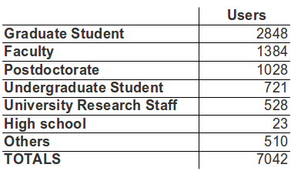
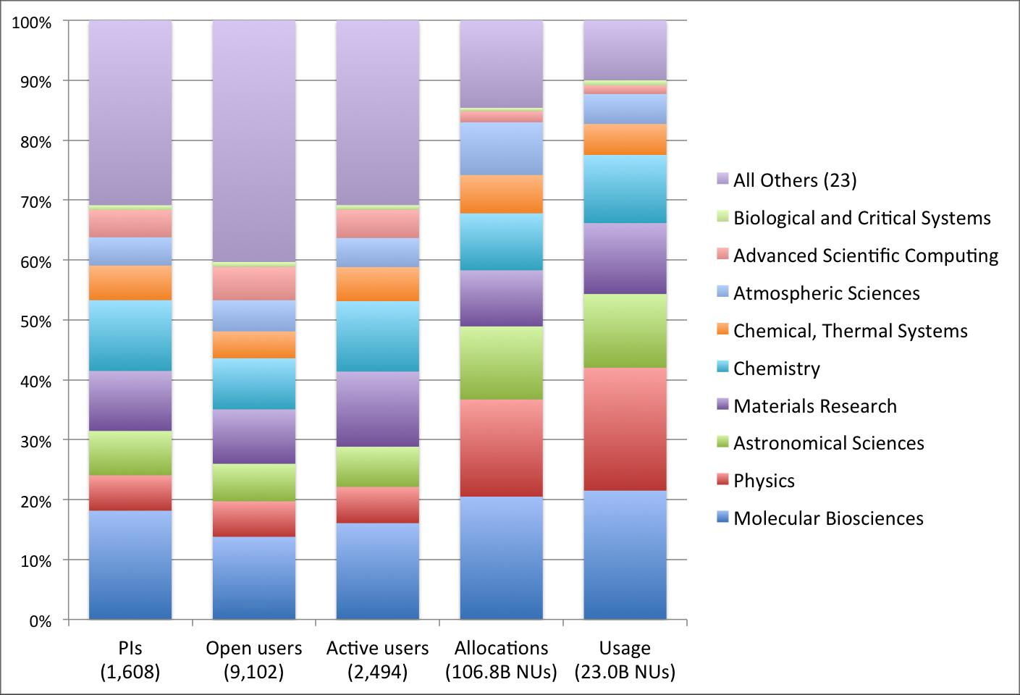
XSEDE User base
https://www.ideals.illinois.edu/handle/2142/44872

Slide 28
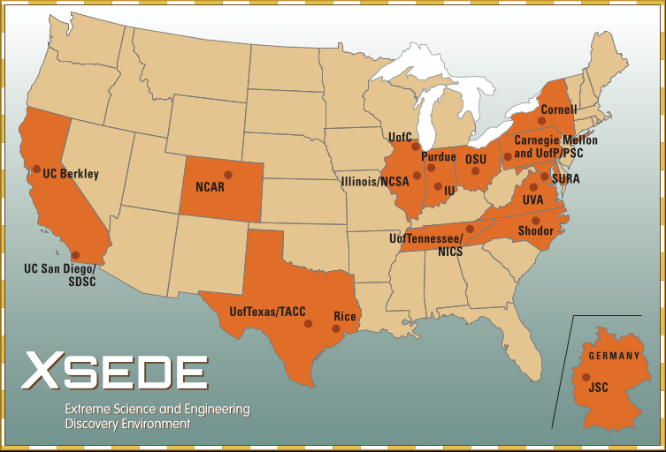
XSEDE on the map

Slide 29
Beyond HW resources
XSEDE has a large number of
people on its payroll
XSEDE provides
  Training, Education and Outreach
  Coding support and advising
  Software development
  Hardware engineering
Aims at providing end-to-end support for enabling innovative science
https://www.xsede.org/what-we-do

Slide 30
Questions?
Questions? Comments?
  Feel free to ask me questions later:
  Igor Sfiligoi <isfiligoi@ucsd.edu>
Upcoming sessions
  Now – 3:00pm
    Interactive session on security
  3:00pm – 3:15pm
    Break
  3:15pm – 4:00pm
    Lecture on Security

Slide 31


Logos

