Slide 1

OSG Site, Software and Services: Overview
Leigh Grundhoefer
Indiana University

Slide 2
OSG Registrations - VO’s
VOs Register with with Operations Center
  Provides URL explaining the resource usage and the location of the VOMS service.
  After approval of the Executive Board, the OSG software is updated with configuration information for the new VOMS service.
  The VORS tools displays information about the VO and Sites which advertise support.
  Users register through VOMRS or directly through VOMS and are approved by the VO administrator.
  Each VO manager is responsible for users to sign AUP.
http://osg.ivdgl.org/twiki/bin/view/Operations/RegistrationInstructions

Slide 3
OSG Registrations - Site/SC’s
Sites Register with the Operations Center
  Accepts the OSG Service Agreement.
  Decides which VOs to support
  Populates local authorization from VOMS information. Chooses local account mapping and scheduling policies.
  Added to the OSG Validation services.
Support Centers Register with the Operations Center
  Aggregate problem handling for groups of VO’s and Site’s.
  Attends the weekly OSG Operations.
  Provides communication channel between OSG Project and VO and Site Managers.

Slide 4
Are you an OSG Site admin?
Is your site registered with the OSG Grid Operations Center?
Have you installed software from the OSG or VDT software caches?
Are you running jobs from VO’s which are part of an OSG VO?
Is your site being validated by OSG validation services?
Are you receiving information about software and security updates from OSG?
Are you reporting problems and downtimes on your Site to the your Support Center and/or to the OSG GOC?

Slide 5
VDT -> OSG Release process
OSG Integration Activity
Readiness
plan
Effort
Resources
Readiness
plan adopted
VO
Application
Software
Installation
Software &
packaging
OSG Directors and Stakeholders
Service
deployment
OSG Operations
Activity
Application
validation
Release
Candidate
Middleware
Interoperability
Functionality &
Scalability
Tests
feedback
Metrics &
Certification
Release
Description

Slide 6
OSG Release packages
Site software - Compute Element - (GT4)
  pacman -get OSG:ce
Storage software - Storage Element
Compute node client - Worker-node Client
  pacman -get OSG:wn-client
Submit Host - Client
  pacman -get OSG:client
Role-based Privilege Service - GUMS
  pacman -get OSG:gums
Authentication Service - VOMS
  pacman -get OSG:voms
HTTP Proxy Service - Squid
  pacman -get OSG:squid

Slide 7
OSG CE Configuration
The VDT environment sourced from setup.sh
Set the OSG environment with “configure-osg.sh” which:
  Populates the osg-attributes.conf
  Based on users responses executes other configuration scripts. I.E. for MonaLisa and the Generic Information Provider.
Setup Local Authorization for VO’s
  Prima callout to GUMS
  Pull from VOMS directly with edg-mkgridmap to populate grid-mapfile
Setup connection between your batch queuing system and the middleware services.
  Install OSG:Globus-[Your-BQ]-Setup. Currently supported are LSF, PBS, Condor, SGE (pre-WS only)
  Define Batch policies for job execution
Setup middleware to be available off site, iptables updates, institutional firewall updates to allow traffic.

Slide 8
OSG Validation Summary
OSG VO’s VOMS validation
  http://voms-monitor.grid.iu.edu/
GridEX - application validation ( pilot job submissions )
  http://www.cs.wisc.edu/condor/tools/exerciser/
Site Policy template and publication
  http://vors.grid.iu.edu/site_policies.html
Generic Information Provider Validation
  http://grow.its.uiowa.edu/osg-gip/Production.shtml
Monitoring validation : MonALisa Client status (VO Jobs I/O)
  http://monalisa.grid.iu.edu:8080/stats?page=summary
CE/SE Validation aggregation : VORS - Site scanning, BDII info
  http://vors.grid.iu.edu/
GridCat and the MIS-CI client
  http://osg-cat.grid.iu.edu/ - Production instance
  Client software: http://software.grid.iu.edu/pacman/tarballs/misci-0.4.1.tar.gz

Slide 9
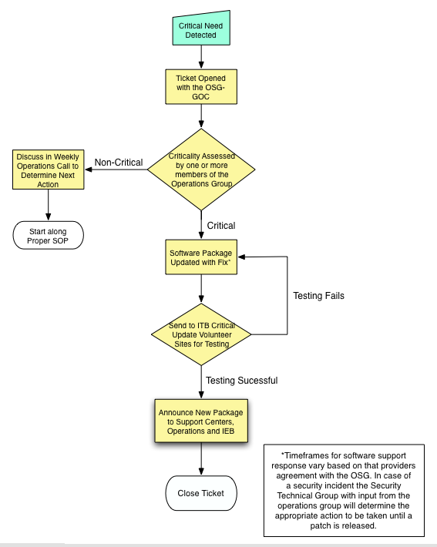
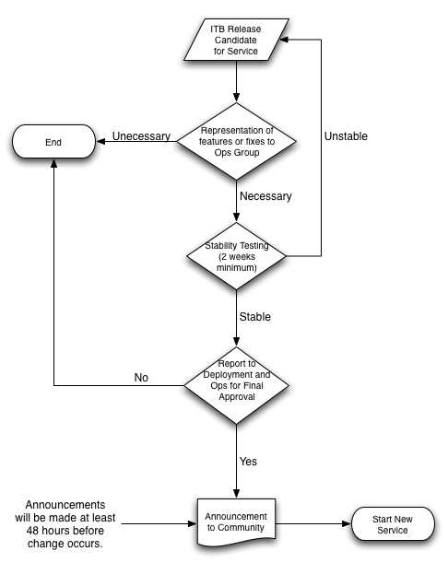
OSG Releases Process for Urgent and Critical Software and Service updates

Slide 10
Thank You!
leighg at indiana.edu

