Slide 1
OSG Software: The Next Year

Slide 2
Thoughts on the transition to RPMs
User feedback:
  Mostly positive (anecdotally)
  Some hiccups, need improve communication
    CVMFS (confused ATLAS when added)
    Need more docs on understanding how to update
More software from the OS instead of us:
  httpd, Tomcat, MySQL, Squid, lfc
Easier to build/test some packages
But some use cases unsupported:
  A couple of Debian sites have no support
  Several sites prefer worker node as non-root
Upgrades are easier… when they work
Harder to recover from bad upgrades

Slide 3
State of software:
A few statistics
# of Source RPM in latest release:
  198 Total
  51 are for Globus (unusual packaging tips the scales)
Compute Elements in OSG:
OSG 3.x | 30 (29%)
OSG 1.2 | 68 (66%)
OSG 1.0.x | 3 (3%)
Total | 102

Slide 4
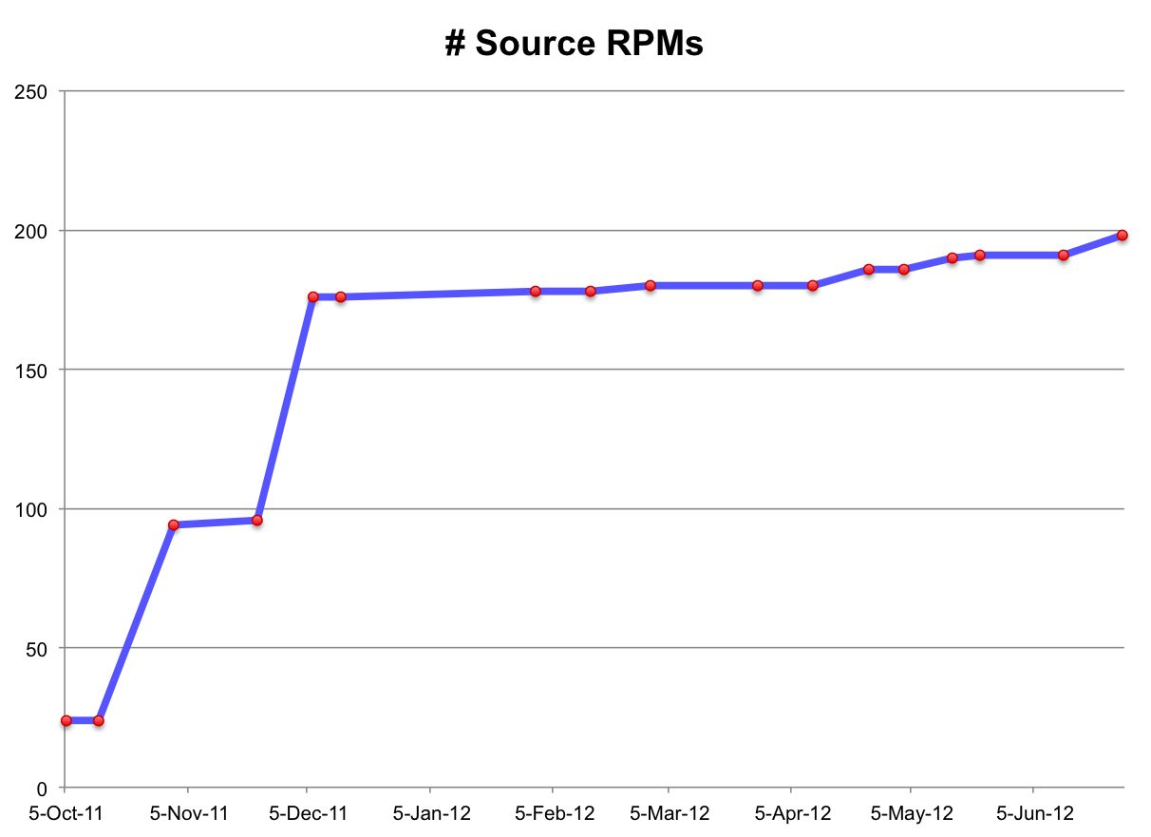
Growth of OSG Software 3
3.1.0: SL6 support
3.1.5: CVMFS
3.0.4: CE
On average:
2 releases per month
3.0.2: Clients
3.0.0: Just VOMS

Slide 5
Current effort
UW Roy, Cartwright, Selmeci, Kronenfeld | 3.5 (hiring one more)
Fermilab Strain, Sharma | 1.0
U Chicago Thapa | 1.0
BNL Zhao | 0.5
UCSD Sfiligoi, Martin, Mortensen | 0.5
Total | 6.5

Slide 6
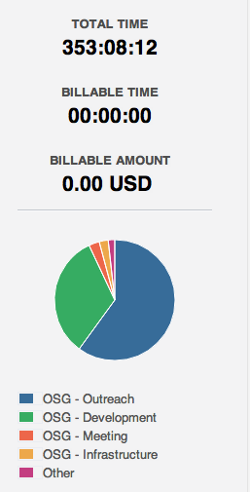
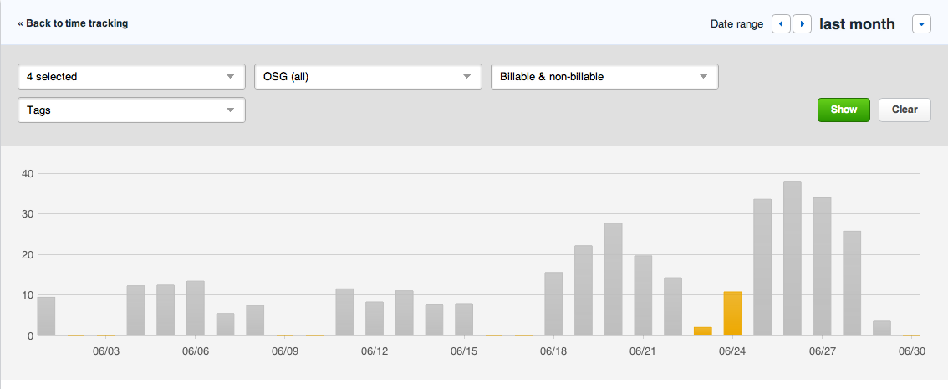
Effort tracking: early results
Have effort tracking for UW subset of Software Team
Will roll out to full Software Team in July

Slide 7
Worries
Globus support & next-gen CE
What should Software Team be doing to help campus infrastructures, non-LHC, etc.?
  Support other OSes?
  Support other packaging?
  Need other software?

Slide 8
Major themes for this year
Improve quality of OSG Software 3
  Well-tested software that works
  Well-documented
  Eliminate surprises
    E.g. Updates should be well-documented, easy to perform
Be responsive to community needs for changes

