Slide 1
Performance Measurement Tools
March 10th 2011, OSG All Hands Workshop - Network Performance
Jason Zurawski, Internet2

Slide 2

Agenda
Tutorial Agenda:
  Network Performance Primer - Why Should We Care? (15 Mins)
  Getting the Tools (10 Mins)
  Use of the BWCTL Server and Client (30 Mins)
  Use of the OWAMP Server and Client (30 Mins)
  Use of the NDT Server and Client (30 Mins)
  Diagnostics vs Regular Monitoring (30 Mins)
  Network Performance Exercises (1 hr 30 Mins)
<number> – 11/08/26, © 2011 Internet2

Slide 3
Basic Premise
Use of the network should meet user expectations.
  See Examples from earlier
  When things don’t look right, time to explore ‘why’
If they don’t you should complain!
  Learn how to do so effectively
    Produce results
    Isolate problem
  ‘The network is slow’ is not how to complain effectively
<number> – 11/08/26, © 2011 Internet2

Slide 4
Underlying Assumption
When problems exist, it’s the networks fault!
  Easy to blame a resource, but where else could a problem be when transferring large data sets?
    Host (Disk, CPU, Kernel, NIC Drivers)
    Network Interface Cards
    Routers/Switches, Routing and Configuration
    Physical Infrastructure
    Protocols
The network is viewed as a single resource in many cases
  Reality – complex series of components
  Multiple vendors/technologies
  Multiple configuration options
  Crossing administrative domains
<number> – 11/08/26, © 2011 Internet2

Slide 5

Network View (Layman’s Terms)
Bob’s
Host
“The Internets”
Carol’s
Host
<number> – 11/08/26, © 2011 Internet2

Slide 6
Network View (Actual)
Switch 2
Switch 3
R5
R4
R8
R1
Switch 1
R3
R6
R9
R2
R7
Switch 4
<number> – 11/08/26, © 2011 Internet2

Slide 7
Addressing a Performance Discrepancy
What are the first steps to address problems related to network performance?
  Try a Tool
What tools are out there
  Numerous
  Different metrics (measurements) available
  How to interpret the results?
<number> – 11/08/26, © 2011 Internet2

Slide 8
Tools, Tools, Tools
Ping
Traceroute
Iperf
Tcpdump
Tcptrace
BWCTL
NDT
OWAMP
AMP
Advisor
Thrulay
Web100
MonaLisa
pathchar
NPAD
Pathdiag
Surveyor
Ethereal
CoralReef
MRTG
Skitter
Cflowd
Cricket
Net100
Pathload
Pathchrip
MRTG
Cacti
Smokeping
PingER
FDT
perfSONAR
Nagios
Ganglia
Thurlay
Etc. etc. etc.
<number> – 11/08/26, © 2011 Internet2

Slide 9
Highlighting some Interesting Tools
Focus on 3 Types of tools (for now)
  Basic Diagnostics
    Ping, Traceroute
  Advanced User Tools
    NDT
  Network Admin Focused
    OWAMP, BWCTL
What about the others?
  Try them out, learn how they work.
  Most tools are designed to solve a specific problem and they may add value to your organization
Integration of multiple solutions
  Measurement frameworks integrate use of tools (operation, collecting results) along with analysis and presentation
  perfSONAR
<number> – 11/08/26, © 2011 Internet2

Slide 10
Software Availability
BWCTL, OWAMP, NDT client applications are available in VDT
Source Packages (Client and Server)
  http://software.internet2.edu/sources/
  Typical ‘configure/make/make install’
RPM Installation (CentOS 5.5 Supported):
  Install our RPM package to enable the Internet2 Repository
  See instructions here: http://software.internet2.edu/
  Support for YUM and APT-RPM
pS Performance Toolkit ISO
  All tools, pre-installed and configured
  More info: http://psps.perfsonar.net/toolkit/
Others Notes:
  Other RPM based distros (Fedora/RHEL) may work with packaged RPMs … YMMV
  To install on Debian, consider source. Alien conversions of RPMs may be problematic
<number> – 11/08/26, © 2011 Internet2

Slide 11
Basic Diagnostic Tools
Ping
  Round Trip (e.g. source to destination, and back)
  Confirms that remote host is ‘up’
  Some network operators block these packets
    Play w/ command options to see if that will change anything
Traceroute
  Identifies the routers along the path
  Same blocking problem as above
  Routers treat TR packets with lower priority
    See presentation from prior JTs:
    http://www.internet2.edu/presentations/jt2009jul/20090722-litvanyi.pdf
<number> – 11/08/26, © 2011 Internet2

Slide 12
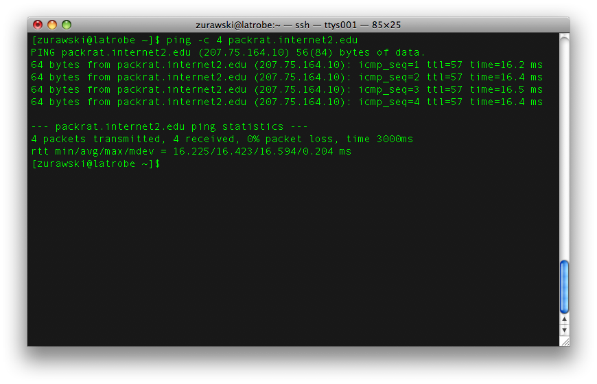
Ping Output
<number> – 11/08/26, © 2011 Internet2

Slide 13
Ping Output
Intro message
  Identifies remote host name and IP address
  States size of packets being sent
    Setting larger sizes may reveal hidden problems
Output lines
  Who responded, and the RTT, maybe other details
Summary lines
  Number of packets sent/received/lost
  RTT statistics min/average/max
  N.B. 1 msec RTT = ~50 miles of between hosts
<number> – 11/08/26, © 2011 Internet2

Slide 14
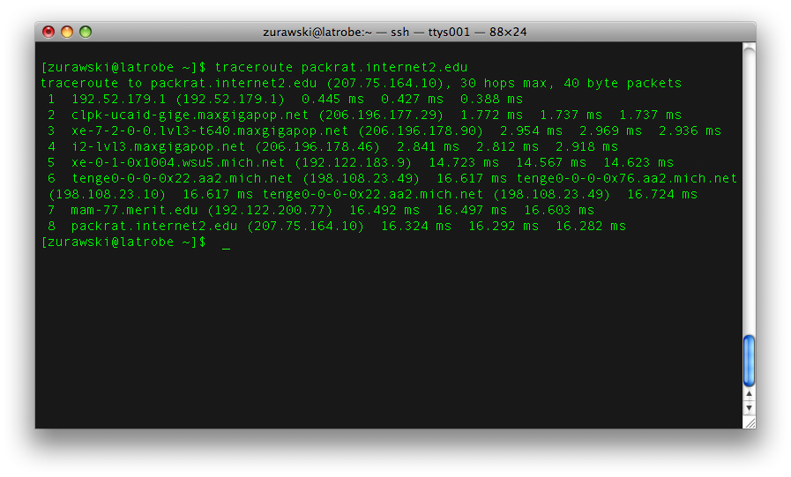
Traceroute Output
<number> – 11/08/26, © 2011 Internet2

Slide 15
Traceroute Output
Intro messages
  Name and address of remote host
  Maximum number of link before giving up
Status messages
  One line per router in path
  ‘*’ indicates router didn’t respond
  Routers usually rate limit replies
  No name indicates DNS entry is missing
  Hops required to reach remote host or max number from above
<number> – 11/08/26, © 2011 Internet2

Slide 16
Advanced User Tool - NDT
NDT = Network Diagnostics Tool
Measure performance to users desktop
Identify real problems for real users
  Network infrastructure could be the problem
  Host tuning issues could be the problem
Make tool simple to use and understand
  Presentation in a method almost all users can access: web browser
Make tool useful for users and network administrators
  Variables for many aspects of host, protocol, and network performance
<number> – 11/08/26, © 2011 Internet2

Slide 17
NDT User Interface
Web-based JAVA applet allows testing from any browser
  One Click testing
  Option to dig deep into available results
  Send report of results to network administrators
Command-line client allows testing from remote login shell
  Same options available
  Client software can be build independent of server software
<number> – 11/08/26, © 2011 Internet2

Slide 18
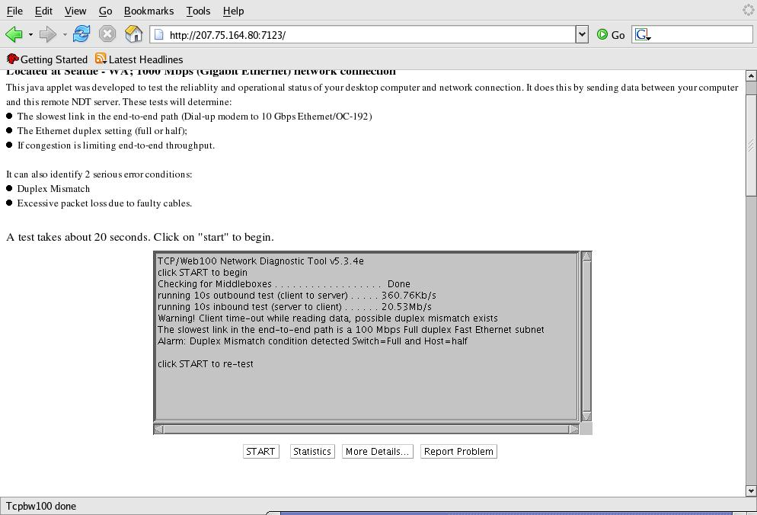
NDT Results
<number> – 11/08/26, © 2011 Internet2

Slide 19
Finding Results of Interest
Duplex Mismatch
  This is a serious error and nothing will work right. Reported on main page, on Statistics page, and mismatch: on More Details page
Packet Arrival Order
  Inferred value based on TCP operation. Reported on Statistics page, (with loss statistics) and order: value on More Details page
Packet Loss Rates
  Calculated value based on TCP operation. Reported on Statistics page, (with out-of-order statistics) and loss: value on More Details page
Path Bottleneck Capacity
  Measured value based on TCP operation. Reported on main page
<number> – 11/08/26, © 2011 Internet2

Slide 20
Installation
Software Dependencies
  Web100 Patched Kernel
    Traditionally not a ‘simple’ operation to maintain
    Questions on security when patching a kernel – also may not cleanly apply to a ‘vendor’ kernel
  NDT Client/Server Package
Software available as:
  Source
  RPM for Web100 Kernel and NDT
  pS Performance Toolkit
    Web100 patched kernel, all measurement tools on a Live Linux CD
<number> – 11/08/26, © 2011 Internet2

Slide 21
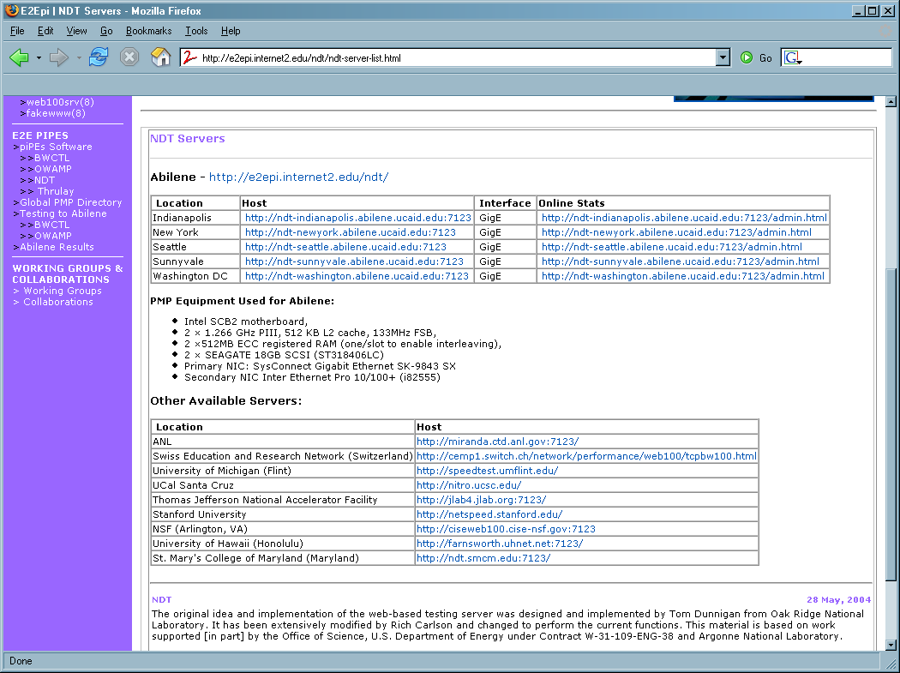
Finding a Server – The Old Way
Static List of servers – doesn’t scale
<number> – 11/08/26, © 2011 Internet2

Slide 22
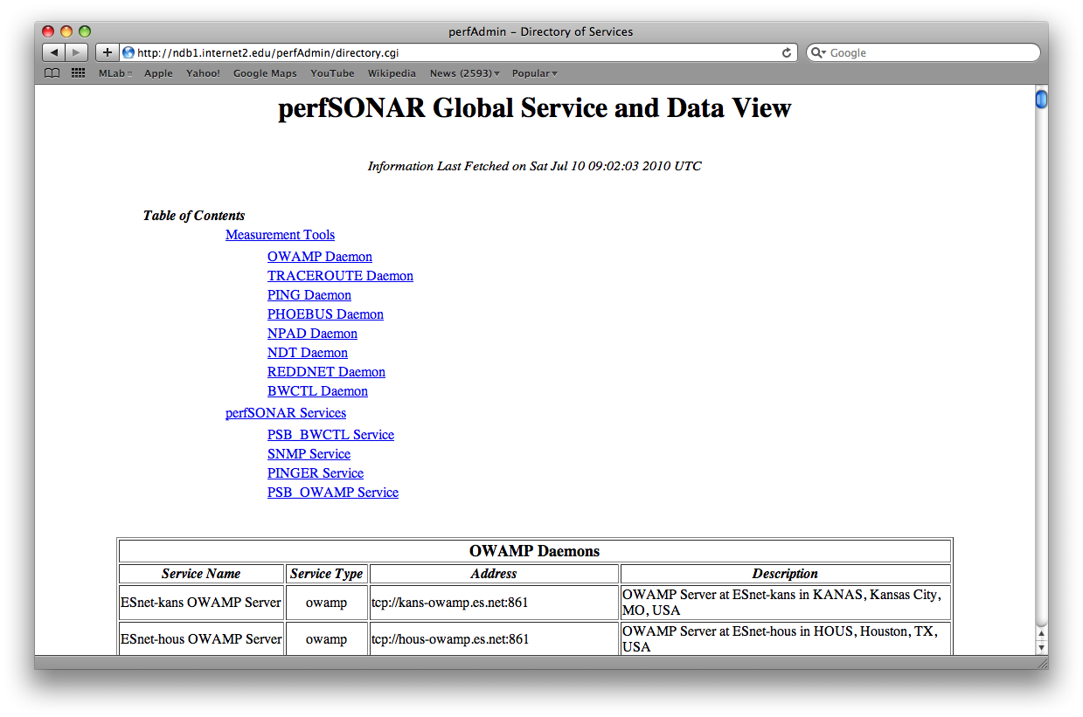
Finding a Server – The New Way
perfSONAR Infrastructure – automatically search for instances
<number> – 11/08/26, © 2011 Internet2

Slide 23
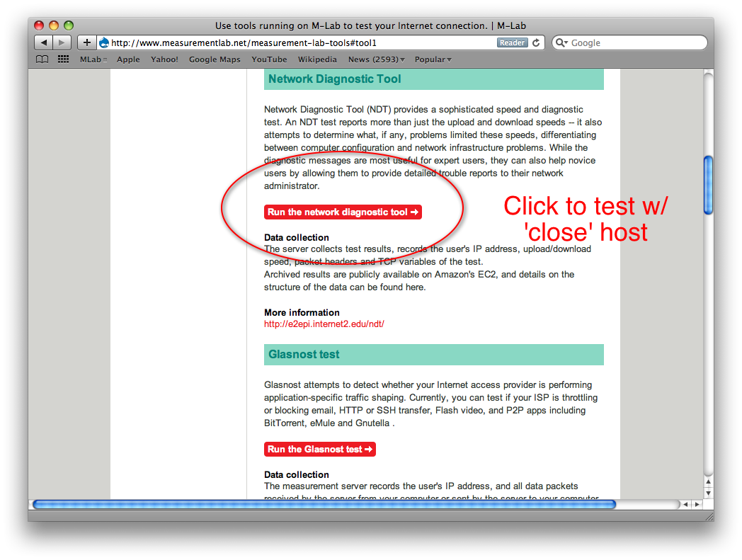
Finding a Server – MLab
Measurement Lab
  Joint Project between several partners
  More Info Here: http://www.measurementlab.net/
Locate a ‘close’ NDT server using DONAR (http://donardns.org/)
<number> – 11/08/26, © 2011 Internet2

Slide 24
Network Administration Tools
BWCTL – Bandwidth Control
  Allows single person operation over wide area testing environment
  Runs NLANR ‘iperf’ program
    Support for Thrulay, nuttcp
OWAMP – One way Delay Measurement
  Advanced ‘ping’ command
    One way vs round trip
  Allows single person operation over wide area testing environment
<number> – 11/08/26, © 2011 Internet2

Slide 25
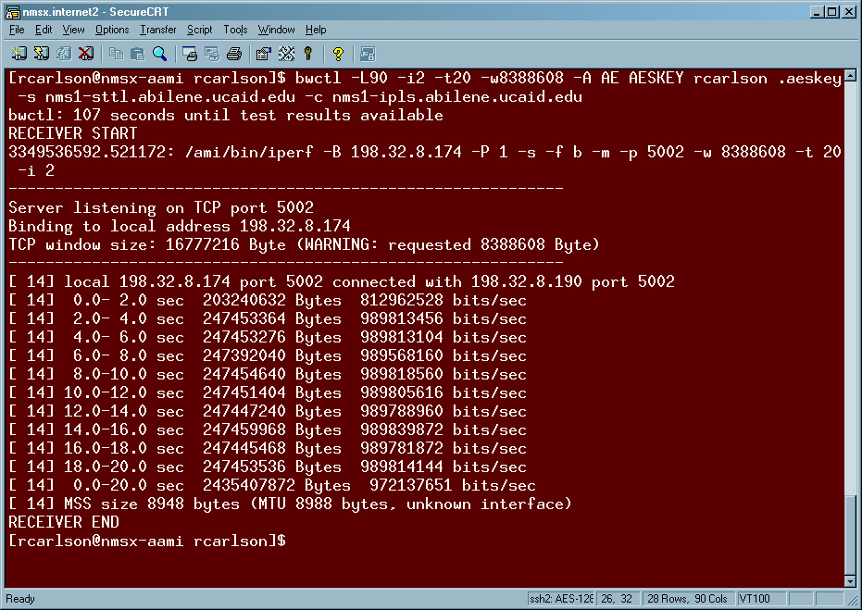
BWCTL Sample Results
<number> – 11/08/26, © 2011 Internet2

Slide 26
BWCTL Highlights
You must pre-install BWCTL software package
  Server/Client required for ends of a test
Internet2 default permission: TCP test from any member
  UDP available on request
Sites can restrict access to ‘known’ remote users
  Rich set of permissions and limitations
<number> – 11/08/26, © 2011 Internet2

Slide 27
BWCTL Commands
bwctl -L90 -i2 -t20 -c bwctl.losa.net.internet2.edu
bwctl -L90 -i2 -t20 -s bwctl.newy.net.internet2.edu
  Bwctl = name of program
  L90 = wait up to 90 seconds for a test
  i2 = report intermediate results every 2 seconds
  t20 – run test for 20 seconds
  s name = remote end will send data to you
  c name = you will send data to the remote host
<number> – 11/08/26, © 2011 Internet2

Slide 28
BWCTL 3rd Party Testing
bwctl -L90 -i2 -t20
-c bwctl.salt.net.internet2.edu
-s bwctl.atla.net.internet2.edu
  User can run a test between 2 remote hosts
<number> – 11/08/26, © 2011 Internet2

Slide 29
Installation
Software available as:
  Source
  RPM – Installable through YUM/APT-RPM
  pS Performance Toolkit
    Web100 patched kernel, all measurement tools on a Live Linux CD
<number> – 11/08/26, © 2011 Internet2

Slide 30
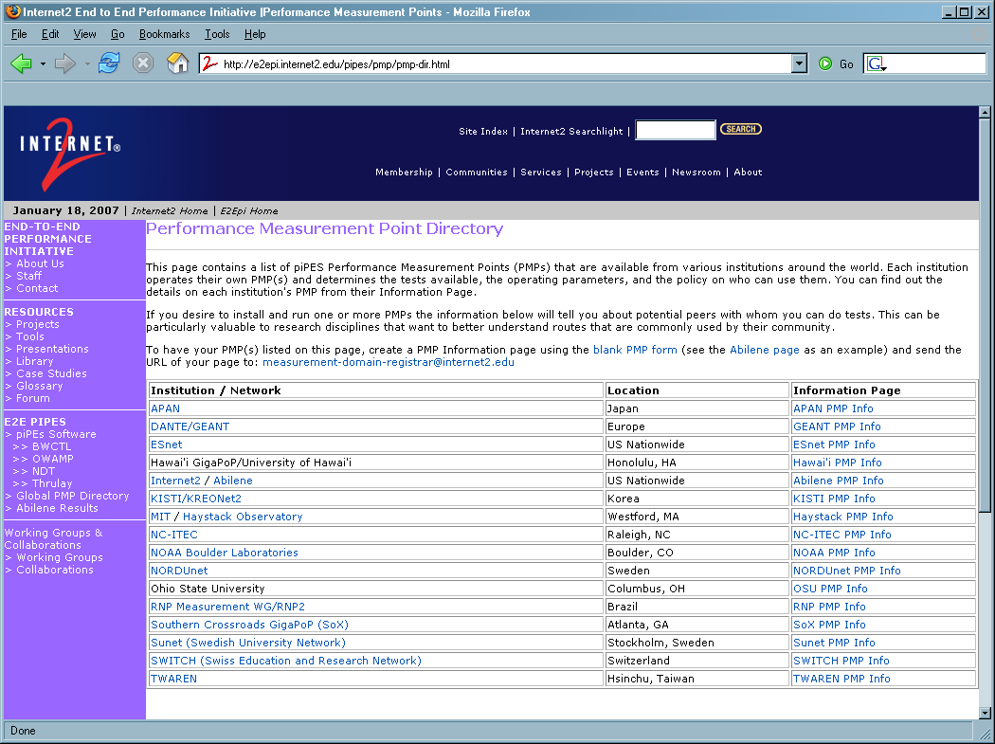
Finding a Server – The Old Way
Static List of servers – doesn’t scale
<number> – 11/08/26, © 2011 Internet2

Slide 31
Finding a Server – The New Way
perfSONAR Infrastructure – automatically search for instances
<number> – 11/08/26, © 2011 Internet2

Slide 32
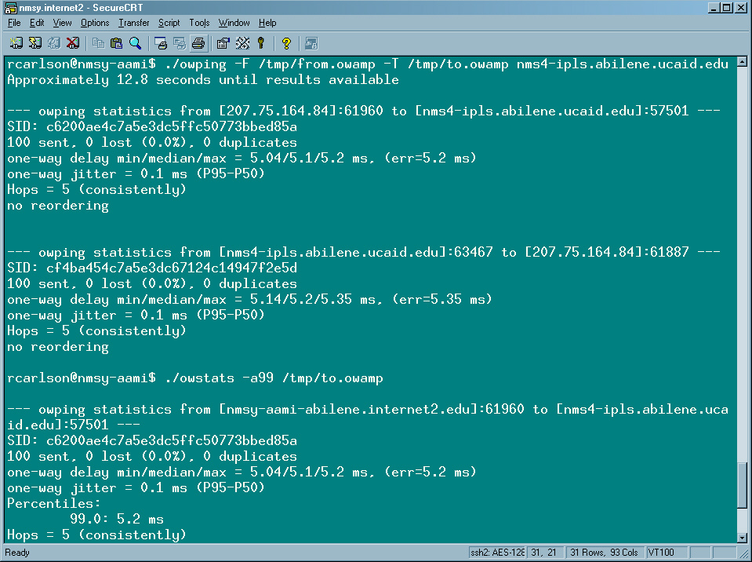
OWPing Results
<number> – 11/08/26, © 2011 Internet2

Slide 33
OWAMP Results
You must pre-install OWAMP software package
User program is called ‘owping’
Internet2 default permissions: basic test from any member
  Other options (e.g. longer test, more data sent) available on request
Sites can restrict access to ‘known’ remote users
  Similar rich set of permissions to BWCTL
<number> – 11/08/26, © 2011 Internet2

Slide 34
Using OWPing
owping owamp.salt.net.internet2.edu
  owping = program name
  owamp… = name of server
Output results
  Separate statistics for both directions
  Number of packets sent and lost
  One-way delay statistics min/median/max
  Number of IP hops in path
  Number of packets that arrives out-of-order
<number> – 11/08/26, © 2011 Internet2

Slide 35
Installation
Software available as:
  Source
  RPM – Installable through YUM/APT-RPM
  pS Performance Toolkit
    Web100 patched kernel, all measurement tools on a Live Linux CD
<number> – 11/08/26, © 2011 Internet2

Slide 36
Finding a Server – The Old Way
Static List of servers – doesn’t scale
<number> – 11/08/26, © 2011 Internet2

Slide 37
Finding a Server – The New Way
perfSONAR Infrastructure – automatically search for instances
<number> – 11/08/26, © 2011 Internet2

Slide 38
Conclusions
Primary tools still useful
  Know the tool
Advanced tools are being developed all the time
Installation using simple methods (e.g. VDT, RPM based package managers)
<number> – 11/08/26, © 2011 Internet2

Slide 39
Performance Measurement Tools
March 10th 2011, OSG All Hands Workshop – Network Performance
Jason Zurawski – Internet2
For more information, visit http://www.internet2.edu/workshops/npw
<number> – 11/08/26, © 2011 Internet2

