Slide 1
Discussion Topics DOE Program Managers and OSG Executive Team 2nd June 2011
Associate Executive Director
Currently planning for FY12
XD XSEDE Starting up. OSG is a Service Provider. Miron/Dan will be on the SP Forum.
Usage of the OSG
Any meetings planned at SciDAC PI meeting?

Slide 2
Associate Executive Director, new Position in OSG:
Lothar Bauerdick has joined the Executive Team as an Associate Executive Director to help coordinate and communicate with the multiple projects that are contributing to the OSG core program of work. This was proposed by me and endorsed by the rest of the team and the OSG Council in May.
The AED :
acts as the liaison to the associated projects, such as Institutes, that make needed contributions to the scope of work of the OSG project.
is a member of the Executive Team.
ensures effective communication of the (technical, schedule, process) requirements of OSG and its stakeholders to the associated projects,
agreement and delivery of the contributions from the associated projects, and
ensure an effective matching of the ongoing program of work to the scientific needs of the stakeholders from the OSG.

Slide 3
OSG Program of Work FY12-FY16:
Proposed full scope of program of work deemed necessary to sustain and extend OSG FY12-FY16 is 32.3 FTEs ($~8M).
~13 FTEs request (~40%) to NSF MPS PIF program.
5 FTEs requested as part of recent ASCR SCiDAC-3 Institute submission - Institute for Distributed High Throughput Computing (InDHTC).
10 FTEs are part of DOE OHEP 1 year continuation. Hope the ongoing effort will match that from NSF.
Remaining FTEs will be part of other “docked project”, satelliteor other proposals to NSF OCI and elsewhere.
Organization necessary to execute the FY12 plan is current basis for FY12 program of work and staffing plan. The time is Now for this work in Data, Software, Security, Campus, etc. This was decided by the Finance Board and endorsed by the Council in May.
With current commitments this means the project will run out of funds sometime between March and May 2012.
Impact will be developed in detail in time for the August 2nd Council meeting.

Slide 4
XD XSEDE Starting up. OSG is a Service Provider
Miron/Dan will be on the SP Forum. Expect this to stimulate increased collaboration.
ID management/access control – can we have commonalities through CILOGON and Shibboleth support?
Campus Infrastructures – direct connection between OSG and XSEDE; XSEDE wants to know “how they can help”.

Slide 5
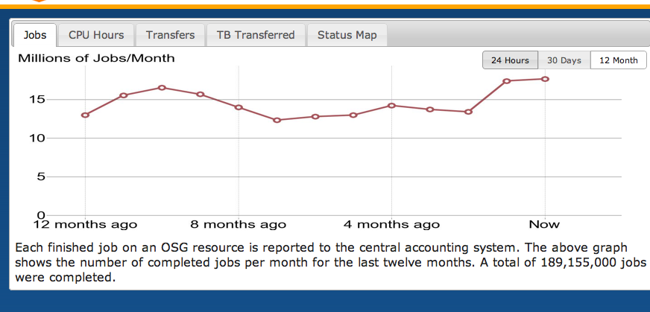
Usage of the OSG – new records in #jobs, cpu hours currently being set

Slide 6
Usage of the OSG – new records in #jobs, cpu hours (not yet sustained for >1 month) currently being set

Slide 7
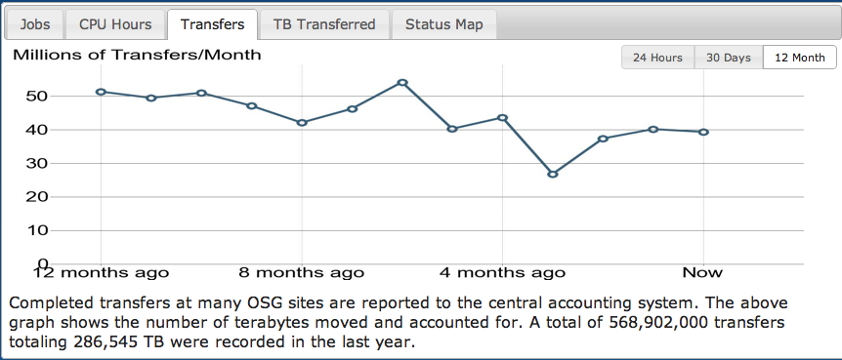
Number of transfers, amount of data transferred Decreasing in total

Slide 8
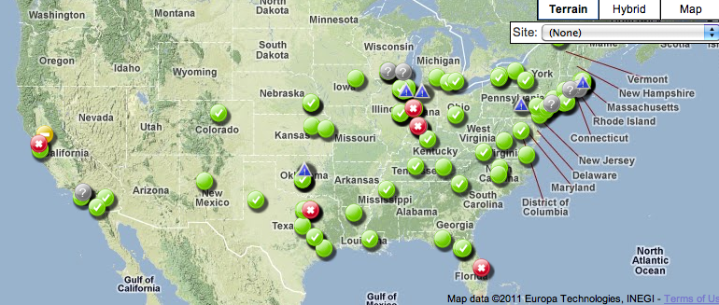
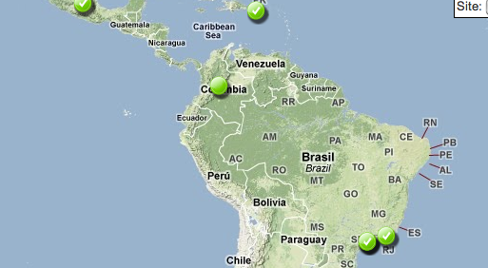
92 “processing end points” contributing:

Slide 9
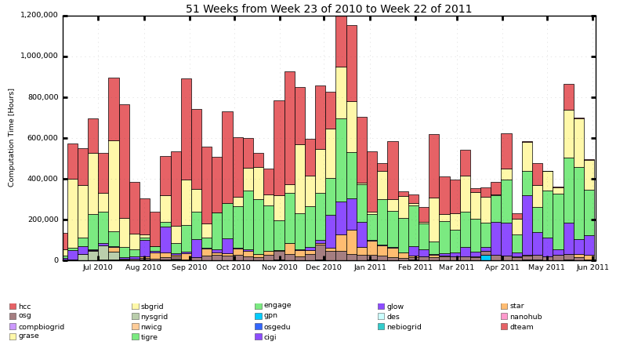
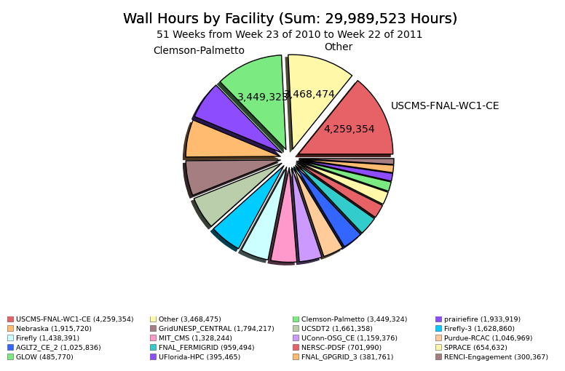
Non –HEP/LIGO usage fluctuates

Slide 10
Change in technology / architecture through use of Campus Infrastructures, Glidein mechanisms etc. means these graphs are no longer complete. There is now significant usage on the intra- campus infrastructures. We are working on gathering and comparing information from each “Submit Host” “Campus infrastructure” and/or “GlideinWMS VO Front End”, some of which give more information to the communities and users themselves.
Example from HCC in Nebraska:
~750,000 hours a month.
Example from GLOW/CHTC in Wisconsin:
Total Usage between 2011-05-29 and 2011-05-30
Group Usage Summary
User Hours Pct
-- ------------------------------ ---------- -----
1 BIOSTAT_Coen 20940.9 77.8%
2 Chemistry 4633.3 17.2%
3 Geoscience_Sahai 1174.5 4.4%
4 Spalding 153.6 0.6%
--------------------------------- ---------- ------
TOTAL 26902.2 100.0%

