Slide 1
Where to go and what to do next — resources, funding, mentors
Thursday afternoon
Ruth Pordes, ruth@fnal.gov
Executive Director
Fermilab

Slide 2
We hope you enjoyed the learning!
And we hope you are interested to continue to work with us:
  Do and/or support research
  Use our software
  Use our resources
  Contribute to our collaboration and team
  Think about our problems and goals

Slide 3
Help after the event
There are many mail lists.
    gridschool-2010@opensciencegrid.org will still exist.
Other useful ones:
    Vdt-support@opensciencegrid.org (software support)
    goc@opensciencegrid.org (operations center)
    Osg-sites@opensciencegrid.org
    Osg-vo-forum@opensciencegrid.org
Condor hompage http://www.cs.wisc.edu/condor/ And
Condor manual http://www.cs.wisc.edu/condor/manual/
OSG homepage www.opensciencegrid.org
TWiki home (don’t be frightened) https://twiki.grid.iu.edu/twiki/bin/view/Main/WebHome
Documents and presentations http://osg-docdb.opensciencegrid.org/cgi-bin/DocumentDatabase/

Slide 4
Keep in Contact
There is the Operations Center who will accept all requests.
There is the All Hands Meeting in March in Boston –
    we will invite (and sponsor) you for this to see how things are going!
There are other meetings .e.g site administrators meeting in August, users phone meetings, Campfire chat rooms.
Subscribe to iSGTW to get updates on science using distributed computing. www.isgtw.org

Slide 5
What if you, your professor, your system admin, your organization wants to participate further in OSG?
If you would like to build a cluster from hardware that you have purchased – or get advice on what hardware to buy – contact Dan Fraser (osg-sites@opensciencegrid.org)
If you would like to access resources on the OSG – talk to your mentor. (see next slide)
If you/your organiation would like to put in a proposal to your organization, NSF, DOE, NIH, NIST etc to collaborate and/or partner and/or be part of the OSG - OK! You can contact me for any information I have. We might write a letter about this being a success of the summer school ;-)
Agencies like to hear about good results from education, collaboration and especially,of course, good research.

Slide 6
Mentors
Our aim is to continue to support and help you – and to know what works and what doesn’t, what was useful from this school to help our planning for next year.
Mentors from the “core” OSG team will keep in touch with you proactively, and you can always contact them.
What do mentors do?
Contact every so often on the phone.
Help where needed.
Tell you what is going on in OSG that might be interesting.
Talk among ourselves on how its going as we plan for next year.
Timothy - Alain
Shanshan – Tanya
Brett – Igor, Dan
Ryan - Igor, Dan
Chen - Brian
Rogerio - Dan
Wenying - Tim
James - Brian
Kyungyong - Alain
Michael - Alain
Vishagan - Mats
Rob - Ruth
Dilip - Tanya
Zhiyong - Dan
Alex - Mine
Yuhong – Mine
Luo - Mats

Slide 7

You are funded to attend TG10 as well as the OSG summer school.
As you know unfortunately JP Navarro was not able to be here today.
I am hoping to be at TG10 on the Monday and Tuesday.
https://www.teragrid.org/web/events/tg10

Slide 8
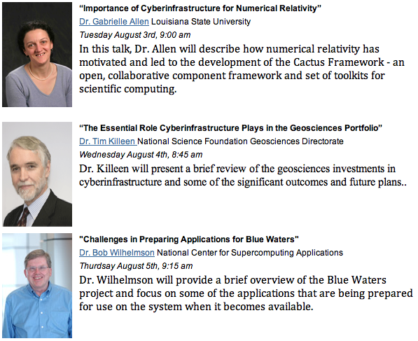
Invited Speakers
OSG Summer School 2010
Notes:
Users: ~20-30 high-level capabilities, versus 100s of components

Slide 9
Tutorials
Running Parallel Simulations and Enabling Science Gateways with the NSF MATLAB Experimental Resource at Cornell
How to Design an HPC Cluster
Scalable Systems Management with Puppet
Hands-on Tutorial for Building Cyberinfrastructure-Enabled and Community-Centric Science Gateway Applications
Remote Scientific Visualization
Cloud Technologies, Data Intensive Science and the TeraGrid
Using vSMP and Flash Technologies for Data Intensive Applications
Introducing RDAV & Nautilus–Resources for Remote Visualization, Data Analysis and Workflow Management
Open Grid Computing Environments Software for Science Gateways
Computing Across Both Open Science Grid and the TeraGrid – John McGee, Mats, Krista Larson
Optimization in Multi-Core Systems
Performance Analysis and Tuning for GPUs
PerfExpert: An Automated Approach to Analyzing and Optimizing the Node-Level Performance of HPC Applications
Running Applications at Scale on the First Academic Petaflop Supercomputer
HPC Advisory Council Tutorial: HPC Applications Best Practices and the Effect of New Acceleration technologies
OSG Summer School 2010
Notes:
Users: ~20-30 high-level capabilities, versus 100s of components

Slide 10
Questions?
Questions? Comments?
Feel free to ask me questions later:
  Ruth, ruth@fnal.gov, ruthpordes on aim (and on facebook)

