Slide 1
Changes and Surprises in OSG 1.0
Suchandra Thapa
Computation Institute/UChicago

Slide 2
Configuration Changes
New Configuration method using configure-osg.py
Change from interactive configuration to batch style configuration
Allows verification of attributes before changing configuration
Better error checking

Slide 3
RSV
More prominently featured in this release
Integration with nagios
Can now use proxy certificate or service certificate
Better and more easily understood web interface

Slide 4
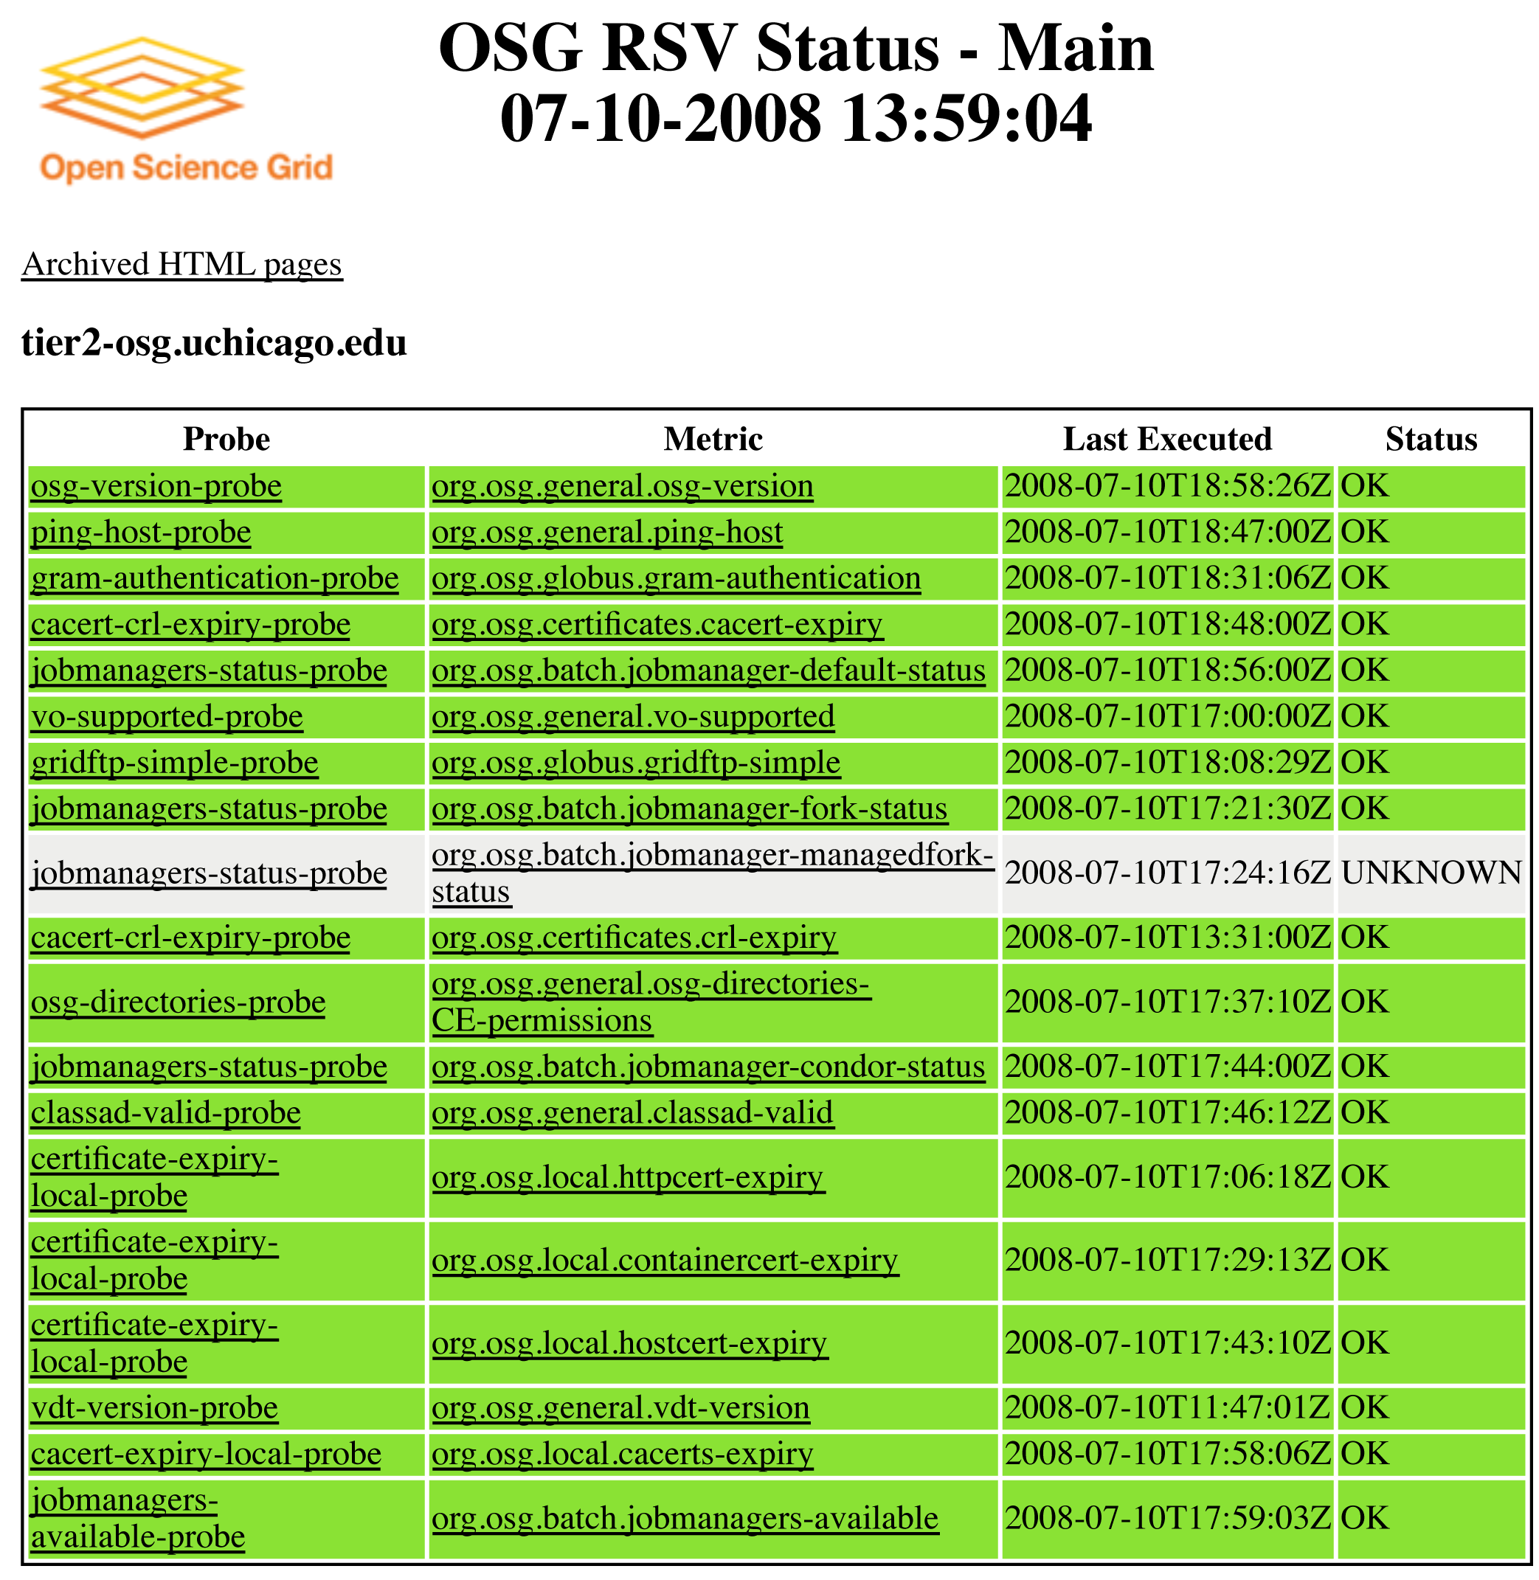
RSV Web Output

Slide 5
Better information systems
GIP updated
  Dynamic providers for PBS and dcache (experimental)
  Future updates coming
Gratia and CEMon also improved with bugfixes and better functionality
More information reporting to central sources

Slide 6
Behind the scenes changes
VDT now uses system openssl library
  Can cause problems if you have custom openssl libraries installed
  Updates to system openssl now update openssl used by osg software
CA certs updater now default way to update certs
Condor-Cron package now used to schedule and run rsv probes

