Slide 1
An Introduction to
High-Throughput Computing
Monday morning, 9:15am
Alain Roy <roy@cs.wisc.edu>
OSG Software Coordinator
University of Wisconsin-Madison

Slide 2


Who Am I?
With Condor since 2001
Open Science Grid Software Coordinator
Taught at six previous summer schools
I have the two cutest kids in the whole world:

Slide 3
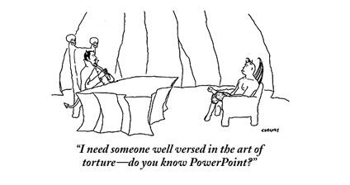
Overview of day
Lectures alternating with exercises
  Emphasis on lots of exercises
  Hopefully overcome PowerPoint fatigue & help you understand better

Slide 4
Some thoughts on the exercises
It’s okay to move ahead on exercises if you have time
It’s okay to take longer on them if you need to
If you move along quickly, try the “On Your Own” sections and “Challenges”
We’ll have an optional evening session if you want more time, and I’ll be there to give help

Slide 5
Most important!
Please ask me questions!
  …during the lectures
  …during the exercises
  …during the breaks
  …during the meals
  …over dinner
  …the rest of the week

Slide 6
Before we start
Sometime today, do the exercise on getting a certificate.
  It is required for all exercises Tuesday-Thursday
  It will be easiest if you do it today

Slide 7
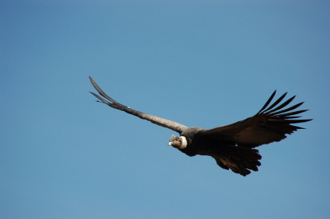
Goals for this session
Understand basics of high-throughput computing
Understand the basics of Condor
Run a basic Condor job

Slide 8
What is high-throughput computing? (HTC)
An approach to distributed computing that focuses on long-term throughput, not instantaneous computing power.
  We don’t care about operations per second
  We care about operations per year
Implications:
  Focus on reliability
  Use all available resources (not just high-end supercomputers)
    That slow four-year old cluster down the hall? Include it!

Slide 9
Good uses of HTC
“I need as many simulation results as possible before my deadline…”
“I have lots of small-ish independent tasks that can be run indepdently”

Slide 10
What’s not HTC?
The need for “real-time” results:
  (Ignore fact that “real-time” is hard to define.)
  HTC is less worried about latency (delay to answer) than total throughput
The need to maximize FLOPS
  “I must use the a supercomputer, because I need the fastest computer/network/storage/…”

Slide 11
An example problem: BLAST
A scientist has:
  Question: Does a protein sequence occur in other organisms?
  Data: lots of protein sequences from various organisms
  Parameters: how to search the database.
More throughput means
  More protein sequences queried
  Larger/more protein data bases examined
  More parameter variation
We’ll try out BLAST later today

Slide 12
Why is HTC hard?
The HTC system has to keep track of:
  Individual tasks (a.k.a. jobs) & their inputs
  Computers that are available
The system has to recover from failures
  There will be failures! Distributed computers means more chances for failures.
You have to share computers
    Sharing can be within an organization, or between orgs
    So you have to worry about security.
    And you have to worry about policies on how you share.
If you use a lot of computers, you have to deal variety:
  Different kinds of computers (arch, OS, speed, etc..)
  Different kinds of storage (access methodology, size, speed, etc…)
  Different networks interacting (network problems are hard to debug!)

Slide 13
Let’s take one step at a time
Small
Large
Local
Distributed
Can you run one job on one computer?
Can you run one job on another local computer?
Can you run 10 jobs on a set of local computers?
Can you run 1 job on a remote computer?
Can you run 10 jobs at a remote site?
Can you run a mix of jobs here and remotely?
This is the (rough) path we’ll take in the school this week

Slide 14
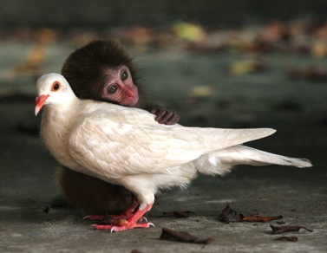
Discussion
For 5 minutes, talk to a neighbor: If you want to run one job in a local cluster of computers:
    What do you (the user) need to provide so a single job can be run?
    What does the system need to provide so your single job can be run?
      Think of this as a set of processes: what needs happen when the job is given? A “process” could be a computer process, or just an abstract task.

Slide 15
Alain’s answer:
What does the user provide?
A “headless job”.
  Not interactive/no GUI: how could you interact with 1000 simultaneous jobs?
A set of input files
A set of output files.
A set of parameters (command-line arguments).
Requirements:
  Ex: My job requires at least 2GB of RAM.
  Ex: My job requires Linux.
Control/Policy:
  Ex: Send me email when the job is done.
  Ex: Job 2 is more important than Job 1.
  Ex: Kill my job if it’s run for more than 6 hours.

Slide 16
Alain’s answer:
What does the system provide?
Methods to:
  Submit/Cancel job.
  Check on state of job.
  Check on state of available computers.
Processes to:
  Reliably track set of submitted jobs.
  Reliably track set of available computers.
  Decide which job runs on which computer.
  Manage a single computer.
  Start up a single job.

Slide 17
Surprise!
Condor does this (and more)
Methods to:
  Submit/Cancel job. condor_submit/condor_rm
  Check on state of job. condor_q
  Check on state of avail. computers. condor_status
Processes to:
  Reliably track set of submitted jobs. schedd
  Reliably track set of avail. computers. collector
  Decide which job runs on where. negotiator
  Manage a single computer startd
  Start up a single job starter

Slide 18
But not only Condor
You can use other systems:
  PBS/Torque
  Oracle Grid Engine (né Sun Grid Engine)
  LSF
  ...
But we won’t cover them.
  Our expertise is with Condor
  Our bias is with Condor
What should you learn?
  How do you think about HTC?
  How can you do your science with HTC?
  … For now, learn it with Condor, but you can apply it to other systems.

Slide 19

A brief introduction to Condor

Slide 20
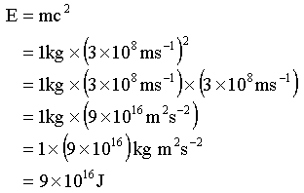
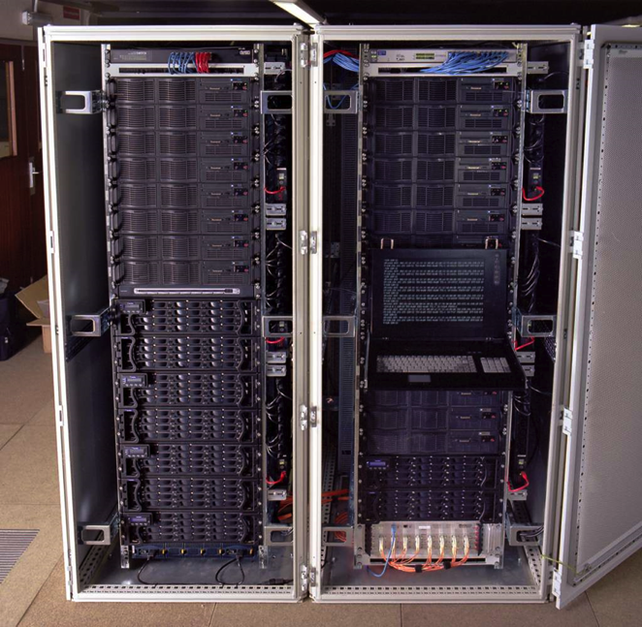
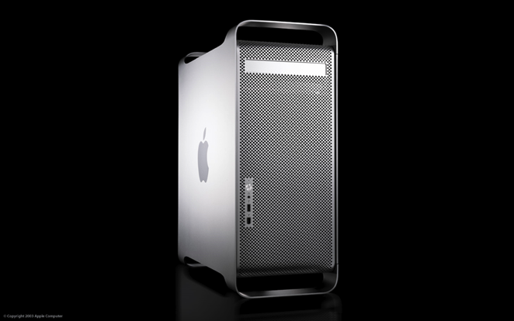
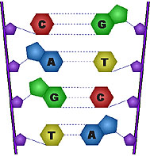
Condor Takes Computers…
…And jobs
…And matches them
I need a Mac!
Dedicated Clusters
Desktop Computers
Matchmaker
I need a Linux box
with 2GB RAM!

Slide 21
Quick Terminology
Cluster: A dedicated set of computers not for interactive use
Pool: A collection of computers used by Condor
  May be dedicated
  May be interactive

Slide 22
Matchmaking
Matchmaking is fundamental to Condor
Matchmaking is two-way
  Job describes what it requires:
  I need Linux && 8 GB of RAM
  Machine describes what it requires:
  I will only run jobs from the Physics department
Matchmaking allows preferences
  I need Linux, and I prefer machines with more memory but will run on any machine you provide me

Slide 23
Why Two-way Matching?
Condor conceptually divides people into three groups:
  Job submitters
  Machine owners
  Pool (cluster) administrator
All three of these groups have preferences
}
May or may not
be the same
people

Slide 24

ClassAds
ClassAds state facts
  My job’s executable is analysis.exe
  My machine’s load average is 5.6
ClassAds state preferences
  I require a computer
  with Linux

Slide 25
ClassAds
ClassAds are:
  semi-structured
  user-extensible
  schema-free
  Attribute = Expression
Example:
MyType = "Job"
TargetType = "Machine"
ClusterId = 1377
Owner = "roy“
Cmd = “analysis.exe“
Requirements =
(Arch == "INTEL")
&& (OpSys == "LINUX")
&& (Disk >= DiskUsage)
&& ((Memory * 1024)>=ImageSize)
…
String
Number
Boolean

Slide 26
Schema-free ClassAds
Condor imposes some schema
  Owner is a string, ClusterID is a number…
But users can extend it however they like, for jobs or machines
  AnalysisJobType = “simulation”
  HasJava_1_4 = TRUE
  ShoeLength = 7
Matchmaking can use these attributes
  Requirements = OpSys == "LINUX"
    && HasJava_1_4 == TRUE

Slide 27

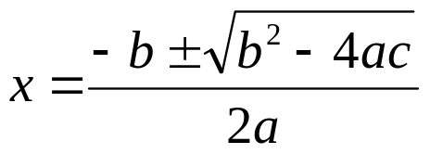
Submitting jobs: condor_schedd
Users submit jobs from a computer
  Jobs described as ClassAds
  Each submission computer has a queue
  Queues are not centralized
  Submission computer watches over queue
  Can have multiple submission computers
  Submission handled by condor_schedd
Queue
Condor_schedd

Slide 28

Advertising computers
Machine owners describe computers
  Configuration file extends ClassAd
  ClassAd has dynamic features
    Load Average
    Free Memory
    …
  ClassAds are sent to Matchmaker
ClassAd
Type = “Machine”
Requirements = “…”
Matchmaker
(Collector)

Slide 29
Matchmaking
Negotiator collects list of computers
Negotiator contacts each schedd
  What jobs do you have to run?
Negotiator compares each job to each computer
  Evaluate requirements of job & machine
  Evaluate in context of both ClassAds
  If both evaluate to true, there is a match
Upon match, schedd contacts execution computer

Slide 30
Matchmaking diagram
Matchmaker
Matchmaking
Service
Information
service
Negotiator
Collector
2
1
condor_schedd
3
Job queue service
Queue

Slide 31
Running a Job
Matchmaker
condor_submit
condor_negotiator
condor_collector
Manages Machine
condor_schedd
condor_startd
Queue
condor_shadow
Manages
Local Job
condor_starter
Job
Manages
Remote Job

Slide 32
Condor processes
Proceess | Function
Master | Takes care of other processes
Collector | Stores ClassAds
Negotiator | Performs Matchmaking
Schedd | Manages job queue
Shadow | Manages job (submit side)
Startd | Manages computer
Starter | Manages job (executtion side)

Slide 33
If you forget most of these remember two (for other lectures)
Proceess | Function
Master | Takes care of other processes
Collector | Stores ClassAds
Negotiator | Performs Matchmaking
Schedd | Manages job queue
Shadow | Manages job (submit side)
Startd | Manages computer
Starter | Manages job (executtion side)
Schedd Manages job queue
Startd Manages computer

Slide 34
Some notes
One negotiator/collector per pool
Can have many schedds (submitters)
Can have many startds (computers)
A machine can have any combination of:
  Just a startd (typical for a dedicated cluster)
  schedd + startd (perhaps a desktop)
  Personal Condor: everything

Slide 35



Example Pool 1
Matchmaker
Dedicated Cluster
(Machine Room)
Single Schedd
(One job queue)

Slide 36
Example Pool 1a
Fail-Over
Matchmakers
Matchmaker
Schedd
(One job queue)
Dedicated Cluster
(Machine Room)
Fail-Over
Schedd

Slide 37
Example Pool 2
Matchmaker
Dedicated Cluster
(Machine Room)
Desktop Schedds
& Execute Nodes
(Many job queues)
Note: Condor’s policy capabilities
let you choose when desktops act
as execute nodes.

Slide 38
Our Condor Pools
One submit computer
  One schedd/queue for everyone
  vdt-itb.cs.wisc.edu
One local set of dedicated Condor execute nodes:
  About 8 computers, about 45 available “batch slots”
Remote resources at UNL
  For Tuesday, not today.

Slide 39
Our Condor Pool
Name OpSys Arch State Activity LoadAv Mem ActvtyTime
slot1@miniosg-c01. LINUX INTEL Unclaimed Idle 0.000 2030 0+00:00:04
slot2@miniosg-c01. LINUX INTEL Unclaimed Idle 0.000 2030 0+00:00:05
slot3@miniosg-c01. LINUX INTEL Unclaimed Idle 0.000 2030 0+00:29:46
slot4@miniosg-c01. LINUX INTEL Unclaimed Idle 0.000 2030 0+00:29:47
slot5@miniosg-c01. LINUX INTEL Unclaimed Idle 0.020 2030 0+00:07:45
slot6@miniosg-c01. LINUX INTEL Unclaimed Idle 0.000 2030 13+01:43:11
slot7@miniosg-c01. LINUX INTEL Unclaimed Idle 0.000 2030 13+01:43:12
slot8@miniosg-c01. LINUX INTEL Unclaimed Idle 0.000 2030 13+01:43:05
slot1@miniosg-c02. LINUX INTEL Unclaimed Idle 0.000 2030 0+05:35:22
slot2@miniosg-c02. LINUX INTEL Unclaimed Idle 0.000 2030 0+05:45:29
slot3@miniosg-c02. LINUX INTEL Unclaimed Idle 0.000 2030 0+01:35:06
...
Total Owner Claimed Unclaimed Matched Preempting Backfill
INTEL/LINUX 44 0 44 0 0 0
Total 44 0 44 0 0 0

Slide 40

That was a whirlwind tour!
Let’s get some hands-on experience with Condor, to solidify this knowledge.
Goal: Check out our installation, run some basic jobs.

Slide 41
Questions?
Questions? Comments?
  Feel free to ask me questions later:
  Alain Roy <roy@cs.wisc.edu>
Upcoming sessions
  9:45-10:30
    Hands-on exercises
  10:30 – 10:45
    Break
  10:45 – 12:15
    More!

