Slide 1

BWCTL
August 10th 2010, OSG Site Admin Workshop - Network Performance
Jason Zurawski, Internet2

Slide 2


Agenda
Tutorial Agenda:
  Network Performance Primer - Why Should We Care? (15 Mins)
  Getting the Tools (10 Mins)
  Use of the BWCTL Server and Client (30 Mins)
  Use of the OWAMP Server and Client (30 Mins)
  Use of the NDT Server and Client (30 Mins)
  BREAK (15 mins)
  Diagnostics vs Regular Monitoring (30 Mins)
  Network Performance Exercises (1 hr 30 Mins)
<number> – 11/07/26, © 2010 Internet2

Slide 3
BWCTL – What is it?
BWCTL is:
  A command line client application
  A scheduling and policy daemon
  Wraps the throughput testing tools Iperf, Thrulay, and Nuttcp.
These tests are able to measure:
  Maximum TCP bandwidth (with various tuning options available)
  The delay, jitter, and datagram loss of a network when doing a UDP test
<number> – 11/07/26, © 2010 Internet2

Slide 4
Problem Statement
Users want to verify available bandwidth/throughput:
  Between their site and a remote resource
  Between two remote resources
  Validate/Verify an SLA
Methodology:
  Verify available bandwidth from each endpoint to points in the middle
  Determine problem area(s)
  Re-run tests over time – requires access to tool instead of doing a ‘one off’ test
<number> – 11/07/26, © 2010 Internet2

Slide 5
Throughput? Bandwidth? What?
The term “throughput” is vague
  Capacity: link speed
    Narrow Link: link with the lowest capacity along a path
    Capacity of the end-to-end path = capacity of the narrow link
  Utilized bandwidth: current traffic load
  Available bandwidth: capacity – utilized bandwidth
    Tight Link: link with the least available bandwidth in a path
  Achievable bandwidth: includes protocol and host issues
45 Mbps
10 Mbps
100 Mbps
45 Mbps
source
sink
Narrow Link
Tight Link
(Shaded portion shows background traffic)
<number> – 11/07/26, © 2010 Internet2

Slide 6
Typical Solution
Run “iperf” or similar tool on two endpoints and hosts on intermediate paths
  Roadblocks:
    Need software on all test systems
    Need permissions on all systems involved (usually full shell accounts*)
    Need to coordinate testing with others *
    Need to run software on both sides with specified test parameters *
Desirable features for an alternate method
  ‘Daemon’ to run in the background
  Protocol to exchange results/errors
  Works with firewalls
  Protect resources
(* BWCTL was designed to help with these)
<number> – 11/07/26, © 2010 Internet2

Slide 7
Implementation
Applications
  bwctld daemon
  bwctl client
Open source license and development
Built upon protocol abstraction library
  Supports “one-off” applications, e.g. add in new testers
  Allows authentication/policy hooks to be incorporated
<number> – 11/07/26, © 2010 Internet2

Slide 8
Server Functionality (bwctld)
bwctl client application makes requests to both endpoints of a test
  Communication can be “open”, “authenticated”, or “encrypted” (encrypted reserved for future use)
  Requests include a request for a time slot as well as a full parameterization of the test
  “Third party” requests – run a test on two distributed hosts
  If no server is available on the localhost, client handles test endpoint
  *Mostly* the same command line options as testers (e.g. iperf, nuttcp – read the help or man pages to be sure…)
<number> – 11/07/26, © 2010 Internet2

Slide 9
Server Functionality (bwctld)
bwctld on each test host
  Accepts requests for “iperf” tests including time slot and parameters for test
  Responds with a tentative reservation or a denied message
  Reservations by a client must be confirmed with a “start session” message
  Acts as the “Resource Broker”
  Runs the test
  Both “sides” of test get results
<number> – 11/07/26, © 2010 Internet2

Slide 10
TCP Measurements
Measures TCP Achievable Bandwidth
  Measurement includes the end system
  Sometimes called “memory-to-memory” tests
  Set expectations for well coded application
Limits of what we can measure
  TCP hides details
  In hiding the details it can obscure what is causing errors
Many things can limit TCP throughput
  Loss
  Congestion
  Buffer Starvation
  Out of order delivery
<number> – 11/07/26, © 2010 Internet2

Slide 11
TCP Performance: Window Size
Use TCP auto tuning if possible
  Linux 2.6, Mac OS X 10.5, FreeBSD 7.x, and Windows Vista
The –w option can be used to request a particular buffer size.
  Use this if your OS doesn’t have TCP auto tuning
  This sets both send and receive buffer size.
  The OS may need to be tweaked to allow buffers of sufficient size.
  See http://fasterdata.es.net/tuning.html for more details
Parallel transfers may help as well, the –P option can be used for this
To get full TCP performance the TCP window needs to be large enough to accommodate the Bandwidth Delay Product
<number> – 11/07/26, © 2010 Internet2

Slide 12
Bandwidth Delay Product Explained
The amount of “in flight” data allowed for a TCP connection
BDP = bandwidth * round trip time
Example: 1Gb/s cross country, ~100ms
  1,000,000,000 b/s * .1 s = 100,000,000 bits
  100,000,000 / 8 = 12,500,000 bytes
  12,500,000 bytes / (1024*1024) ~ 12MB
<number> – 11/07/26, © 2010 Internet2

Slide 13
TCP Performance: Read/Write Buffer Size
TCP breaks the stream into pieces transparently
Longer writes often improve performance
  Let TCP “do it’s thing”
  Fewer system calls
How?
  -l <size> (lower case ell)
  Example –l 128K
UDP doesn’t break up writes, don’t exceed Path MTU
<number> – 11/07/26, © 2010 Internet2

Slide 14
TCP Parallel Streams
Parallel streams can help in some situations
TCP attempts to be “fair” and conservative
  Sensitive to loss, but more streams hedge bet
  Circumventing fairness mechanism
    1 bwctl stream vs. n background: bwctl gets 1/(n+1)
    X bwctl streams vs. n background: bwctl gets x/(n+x)
    Example: 2 background, 1 bwctl stream: 1/3 = 33%
    Example: 2 background, 8 bwctl streams: 8/10 = 80%
How?
  The –P option sets the number of streams/threads to use
  There is a point of diminishing returns
<number> – 11/07/26, © 2010 Internet2

Slide 15
UDP Measurements
UDP provides greater transparency
We can directly measure some things TCP hides
  Loss
  Jitter
  Out of order delivery
Use -b to specify target bandwidth
  Default is 1M
  Two sets of multipliers
    K. m, g multipliers are 1000, 10002,10003
    K, M, G multipliers are 1024, 10242,10243
  Eg, -b 1m is 1,000,000 bits per second
<number> – 11/07/26, © 2010 Internet2

Slide 16
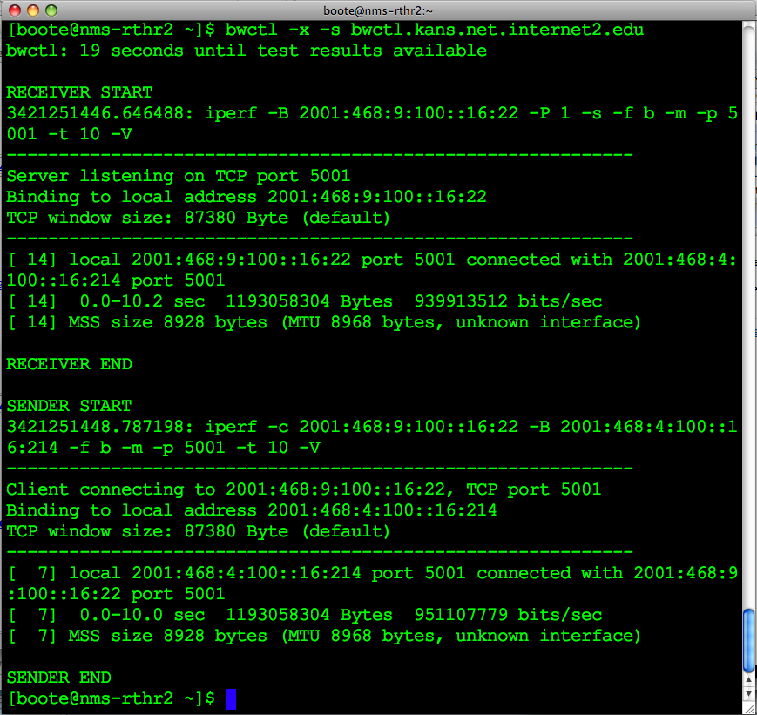
Example
<number> – 11/07/26, © 2010 Internet2

Slide 17
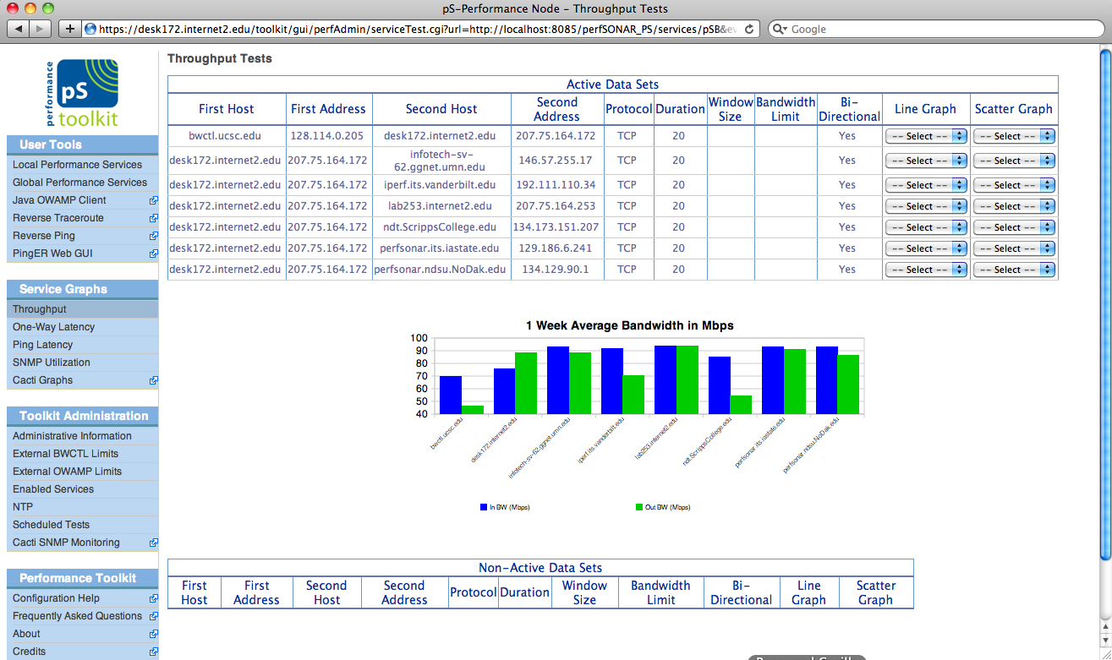
BWCTL GUIs
<number> – 11/07/26, © 2010 Internet2
Notes:
Regular bandwidth tests available via perfSONAR

Slide 18
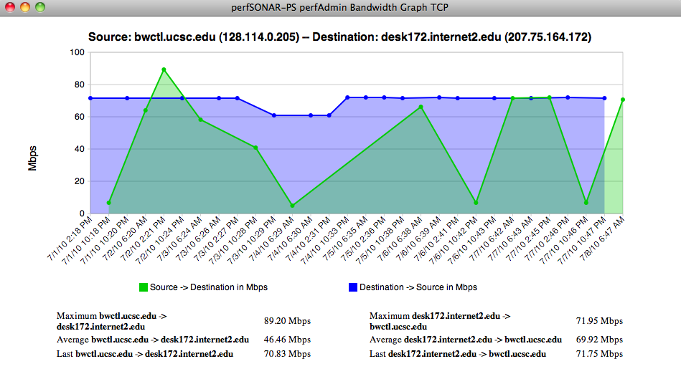
BWCTL GUIs
<number> – 11/07/26, © 2010 Internet2
Notes:
Bandwidth graph available from perfSONAR

Slide 19
Resource Allocation
Each connection is “classified” (authentication)
Each classification is hierarchical and has an associated set of hierarchical limits:
  Connection policy (allow_open_mode)
  Bandwidth (allow_tcp,allow_udp,bandwidth)
  Scheduling (duration,event_horizon,pending)
    A time slot is simply a time-dependent resource that needs to be allocated just like any other resource. It therefore follows the resource allocation model.
<number> – 11/07/26, © 2010 Internet2

Slide 20
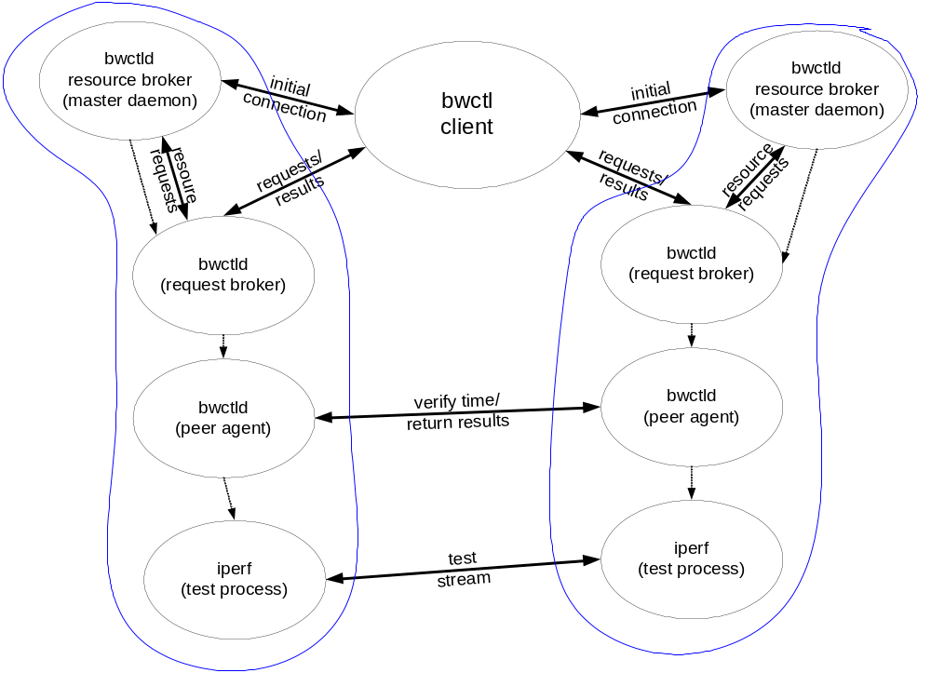
3rd Party Testing
<number> – 11/07/26, © 2010 Internet2

Slide 21
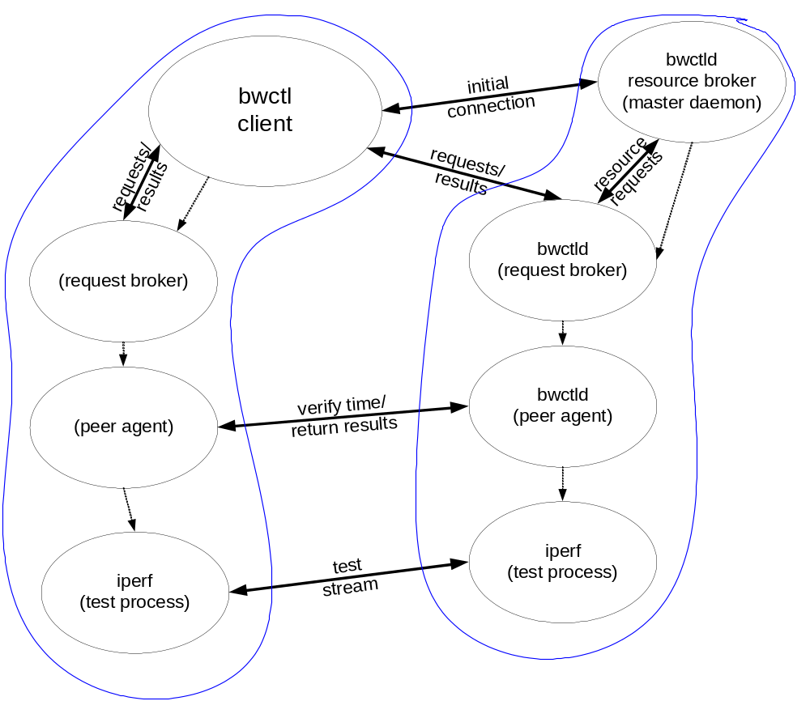
Testing with no “Local” Server
<number> – 11/07/26, © 2010 Internet2

Slide 22
Tester Applications
Iperf is primary “tester”
  Well known – widely used
Problems integrating exec’d tool
  Server initialization (port number allocation)
  error conditions
  No indication of partial progress (How full was the send buffer when the session was killed?)
thrulay/nuttcp are available also
<number> – 11/07/26, © 2010 Internet2

Slide 23
General Requirements
Iperf version 2.0 and 2.0.2
NTP (ntpd) synchronized clock on the local system
  Used for scheduling
  More important that errors are accurate than the clock itself
Firewalls:
  Lots of ports for communication and testing
End hosts must be tuned!
  http://fasterdata.es.net
<number> – 11/07/26, © 2010 Internet2

Slide 24
Supported Systems
Source should compile for all modern *NIX
  *BSD, Linux, OS X
RPMs compiled specifically for CentOS 5.x
  May work with other RPM based systems (Fedora, RHEL)
<number> – 11/07/26, © 2010 Internet2

Slide 25
Security Considerations
DoS source
  Imagine a large number of compromised BWCTLD servers being used to direct traffic
DoS target
  Someone might attempt to affect statistics web pages to see how much impact they can have
Resource consumption
  Time slots
  Network bandwidth
<number> – 11/07/26, © 2010 Internet2

Slide 26
Policy Approaches
Restrictive for UDP
More liberal for TCP tests
More liberal still for “peers”
Protect AES keys! (if using)
<number> – 11/07/26, © 2010 Internet2

Slide 27
Availability
Main Page:
  http://www.internet2.edu/performance/bwctl/
Mailing lists:
  bwctl-users@internet2.edu
  bwctl-announce@internet2.edu
<number> – 11/07/26, © 2010 Internet2

Slide 28
Hands On
Testing BWCTL:
  Log on to testbed
  Test from one host to another:
    bwctl –f m –t 10 –I 1 –c HOSTNAME
  Test the other direction:
    bwctl –f m –t 10 –I 1 –s HOSTNAME
  Test UDP:
    bwctl –f m –t 10 –I 1 –u –b 100M –c HOSTNAME
  Try different hosts. Try longer tests. What happens when we use:
    -w (Window size, try 128k and 4M)
    -P (Parallel threads, try 2, try 4)
<number> – 11/07/26, © 2010 Internet2

Slide 29
BWCTL
August 10th 2010, OSG Site Admin Workshop – Network Performance
Jason Zurawski – Internet2
For more information, visit http://www.internet2.edu/workshops/npw
<number> – 11/07/26, © 2010 Internet2

