Slide 1
OSG User Support Update OSG Area Coordinators Call February 12, 2014
Chander Sehgal - FNAL

Slide 2
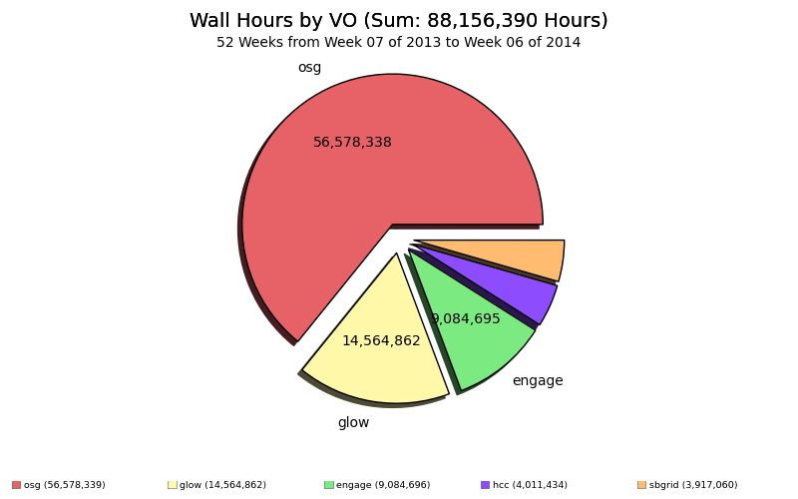
Overall Opportunistic Usage Last 12 months
The trailing 12 month cumulative usage is growing at the rate of 1M hours per week

Slide 3
Researcher Enabled in last 12 months OSG-XD
Project Name | PI | University | Science Domain | Hours
TG-ATM130009 | Phillip Anderson | University of Texas at Dallas | Atmospheric Sciences | 46,028
TG-ATM130015 | Phillip Anderson | University of Texas at Dallas | Atmospheric Sciences | 77,168
TG-OCE130029 | Yvonne Chan | University of Hawaii, Manoa | Ocean Sciences | 21,493
TG-IRI130016 | Joseph Cohen | University of Massachusetts, Boston | Information, Robotics, and Intelligent Systems | 70,536
TG-MCB100109 | Lillian Chong | University of Pittsburgh | Molecular Biosciences | 264,362
TG-CCR120041 | Luca Clementi | San Diego Supercomputer Center | Computer and Computation Research | 12
TG-DMR130036 | Emanuel Gull | University of Michigan | Materials Research | 212,059
TG-DMR120085 | Emanuel Gull | University of Michigan | Condensed Matter Physics | 60,624
TG-MCB090163 | Michael Hagan | Brandeis University | Biophysics | 33,785
TG-MCB120070 | Joseph Hargitai | Albert Einstein College of Medicine | Molecular Biosciences | 39
TG-MCB090174 | Shantenu Jha | Rutgers, the State University of New Jersey | Molecular Biosciences | 127
TG-IBN130001 | Donald Krieger | University of Pittsburgh | Integrative Biology and Neuroscience | 24,338,299
TG-CHE130103 | Jeremy Moix | Massachusetts Institute of Technology | Chemistry | 48,768
TG-PHY110015 | Pran Nath | Northeastern University | Physics | 303,931
TG-DMS120024 | Benjamin Ong | Michigan State University | Mathematical Sciences | 68,907
TG-MCB130072 | Robert Quick | Indiana University | Molecular Biosciences | 15
TG-TRA100004 | Andrew Ruether | Swarthmore College | Training | 444,374
TG-IBN130008 | Jorden Schossau | Michigan State University | Integrative Biology and Neuroscience | 9,042
TG-PHY120014 | Qaisar Shafi | University of Delaware | Physics | 525,616
TG-CHE130091 | Paul Siders | University of Minnesota, Duluth | Chemistry | 80,325
TG-STA110014S | Nancy Wilkins-Diehr | University of California-San Diego | Center Systems Staff | 5
TG-STA120004 | XD Staff | Various | Testing & Integration | 14
TG-TRA120041 | Hanning Chen | George Washington University | Computer and Information Science and Engineering | 230
 |  |  | OSG-XD Total | 26,605,770

Slide 4
Researcher Enabled in last 12 months OSG-Direct
Project Name | PI | University | Science Domain | Hours
Duke-QGP | Steffen A. Bass | Duke University | Nuclear Physics | 2,399,539
SPLINTER | Robert Quick | Indiana University School of Medicine | Medicine | 3,979,535
IU-GALAXY | Robert Quick | Indiana University | Bioinformatics | 200,377
RIT | Alexander Arlange | Rochester Institute of Technology | Ramsey Numbers R(C4,Km) | 764,216
Snowmass | Meenakshi Narain | Brown University | LPC group | 9,972,492
ECFA | Meenakshi Narain | Brown University/LPC group | Particle Physics | 1,744,646
SNOplus | Joshua R Klein | University of Pennsylvania | Physics - Neutrino | 488
detectorDesign | John Strologas | University of New Mexico | Medical Imaging | 444,403
BNLPET | Martin Purschke | Brookhaven National Lab | Biomedical Imaging | 22,453
UMich | Paul Wolberg | University of Michigan | Microbiology | 1,056,952
EIC | Thomas Ullrich | Brookhaven National Lab | Particle Physics | 410,593
UPRRP-MR | Steven Massey | Universidad de Puerto Rico, Rio Piedras Campus (UPRRP) | Bioinformatics | 609,433
DeerDisease | Lene Jung Kjaer | Southern Illinois University | Biological Sciences | 11,692
Pheno | Stefan Hoeche | SLAC | High Energy Physics | 367,660
Unknown |  |  |  | 4
 |  |  | OSG-Direct Total | 21,984,490

Slide 5
Key Initiatives
Effective service delivery for XSEDE Users of OSG – proceeding well
Enabling new researchers, who contact OSG directly, to access DHTC – proceeding OK (need more customers – must cultivate new channels)
Engage VO at RENCI is wrapping up; we must transition all the users to either OSG-XD or OSG-Connect/Duke-Connect – proceeding well
Working with LBNE to enable MC simulations on multiple OSG sites – just started (similar to work done for SNOWMASS; but there are many stakeholders who want to influence the technical plan)
More opportunistic access; develop a plan for 2014 to increase sites and cycles accessible to the osg vo by 50% – new initiative (and a big concern since we have very few tools that provide visibility into usage and issues)

Slide 6
Top Concerns
How do we identify more researchers who can benefit from access to OSG DHTC ? *** a priority ***
We continue to struggle with inadequate tools for understanding production for our front-end using the Glide-in WMS system; schedule & status of requests to glideinWMS project is unknown
Need to develop a plan for site support – especially as we understand the division of effort between gFactory operations and related site support
User Support workload has increased to the point that we are now feeling the pain of not having the 0.5FTE planned in the Nebraska SOW for User Support

Slide 7
Other Work Items
Work with Gratia to develop a report that shows all OSG VO usage broken down by submit host (recall we have many host flocking into OSG) – need a complete picture of work done (batch_pilot) via this framework
OSG-Connect flocking
Duke-Connect flocking
iPlant flocking
VT flocking
SAGA flocking
Bakerlab flocking
Transition UCSD from Engage VO ➔ OSG VO
Review Intensity Frontier Data Handling plan and provide inputs for FIFE on how to improve and leverage other OSG initiatives

Slide 8
Recent Accomplishments
With assistance from glideinWMS project, we audited the configuration of the OSG-XD frontend – no major issues identified but some fine tuning done
OSG-VO access to opportunistic resources appears to have broken thru the 12K cores barrier; recently achieved >18K cores – a couple of days with over 450K hours (unfortunately we can’t explain why we were stuck at 12K cores and what broke the log-jam)
Continued to operate the OSG Public storage service (based on iRODs) for the benefit of the OSG VO community; planning to move this services to be hosted at GOC.

Slide 9
User Support Team
Name | Institution | %FTE
Mats Rynge | ISI | 50%
Marko Slyz | FNAL | 60%
Tanya Levshina | FNAL | 25%
tbd@Nebraska | Nebraska | 50%
Alex Zaytsev | BNL | 10%
Chander Sehgal | FNAL | 40%

